Slide 1
What’s new with DDI 3.2 and beyond
Jeremy Iverson
Wendy Thomas
NADDI 2014

Slide 2
Agenda
Changes and New Content in 3.2
Changes in content that effect decisions to stay with an earlier DDI version or use 3.2
Improvements for Developers
Structural and other improvements that support the work of developers
Moving Forward
The projects, sprints, activities to date, and where to find the details

Slide 3
Changes and New Content in 3.2

Slide 4
Changes in the structure of existing content
Bundling language equivalents in a single element
Representations and missing values
Managing identification content
Name clashes
New Code Value Types

Slide 5
Changes in the structure of existing content
Bundling language equivalents in a single element
Make sure multiple language content is complete
Note where cardinality has been constrained in 3.2
Loss of Identified Structured String – when multiple languages are involved
Representations and missing values
Managing identification content
Name clashes
New Code Value Types

Slide 6
Changes in the structure of existing content
Bundling language equivalents in a single element
Representations and missing values
Valid and Invalid (Missing) Values are handled separately in 3.2 – and probably into the future
Create CodeSchemes that combine a CodeScheme of valid values and a CodeScheme of invalid (missing) values
Managed Representations (Numeric, Text, DateTime,…)
Managing identification content
Name clashes
New Code Value Types

Slide 7
Changes in the structure of existing content
Bundling language equivalents in a single element
Representations and missing values
Managing identification content
Use URN’s! This is the only place where all the content of the full object identification can be expressed for Identifiable and Versionable types
Name clashes
New Code Value Types

Slide 8
Changes in the structure of existing content
Bundling language equivalents in a single element
Representations and missing values
Managing identification content
Name clashes
Note where object names are changing (these may be namespace specific)
New Code Value Types

Slide 9
Changes in the structure of existing content
Bundling language equivalents in a single element
Representations and missing values
Managing identification content
Name clashes
New Code Value Types
Many attributes were changed to elements to support external controlled vocabularies (CodeValueType)
Constrain current content of these fields to values you plan to provide in an external controlled vocabulary

Slide 10
New Content
Complex Questionnaires
Question Grids and Question Blocks
Data Processing
New representations and response domains
Concept Management
Conceptual modeling
Managed representations and missing (invalid) values
Content Management
Quality and authority statements
Reorganizing Organizations and Individuals
Archiving submitted content
Consistency
Multilanguage content
Geographic content consistency
Scheme structure consistency

Slide 11
Complex Questionnaires
The primary reason for using 3.2
Complex questionnaires are defined as those using:
Complex Question Grids
Question Blocks - where a set of questions are related to a specific stimulus item (common in educational testing)
Need for a broader set of response domains
Scales, capturing a mark on an object, geographic codes, ranking, distribution, etc.
Complex routing and reuse of data for calculations
Incorporating pre-loaded content
Extensive use of response information to inform the content of dynamic text
Data validation done during the collection process

Slide 12
Question Grids
Simple grids where a single response type such as a Value or “Yes/No” response is required for each item in a list
Complex grids where the list may be provided or entered by the respondent and multiple responses may be required for each item in a list (“Yes/No” plus a Value plus a Percent, etc.)

Slide 13
Did you visit any one of the following performances or facilities over the past 12 months?
(Circle the correct response for each)
Yes No a theatre performance
Yes No a cabaret performance
Yes No a concert of classical music
Yes No an opera or operetta
Yes No a concert of popular music, pop, jazz, musical or pop opera
Yes No a 'dance' event, houseparty
Yes No a ballet performance
Yes No the cinema
Yes No an art gallery
Yes No a museum

Slide 14
14. Please write down the names of the places you stayed overnight and the duration of the stays in chronological order separately.
14. Please write down the names of the places you stayed overnight and the duration of the stays in chronological order separately.
Places you stayed overnight in chronological order |  |  | Type of accommodation for overnight stays (Please specify the number of nights)
 | Name of the place (City, town, etc.) | Total number of nights | Hotel | Motel | village | Pension | Camp/ Caravan | Youth And Camp | Own House | Rented House | House of a relative or friend | In the vehicle (Cruise, Yacht, Train, TIR) | Other (Please specify) (…………………..........)
 |  |  | 01 | 02 | 03 | 04 | 05 | 06 | 07 | 08 | 09 | 10 | 11
...... | ............... | ................ | ......... | ......... | ......... | ......... | ...... | ........... | ......... | ......... | ......... | ........... | .....................................
...... | ............... | ................ | ......... | ......... | ......... | ......... | ...... | ........... | ......... | ......... | ......... | ........... | ....................................
...... | ............... | ................ | ......... | ......... | ......... | ......... | ...... | ........... | ......... | ......... | ......... | ........... | .....................................
...... | ............... | ................ | ......... | ......... | ......... | ......... | ...... | ........... | ......... | ......... | ......... | ........... | .....................................

Slide 15
Question Blocks
Contains “Stimulus Material” (image, sound, text, etc.) to which a set of questions pertain.
The set of specific questions generally make sense only in context of the stimulus material.
Commonly used in educational testing
Difference between a Question Block and sequence of questions is the need to tightly tie the questions to a specific stimulus material in order to assess the comparability of the question content

Slide 16
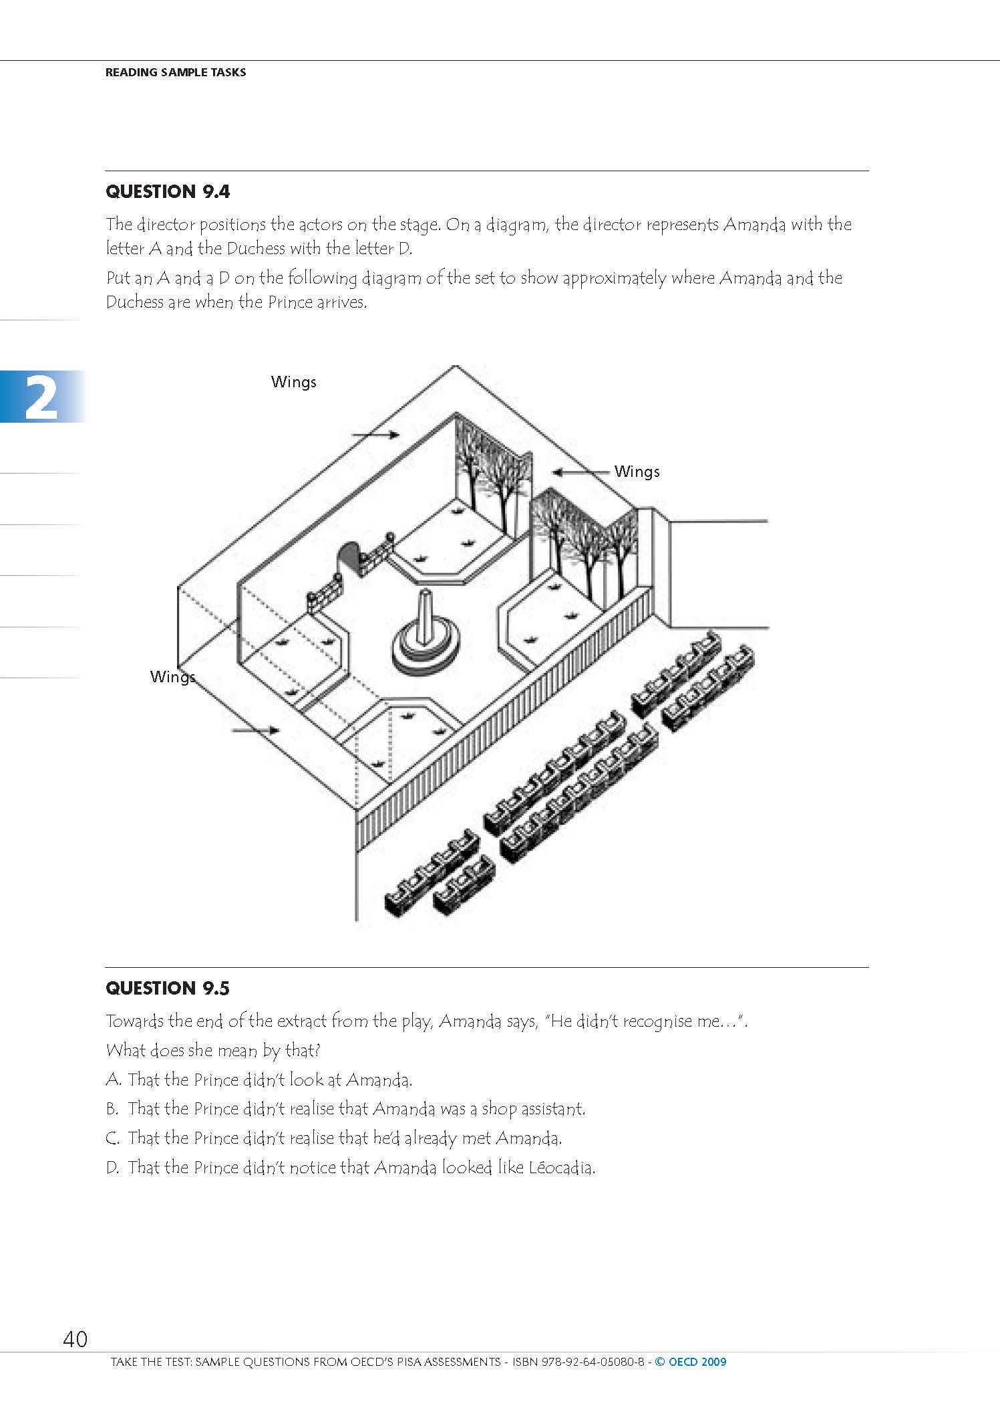

Slide 17
New representations/response domains
Response domains needed to capture information in specialized situations:
Marks on an image or audio/visual
Ranking behaviors
Controlled distributions
Ability to use Geographic Structure and Geographic Location content directly as a specialized code representation
Scales as response domains and value representations
The actual layout of scales may effect the accuracy of the response

Slide 18
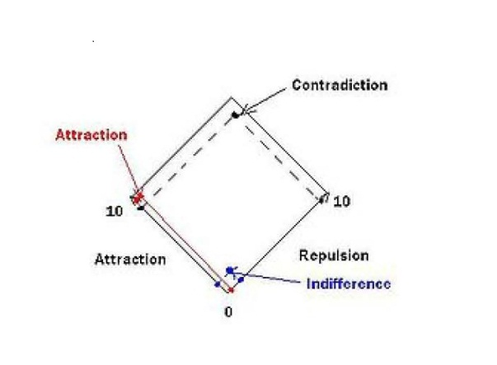

Slide 19
Concept Management
DDI is not fully there but 3.2 dramatically improves support for concept management and expression
Alignment with GSIM content regarding Concepts, Conceptual Variables, and Represented Variables
Managed representations allow numeric, textual, datetime and other representations to be captured once and reused
BONUS: managed representations can be mapped for comparison, i.e. a numeric representation of age to a coded set of age cohorts

Slide 20
Concept
Universe
Conceptual Variable
Represented Variable
May constrain the Universe and Representation for a specific applied usage
Representation
Variable

Slide 21
Content Management: Quality
Capture information on Quality Frameworks, Quality Standards, and other means of assuring the quality of the data, metadata, and process.
Quality statements can be referenced from many levels within DDI
Additional content to reflect authorization, legal status, budget, and evaluation procedures have been added

Slide 22
Content Management: Actors/Agents
Organization Scheme content has been cleaned up and stripped down
Organization and Individual information can be better managed over time (specific contact information is time stamped, etc.)
Relationships between any two Organizations and/or Individuals is tracked separately under “Relation”. Roles are assigned as part of the Relation
Locations in DDI where names are associated with specific roles within the context of the Study can now reference an Individual or Organization

Slide 23
Content Management: Archiving
Supports inclusion of all major packaging types as submitted (deposited) content (StudyUnit, Group, ResourcePackage)
Supports Local Added Content of all packaging types
Links Local Added Content to Submitted (Deposited) content by mapping
Local Object Reference
Depository Object Reference
Relationship Action (CodeValueType) i.e. Overides, Deletes, Extends, Restricts, etc.
Description

Slide 24
Language Consistency
Bundling equivalent content expressed in multiple languages
<r:Label xml:lang=“en”>What is it?</r:Label>
<r:Label xml:lang=“de”>Was ist das?</r:Label>
<r:Label>
<r:String xml:lang=“en”>What is it?</r:String>
<r:String xml:lang=“de”>Was ist das?</r:String>
</r:Label>

Slide 25
Geographic content consistency
Added composite geographies (Metropolitan Areas – composite of counties)
Improved management of geographic change over time
Added ability to use geographic structures (names and codes) and geographic locations (names and codes) directly as representations or response domains
Added ability to reference specific locations for the purpose of defining Spatial Coverage

Slide 26
Scheme structure consistency
All schemes have the following structural features
XxxxSchemeName, Label, Description
Inclusion of a scheme by reference
Object type included in-line or by reference
Object Group included in-line or by reference
All schemes have an XxxxGroup to support grouping for administrative or conceptual purposes
XxxxGroupName, Label, Description, and TypeOfXxxxGroup
Universe and Concept references
Subject and Keyword
Group and object included by reference

Slide 27
What if I’m just starting out?
A number of new tools are already available for 3.2
Colectica
Rogatus Platform
If DDI-C or DDI-L 3.1 does it for you and there are tools to support your work, USE THEM
But….pay attention to the consistency changes made in 3.2 to make your work easy to migrate forward. These changes were made in anticipation of future version needs.

Slide 28
Improvements for Developers

Slide 29
What’s New in DDI 3.2 and Beyond
NADDI 2014 - Vancouver, Canada
Notes:
In the keynote yesterday, Ann talked about how in the 90s, the purpose of DDI was to make data more accessible to researchers. I think that’s an important goal.
The perception about DDI Lifecycle is that this is not the case, and there’s a good reason for people to think that.
Nobody has really been talking about this, but with DDI 3.2, it’s true again.
DDI 3.2 let’s us focus on the content that researchers care about, again.
Today I want to say something that might be surprising, but: DDI 3.2 is really simple, and really powerful.

Slide 30
Controversial Thesis
DDI 3.2 is Simple
DDI 3.2 is Powerful
Notes:
I want to start off with a quick example to show the main reasons why I think this is true, and then highlight some of the other changes in DDI 3.2 that make the standard a lot nicer to work with.

Slide 31
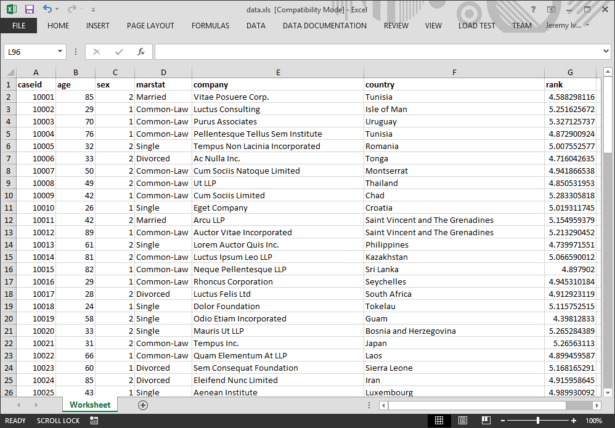
Document a Single Variable with DDI 3.1
Notes:
One of the things that stuck out at me at the European DDI meeting in December was somebody who commented that, attending a DDI meeting, they expected to see a lot of actual DDI.
I have no idea whether this is a good idea or not, but it seemed like they might have a point, so I’m going to talk through some XML here.

Slide 32
<ddi:DDIInstance id="ddii1" version="1.0.0" agency="int.example">
<r:Citation>
<r:Title xml:lang="en">MyDdiInstance</r:Title>
</r:Citation>
<g:ResourcePackage id="rp1">
<r:Citation>
<r:Title xml:lang="en">MyResourcePackage</r:Title>
</r:Citation>
<g:Purpose id="purpose1">
<r:Content xml:lang="en">Not specified</r:Content>
</g:Purpose>
<l:VariableScheme id="varscheme1">
<r:Label xml:lang="en">MyVariableScheme</r:Label>
<l:Variable id="var1">
<l:VariableName xml:lang="en">age</l:VariableName>
<r:Label xml:lang="en">Age of the respondent</r:Label>
<l:Representation>
<l:NumericRepresentation type="Integer" />
</l:Representation>
</l:Variable>
</l:VariableScheme>
</g:ResourcePackage>
</ddi:DDIInstance>
Notes:
First, let’s see what it looks like to create DDI 3.1 XML to describe that single column of data.

Slide 33
<ddi:DDIInstance id="ddii1" version="1.0.0" agency="int.example">
<r:Citation>
<r:Title xml:lang="en">MyDdiInstance</r:Title>
</r:Citation>
<g:ResourcePackage id="rp1">
<r:Citation>
<r:Title xml:lang="en">MyResourcePackage</r:Title>
</r:Citation>
<g:Purpose id="purpose1">
<r:Content xml:lang="en">Not specified</r:Content>
</g:Purpose>
<l:VariableScheme id="varscheme1">
<r:Label xml:lang="en">MyVariableScheme</r:Label>
<l:Variable id="var1">
<l:VariableName xml:lang="en">age</l:VariableName>
<r:Label xml:lang="en">Age of the respondent</r:Label>
<l:Representation>
<l:NumericRepresentation type="Integer" />
</l:Representation>
</l:Variable>
</l:VariableScheme>
</g:ResourcePackage>
</ddi:DDIInstance>
Notes:
That’s quite a lot, given that we’re really just trying to document this much information.
It’s not really the number of lines that is the problem here. It’s the fact that everything in red is an identified, versioned item, that we somehow need to keep track of in whatever system is generating this. That’s a lot of management overhead.

Slide 34
Document a Single Variable with DDI 3.2
Notes:
Now let’s take a look at what it looks like to document this column of data with DDI 3.2

Slide 35
<Fragment>
<Variable>
<URN>urn:ddi:int.example:var1:1</URN>
<Agency>int.example</Agency>
<ID>var1</ID>
<Version>1</Version>
<VariableName>
<String xml:lang="en">age</String>
</VariableName>
<Label>
<Content xml:lang="en">Age of the respondent</Content>
</Label>
<VariableRepresentation>
<NumericRepresentation>
<NumericTypeCode>Integer</NumericTypeCode>
</NumericRepresentation>
</VariableRepresentation>
</Variable>
</Fragment>
Notes:
You can say there are a lot of tags there and it’s true, but
Notice how there’s only one versionable item. That’s important.

Slide 36
The DDI 3.1 Way
<ddi:DDIInstance id="ddii1" version="1.0.0" agency="example.org">
<r:Citation>
<r:Title xml:lang="en">MyDdiInstance</r:Title>
</r:Citation>
<g:ResourcePackage id="rp1">
<r:Citation>
<r:Title xml:lang="en">MyResourcePackage</r:Title>
</r:Citation>
<g:Purpose id="purpose1">
<r:Content xml:lang="en">Not specified</r:Content>
</g:Purpose>
<l:VariableScheme id="varscheme1">
<r:Label xml:lang="en">MyVariableScheme</r:Label>
<l:Variable id="var1">
<l:VariableName xml:lang="en">age</l:VariableName>
<r:Label xml:lang="en">Age of the respondent</r:Label>
<l:Representation>
<l:NumericRepresentation type="Integer" />
</l:Representation>
</l:Variable>
</l:VariableScheme>
</g:ResourcePackage>
</ddi:DDIInstance>

Slide 37
The DDI 3.2 Way
<Fragment>
<Variable>
<URN>urn:ddi:int.example:var1:1</URN>
<Agency>int.example</Agency>
<ID>var1</ID>
<Version>1</Version>
<VariableName>
<String xml:lang="en">age</String>
</VariableName>
<Label>
<Content xml:lang="en">Age of the respondent</Content>
</Label>
<VariableRepresentation>
<NumericRepresentation>
<NumericTypeCode>Integer</NumericTypeCode>
</NumericRepresentation>
</VariableRepresentation>
</Variable>
</Fragment>

Slide 38
DDI 3.2: Focus on the Content
Study
Survey
Data
Group
StudyUnit
Quality
DataCollection
Instrument
Question
ControlConstructs
PhysicalInstance
DataRelationship
Variable
Foundational
Concept
Universe
Organization
CodeList
CategoryList
Category
Notes:
DDI 3.2 let’s us focus on the content.
That’s important because the content is what helps researchers discover an understand the data that are important.

Slide 39
Overview
Schemas
Simplified packaging
Clearer identification
More consistency
Bug fixes
Content
Data Collection Instruments
Data
Harmonization
Groups

Slide 40
Simplified Packaging

Slide 41
Simplified Packaging
New DDI Fragment allows simple listing of DDI items
Web services can be item-specific
Useful for import and export
Notes:
The example I started with showed some of the issues around DDI packaging, but it’s actually a lot worse than that.
It showed how the Variable was contained in a VariableScheme, but where is the VariableScheme contained?

Slide 42
Ambiguous Location of Information
Where are Variables defined?
<DDIInstance>
<ResourcePackage>
<VariableScheme>
<Variable />
</VariableScheme>
</ResourcePackage>
</DDIInstance>
<DDIInstance>
<StudyUnit>
<LogicalProduct>
<VariableScheme>
<Variable />
</VariableScheme>
</LogicalProduct>
</StudyUnit>
</DDIInstance>
<DDIInstance>
<Group>
<LogicalProduct>
<VariableScheme>
<Variable />
</VariableScheme>
</LogicalProduct>
</Group>
</DDIInstance>
<DDIInstance>
<Group>
<StudyUnit>
</StudyUnit>
<StudyUnit>
<LogicalProduct>
<VariableScheme>
<Variable />
</VariableScheme>
</LogicalProduct>
</StudyUnit>
</Group>
</DDIInstance>
<DDIInstance>
<Group>
<StudyUnit>
<LogicalProduct>
<VariableScheme>
<Variable />
</VariableScheme>
</LogicalProduct>
</StudyUnit>
</Group>
</DDIInstance>
<DDIInstance>
<ResourcePackage>
<LogicalProduct>
<VariableScheme>
<Variable />
</VariableScheme>
</LogicalProduct>
</ResourcePackage>
</DDIInstance>

Slide 43
Consistent Location of Information
<FragmentInstance>
<Fragment>
<Variable />
</Fragment>
</FragmentInstance>
Notes:
In DDI 3.2, using the Fragments, there’s a pretty precise location where you’ll find a Variable.

Slide 44
Explicit Top Level Element
Notes:
Another nice thing about the DDI 3.2 fragments is it lets you indicate the item of interest in your metadata payload.
In an example like this, we’ll have a PhysicalInstance to describe the data file, some variables, some code lists, and some categories.
If we just get a big DDIInstance, how do we know what the principle item is supposed to be?

Slide 45
Explicit Top Level Element
<FragmentInstance>
<TopLevelReference>
<!-- Points to the PhysicalInstance-->
</TopLevelReference>
<Fragment>
<PhysicalInstance />
</Fragment>
<Fragment>
<Variable />
</Fragment>
<Fragment>
<Variable />
</Fragment>
<Fragment>
<Category />
</Fragment>
<Fragment>
<Category />
</Fragment>
...
</FragmentInstance>

Slide 46
Clearer Identification

Slide 47
Clearer identification
DDI items are identified using three pieces that create a key
Agency Name
Item Identifier
Item Version
Item Identifier should be unique
Recommend using UUID
No more containership rules

Slide 48
Consistency

Slide 49
Consistency
DDI items can be used by reference everywhere they are used
Most previously required elements are now optional
DDI schemes all look similar
Cleanup
Spelling mistakes
Repeated use of the same element names for different uses

Slide 50
Bug Fixes

Slide 51
Bug Fixes
Hundreds of bugs reported in 3.1 are addressed
Can describe hierarchical datasets!

Slide 52
Surveys and Data Collection
New Question Types
Surveys with Data Flows
DDI Parameters and Bindings

Slide 53
Question Grid: Roster
QuestionText
For each of your children, please provide the following information.
TextDomain
CodeDomain
NumericDomain
 | Name | Gender | Age | Rank
1 |  | M / F
2 |  | M / F
3 |  | M / F
4 |  | M / F
5 |  | M / F
RankingDomain
Roster

Slide 54
Question Grid: Predetermined
QuestionText
Please rank your favorite ways to travel.
RankingDomain
 | Rank
Plane
Train
Automobile
Boat
Bike
Foot
CodeDomain

Slide 55
Question Block
StimulusMaterial
What city is this?
How many buildings can you count?
How many boats can you count?
QuestionItemReference
QuestionItemReference
QuestionItemReference

Slide 56
Other: Specify
What is your name? .
How did you get to NADDI?
Plane
Train
Automobile
Other (please specify): ____________________
Thanks for taking the survey, Jeremy.
CodeDomain
TextDomain with AttachmentLocation

Slide 57
Scales
How great is this year’s NADDI conference?
Anchors
Great Greatest
1 2 3 4 5
Low
High
ValueIncrements

Slide 58
Surveys with Data Flows
What is your name? Jeremy .
How did you get to NADDI?
Plane
Train
Automobile
Other (please specify): ____________________
Thanks for taking the survey, Jeremy.
Notes:
Can designate input and output parameters
Makes Questions and Sequences reusable across different surveys

Slide 59
DDI Parameters and Bindings
What is your name?
Output: FirstName
How did you get to NADDI?
Binding
Source: FirstName
Target: Name
Input: Name
Thank you, {Name}.

Slide 60
Groups

Slide 61
DDI 3.1: VariableGroups
Group variables together
Topic
Section
…
Nested
Create a hierarchy of items using subgroups

Slide 62
DDI 3.2: Lots of Groups
Groups can be created of most versionable item types
Groups can have assigned concepts, subjects

Slide 63
InstrumentGroups and Batteries
WAIS Information
WAIS Comprehension
WAIS Arithmetic
WAIS Similarities
…
InstrumentGroup: “Wechsler Adult Intelligence Scale”
TypeOfGroup: Battery

Slide 64
Harmonization with Groups
QuestionGroup: “Age Questions”
TypeOfGroup: similar
Concept: age
How old are you?
What is your age?
What age are you?
What’s your current age?

Slide 65
Harmonization

Slide 66
RepresentedVariable
Variable
Variable
Variable
Variable
marStat2000
marStat2005
marStat2010
marStat2015
marStat
RepresentedVariable

Slide 67
Extended Data

Slide 68
What about when information does not fit the DDI content model?
Previous Options
Abuse tags
Extend the schemas
Don’t use DDI
Notes:
All of these options are bad for interoperability

Slide 69
DDI 3.2 UserAttributes
<s:StudyUnit>
<r:Citation>
<r:Title xml:lang="en">My Study</r:Title>
</r:Citation>
...
<r:UserAttributePair>
<r:AttributeKey>Contact</r:AttributeKey>
<r:AttributeValue>Alice</r:AttributeValue>
</r:UserAttributePair>
<r:UserAttributePair>
<r:AttributeKey>Data Custodian</r:AttributeKey>
<r:AttributeValue>Bob</r:AttributeValue>
</r:UserAttributePair>
</s:StudyUnit>

Slide 70
3.2: A Little Understated
Notes:
Version numbers are rather arbitrary, but the small increase here understates the significance of the update.

Slide 71
Schemas
Simplified packaging
Clearer identification
More consistency
Bug fixes
Content
Data Collection Instruments
Data
Harmonization
Groups

Slide 72
Focus on the Content, not Packaging and Arbitrary Rules
Study
Survey
Data
Group
StudyUnit
Quality
DataCollection
Instrument
Question
ControlConstructs
PhysicalInstance
DataRelationship
Variable
Foundational
Concept
Universe
Organization
CodeList
CategoryList
Category
Notes:
We spent two days last month training a group at the University of Michigan on DDI 3.2, and at dinner one night somebody said something that kind of struck me.

Slide 73
DDI 3.2 is Simpler
“It all seems so simple.”
Attendee, DDI 3.2 Training Workshop at the University of Michigan
Notes:
I’ve trained groups in both DDI 3.1 and DDI 3.2. I never heard anything like this about DDI 3.1.
Learning and using DDI 3.2 is far simpler than DDI 3.1. If you haven’t looked at DDI Lifecycle in a while, it’s worth another look.

Slide 74
DDI 3.2 is More Powerful
Active DDI 3.2 Projects
Longitudinal Data Harmonization and Extraction
Cognition Measurement Item Batteries
Question Banks
Survey Instrument Designers and Code Generators (at least 4 of these projects)
Data Curation and Archive Workflow Management
Classification Management
Eurostat Quality Reporting
What else?

Slide 75
Thank You
Jeremy Iverson jeremy@colectica.com
 | Web | colectica.com
 | Blog | blogs.colectica.com
 | Twitter | @Colectica
 | YouTube | youtube.com/colectica
NADDI 2014 - Vancouver, Canada

Slide 76
Moving Forward

Slide 77
DDI Moving Forward Project
The DDI project began around 20 years ago with the aim of creating a structured metadata standard for the social sciences. We are seeking to again improve the value we provide to our members by creating a 'model-based DDI'. This next generation DDI will:
be easier to use,
be able to be quickly adapted to changing future needs
provide an even smarter and more economical way for organisations to manage their metadata, and
make it easier for you to interact with data from other disciplines and standards.

Slide 78
An Agile Project
In order to accelerate the development of DDI4, it has been decided to use an Agile approach
Agile project management is a 'start and adjust' model, rather than a fixed plan
This allows for the adjustment of plans to ensure that user needs are being met

Slide 79
Project Deliverables
Project deliverables will include a UML model for DDI 4 but also XML and RDF bindings.
The DDI Alliance will release two types of products to meet the needs of a diverse audience:
Functional Views - These views are in essence profiles of the full specification oriented around specific user needs – for example, simple data description, simple codebook, and discovery are functional views. Most users would interact only with the Functional View(s) that interest them. The DDI Alliance would publish a set of official standard views.
The Library of Objects, which encompasses the entire DDI 4.0 model. Objects are organized into packages in the Library. Packages are mutually exclusive and comprehensive. This second product is intended for use by more sophisticated users

Slide 80
Sprints
Sprints are a way to further accelerate progress.
During a sprint, participants brought together for a set period to progress specific outputs and out comes.
Key features of sprint process:
Priorities are adjusted on an on-going basis
The group is “self-organizing”
Frequent plenary sessions and flexible assignments of participants
Groups are organized and re-organized based on the perceived rate of progress and priorities of the deliverables

Slide 81
Activities to date
Three sprints:
Dagstuhl (October 2013)
EDDI (December 2013)
NADDI (March 2014)
Virtual task teams – Following the sprints, a number of task teams were created to follow up work.

Slide 82
Want to know more?
Minutes and formal products from the Dagstuhl and EDDI sprints are found at the DDI site
http://www.ddialliance.org/ddi-moving-forward-process
A new public wiki has been established to maintain and organize all working and final documents
http://www1.unece.org/stat/platform/display/DDI4/DDI+Moving+Forward+Project+Home
Current development platform for content capture
http://lion.ddialliance.org/

Slide 83
Want to get involved?
It is open to participation from any interested country or organisation, with a strong interest in DDI.
Participation is on a voluntary, unfunded basis, therefore the specific outcomes will automatically focus on areas considered to be priorities for the participating organisations.

Slide 84
Questions?
Technical Committee – ddi-srg@icpsr.umich.edu

