Slide 1
Social Survey Data Collection Challenges and Trends
Gina Cheung
Beth-Ellen Pennell
North American DDI Conference
April 1-2, 2014

Slide 2
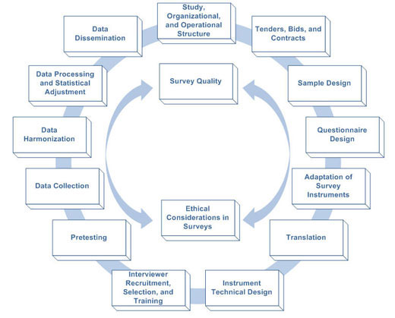
Survey Life Cycle
Questionnaire design
Questionnaire & SMS programming
Interviewer training
Field work
Data processing; coding
Quality assurance
Data dissemination
Text
Guidelines for Best Practice in Cross-Cultural Surveys. Ann Arbor, MI: Survey Research Center, Institute for Social Research, University of Michigan. http://www.ccsg.isr.umich.edu

Slide 3
DDI Lifecycle

Slide 4
Agenda
Questionnaire Design Challenges
Survey Management Challenges
“New” Technology Challenges

Slide 5
Agenda
Questionnaire Design Challenges

Slide 6
Questionnaire Design
Traditional Q-list questionnaire
Word memory list
Event History Calendar
Computer assisted self-administered interview
Neurocognitive tests
Biomarker data collection and Consent form
Traditional Web surveys
Classes Room Observation/Coding/Tagging

Slide 7
How large is large? -- Examples
Ghana Socioeconomic Panel Survey
Sample size of 5009 households, with approximately 18,000 individuals
Instrument variables ~ 65,000
China Family Panel Study(CFPS)
Sample size: 13,000~ HHs, 50,000 ~ Individuals
7 instruments total of 40,000 variables
Mental Health Survey(WMHS)
25+ counties and 30+ languages
Complex questionnaire design (World Health Organization’s Composite International Diagnostic Interview CIDI)

Slide 8
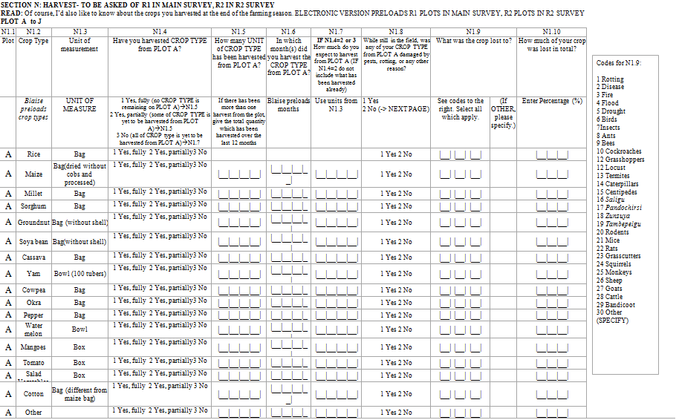

Slide 9
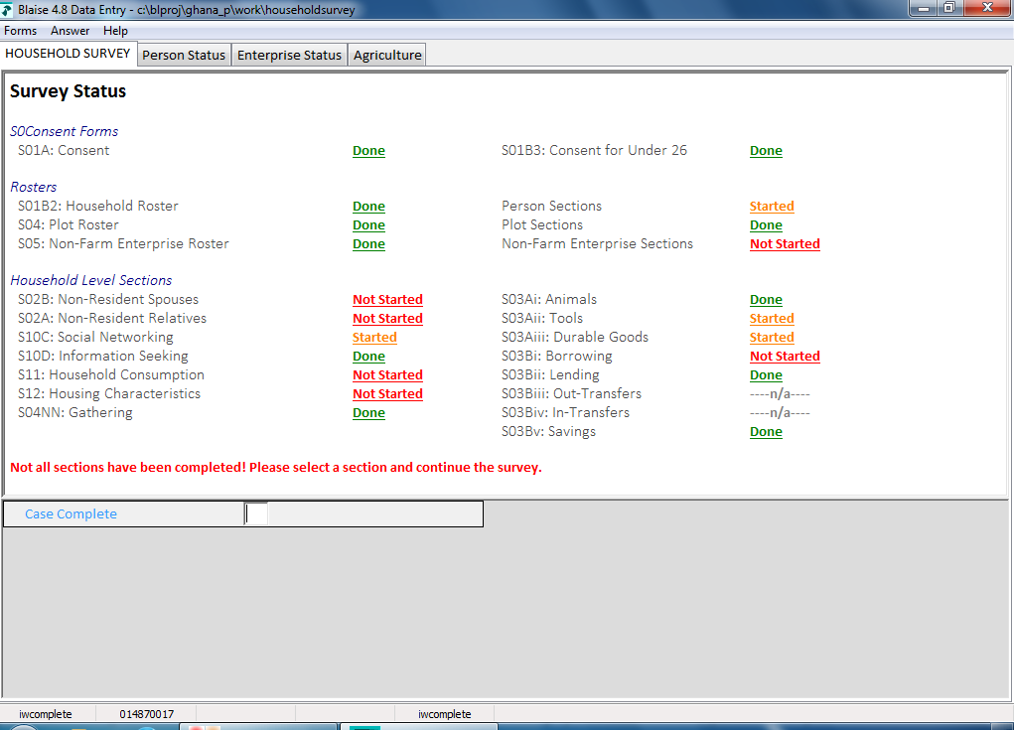

Slide 10
Major Aspects of Design and Implementation
Questionnaire length
Question type
Response options
Closed vs open-ended
Use of visuals
Screen layout
Progress bar
Slide bars, drop & drag

Slide 11
PAPI to CAI
Transition from a well-defined paper & pencil (PAPI) questionnaire to a computer assisted interview (CAI) instrument
VERY Complex grid designs
No explicit consistency checks
Preload previous data collection
Question fills
Interviewer instructions
Question-by-question on-line help
Questionnaire translation

Slide 12
Agenda
Questionnaire design Challenges
Survey Management Challenges

Slide 13
Survey Data Collection “Mode”
Computer Assisted Telephone Interview (CATI)
Computer Assisted Personal Interview (CAPI)
Computer Assisted Web Interview (CAWI)
Computer Assisted Self-administrated Interview (CASI)
Computer Assisted Data Entry (CADE)
Paper Pencil Survey
Mail Survey
Group Administrated Survey (either by paper or by computer)

Slide 14
Survey Management System (SMS)
Survey Management System differs between modes
Major Common Functions are:
Sample assignment
Delivery of sample to interviewers/respondents
Launch survey data collection software
Administrate sample status and the outcome
Send interview data to central database
Merge all the individual interviewer’s data files to a master data file

Slide 15
Context – Mixed Modes of Collection
“One of the most important challenges to survey researchers is deciding which data collection method or mix of methods is optimal…”
de Leeuw, E. 2005. “To Mix or Not to Mix Data Collection Modes in Surveys.” Journal of Official Statistics. Vol. 21. No.2:233-255

Slide 16
Pressures to use Mixed Modes of Collection
Declining response rates
Complex human measurements
Increasing effort to collect surveys
Increasing burden on respondents
Management information to inform
decision making while fielding a survey; multi-mode or single-mode

Slide 17
Definition: Mixed Mode
The use of multiple ways to access, obtain self-reports, collect observations, or measure attributes, within the same survey effort.
Mixed-mode designs can use multiple modes concurrently or sequentially on the same and different sample units.

Slide 18
Survey Design Modes Example
Data collection with multiple modes (sequential or concurrent) or single mode:
Concurrent Mixed Modes
Single Mode
Mode #1
Mode #1
Mode #2
Sequential Mixed Modes
Mode #n
Mode #1
Mode #2
Mode #n

Slide 19
Mixing Modes
Data collection often involves trade-off between the stronger and weaker points of each mode and method
Mixed modes survey are appealing but have risks and inherent issues
measurement error
cost considerations
bias

Slide 20
Survey Management Considerations for Mixed Mode
Survey Design
Multiple sample frames
Types of contact and modes
Sequence of modes
Switching modes
Propensity models and responsive design
Staffing and resource management
Sample delivery
Parameter/rules-based
Often link sample to mode of collection
Sample element only available to one ‘location’ at a time

Slide 21
Agenda
Questionnaire Design Challenges
Survey Management Challenges
“New” Technology Challenges

Slide 22
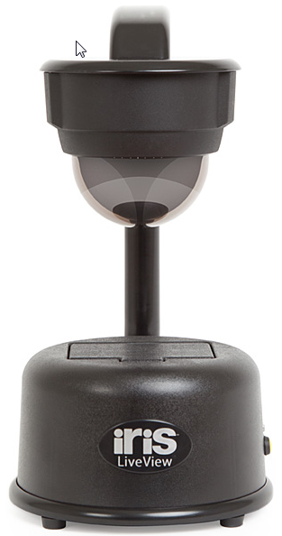
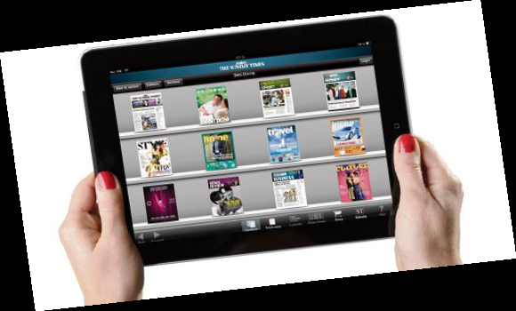
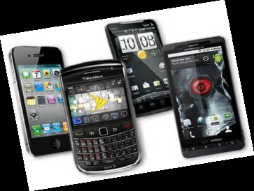

Slide 23
The Trends
Rising smartphone and internet usage creates a viable mode for survey data collection and needs formal investigation (Buskirk and Andrus, 2012)
Recent study found 23% respondents completed the internet survey via mobile, even though an attempt was made to redirected Rs (Wells, Bailey, & Link, 2012)
The Pew Research Center Report (Smith, 2012)
Smartphone ownership grew 11% in just nine months to 46%
17% of all adult mobile phone owners mostly access the internet via their device only
For 10%, their phone is their only option for online access
31% of American adults own a tablet computer

Slide 24
More bad news than good news
Optimizing design of web surveys for so many devices, OS versions, and browsers
Usability of the survey instrument
Connectivity (and efficiency)
Mobile app programming
Survey sample management
Data transmission and security
Survey preload and paradata collection
Quality assurance procedures
Optimizing other mobile components to enhance data collection
Methodological implications of using mobile technology

Slide 25
Questions to ask us
Will off-the-shelf “iCAPI” /”iCollector” type of survey development software provide capability to design effective, tailored instruments?
Does the depreciation of the mobile devices present a cost-prohibitive driver for expanded use?
Overcome all the usability's concerns for the field data collectors?

Slide 26
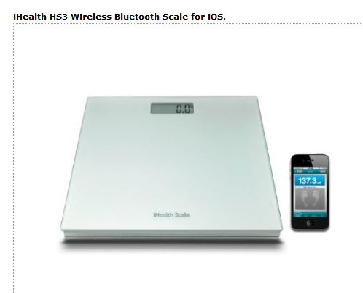
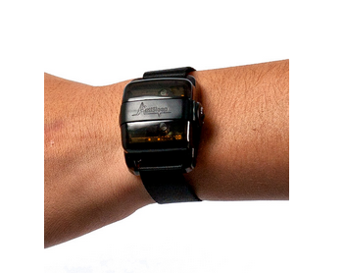
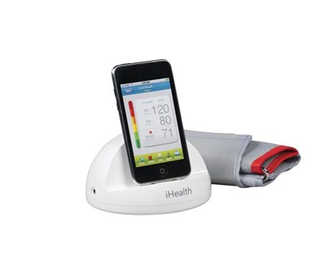
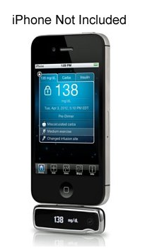
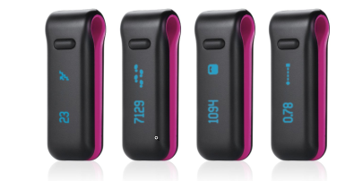
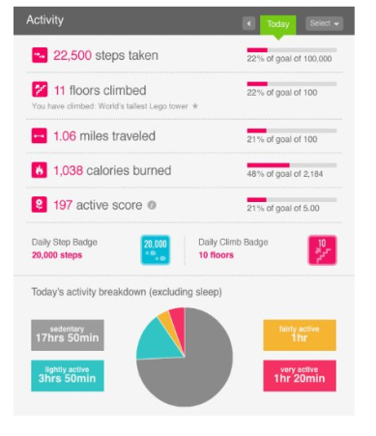
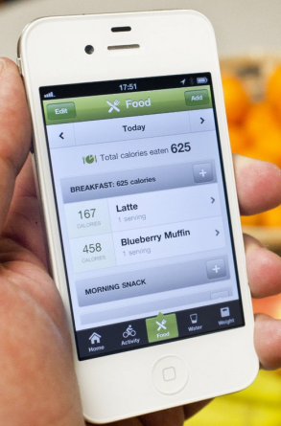

Slide 27
Social Media (Twitter, Facebook…)
Purpose: Service for building & reflecting social connections & communications
Current some uses in Survey Research:
Locating respondents
Question testing
Focus group recruitment
Study “Groups”
“Big Data” is very hot topic!!!

Slide 28
Final Comments
Rapid and continuous change: new technologies and new approaches to collect data making dramatic changes in our survey designs (multiple and mixed mode data collection)
Face some old issues: COVERAGE, SAMPLING, MEASUREMENT ERROR, NONRESPONSE, DIFFERENTIAL NONRESPONSE
New opportunities & challenges for social survey researchers

Slide 29
Thank you!
EMAIL: QIANYANG@UMICH.EDU

