Slide 1
New Solutions for Transnational Access and the Need for Proper Data Documentation
NADDI 2014
02.04.2014, Vancouver (Canada)
David Schiller, IAB
Ingo Barkow, DIPF

Slide 2
Outline
Examples for Transnational Access (TNA) innovations
Safe Centre approach
European Remote Access Network (proposed)
Data Documentation Challenges for TNA
Solutions
Summary

Slide 3
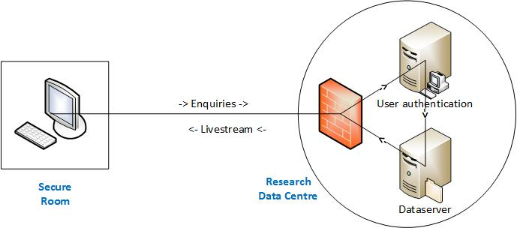
Safe Centre approach
Secured Remote Desktop solution with physically and organisationally secured access devices.
Resulting in a completely secured environment to access confidential microdata.
VPN

Slide 4
European Remote Access Network (Eu-RAN)

Slide 5
European Remote Access Network (Eu-RAN)
There is one European Research Area (ERA) but
many country specific differences regarding:
Content related issues (e.g. educational, labour market system)
Data access issues (e.g. accreditation process, disclosure control)
Data Documentation standards (language, coverage, used standard)
High obstacle for starting transnational research projects; even more for comparative research

Slide 6
Challenges for Data Documentation
Central point for data documentation
Complete documentation for a international audience (language)
Documentation available when searching for data (unrestricted) and when working with data (restricted)
Standard for data documentation regarding:
Usability for researcher (know where to find what)
Usability for machines (machine-readable)

Slide 7
Documentation needs - content
What data sources are available?
Description on “study” level (not only survey data)
What is the content and quality on variable level?
What exactly is measured and how good is this done
What is the accreditation procedure?
Simple online form or proposal and scientific board; what is the expected duration of the procedure?
What are the access ways to work with data?
Download file, travel to data holde, use remote access

Slide 8
Documentation needs - technic
Data Documentation standard
Frontend (for user) and backend for software and interfaces
Harvesting mechanism for data documentation
Easy way to collect information from all partners
Data Documentation standard for exchange

Slide 9
Documentation needs - technic
Data documentation available in restricted and non-restricted virtual research environments
For finding right data before project
For understanding details about data during projects
Archiving and long-time preservation
Support on a technical level to ensure the preservation of complete project documentations
Enable the possibility to reproduce and build on conducted research

Slide 10
European Remote Access Network (Eu-RAN)

Slide 11
European Remote Access Network (Eu-RAN)
Service Hub
User Account Management
Information Platform
MiCoCe
Web portal
Data Access
Datasets available
Variable level documentation
Accreditation
Additional Service
Virtual Research Environment
Collaborative work
Documentation of program syntax
Interface for syntax
Interface for syntax documentation

Slide 12
Data without Boundaries (DwB) project
DwB aims on making transnational access in Europe easier.
Runtime 2011 to 2015, www.dwbproject.org

Slide 13
European Research Area Consortium (ERIC)
COUNCIL REGULATION (EU) No 1261/2013
Gives official structures,
by creating a legal entity, and
is open to third party countries as well (not only EU member states and associated countries).

Slide 14
Summary
Transnational access to microdata should be easier. Especially for Europe but also beyond.
This has to go hand in hand with useful data documentations (need to have the project live cycle in mind).
Only joint approaches and projects (access and documentation) will deliver usable solutions.

Slide 15
Thank you for your attention
david.schiller@iab.de
barkow@dipf.de
http://fdz.iab.de
http://www.dipf.de

