Slide 1


Seminar:
On Health Research Uses of DDI

Slide 2
Seminar:
On Health Research Uses of DDI
Barry T. Radler, PhD
  - MIDUS
  (University of Wisconsin Institute on Aging)
David K. Johnson, PhD
  - CHARM
  (Kansas University Department of Psychology & Gerontology Center)

Slide 4
Overview
Barry
  Use of DDI in MIDUS
    Accommodating non-survey measures
David
  ?
Discussion Points

Slide 5

Background
http://www.midus.wisc.edu/
Notes:
MIDUS acronym.
MIDUS (Midlife in the U.S.) is a national longitudinal study of health and well-being that
examines how different factors (behavioral, social, psychological, biological, neurological)combine
to influence health and well-being as people age from early adulthood
into midlife and old age. It was conceived by a multidisciplinary team of
scholars interested in understanding aging as an integrative process.
MIDUS began at Harvard in 1995 with funding from the MacArthur Foundation. In 2004 MIDUS received funds from National Institute on Aging to conduct a followup study of the original respondents, transforming it into a longitudinal study with a 9-10 year interval between waves. Madison became its home.
At that same time, MIDUS expanded to include multiple cohorts; an African-American sample in Milwaukee and a Japanese version of MIDUS in Tokyo.
The study has expanded even more since then to include a new national sample designed to refresh the original cohort and examine the impact of the economic Recession on Americans’ health and well-being. We’ve Refreshed the Milwaukee sample as well.

Slide 6
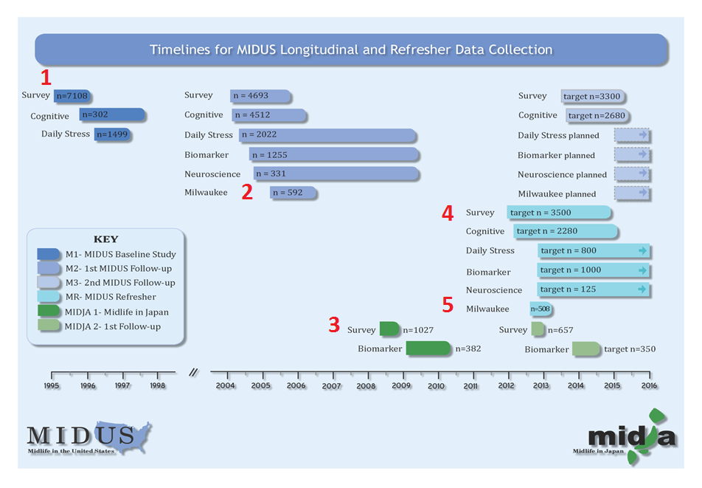
Notes:
So MIDUS has expanded its samples and become considerably more complex. Each of these bars also represent a dataset.
This slide shows the timelines for data collection for the 5 distinct cohorts (numbered in red) proceeding longitudinally and indefinitely into the future (every 9-10 years if the funding gods will it).
(Currently in the field for M3 and the Refresher data collection.)
MIDUS has also expanded its content – the slide details of different data collection projects in each wave and that’s what I want to explain a bit more.

Slide 7
MIDUS Guiding Conceptual Framework
Notes:
This slide shows the guiding conceptual framework of MIDUS in approaching the study of aging as an complex integrated process. Aging is not adequately described or understood by one approach, field of study or research method. Our methods must reflect this complexity and that requires a multi-disciplinary approach.

Slide 8
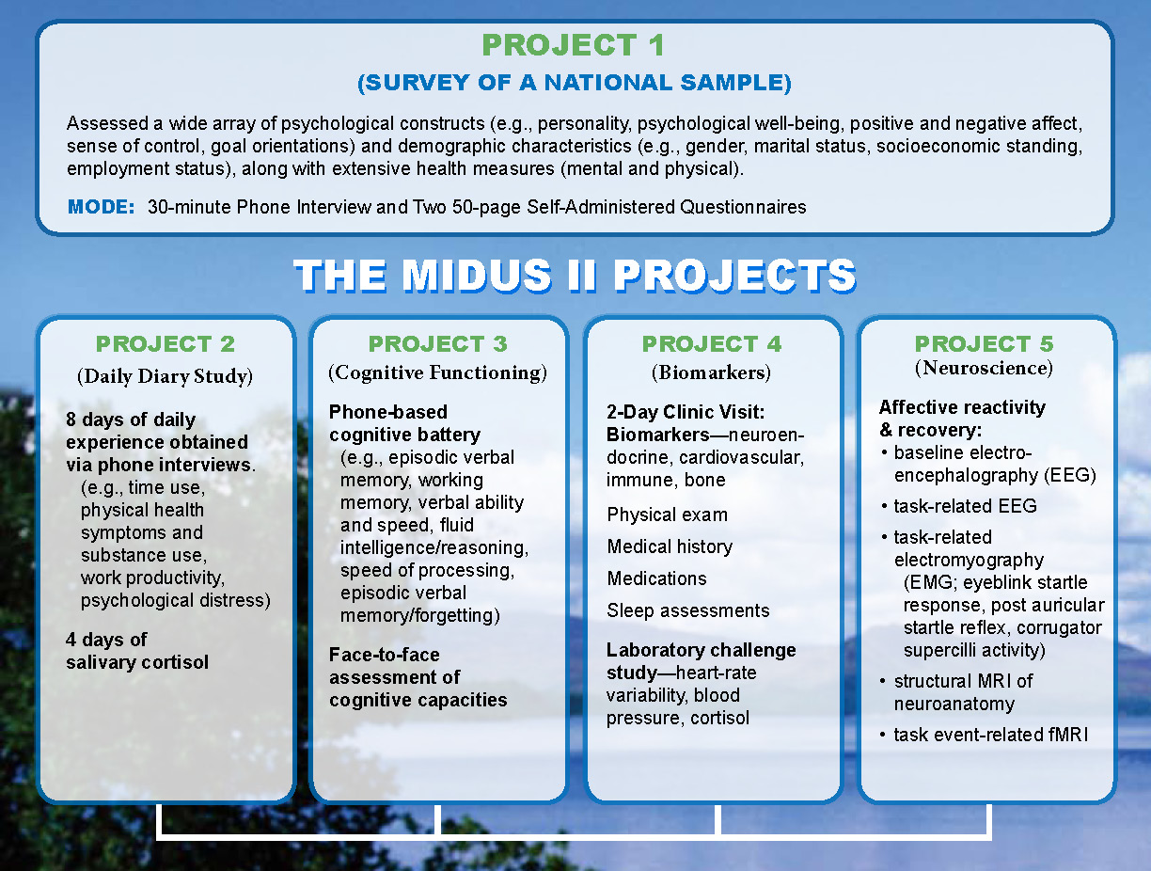
Notes:
To accomplish this, MIDUS includes multiple research protocols designed to obtain different types of data from our participants. This entails separate data collection sites and results in separate datasets; a situation which greatly benefits from a standard documentation system.
Our funding supports a project-based study, meaning that there is a central Administrative Core that can manage and administer multiple relatively autonomous projects.
MIDUS is organized around survey project at UW-Madison. All respondents participate in survey (Phone & SAQ): includes measures of socio-demographics, psycho-social constructs, mental and physical health.
Participants then become eligible for participation in satellite projects.
Project 2 (Penn State) – an 8-day diary study of stressful experiences, 4 days of salivary cortisol collected.
Project 3 (Brandeis) – unique phone-based cognitive assessment.
Project 4 (UCLA, UW-Madison, Georgetown) – Rs travel to 3 clinical research units for a 2-day visit; entails a physical exam, tissue samples, experimental protocols, self-report data (medical history, medication use), sleep assessment, perform bone scans.
Project 5 (UW-Madison) – Takes place at a neuroscience lab, obtain measures of brain imaging and functioning.

Slide 9
MIDUS Background
Multidisciplinary design
  Aging as integrated bio-psycho-social process
Multiple waves (9-10 year interval)
Multiple samples/cohorts
  1 National (MIDUS Core)
  2 Milwaukee
  3 Japan (MIDJA)
  4 National (MIDUS Refresher)
  5 Milwaukee (Refresher)
Result
  N=11,500
  34,000 variables
Notes:
An increasing complex study design due to:
Multi-disciplinary approach
Multiple wave, cohorts
…Resulting in a large amount of data (34,000 variables on over 11,000 participants).
Will continue to grow?

Slide 10
Guiding Principles of DDI use
Integrative, boundary-crossing studies
  Facilitate multi-disciplinary research
Data sharing
  Central to DDI: discoverability, use, replicability, management of data
    Stakeholders: researchers
    Practical uses of DDI
DDI non-questionnaire data capture
Notes:
Bring into high relief the inter-rated nature of MIDUS data to study dynamics of aging.
This goals is supported by centrally administered documentation system and a standard that’s internet friendly.
Data sharing: our “clients” are researchers who not only find and analyze data, but to replicate and use our instruments and protocols.
A good codebook can become the most important tool for exploration, hypothesis generation, especially if it contains descriptive statistics for each variable.
Exploit DDI’s capability to document non-questionnaire data capture or different instruments that do not use a traditional survey protocol.
XML is extensible – by definition it is flexible and can accommodate change.

Slide 11
Status of Current DDI Efforts
Interuniversity Consortium for
Political and Social Research
www.icpsr.umich.edu
MIDUS Metadata Repository:
midus.colectica.org
Notes:
We’ve made DDI a centerpiece of the MIDUS approach to documentation. Also helps that ICPSR is our official archive and where we offer data and documentation downloads – primary medium of dissemnation. Not only is ICPSR DDI-friendly but they are a major supporter of DDI.
However, we want to take advantage of all the capabilities of DDI 3, which ICPSR doesn’t currently support. So along with some DDI software called Colectica, we’ve created a metadata repository using DDI 3.1.
[CLICK ON LINK]
Offers centralized location for all Metadata and codebooks
We have much more latitude and control over the content and presentation
Searchable across datasets with MIDUS
We submit DDI XML files to IPCSR as part of our documentation. We can use the same XML files in our repository, in different DDI-compliant systems.

Slide 12
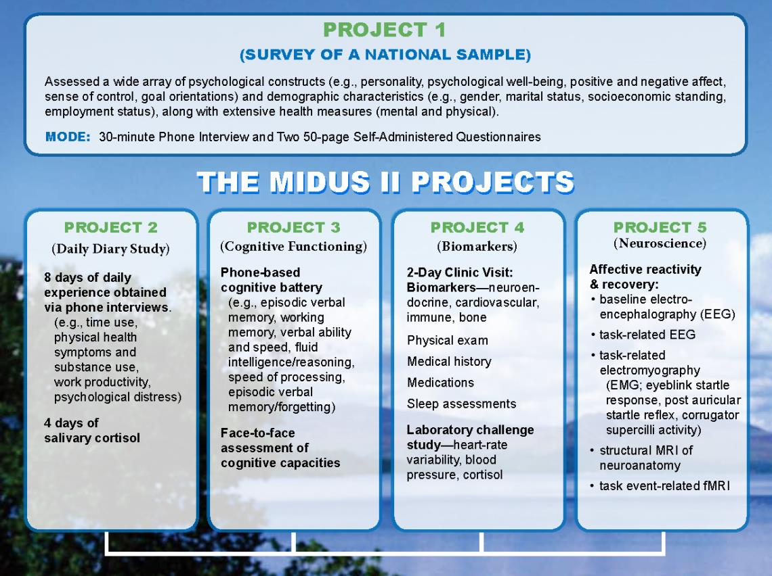
Describing MIDUS(non-survey)
Health Meaures
Notes:
Transition.
MIDUS provides researchers with an advantage: MIDUS contains a wealth of traditional survey and self-report data (from national and geographically specific samples) that can be integrated with important biological information – this provides new perspectives and opportunities for analysis.
Researchers often want to combine these different types of data – cross-fertilization being the raison d’etre of MIDUS. Researcher is working with Cognitive or Biomarker data, must obtain demographic information from Project 1 dataset.
Clear documentation on the variables and their relationships is critical. Because MIDUS offers data from different domains, it forces researchers to stretch their understanding – to use types data they may not be familiar with.

Slide 13
MIDUS(non-survey) Health Measures
Biomarkers
Biomarkers reflecting the functioning of the hypothalamic-pituitary-adrenal (HPA) axis, the autonomic nervous system, the immune system, cardiovascular system, musculoskeletal system, antioxidants, and metabolic processes.
Biological specimens (fasting blood draw, 12-hour urine, saliva – in Biomarker and Daily Stress projects).
Assessments by trained clinicians and staff of vital signs, morphology, functional capacities, bone densitometry, medication usage, a physical exam, heart-rate variability, beat to beat blood pressure, respiration, and salivary cortisol.
Self-reported sleep assessments and objective sleep assessments using an Actiwatch® activity monitor.
Notes:
Review of the instruments used to collect Biomarker and Neuroscience data.
Indulge me in presenting some visuals of instruments used in these data captures in the next few slides.
These not only jazz up the slides, but really emphasize the difference between the data captured by these instruments and that from a typical survey or questionnaire instrument.

Slide 14
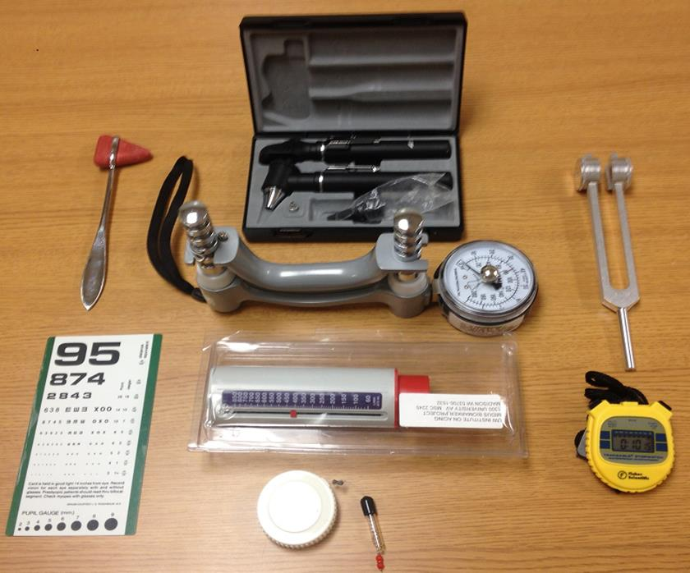
Example: Clinical Exam
Notes:
Instruments used for a physical when you visit your Dr.
BP cuff; scale, eye chart, stethoscope, dynanometer (grip strength), spirometer (peak flow breathing), stop watch (times walk), homonculus (neuromuscular exam), Otoscope (ears, nose), reflex hammer, tuning fork (hearing), Gulik tape measure (It eliminates the guesswork by applying a known amount of tension (four ounces) to the measuring tape)

Slide 15
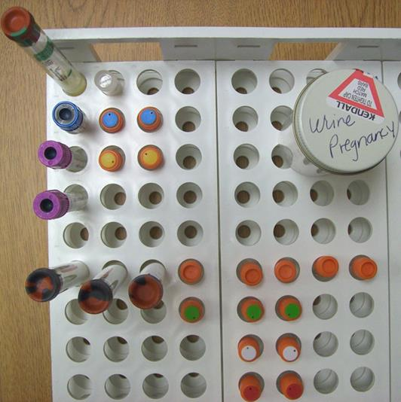
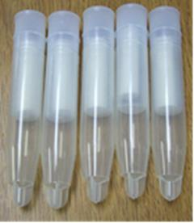
Example: Tissue Samples
Notes:
Equipment involved in obtaining tissue samples:
Saliva tubes on left.
Tubes containing blood draw and urine samples.
Blood sample (14 assays) Urine sample (6 assays) Saliva sample (Cortisol)
Physical specimens must also be processed and archived (frozen) to maintain integrity.

Slide 16
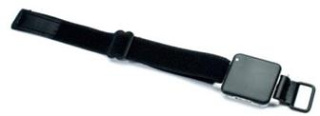

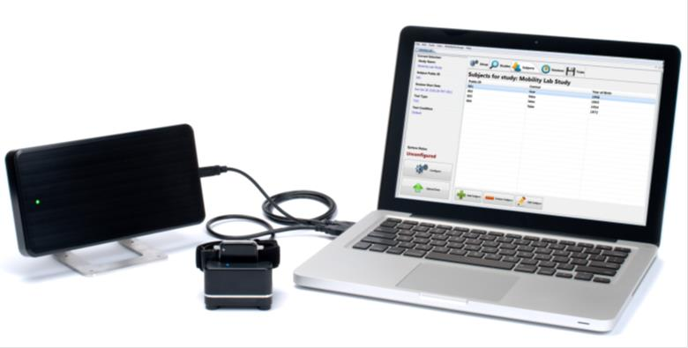
Example: Gait Analysis
Notes:
Gait analysis 3 sensors attached to arms, legs, waist. These transfer spatial and temporal data via wireless receiver to software; outputs 14 different variables to Excel

Slide 17
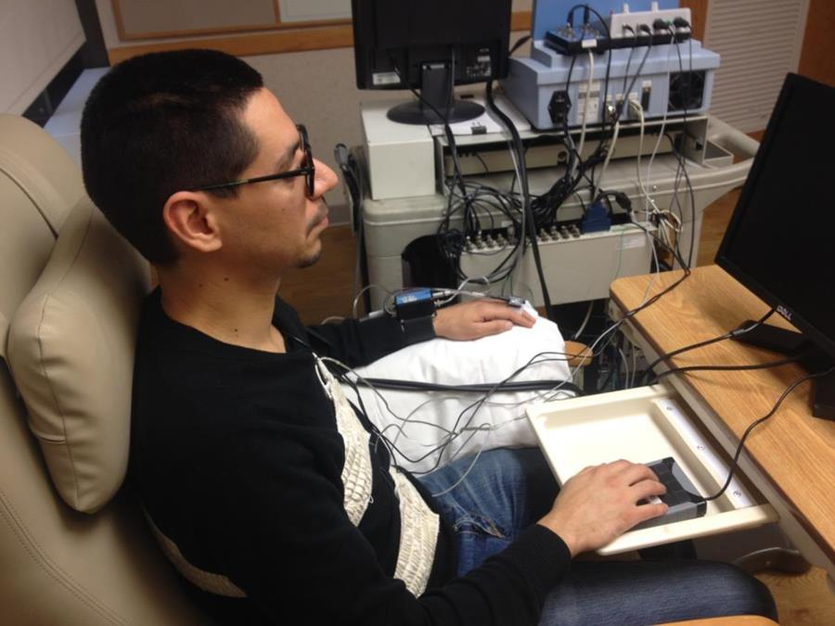
Example: Psychophys Protocol
Notes:
Psycho-Physiology experiment (Designed to measure physiological response to mental or psychological stress: protocol includes the subject performing computer-administered adaptive math and stroop tasks): finometers (hooked up to the finger) measure beat-to-beat heart rate and blood pressure; wearing a respiration band too.
Point: to measure how well your body reacts to (and recovers from) stress.
5 saliva samples - cortisol (before, during, after)

Slide 18
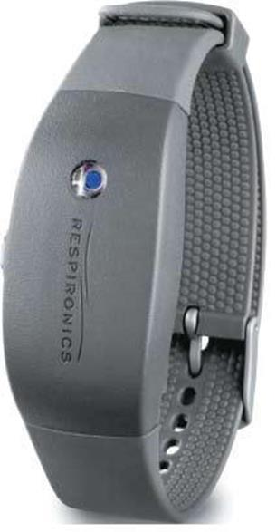
Example: Sleep Assessment
Notes:
Somewhat of a misnomer since this sleep watch is worn by our biomarker participants 24-7 for a whole week.
Data is recorded by wrist-worn sensor with an omnidirectional accelerometer; breaks down each 30 second epoch to a raw numerical value. Essentially measures the magnitude of physical activity every 30 seconds for a week.

Slide 19
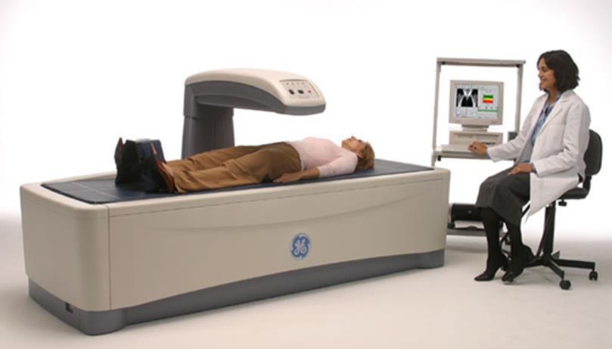
Example: Bone Density
Notes:
Bone densitometry (flat scan of body yielding bone density and body composition (% fat) data)

Slide 20
Example: Biomarker
Processing & Transformations
HDL-cholesterol adjustments
Serum is first mixed with synthetic polyanions, which adsorb to the surfaces of the other lipoproteins (LDL, VLDL, and chylomicrons); they are thereby transformed into detergent-resistant forms, whereas HDL is not. After solubilizing the HDL with detergent, it is measured as described above for total cholesterol. The HDL assay was re-standardized by Roche Diagnostics on August 6, 2007. The results of assays done after that date are adjusted, as follows, to bring the new values in line with the existing data:
Adjusted value = 1.1423(new value) - 0.9028
Notes:
Once data capture is complete, the raw data needs to be massaged to become an interpretable data point. Accompanying the variables derived from these instruments is reams of metadata that describe their collection, processing, tranformation, quality metrics and storage (physical specimens are archived – frozen!).
This text describes changes in the HDL assays whereby a new standardized value was applied to new assays after a certain date during the field period. Assay levels and sensitivities vary by company and lab, so this extra metadata is crucial to understanding the final product, a variable.

Slide 21
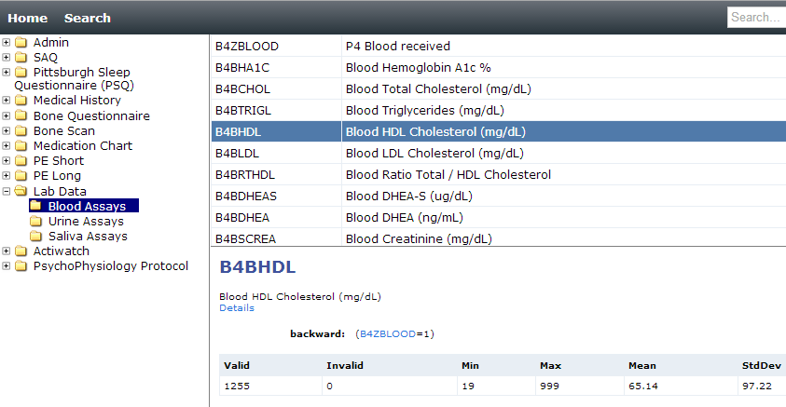
Example: Biomarker
Processing & Transformations
M2 Biomarker Codebook
Notes:
Here’s how the resulting variable is represented in our DDI codebook. You can see the paucity of information here. The traditional survey-based metadata fields (like Question, or InterviewInstruction) aren’t relevant, so other metadata fields are necessary to adequately describe the variable and help researchers interpret it.

Slide 22
MIDUS(non-survey) Health Measures
Affective Neuroscience
Examine the central circuitry associated with individual differences in :
Both emotional reactivity and emotional recovery using psychophysiological measures such as corrugator electromyography and eyeblink startle magnitude.
Brain morphology, in particular amygdala and hippocampal volume, using structural magnetic resonance imaging (MRI)
Activity within the neural circuitry of emotion regulation using both electroencephalography and fMRI
Notes:
Pivoting to examples of measures obtained in the MIDUS project “Affective Neuroscience”. Examining how the brain processes emotion.

Slide 23
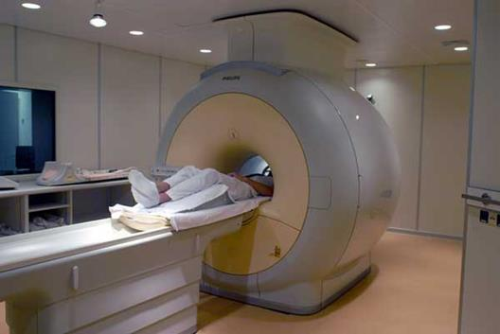
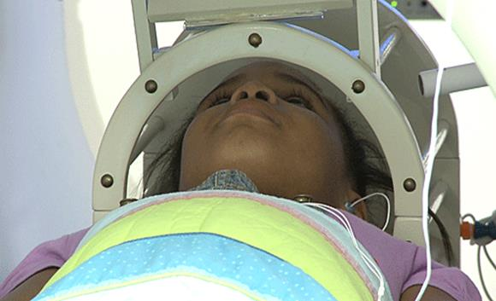
Example: functional MRI
Notes:
Pictures of neuroscience instruments – an MRI tube.
Obtains Structural and Task or Functional MRI data
Structural MRI obtains data on shape and size of brain, the amygdala, hippocampus.
Functional MRI measures change in blood flow, how brain reacts to and processes stimuli.
Note the right picture; participant is looking at a screen which projects visual stimuli.

Slide 24

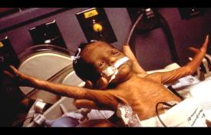
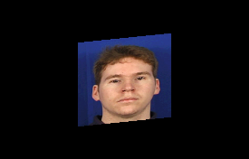
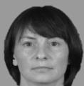
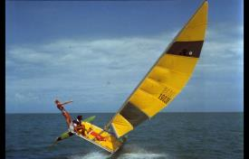
Example: functional MRI
IAPS pictures: 30 positive, 30 negative, and 30 neutral picture trials.
1 s
4 s
2 s
0.5 s
ITI average of 7.5 s
ITI range from 3.5-27.5 s
1 s
Face “probes” 2 s after IAPS picture offset:
45 neutral, multiethnic, male and female faces
Each face is presented twice and paired with
the same valence type of picture.
Participants identify the gender of the face via a responsepad.
4 s
Notes:
This is a brief schematic of the Protocol designed to examine affective reaction and recovery to positive, negative, and neutral visual images.
It records not only brain images and processing, but accuracy and other input data are obtained via a response pad R is keying in with their fingers while in the tube.

Slide 25
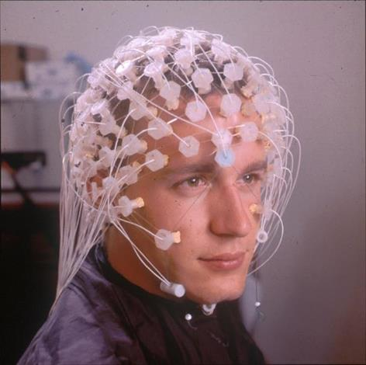
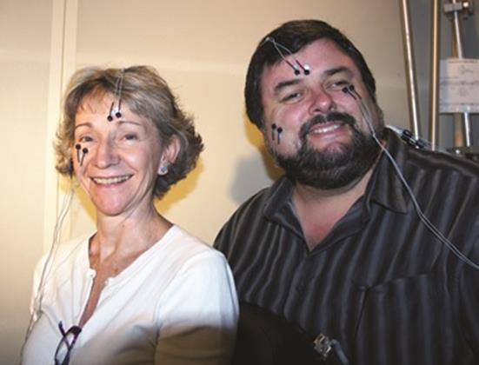
Example: EMG, EEG
Notes:
More neuroscience instruments – more crude than MRI.
Startle eyeblink reflex and corrugator supercilli (Electromyography – measures electrical activity of muscles)
Measures Resting baseline asymmetry (relative activity of left and right brain) (Electroencelphalography – measures electrical activity of brain)

Slide 26
Example: EEG
Processing & Transformations
EEG recording
  EEG activity was recorded using a 128-channel geodesic net of Ag/AgCl electrodes encased in saline-dampened sponges (Electrical Geodesics, Inc [EGI], Eugene, OR). Electrode impedances were reduced to less than 100 KΩ, and analog EEG signals were amplified and sampled at a rate of 500 Hz (band-pass filtered from 0.1-100 Hz) with 16-bit precision using an online vertex (Cz) reference.
Notes:
Many steps and processes that need to be completed to result in a single variable, with a single value for each individual, representing in this instance a measure of brain asymmetry or lateralization.

Slide 27
Example: EEG
Processing & Transformations
EEG data cleaning
After 60 Hz notch filtering and 0.5 Hz high-pass filtering to remove slow frequency drift, bad channels were identified and removed. Bad sections of data were also removed. Using EEGLAB6, the EEG data was then submitted to a PCA/ICA forcing the identification of 20 components. Components containing obvious eye blinks, eye movements, and other artifacts were then removed from the data. Bad channels were then replaced using a spherical spline interpolation. Epochs of 2 second length were then created. The EEGLAB automated artifact identification routine was then run on these epoched data files, identifying epochs containing deviations of ±100 microvolts, which were then subsequently removed.
Notes:
Raw data points in this example is nearly uninterpretable – needs extensive cleaning and massaging described here.
This type of processing not so foreign survey data either – transformations, scaling, recoding all common with self-reported health data too.

Slide 28
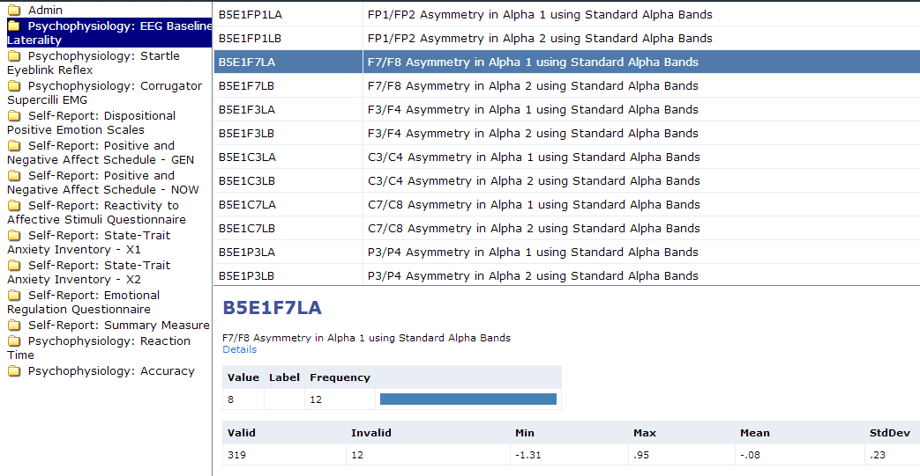
Example: EEG
Processing & Transformations
M2 Neuroscience Codebook
Notes:
Many steps and processes need to be completed to result in a single variable, with a single value for each individual, representing in this instance a measure of brain asymmetry or lateralization, shown here from our DDI codebook.
As you can see, MIDUS is still at a nascent or fundamental stage in the development of DDI codebook that adequately capture (on their own) non-survey health metadata.

Slide 29
How can DDI Document
non-Questionnaire
Data Capture?
Rudimentary Example:
ICPSR Version of M2P1 Codebook - Links
Notes:
Answer: Yes, we think so. Many health-related measures are more typical of the hard physical sciences which use diverse data capture methods or collecting event protocols. This type of processing not so foreign survey data either – transformations, scaling, recoding all common with self-reported health data too.
Yet, many social science studies are starting to collect rudimentary biomarker data because of its explanatory power. DDI is powerful enough, partly due to it’s extensibility, to capture this
Here’s a proof of concept that I had done at ICPSR (University of Michigan Archive) that embeds URLs of the stand-alone documentation in the DDI.
CLICK ON LINK
bradler@wisc.edu
244799
Not ideal:
Links can break – updates to the documentation require updates throughout the DDI for references.
A bit blunt – the stand-alone documents can be quite large. Information pertinent to a specific variable might be buried in this large file.
Better than nothing; but have only implemented this for the survey data.

Slide 30
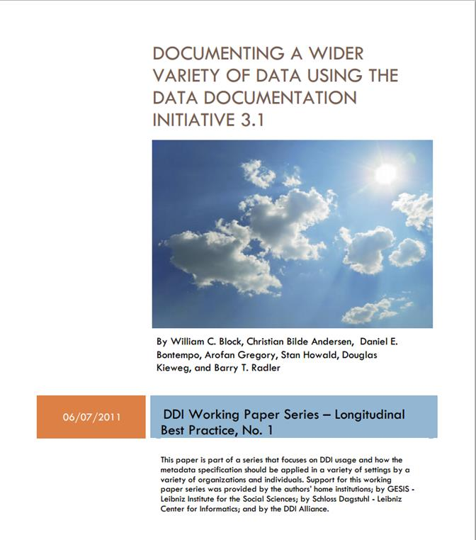
http://www.ddialliance.org/resources/publications/working/BestPractices/LongitudinalData/DocumentingAWiderVarietyOfData-Final.pdf
Notes:
A more nuanced and elegant approach is described in a white paper created a few years ago at the Dagstuhl DDI workshop in Germany.
It examined a variety of non-survey data capture contexts and suggested elements within DDI that could capture more information on these. Use real world examples, including MIDUS biomarker and neuroscience data.

Slide 31
DDI 3.x Elements
In Instrument, it is possible to provide information about the name of the instrument, a description of it, a type designation (which can come from a controlled vocabulary), information about any software tool that constitutes the instrument, and a reference to an external location (a URL at which the instrument resides, if applicable).
In the CollectionEvent element, one can refer to the organization performing the data collection, describe its source, the date of the event, its frequency if repeated, the mode of the data collection, and the collection situation.
ProcessingEvent permits the inclusion of a Coding, which contains a GenerationInstruction element. This allows one to specify many useful pieces of information. One can reference external information about the processing (e.g., the document quoted from MIDUS 2), provide a textual description of the processing as part of the DDI file, include specific commands used in the data collection, and include a description of the aggregation or scoring rules.
The collMode (within dataColl) describes the method used to collect the data; instrumentation characteristics.
Notes:
Here are some of the elements in DDI we used to describe more complex non-survey data capture contexts.
These solutions either rely on URIs that reference documentation and materials already available via the web, or they actually encode the documentation in the XML code.
Many ways to skin a cat in DDI. This cuts both good and bad;
good because DDI is flexible, it’s comprehensive;
bad because it can be complex and confusing, with few established conventions for describing the same thing.

Slide 32
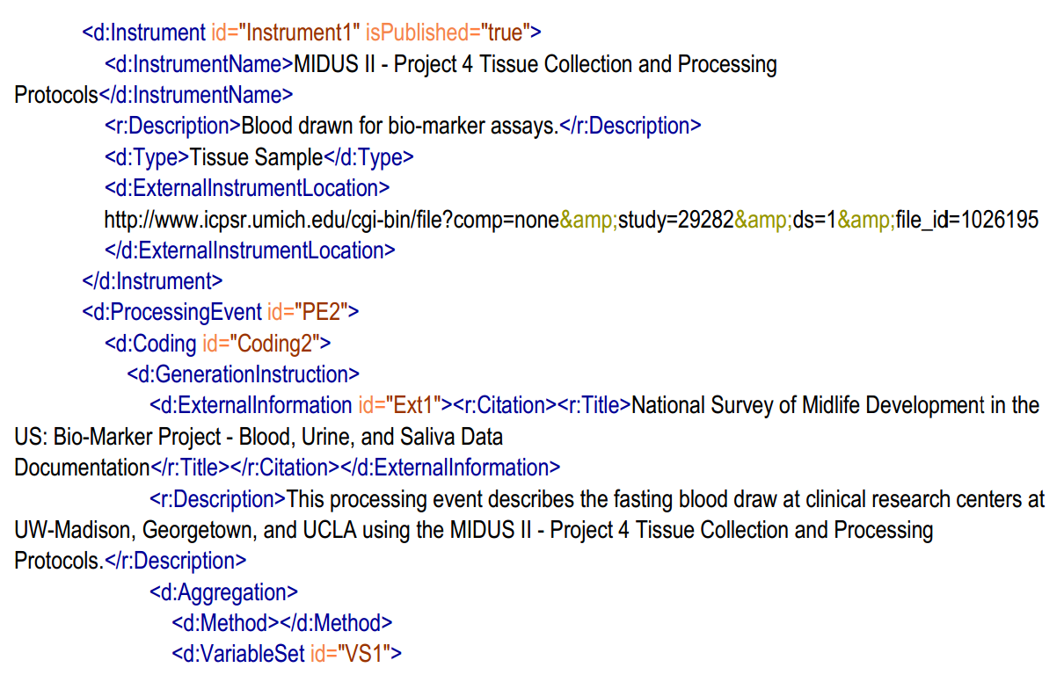
DDI Markup: Biomarkers
Notes:
Here’s the actual XML code showing how the documentation for the collection and processing of MIDUS blood assays can be referenced under ProcessingEvent. Note a brief description and a external link.

Slide 33
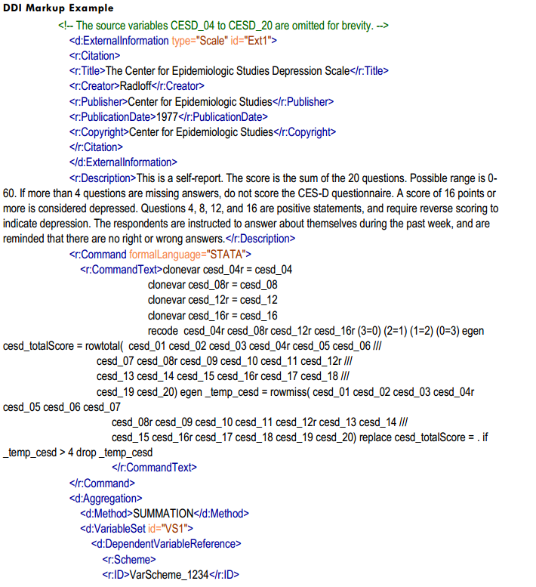
DDI Markup: Derived Scales
Notes:
I’ve given short shrift to traditional survey measures in this presentation. But this slide shows an example for survey data from the whitepaper: the DDI markup for a constructed variable, the CESD depression scale.
Note that in addition to a description of the scale (even some citation information for its origin), the actual STATA code used to derive the scale is baked into the XML itself. This is great because all the documentation of the scale construction or algorithm can be represented via the actual syntax used to derive scale values: this information can include whether the items were summed, averaged or reverse-coded, how missing values were handled, any imputation procedures, etc.

Slide 34
DDI - The Future

Slide 35
DDI - The Future:
Other Standards
Clinical Data Interchange Standards Consortium
www.cdisc.org/standards-and-implementations
Ontology for Biomedical Investigations
bioportal.bioontology.org/ontologies/OBI
Notes:
For clinical and bio-medical data, it might be argued that DDI should avoid re-inventing the wheel. There are other metadata standards more germane to describing this type o health data.
CDISC: XML-based standard to develop and support global, platform-independent data standards that enable information system interoperability to improve medical research and related areas of healthcare. Apparently, the DDI model is aligned for CDISC SDTM vocabularies.
OBI: has project to develop a DDI-based ontology for the description of drug discovery investigations – Jay Greenfield (and Sofia Kuan?) is doing some groundbreaking work in this area.
Does MIDUS try to build bridges to these other standards (maybe contribute to the development of thesausi or ontologies for describing unorthodox or non-traditional data capture?), or does it try to go alone in adequately describing and documenting non-survey instruments?
By serving too many masters does DDI end up making the perfect the enemy of the good? It may have done that with DDI 3, making it too complex to try to document everything.

Slide 36
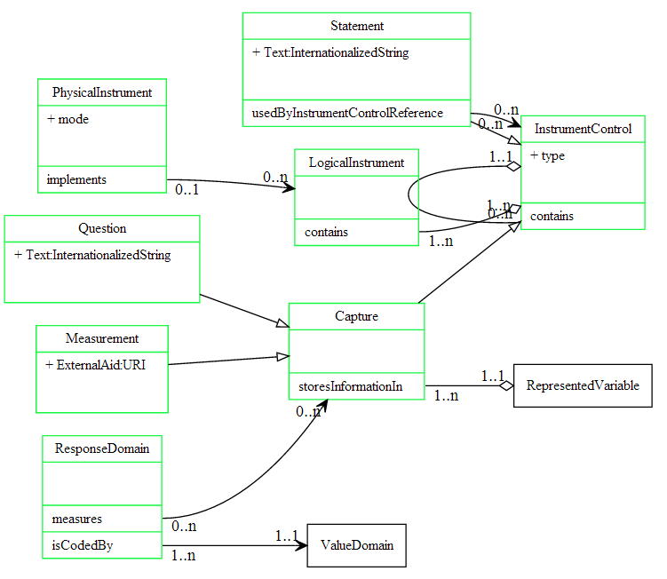
DDI - The Future: SimpleInstrument
Notes:
Next generation of DDI will be model-based spec using Unified Modelling Language – should result in a cleaner, more simple and elegant standard.
The UML seems to use a deductive approach to model building, Reasoning from general to specific.
Critical piece: describing foundational objects that are the core of the model; characteristics that nearly omnipresent in social, behavioral, bio-medical research but that can also form the basis and be extended for more complex constructions.
Screen shot of what is being called SimpleInstrument – charged with describing a simple instrument - principle of parsimony.
Instead of referring to a Question as the main implentation of an instrument, we are using the broader term “data capture”.

Slide 37
DDI - The Future
http://www.midus.wisc.edu/
Notes:
MIDUS has no plans to link to these other standards at the present. We are putting all of our eggs firmly but gently in the DDI basket.
My own plans are to implement some of the ideas that are explored in our white paper and update the MIDUS DDI codebooks accordingly.

Slide 38
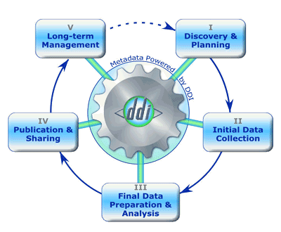

Questions?

Slide 40
Monday March 31st 2014

Slide 41

R21 TW009665
Notes:
CHARM is one part of the Epidemiology and Development of Alzheimer’s Disease (EDAD) in Central America
A biobehavioral clinical research collaboration of the University of Kansas with the University of Costa Rica
R21 TW009665 Sincere thanks – Award has been pivotal in shaping mine and many others in KS about the role of preventative medicine at home and abroad
CHARM is what I anticipated would be the eventual grant product of the R21; however, my great lesson to share today is that as we got in country it became painfully apparent that it was the very thing we needed complete first. Thankfully we have been in country laying the foundation for the CHARM with 6 years of interuniversity faculty exchange and graduate training.
CHARM is but one piece of a more extensive collaboration to promote the development of health sciences at UCR and to extend the KU biomedical and behavioral research globally.
By result we have benefited from over 70k in startup monies at the University of Kansas for health initiative.
Embedded in 121 years of formal exchange program
Strong university connections for advanced training
Share over 30 academic training programs
Trained over 1000 exchange students
A tradition built in mutualism that I am very proud to be a part of

Slide 42
Epidemiology and the Development of Alzheimer’s Disease (EDAD)
A Collaboration of the University of Kansas with
the University of Costa Rica
R21 TW009665
Notes:
CHARM is also a direct extension of the assessment I conduct at the KU Alzheimer Disease Center (P30 AG035982). Leader in the US for the study of exercise and metabolism on brain health and the lifestyles that prevent Alzheimer’s disease
EDAD interrelated and rafted on a number of thematically related grants
Alzheimer Prevention Through Exercise Program (APEX; R01AG043962)
Trial for Exercise, Aging & Memory (TEAM; R01 AG034614)
Alzheimer Disease Exercise Program Trial (ADEPT; R01 AG033673)
KU Alzheimer Prevention Program (APP in collaboration with A4)
Trial of Resistance Training for Increased AD Susceptibility (TORTIAS; KL2 TR000119)
Clinical Tranlational Science Award (FRONTIERS CTSA; UL1 TR000001)
Sincerest Thanks to NIA
As Diagnosis gets better and in the absence of disease modifying treatments, prevention is the next logical step in clinical research.
Cornerstones of prevention are of course: diet, exercise, adherence and development of sensitive screening with follow up of specific testing
Costa Rica Turns out to be an ideal crucible for studying healthy aging and prevention because of the Hispanic Paradox.
Hispanic Paradox: Rural older adult Costa ricans live longer than we would expect given what we know (predict) about mortality
Popular culture of social participation which facilitates the recruitment of motivated Latin American research participants.
EDAD’s Scientific Aim
Examine a mortality advantage found in Costa Rican epidemiological data that indicaes lifestyle and environmental factors protect lower and low-middle class rural population sectors against age-related neurocognitive and physical decline.
Hypothesis
Lifestyle factors endemic to specific Costa Rican rural regions afford greater cardiovascular health which is the protective factor in healthy brain aging;
R21 Focus On: Cognitive determinants of physical fitness and functional ability in healthy agentic CR older adults
Lesson One: Getting this R21 and linking the mission of the Alzheimer’s disease Center to this project has resulted in a halo effect which has translated into more university support all of a sudden I could legitimately give chairs, deans and provosts talking points that I largely crafted and these administrators use them to find money to support what they can easily define as successful.
I should point out the more than 30K of the 70K has come since our June award.
This experience has me acutely aware of brand awareness, vision statements and rehearsed elevator talks. And yes I have developed a certain skill for creating mnemonics that help administrators to remember the name of the program and possibly act as a memory aid for the talking points I gave them earlier.

Slide 43
AD in Latin America
Low and middle income nations will experience an unprecedented growth of the elderly population and subsequent increase in age-related neurological disorders
  increased incidence (earlier detection/diagnosis becomes more available)
  introduction of effective life extending technologies that yield increased duration of survival with disease.
Worldwide prevalence and incidence of Alzheimer’s disease will increase as life expectancy increases across the globe

Slide 44
Why Costa Rica?
Nicoya Peninsula = Blue Zone (more older adults living 90+)
Equivalent Life Expectancy (CR=35th vs. US=33rd).
Hispanic Paradox: Rural older adult Costa Ricans live longer than we would expect given what we know (predict) about mortality
Popular culture of participation
Strong university connections for advanced training

Slide 45
University of Costa Rica (UCR)
& University of Kansas (KU)
Century long tradition of international academic exchange
Share over 30 academic training programs
Trained over 1000 exchange students.
By June 2011 centralized IT services at KU will support most of the UCR library and administrative services.
Both identified health sciences as the next shared initiative and the KU-UCR endowment fund awarded $25,000 development grants
Identify faculty and resources at UCR to extend the KU AMP’s research success to include Costa Rican clinical samples collected by UCR affiliates.

Slide 46
UCR-CRELES
Preliminary inquiries into this paradox suggest that the environmental protective factors are diet and exercise.
BUT far more research needs to be conducted to draw any definitive conclusions about why rural Costa Rican elders enjoy unusually protective environmental factors that support vital aging.
Notes:
Costa Rica turns out to be an ideal crucible for studying healthy aging and prevention because of the
Hispanic Paradox: Rural Older adult Costa Ricans live longer than we would expect given what we know (predict) about mortality
Popular culture of social participation which facilitates the recruitment of motivated Latin American research participants

Slide 47
KU Alzheimer Disease Center (P30 AG035982)
Leader in the US for the study of exercise and metabolism on brain health and lifestyles that prevent Alzheimer’s disease
Trial for Exercise, Aging & Memory (TEAM; R01 AG034614)
Alzheimer Disease Exercise Program Trial (ADEPT; R01 AG033673)
KU Alzheimer Prevention Program (APP)
  Alzheimer Prevention through Exercise Program (APEX; R01 AG043962)
  Anti-Amyloid in Asymptomatic Amyloidosis (A4 )
  Aspirin in Reducing Events in the Elderly (ASPREE)
  Trial Of Resistance Training for Increased AD Susceptibility (TORTIAS; KL2 TR000119)
Clinical Translational Science Award (FRONTIERS CTSA; UL1 TR000001)

Slide 48
Cornerstones of prevention in AD and related chronic diseases
•“Heart Healthy” lifestyle
  –Physical activity
  –Nutrition
• Preventative medicine
  –Avoidance of preventable brain injury and disease
  –Management of heart disease, diabetes, depression, thyroid disease, etc.
Cognitive stimulation
  –Meaningful social engagement of our elders
  –Education builds greater cognitive reserve
Notes:
As diagnosis gets better and in the absence of disease modifying treatments, prevention is the next logical step in clinical research
Cornerstones of prevention are of course: diet, exercise and adherence

Slide 49
New research directions should include:
More sensitive diagnosis
Prospective study designs with hypotheses informed by epidemiological findings
Focus on public health
Developing new prevention technologies (behavioral, medical, digital)
Notes:
Development of sensitive screening with follow up specific testing.

Slide 50
EDAD’s Scientific Aim
Examine a mortality advantage found in Costa Rican epidemiological data that indicates lifestyle and environmental factors protect lower and low-middle class rural population sectors against age-related neurocognitive and physical decline.

Slide 51
Hypothesis
Lifestyle factors endemic to specific Costa Rican rural regions afford greater cardiovascular health which is the protective factor in healthy brain aging; between-group contrasts of urban versus rural CR elders will reveal significant moderating environmental factors of healthy versus unhealthy aging and that these environmental factors interact with measures of cardiovascular health.
Notes:
EDAD’s Scientific Aim: Examine mortality advantage found in Costa Rican epidemiological data that indicates lifestyle and environmental factors protect lower and low-middle class rural population sectors against age-related neurocognitive and physical decline

Slide 52
Prospective memory and aging pilot study
Step 1: Implement existing KU AMP protocols for neurocognitive, geriatric, and functional data in urban and rural based clinics.
Step 2: Recruit and assess 150 rural (blue zone) and 150 urban CR elders in the longitudinal epidemiological program (CRELES).
Step 3: Test group differences and develop risk stratification algorithm using multivariate logistic regression.
Step 4: Conduct multicultural comparison studies of clinical indices to determine sensitivity and specificity of common AD diagnostics and treatment indicators

Slide 53
How?
To that end we have created a buddy system of training where specific KU expertise is paired with a “mirror” at UCR.
Pairs of responsible agents implement a specific clinical research role in Costa Rica to achieve set milestones.

Slide 54
EDAD’s Aim to Build Infrastructure
Extend the clinical research infrastructure of KU AMP to the University of Costa Rica and build its clinical research expertise for neurological diseases.
  Step 1: Extend preexisting KU-UCR information technologies to underdeveloped Costa Rican clinical research centers; the IIP and CCP. KU will host data capture, management, and storage systems on the shared KU-UCR network system.
  Step 2: Train existing faculty at UCR for clinical assessment and research methods in the assessment and treatment of neurological diseases in the developing world to support future clinical research in Costa Rica and across Central America.
  Step 3: Create a baseline for a sustainable longitudinal study of Latin American aging and neurological diseases modeled on the KU Alzheimer and Memory Program.

Slide 55
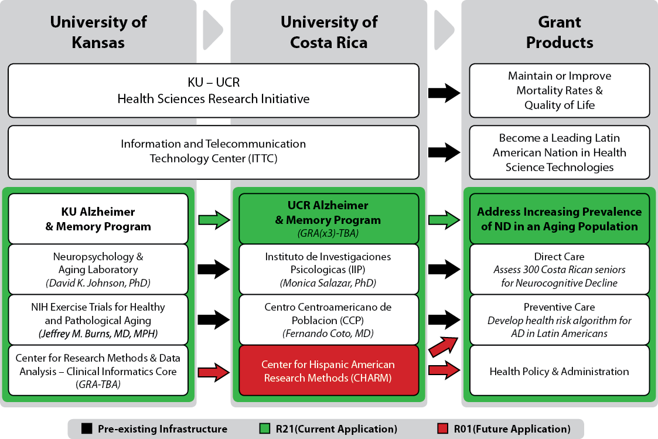
Notes:
Here we see a conceptual cartoon of the relationship among key partners in the EDAD research program.
What I really want to highlight is that over the past 6-years we have really focused on human capital. Training and faculty exchange is a bedrock to the KU-UCR relationship and by result also our research program. In Costa Rica we found local champions, brought them into the KU ADC family. There we train them in clinical assessment, research methods, and acculturate them to a research one institution.
I will point out that both memory programs are founded upon research methods training. In both locations we use advanced statistical models like SEM, IRT and Bayesian Network models. Because our Research is methodologically rigorous and applied in a population based assessment our projects are clinically relevant and empirically compelling
This relationship is not a one way street:
In return I have learned how to do research in low resource countries, and gained a critical perspective on the politics of science, appreciate better who science really serves (the population). I think I have become a more reflective and creative scientist.
My analogue is in the audience of Monica and without her vision and dedication to this project would not be possible.
Physician to physician relationship between Drs. Burns and Coto. Drs. Salazar and Coto become the in-country advocates we need to succeed in our research.

Slide 56
R21 TW009665

Slide 57
To succeed harmonizing data collection across 5 different research programs taking place in 2 languages, we needed to create CHARM:
The Center for Hispanic American Research Methods (CHARM) is a cooperative of US and Latin American research laboratories interested in coordinating biobehavioral research.
CHARM relies on DDI and metadata standards to implement, collected, manage, and archive clinical research data

Slide 58
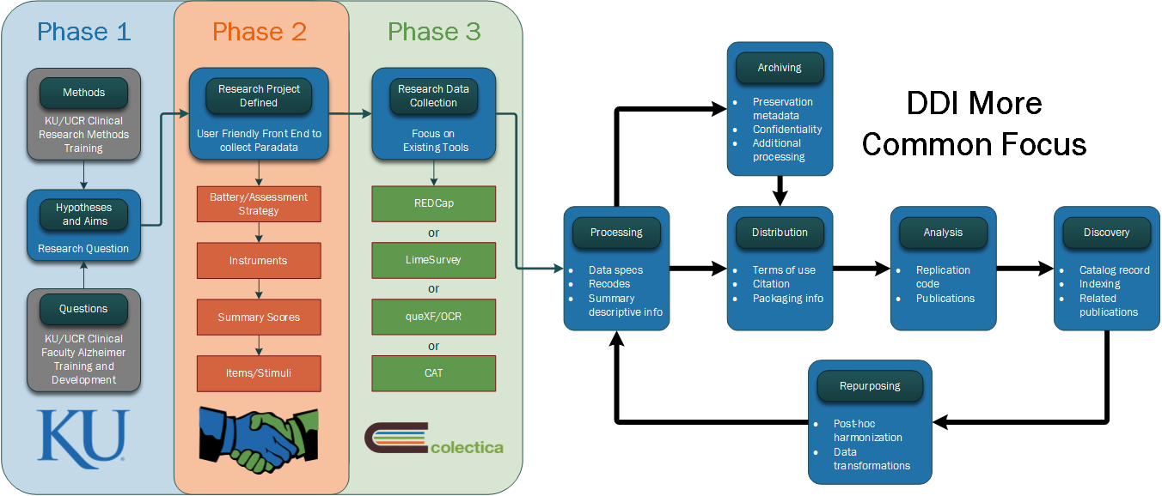
Clinical Research Data Lifecycle
Notes:
We found new challenges when we went to do field testing. Namely our rural CR older adults found tablet technology too alien and that in the field our data collection teams were having reliability issues with the wireless technology.
We were forced to return to paper and pencil testing for everything
Went against every fiber of my body – I designed and our most excellent biostatistics department implemented, KU is the first ADC in the country that is completely paperless. Going back to paper seemed like a step back to the stone age.
I decided that I needed a paradigm shift. We were not going to collect using wireless but we would collect using DDI.
DDI is a set of research methods and standards that streamline research design collection, archiving of data and are intended to enhance collaboration.
We contracted with a small research support company called Colectica and established a public private partnership that had the most mature front end of the DDI lifecycle and helped develop with them the XML standards to accommodate the ADC, NACC, NAL, and the psychology department entire biopsychosocial library of tests.
Using those sthandards we populated a library in Spanish and English and are able to implement over 450 instruments in approximately 800 variations in electronic and paper formats and marry the data on the back end to our existing AD research projects simply because the paradata/metadata is in place before we went to the field.

Slide 59
KU Instrument Library (KUIL)
KUIL is a distributed research process
If the adoption of DDI is easy and committed to from beginning of many research studies then aggregating data reaches an economies of scale
KUIL is a large database of pre-formed items that are libraried (i.e., rationally stored using standard conventions) in a large assessment database that can be accessed and implemented in a user friendly interface
Designed to aid grassroot researchers to economically implement a sophisticated study using best-practice assessment.
  Efficient
  Collaborative
Because the heavy burden of adopting DDI at the start up is carried by the KUIL then that cost is distributed across many broad shoulders.
  But Planning the interface becomes critical
  Instrumentation needs vetting
Participation in item/instrument/method validation studies need to shared by all users - part of the user agreement

Slide 60
Goal 1:
Create a multilingual applied clinical research library (to-date over 400 unique instruments in 850 different applications) that can be shared widely by investigators throughout the US and Latin America to facilitate high quality biobehavioral research on medical issues germane to Hispanic Americans.

Slide 61
Goal 2:
Use data standards that specify a research lifecycle (the Data Documentation Initiative – version 3; DDI-3). By applying an international data standard to the clinical research instrument library, the CHARM offers participating investigators a database of well-described clinical instruments and code libraries that bootstrap the investigative process.
An investigator assembles a neurocognitive battery using a flexible assessment battery approach. The selected battery can be implemented using Computer Assisted Testing (CAT), REDCap (both online data entry or email surveys), LIME Survey and its associated Optical Character Recognition (OCR) software (QueXF), or more traditional Paper-and-Pencil via PDFs.
DDI standards create the database frame so that investigators move quickly to collect the data as well as offering open source tools to facilitate data entry and verification.

Slide 62
Goal 3:
Provide a rational heuristic to pool data across sites, thus increasing power to detect meaningful differences while distributing the research costs, and subject burden.
So long as a cooperative of multi-site investigators used similar DDI standards (instrumentation, question phrasing and collection methods – all specified by the CHARM library) then those data can be pooled to answer a shared research question.
This framework promotes a coordinated, interdisciplinary approach to research while allaying some of the administrative burden of deploying a research project by an (usually) over-encumbered investigator.

Slide 63
DDI Philosophy - Why focus on metadata?
  Premium/costly datasets that contain valuable observations.
    People
    Tests
    Labor to prep/process data
  Outlines a rational plan to make data compatible (backward and forward in time)
    Lots of work to bridge the divide across projects that worked in isolation
    Taught a lesson for the forward looking planning to build comparability in to research projects from the start
  Funding agencies now encourage research projects
    coordinate with existing databases
    use standardized measures
    share data and data plans
  Examples of heavy DDI users
    Pan-European longitudinal studies
    Harmonization of longitudinal datasets (e.g., NHANES & MIDUS)

Slide 64
Phase 1:
Training & Acculturating KU/UCR faculty
Clinical research methods
  CHARM hosted 7 UCR faculty trainings over the last 5-years
    Lawrence – Kansas City – San Jose – Liberia
  KU dedicated graduate training in quantitative psychology for UCR candidates
  New UCR Methods focus “Summer School” conducted every February
Alzheimer training and development
  Extended psychometric training in San Jose and Nicoya Penisula
  Autobiographical research program
  CRELES secondary data analysis for cognitive change and ADL
  Partnering with Memory Clinic at San Juan de Dios Hospital, San Jose

Slide 65
Phase 2
Creating KU Instrument Library
July 2013: PI’s finalized battery used in EDAD research program
August 2013: PI’s researched and proofed an indexing system for clinical tests to be used in the field
September 2013: Two graduate students supervised a team of 4 research assistants to create the EDAD test library
October 2013: Data collected on 1st research participant in San Jose
November2013: Data collected on 1st research participant in Nicoya
Current: Over 400 unique instruments in 850 different applications

Slide 66
Immediate targets of EDAD are also the initial targets for KUIL
Focus on collecting instruments related to:
  Validated Bilingual Instruments
  Aging & Development
  Psycho-Social Assessment
  Cognition
  Physical fitness and health

Slide 67
Phase 3:
Colectica creates new features based on EDAD needs
Optical Character Recognition platform added to exportable output
Software written to input and manage multiple languages in item database
REDCap import/export capability finalized and copy of the KUIL is contributed to REDCap Shared Dat Instrument Library (SDIL)
Currently - KU and Colectica collaborate on refining DDI metadata to make it more robust for clinical and biobehavioral instrumentation

Slide 68
Phase 4:
Spanish Translation and Validation
Although we use validated and published translations wherever possible, there are many clinical instruments that still need translation by trained clinicians (about ⅔ of the library).
We are establishing an online referee process for these translations as well coordinating the translation assignments.
Plan to identify DDI and associated metadata to facilitate Mean And Covariance Structures (MACS) analysis of cross-cultural data
  Increase the pace of cross cultural research
  Efficiently validate cross-cultural instrumentation
  Increase generalizability of translated instruments and items
Notes:
TEASER FOR TOMORROWS TALK

Slide 69
Seminar:
On Health Research Uses of DDI
Discussion Points

Slide 70
Discussion Points
Challenges
  Standardization
    Procedures, measures, coding,
    Ontologies (common language)
    How to encourage adoption of standard!
  Harmonization
    Highlighting, resolving, ameliorating differences
  Good data management practices
    Proactive, not reactive, approach
    Citing, replication, sharing, tenure
Notes:
Standardization
- Can be hard to get researchers to agree on much.
- Ontologies helpful: thesaurus with synonymsEncourage adoption by health researchers.
- Expertise is needed to develop ontologies (how to we talk about non-survey measures) and standards for non-questionnaire data capture.
Where there isn’t agreement, how to harmonize and document it?
Good data management
Life course approach, metadata not an afterthought.
How do we use DDI to support proper citation, replication, sharing? Larger issues of intellectual property, security, attribution.

Slide 71
Discussion Points
Challenges (cont’d)
  Special collections
    MRI imaging, size, special software
  Cross-cultural, language
    CHARM
    MIDJA-MIDUS
  Funding/resources
Notes:
MIDUS MRI data not publicly available.
Raw data enormous; require special software to access, analyze.
Cross-cultural (David)
Funding!
There is an initial cost to adopting DDI, but it quickly realizes some efficiencies and becomes economical.

