Slide 1
Metadata from Blaise and DDI 3.0/3.2
Gina Cheung
Beth-Ellen Pennell
North American DDI Conference
April 1-2, 2014

Slide 2
Agenda
Blaise Metadata (MQDS)
DDI 3.0/3.1 – DDI 3.2
Next Step

Slide 3
What is MQDS?
The Michigan Questionnaire Documentation System (MQDS) was designed to extract comprehensive metadata from Blaise survey instruments and render it as an eXtended Markup Language (XML) document using the Data Documentation Initiative (DDI) standard.
From 2013 NADDI presentation

Slide 4
MQDS Development Timeline
Version 1
2004
BlaiseDoc
Version 2
2007
.Net Programming
Version 3
2009
Version 4
2011
Version 5
2014?
Database driving and DDI 3.0 compatible
Able to handle large data model and DDI 3.1 compatible
Able to work with Blaise 5 new structures and DDI 3.2 compatible
From 2013 NADDI presentation

Slide 5
MQDS usage
Free to all Blaise community users
Questionnaire design
Questionnaire documentation
Quick data transformation (BDB format to SAS, SPASS or SQL DB format)
Creating interviewers’ training materials
Codebook with universe info and “go-to” logic

Slide 6
MQDS Limitations
Complex Blaise questionnaire roster structure
Blaise alien router
Paradata documentation
Not a tool for Survey life circle documentation yet….
From 2013 NADDI presentation

Slide 7
DDI History
DD2:
  Documents variables in a dataset
  Question text from a survey is associated with a single variable
  No detailed description of the question or response options
  No question flow, only simple forward and backward links
DDI 3.0/3.1
  Describes instrument flow
  Textual description of conditions for if/then, loops, and dynamic text
From 2013 EDDI Colectica’s presentation

Slide 8
Blaise Metadata Show Case
Collaborative Psychiatric Epidemiology Surveys (CPES): to collect data re: distributions, correlates and risk factors of mental disorders as well as explore ethnic disparities, support systems, discrimination, and assimilation
  Interviewing extended from 2001 -- 2003
  All probability samples of non-institutionalized adults living in coterminous US
  Version of World Health Organization’s Composite International Diagnostic Interview (CIDI) programmed in Blaise
CPES Harmonization Project:
  Harmonize and merge CPES datasets
  Prepare enhanced tools (interactive codebook) and data for on-line analysis
  Develop Web site
  Disseminate for public use

Slide 9
Challenges
Documented 3 instruments with multiple datamodels
  Needed to create pseudo instrument for CPES merged dataset
  Edited instrument datamodels to improve documentation
Created eXtended Markup Language (XML) files with question metadata for 9 XML files
  CPES
  Individual studies
  NLAAS five languages

Slide 10
Complete Process

Slide 11
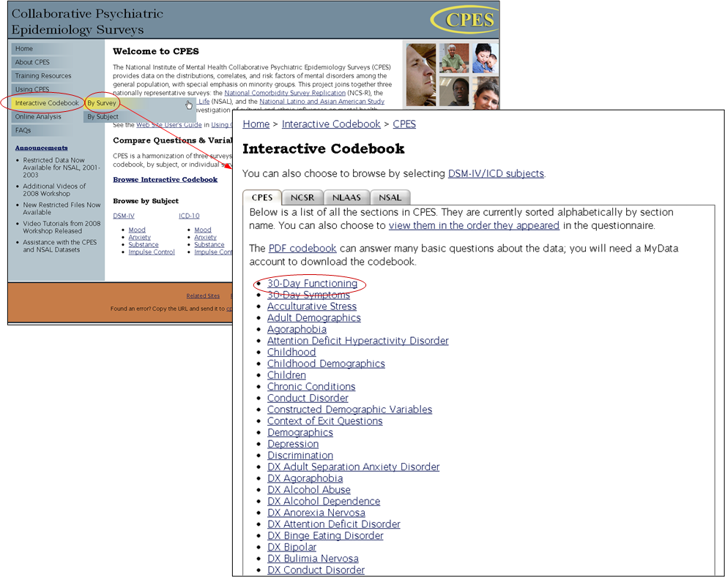
Interactive Codebook

Slide 12
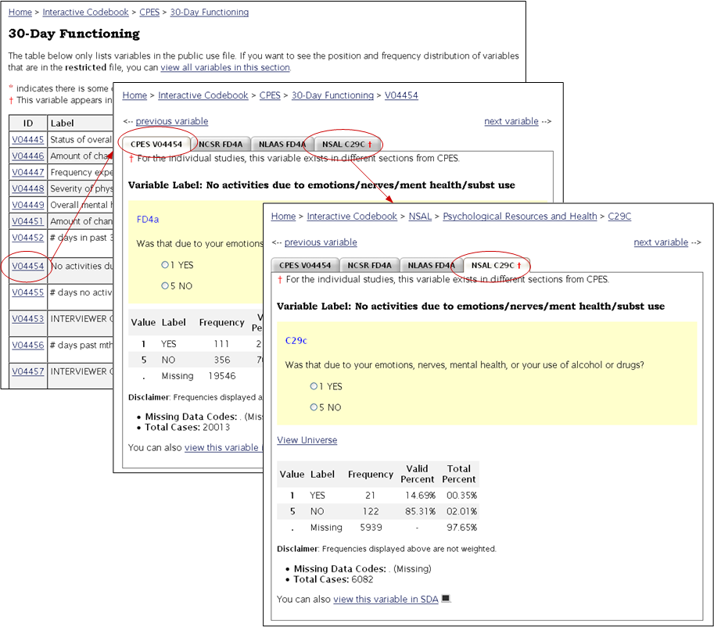
CPES V04454 Frequencies

Slide 13
ICPSR Developed Web site
Used XML files and the crosswalk to create interactive codebook
Provided
  keyword search capability
  downloadable datasets and codebooks
  online analysis tools
  links to study documentation, publications, and related sites
Web site maintenance and user support

Slide 14
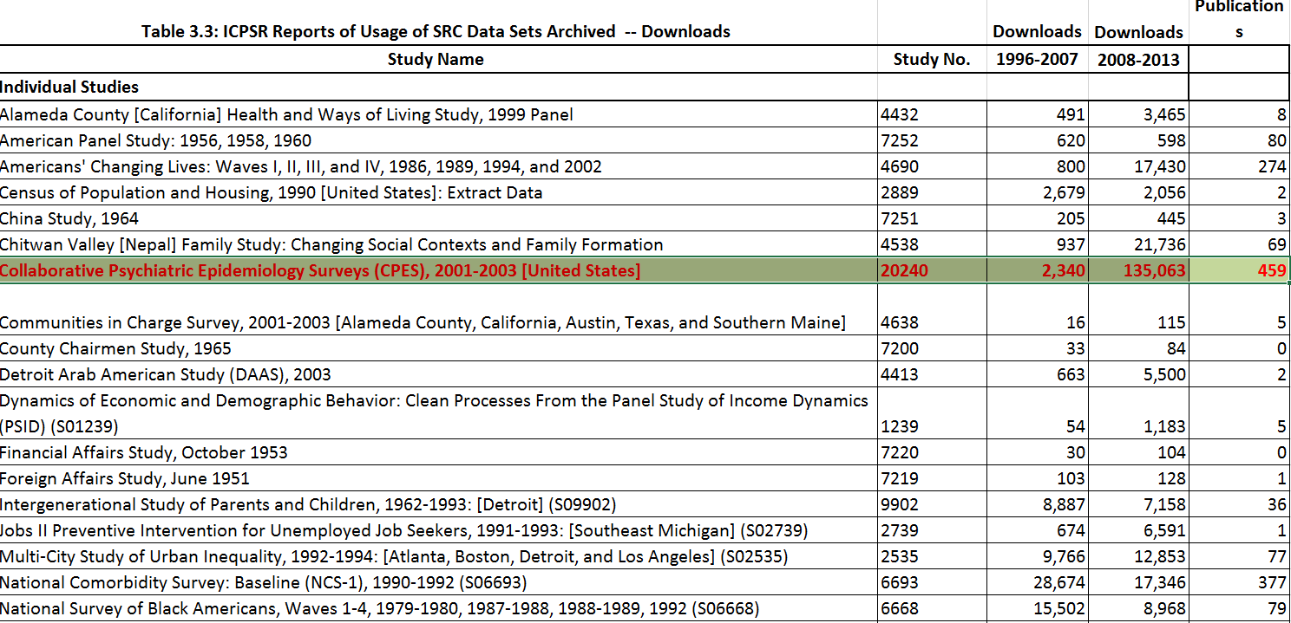

Slide 15
New to DDI 3.2
The main new things around questions and surveys in DDI 3.2 are:
  Fragments, Groups, Represented variables
  Modeling data flows through an Instrument with InParameters, OutParameters, and Bindings
  QuestionGrids
  QuestionBlocks
  Scale questions
  Ranked questions
  Point distribution questions

Slide 16
Fragments
DDI 3.0
<s:StudyUnit id="GITFIELD"> ...
<r:Citation> ...
<s:Abstract id="ABS_1"> ...
<r:UniverseReference isReference="true"> ...
<s:Purpose id="PUR_1"> ...
<c:ConceptualComponent isMaintainable="true"
id="CC_1"> ...
<d:DataCollection isMaintainable="true" id="DC1"
version="1.0.0"
versionDate="2014-03-26"> ...
<l:LogicalProduct id="LP1"> ...
<l:Category isVersionable="true"
id="cat_17_C82" missing="false">
<l:CategoryName>Male</l:CategoryName>
<r:Label xml:lang="en-US">Male</r:Label>
</l:Category>
...
DDI 3.2
<ddi:Fragment>
<l:Category>
<r:Agency>int.example</r:Agency>
<r:ID>Male</r:ID>
<r:Version>1</r:Version>
<r:Label>
<r:Content xml:lang="en-US">Male</r:Content>
</r:Label>
</l:Category>
</ddi:Fragment>

Slide 17
Groups
DDI 3.1
<l:VariableGroup id="varGroup1">
<r:UserID type="G">GITFIELD</r:UserID>
<l:GroupType>section</l:GroupType>
<r:Label xml:lang="English">GITFIELD</r:Label>
<l:VariableReference>
<r:ID>V1</r:ID>
</l:VariableReference>
<l:VariableReference>
<r:ID>V461</r:ID>
</l:VariableReference>
<l:VariableReference>
<r:ID>V23</r:ID>
</l:VariableReference>
</l:VariableGroup>
DDI 3.2
<l:VariableGroup>
<r:Agency>UoM</r:Agency><r:ID>VG1</r:ID>
<r:Version>1</r:Version>
<l:VariableGroupName>
<r:String>varGroup1</r:String>
</l:VariableGroupName>
<r:VariableReference>
<r:Agency>UoM</r:Agency><r:ID>V1</r:ID>
<r:Version>1</r:Version>
<r:TypeOfObject>Variable</r:TypeOfObject>
</r:VariableReference>
<r:VariableReference>
<r:Agency>UoM</r:Agency><r:ID>V461</r:ID>
<r:Version>1</r:Version>
<r:TypeOfObject>Variable</r:TypeOfObject>
</r:VariableReference>
<r:VariableReference>
<r:Agency>UoM</r:Agency><r:ID>V23</r:ID>
<r:Version>1</r:Version>
<r:TypeOfObject>Variable</r:TypeOfObject>
</r:VariableReference>
</l:VariableGroup>

Slide 18
Represented Variables
<ddi:Fragment>
<l:Variable>
<r:Agency>int.example</r:Agency>
<r:ID>lvar1</r:ID>
<r:Version>1</r:Version>
<l:VariableName>
<r:String>marStat2000</r:String>
</l:VariableName>
<r:Label>
<r:Content>Marital status of respondent in 2000</r:Content>
</r:Label>
<l:RepresentedVariableReference>
<r:Agency>int.example</r:Agency>
<r:ID>repVar1</r:ID>
<r:Version>1</r:Version>
<r:TypeOfObject>RepresentedVariable</r:TypeOfObject>
</l:RepresentedVariableReference>
<l:VariableRepresentation>
<r:CodeRepresentation/>
</l:VariableRepresentation>
</l:Variable>
</ddi:Fragment>

Slide 19
Data flow: InParameters, OutParameters, and Bindings
<ddi:Fragment>
<d:IfThenElse>
<r:Agency>int.example</r:Agency>
<r:ID>ifThen1</r:ID>
<r:Version>1</r:Version>
<r:InParameter>
<r:Agency>int.example</r:Agency>
<r:ID>inParam2</r:ID>
<r:Version>1</r:Version>
<r:Alias>genderOfRespondent</r:Alias>
<r:CodeRepresentation>
<r:CodeListReference>
<r:Agency>int.example</r:Agency>
<r:ID>codeListGender</r:ID>
<r:Version>1</r:Version>
<r:TypeOfObject>CodeList</r:TypeOfObject>
</r:CodeListReference>
</r:CodeRepresentation>
</r:InParameter>
<d:IfCondition>
<r:Command>
<r:ProgramLanguage>MetaEnglish</r:ProgramLanguage>
<r:CommandContent> genderOfRespondent == Female </r:CommandContent>
</r:Command>
</d:IfCondition>
<d:ThenConstructReference>
<r:Agency>int.example</r:Agency>
<r:ID>seq2</r:ID>
<r:Version>1</r:Version>
<r:TypeOfObject>Sequence</r:TypeOfObject>
</d:ThenConstructReference>
</d:IfThenElse>
</ddi:Fragment>

Slide 20
Question representations
QuestionGrids
QuestionBlocks
Scale questions
Ranked questions
Point distribution questions

Slide 21
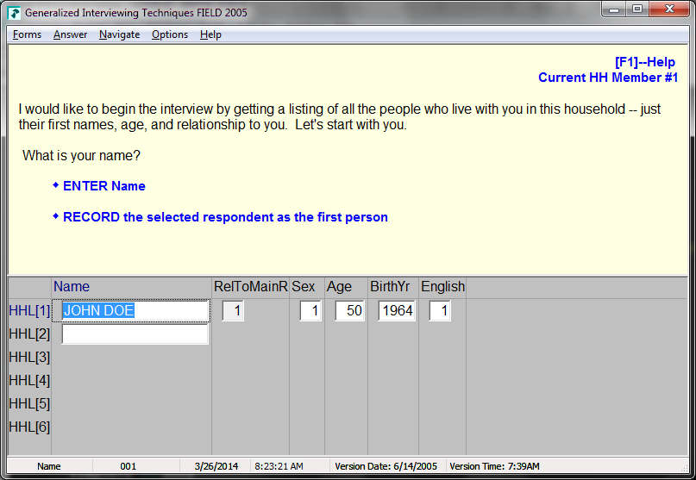
QuestionGrids

Slide 22
QuestionGrids - 3.1
<d:QuestionItem isVersionable="true" id="Q29">
<d:QuestionItemName xml:lang="English">Name</d:QuestionItemName>
<d:QuestionText isStructureRequired="true" xml:lang="English">
<d:LiteralText>
<d:Text>What is your name?</d:Text>
</d:LiteralText>
</d:QuestionText>
<d:CodeDomain>
<r:CodeSchemeReference>
<r:ID/>
</r:CodeSchemeReference>
</d:CodeDomain>
</d:QuestionItem>
<l:Variable id="V29">
<l:VariableName>GIT.HHL.HHL[1].Name</l:VariableName>
<r:Label type="var">Name</r:Label>
<l:QuestionReference>
<r:ID>Q29</r:ID>
</l:QuestionReference>
<l:Representation>
<l:TextRepresentation maxLength="40"/>
</l:Representation>
</l:Variable>
<l:VariableGroup id="varGroup5">
<r:UserID type="G">GIT.HHL.HHL[1]</r:UserID>
<l:GroupType>array</l:GroupType>
<r:Label xml:lang="English"/>
<r:UniverseReference>
<r:ID>U20</r:ID>
</r:UniverseReference>
<l:VariableReference>
<r:ID>V28</r:ID>
</l:VariableReference>
<l:VariableReference>
<r:ID>V29</r:ID>
</l:VariableReference>
<l:VariableReference>
<r:ID>V31</r:ID>
</l:VariableReference>

Slide 23
QuestionGrids - 3.2
<ddi:Fragment>
<d:QuestionGrid>
<r:Agency>int.example</r:Agency>
<r:ID>grid1</r:ID>
<r:Version>1</r:Version>
<d:GridDimension rank="1">
<d:Roster baseCodeValue="1" codeIterationValue="1" minimumRequired="1" maximumAllowed="25"
> </d:Roster>
</d:GridDimension>
<d:StructuredMixedGridResponseDomain>
<d:GridResponseDomain>
<d:TextDomain>
<r:Label>
<r:Content>Name</r:Content>
</r:Label>
</d:TextDomain>
</d:GridResponseDomain>
<d:GridResponseDomain>
...
ddi:Fragment>
<d:QuestionItem>
<r:Agency>int.example</r:Agency>
<r:ID>question1</r:ID>
<r:Version>1</r:Version>
<d:QuestionItemName>
<r:String>q1</r:String>
</d:QuestionItemName>
<r:OutParameter>
<r:Agency>int.example</r:Agency>
<r:ID>outParam1</r:ID>
<r:Version>1</r:Version>
<r:Alias>firstName</r:Alias>
<r:TextRepresentation/>
</r:OutParameter>
<d:QuestionText audienceLanguage="en-US">
<d:LiteralText>
<d:Text>What is your name?</d:Text>
</d:LiteralText>
</d:QuestionText>
<d:TextDomain/>
</d:QuestionItem>
</ddi:Fragment>
<

Slide 24
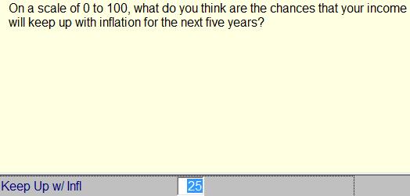
Scale questions - 3.0
  ...
<l:Variable id="V387">
<l:VariableName>KeepUp</l:VariableName>
<r:Label xml:lang="en-US">Scale Intro</r:Label>
<r:Label type="var">KeepUp</r:Label>
<l:QuestionReference>
<r:ID>Q387</r:ID>
</l:QuestionReference>
<l:Representation>
<l:NumericRepresentation type="Integer">
<r:NumberRange>
<r:Low>0</r:Low>
<r:High>100</r:High>
</r:NumberRange>
</l:NumericRepresentation>
</l:Representation>
</l:Variable>
<d:QuestionItem id="Q387">
<d:QuestionItemName xml:lang="en-US">Keep Up w/ Infl</d:QuestionItemName>
<d:QuestionText isStructureRequired="true" xml:lang="English">
<d:LiteralText>
<d:Text>On a scale of 0 to 100, what do you think are the chances that your income will keep up with inflation for the
next five years?</d:Text>
</d:LiteralText>
</d:QuestionText>
<d:CodeDomain>
<r:CodeSchemeReference>
<r:ID/>
</r:CodeSchemeReference>
</d:CodeDomain>
</d:QuestionItem>

Slide 25
Scale questions - 3.2
<ddi:Fragment>
<d:QuestionItem>
<r:Agency>int.example</r:Agency>
<r:ID>Q1</r:ID>
<r:Version>1</r:Version>
<d:QuestionItemName>
<r:String>KeepUp</r:String>
</d:QuestionItemName>
<d:QuestionText audienceLanguage="en-US">
<d:LiteralText>
<d:Text>On a scale of 0 to 100, what do you think are the
chances that your income will keep up with inflation for the
next five years?</d:Text>
</d:LiteralText>
</d:QuestionText>
<d:ScaleDomain>
<r:ScaleDimension>
<r:NumberRange>
<r:Low>0</r:Low>
<r:High>100</r:High>
</r:NumberRange>
<r:ValueIncrement startValue="0" endValue="100" increment="1"/>
</r:ScaleDimension>
<r:Label>
<r:Content>Keep Up w/ Infl</r:Content>
</r:Label>
</d:ScaleDomain>
</d:QuestionItem>
</ddi:Fragment>

Slide 26
Ranked questions
<ddi:Fragment>
<d:QuestionGrid>
<r:Agency>int.example</r:Agency>
<r:ID>grid1</r:ID>
<r:Version>1</r:Version>
<d:GridDimension rank="1">
<d:Roster baseCodeValue="1" codeIterationValue="1"
minimumRequired="0" maximumAllowed="100"
> </d:Roster>
</d:GridDimension>
<d:StructuredMixedGridResponseDomain>
<d:GridResponseDomain>
<d:TextDomain>
<r:Label>
<r:Content>Name</r:Content>
</r:Label>
</d:TextDomain>
</d:GridResponseDomain>
<d:GridResponseDomain>
<d:RankingDomain>
<r:RankingRange>
<r:MinimumValue included="true">1</r:MinimumValue>
<r:MaximumValue
included="true">5</r:MaximumValue>
</r:RankingRange>
</d:RankingDomain>
</d:GridResponseDomain>
<d:GridResponseDomain>
<d:DistributionDomain>
<r:DistributionValue>100</r:DistributionValue>
</d:DistributionDomain>
</d:GridResponseDomain>
</d:StructuredMixedGridResponseDomain>
</d:QuestionGrid>
</ddi:Fragment>

Slide 27


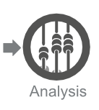

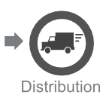

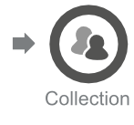

DDI 3.2 is much more powerful to
Document the full survey lifecycle in a standard manner

Slide 28
Next Step
DDI3.2
MQDS 5?
Blaise 5?
Colectica 5?
Thank YOU!

