Slide 1
GSIM, CSPA, and Related Activities of the High-Level Group
Arofan Gregory
Metadata Technology NA
April 1. 2014
NADDI, Vancouver

Slide 2
Introduction
It’s all about acronyms:
UNECE
CES
GSBPM
GSIM
CSPA
DDI

Slide 3
Official Statistics
UN/ECE – The United Nations Economic Commission for Europe
Based in Geneva (Palais de Nations)
Not strictly European in Scope
CES – The Committee of European Statisticians
Not strictly European in Scope
Coordinates statistical activity among national and supra-national statistical agencies
HLG – The High Level Group for the Modernization of Statistical Production and Services
What do you think?

Slide 4
The Perceived Problem
In the age of Google, “Big Data”, and Open Data, statistical agencies fear they may become irrelevant
The demand for data is huge, but traditional statistical production is relatively slow, and very expensive
Budgets are shrinking, but the legal requirements for official data are not changing

Slide 5
A Reference Model for Process
Over the past few years, the CES community produced a “reference model” describing the statistical production process
GSBPM – the Generic Statistical Business Process Model
Very effective in allowing statistical agencies to describe their processes, and to communicate among themselves
Defines a non-linear process model, with clear terms and definitions

Slide 6
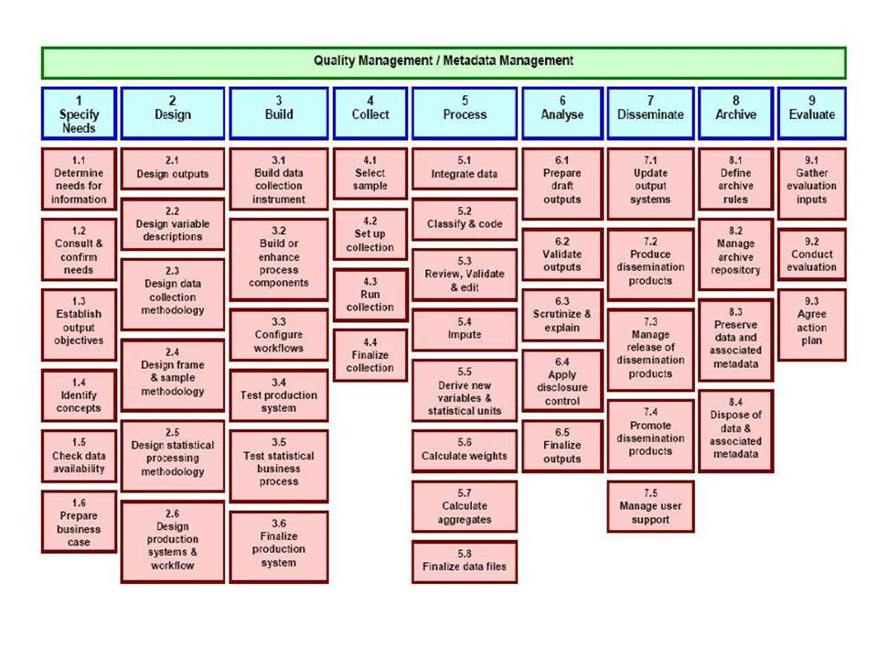
GSBPM

Slide 7
Success Leads to Success…
Following the GSBPM model. The HLG decided to create an information model…
GSIM – the Generic Statistical Information Model
One year to produce version 1.0 in a series of “sprints”
Version 1.1 delivered December 2013
A reference model for data and metadata

Slide 8
GSIM
Version 1.0 was organized into four areas:

Slide 9
Version 1.1
Version 1.1 re-organized and simplified the model:
Task-based models
Identifying statistical needs
Managing statistical programs
Designing and running statistical processes
Collecting, processing, and disseminating statistical information
“Foundational” information
Concepts, populations, codelists and classifications, variables, data sets, quality metadata
Neuchatel Classification model is now part of GSIM
DDI 4 is aligning with the GSIM model
Some parts of DDI 3.2 were influenced by GSIM

Slide 10
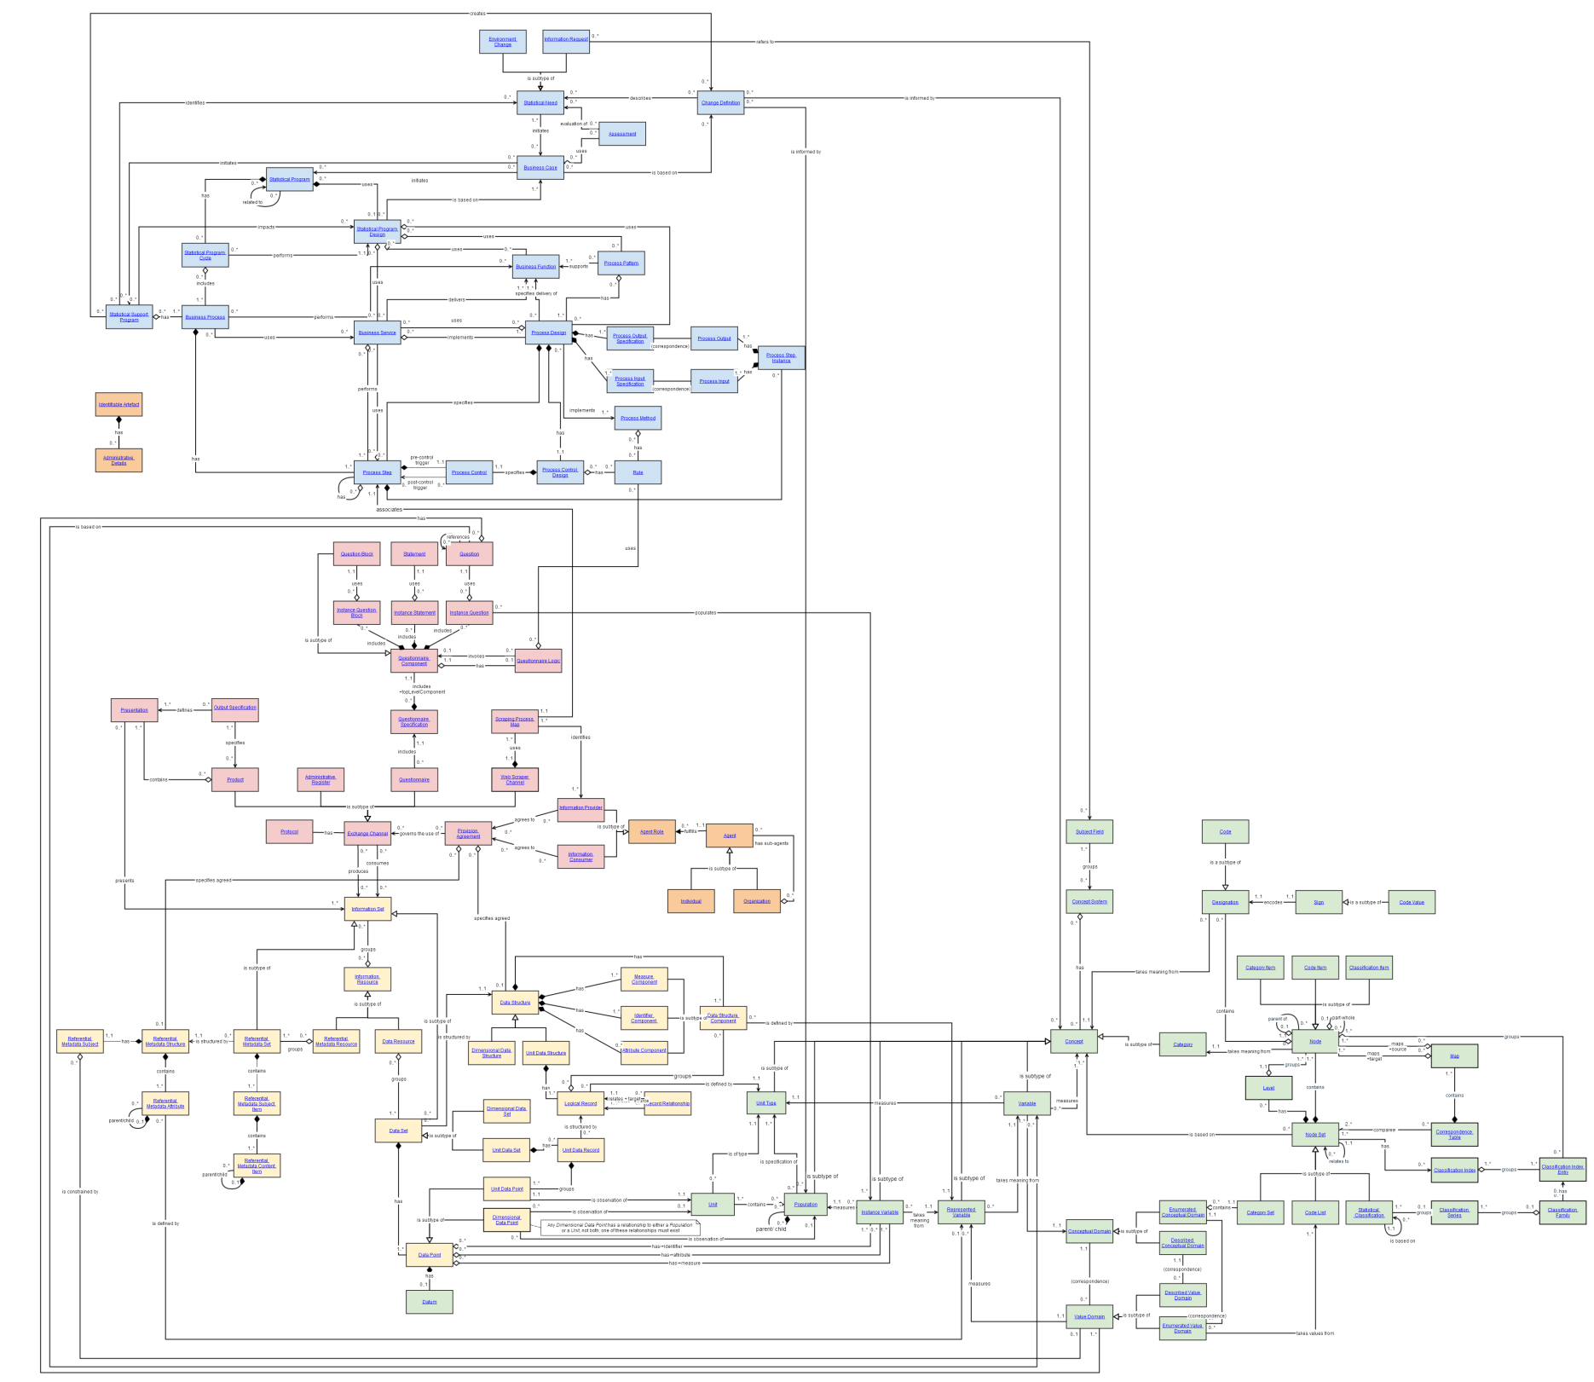
“Full” GSIM Model

Slide 11
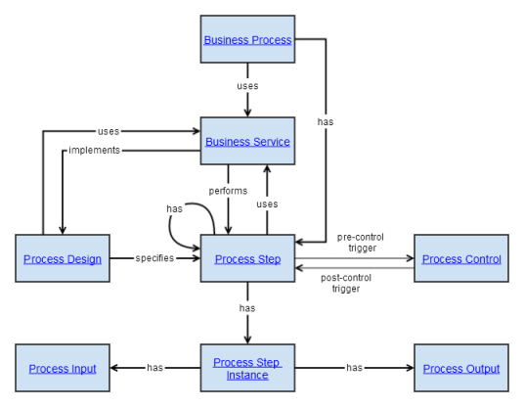

Slide 12
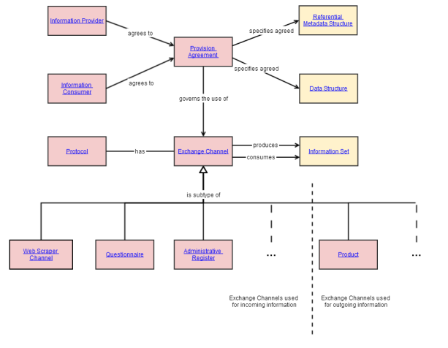

Slide 13
Resources
There is an easy-to-use “Clickable GSIM” available on the UN/ECE site:
http://www1.unece.org/stat/platform/display/GSIMclick/Clickable+GSIM
Users can add “views”
Specification is available
Includes some profiles of DDI for implementing GSIM (more to come)

Slide 14
Statistical Architecture
To increase efficiency, statistical agencies want to share IT development resources by sharing services
CSPA – Common Statistical Production Architecture
“Plug and play” services using standard interfaces
Standard architecture model was developed

Slide 15
This makes it hard to share and reuse!
Collect
Process
Analyse
Disseminate
Canada
?
Sweden
?

Slide 16
…but if statistical organisations work together?
Notes:
HLG sponsor project: Desired Project Outcomes
Increased:
interoperability in Official Statistics through the sharing of processes and components
ability to find real/genuine collaboration opportunities
ability to make international decisions and investments
sharing of architectural/design
knowledge and practices

Slide 17
This makes it easier to share and reuse!
Collect
Process
Analyse
Disseminate
Canada
?
Sweden
?

Slide 18
CSPA Prototype
A number of shared services were developed in 2013
Based on DDI interfaces
“Wrapping” existing production proceses
The prototype was a success!
Feedback to DDI is being incorporated into the DDI 4 development

Slide 19
Looking Forward
HLG has now focused on two areas:
Big Data (from a statistical office perspective)
More CSPA services
Several are now being developed, based not only on DDI but also on SDMX
DDI-related work is now being coordinated by the Modernization Committee on Standards
Emphasis is placed on having standard profiles and mappings from GSIM to DDI
Work now being organized for 2014
DDI Alliance is represented on this committee

Slide 20
Questions?

