Slide 1
DDI Profiles to Support Software Development as well as Data Exchange and Analysis
NADDI 2014
02.04.2014, Vancouver (Canada)
David Schiller, IAB
Ingo Barkow, DIPF

Slide 2
Outline
When developing software for data documentation one has to think about how to incorporate the DDI standard
DDI-L 3.2 is a powerful standard that can support sophisticated data models and data production modes
At the same time software needs to be manageable and adjusted to the given institution

Slide 3
DDI-L - considerations
DDI Lifecycle 3.2
XML Schema
DDI 3.2 – about 1150 main elements
Each element might contain a number of sub-elements
Some elements are quite domain specific
High degree of complexity
Number of mandatory element quite low due to the demands of different organizations or domains

Slide 4
Challenge when building tools
Normally there is only a need for 50-60 main elements for a given survey or organisation
But not always for the same 50-60 main elements
Huge challenge when building software tools
Especially when it is about DDI import and export functionalities
The results are likely not interoperable solutions

Slide 5
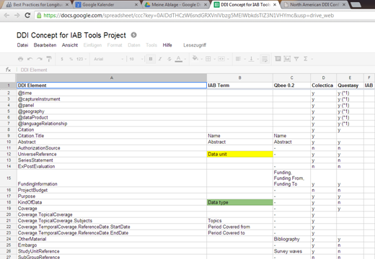
Example from the IAB Metadata project

Slide 6
Solution DDI Profiles by “topic”
Creating of DDI Profiles is described in an article from 2009 (Ionescu, Sanda)
The idea is to not have individual profiles but standardized profiles by “topics”
Examples of topics may include: “survey design”, “data collection” or more specific “administrative data”; what else?
Institutions can than choose the needed profiles for their institution and be interoperable with others

Slide 7
Standard DDI profiles: Main goals
Standard DDI profiles should cover the most used DDI elements by topics
Agencies can choose from those profiles
This will lead to an harmonized use of DDI
And to easier exchange between tools and agencies

Slide 8
Use Case I – Data Exchange
FDZ of BA at IAB has administrative and social insurance data
Responsible German law: social code book
Survey, health, financial and geo data is or will be merged to IAB data
Normally data stays in the facilities of the BA, due to the availability of high data security standards
Merging data sources will be easier when using DDI profiles excepted within the community

Slide 9
Use Case II – Data Exchange
International research becomes more and more important
Moving confidential data to a central storage is normally no option, due to legal restrictions
Trusted third party infrastructures could solve that challenge, by providing secure trusted environments
DDI profiles will ease the job of finding comparable data sources within different countries

Slide 10
Use Case III – Software development
DIPF/TBA21 provides a DDI-based survey system
A full DDI-L instance is much too complex to describe a questionnaire for field work
Needed is only an extract containing e.g. QuestionItems, ReponseDomains and Conditionals (working questionnaires can only be created in DDI-L 3.2)
Solution to exchange questionnaires between tools is a „simple questionnaire“ DDI profile

Slide 11
Summary
Goal is:
to make DDI-L manageable and
to ensure exchange possibilities between different software (harmonization between agencies)
to prepare shift to DDI-L 4.0
Useful standard DDI-L profiles need to be discussed and agreed on

Slide 12
Thank you for your attention
david.schiller@iab.de
barkow@dipf.de
http://fdz.iab.de
http://www.dipf.de

