Slide 1
DDI Discovery: An Overview of Current RDF Vocabularies
Arofan Gregory
Metadata Technologies NA
Joachim Wackerow
GESIS

Slide 2
Background
For many years, interest has been increasing in the set of standards-based technologies from W3C around “Linked Data”
(aka “The Semantic Web”, RDF, etc.)
RDF stands for the “Resource Description Framework” – a way of making the Web semantically richer and machine-actionable
In the recent past, these technologies have shown increasing promise
DDI has always been an “XML standard”
But this has changed!
DDI now does both RDF and XML as underlying syntaxes for implementation
RDF is based on the model implicit in DDI Codebook and DDI Lifecycle XML

Slide 3
A Tale of Two Ontologies
This presentation is not a modeler’s view of the DDI RDF ontologies
Thomas Bosch of GESIS (and others) have done many good presentations in this style
This is more of a general overview, to explain what has been developed and published, and how it might broaden the use of DDI
DDI RDF Discovery Vocabulary (studies & research data)
XKOS Vocabulary (statistical classifications)

Slide 4
Well, Maybe Three Ontologies…
In the recent past, as a result of pressure from the Open Data movement in the UK, an ontology had been developed for publishing aggregate statistics
Data Cube
Now part of the W3C Open Data suite of standards
This was based on the Statistical Data and Metadata Exchange (SDMX) standard
Also designed to be used as a description of tabulations in a DDI-based vocabulary for describing microdata

Slide 5
DDI RDF Discovery Vocabulary (“Disco”)
The initial application of DDI to RDF was to handle the majority use-case we see with RDF
Publication on the Web!
Describes conceptual metadata about studies and data sets for finding them across the Web of Linked Data
Both at the study level and at the variable level
For research data, this is a function most often seen after data has been produced and disseminated
Data archives
Data libraries
Data producers
Statistical and government agencies

Slide 6
XKOS
The second most-used RDF vocabulary is the Simple Knowledge Organization System (SKOS) vocabulary
XKOS is a set of extensions to SKOS to support formal statistical classifications
Useful as a stand-alone vocabulary, and in combination with Disco and Data Cube

Slide 7
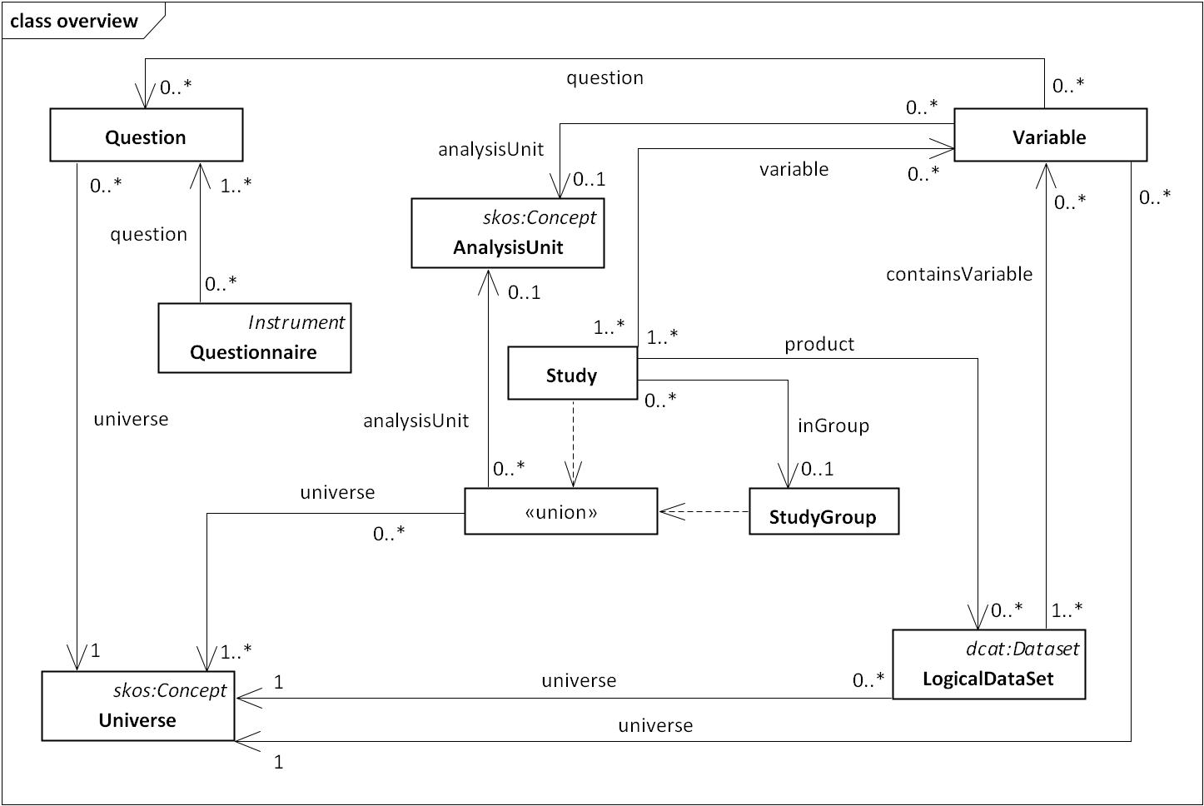
DDI Discovery

Slide 8
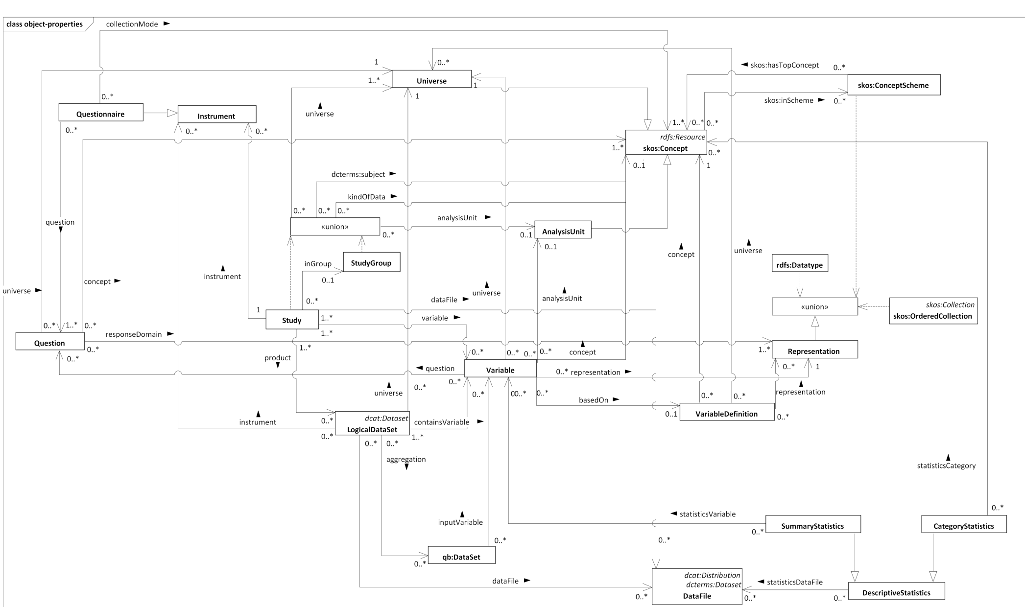
The Full Picture

Slide 9
DDI Discovery Publication
Available on the DDI Alliance website (www.ddialliance.org)
As an HTML specification, but also available in machine-processable formats (TURTLE, N3, RDF XML)
“Unofficial Draft” status
Still responding to implementer’s issues and comments
Relatively stable

Slide 10
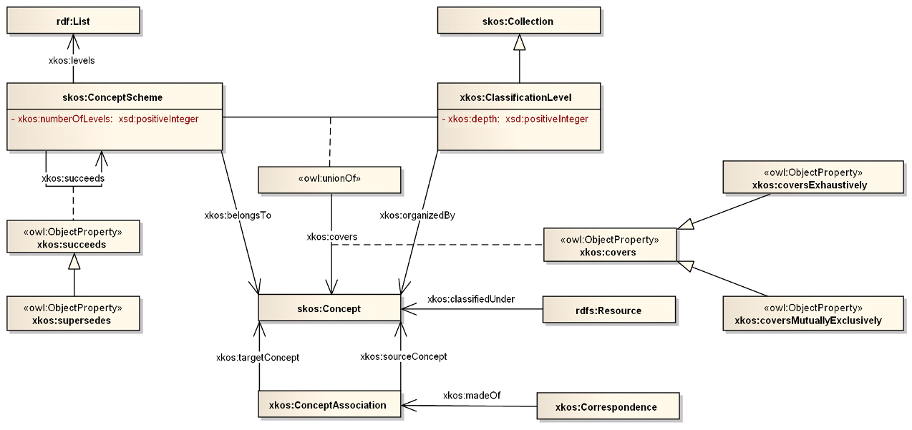
XKOS

Slide 11
XKOS Publication
Available at the DDI Alliance website
Published as an HTML specification
Also published in machine-actionable formats (TURTLE, N3, RDF XML)
Also with an “Unofficial Draft” status
More stable than the Disco vocabulary

Slide 12
Looking Forward
There is one more RDF vocabulary being worked on in this series…
Achim Wackerow will present this in the next session…
The “next generation” DDI 4 will provide broader support for RDF
Every part of the DDI Model will be expressed both as a set of XML schemas and as a set of RDF vocabularies

Slide 13
DDI 4 as a “Model-Based” Standard
DDI 4 Model
DDI XML Schemas
DDI RDF Vocabularioes
Semantically Equivalent

Slide 14
Questions?

