Slide 1
The Complicated Provenance of American Community Survey Data: How Far will PROV and DDI Take Us?
William C. Block,¹ Warren Brown, ¹ Jeremy Williams, ¹ Lars Vilhuber, ² and Carl Lagoze,³
¹ Cornell Institute Social and Economic Research (CISER), Cornell University
² Labor Dynamics Institute (LDI), Cornell University
³School of Information, University of Michigan
Presentation at the 2nd Annual North American DDI User Conference (NADDI14)
Vancouver, British Columbia, Canada
2 April 2014

Slide 2
Outline
Answering the Q: How far will PROV and DDI take us? We don’t know; complicated story!
Background/Previous Work
Use Case(s) involving ANCESTRY Variable in ACS
Technical solutions at File (Dataset) and Variable Level
Future Work
Questions and Discussion

Slide 3
NSF-Census Research Network (NCRN) – Cornell Node (“Integrated Research Support, Training and Documentation”)
CED²AR is one part of this project
Funded by NSF Grant #1131848.
For more information, see www.ncrn.cornell.edu.
3

Slide 4
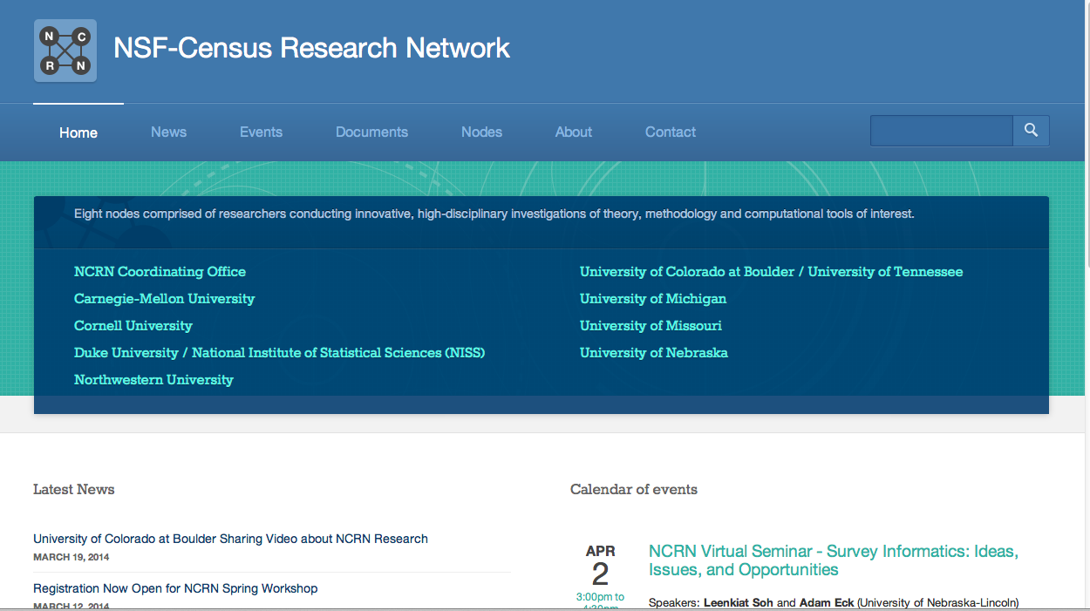
Part of NCRN Research Network

Slide 5
(CED²AR): Comprehensive Extensible Data Documentation and Access Repository
Method for solving the data curation problem that confronts the custodians of restricted-access research data and the scientific users of such data
Accommodates physical security and access limitation protocols, and allows for much improved provenance tracking
Metadata repository system that allows researchers to search, browse, access, and cite confidential data and metadata (via a web-based user interface or programmatically through a search API)
5

Slide 6
Proposed a <dataAccs> Solution at EDDI12 in Bergen
NCRN DDI Solution at the Variable Level: <dataAccs>
6

Slide 7
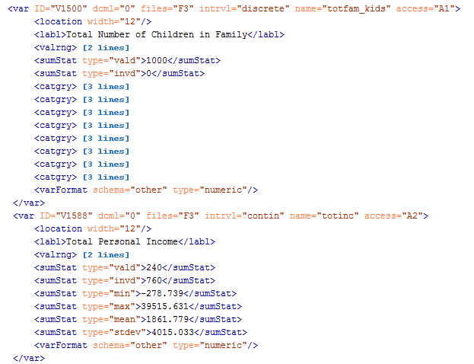
Variable Level Solution (continued)
7
Notes:
In this scenario, totfam_kids is public and totinc is confidential

Slide 8
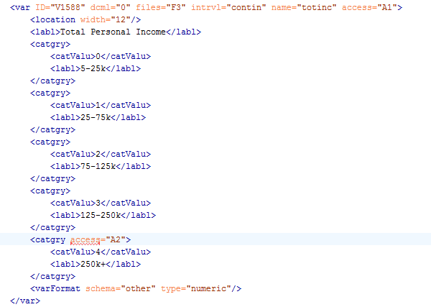
No DDI Solution at the level of a Value Label
Small tweak to the DDI Codebook Schema would fix this.
8
Notes:
Wouldn’t it be cool if we could make totinc public, but make certain value codes confidential (currently not possible to assign access id to catgry element in DDI 2.5)

Slide 9
<dataAccs> developments since EDDI12
In Lagoze, Block et.al. (2013) we more completely described
the solution for embedding field-specific and value-specific
cloaking in DDI Metadata*
Proposed formal change to DDI 2.5 (April 2013)
Brought modified “DDI 2.5.NCRN” schema online for testing
(Fall 2013)
Look forward to DDI Technical Implementation Committee
taking up our proposal
*Lagoze, C., Block, W., Williams, J., Abowd, J. M., & Vilhuber, L. (2013). Data Management of Confidential
Data. In International Data Curation Conference. Amsterdam.
9
Notes:
Wouldn’t it be cool if we could make totinc public, but make certain value codes confidential (currently not possible to assign access id to catgry element in DDI 2.5)

Slide 10
Select Cornell NCRN Publications
Forthcoming. “Lagoze, Carl, Lars Vihuber, Jeremy Williams, Benjamin Perry, and William C. Block, “CED²AR: The Comprehensive Extensible Data Documentation and Access Repository.” In: Proceedings of the ACM/IEEE Joint Conference on Digital Libraries (JCDL), London UK, September 2014.
2013 Lagoze, Carl, with William C. Block, Jeremy Williams, John M. Abowd, and Lars Vilhuber. “Data Management of Confidential Data”. In: International Journal of Digital Curation 8.1, pp.265-278. DOI: 10.2218/ijdc.v8il.259
2012 Abowd, John M., Lars Vilhuber, and William C. Block. “A Proposed Solution to the Archiving and Curation of Confidential Scientific Inputs.” In: Privacy in Statistical Databases. Ed. By Josep Domingo-Ferrer and Ilenia Tinnirello. Vol. 7556. Lecture Notes in Computer Science. Springer, pp.216-225. DOI: 10.1007/978-3-642-33627-0_17
10

Slide 11
Provenance
“data provenance, one kind of metadata, pertains to the derivation history of a data product starting from its original sources” [...] “from it, one can ascertain the quality of the data base and its ancestral data and derivations, track back sources of errors, allow automated reenactment of derivations to update the data, and provide attribution of data sources”*
*Simmhan, Plale, and Gannon, “A survey of data provenance in e-science,” ACM Sigmod Record, 2005
11

Slide 12
Provenance and Metadata
Not (currently) a “native” component of DDI, closest thing is:
<xs:complexType name="othrStdyMatType">
<xs:complexContent>
<xs:extension base="baseElementType">
<xs:sequence>
<xs:element ref="relMat" minOccurs="0" maxOccurs="unbounded"/>
<xs:element ref="relStdy" minOccurs="0" maxOccurs="unbounded"/>
<xs:element ref="relPubl" minOccurs="0" maxOccurs="unbounded"/>
<xs:element ref="othRefs" minOccurs="0" maxOccurs="unbounded"/>
</xs:sequence>
</xs:extension>
</xs:complexContent>
</xs:complexType>
Downside: No structure. Mostly verbose entries.
12

Slide 13
2013 work with PROV
Explored encoding PROV in RDF/XML* (Required use of CDATA tag to avoid interfering with schema compliance; deemed less promising)
More recently: exploring W3C PROV Model as basis for encoding provenance metadata in DDI
W3C PROV Model is based upon:
entities that are physical, digital, and conceptual things in
the world;
activities that are dynamic aspects of the world that change and create entities; and
agents that are responsible for activities.
A set of relationships that can exist between them that express attribution, delegation, derivation, etc.
*Lagoze, C., Williams, J., & Vilhuber, L. (2013). Encoding Provenance Metadata for Social Science Datasets. In 7th Metadata and Semantics Research Conference. Thessaloniki.
13

Slide 14
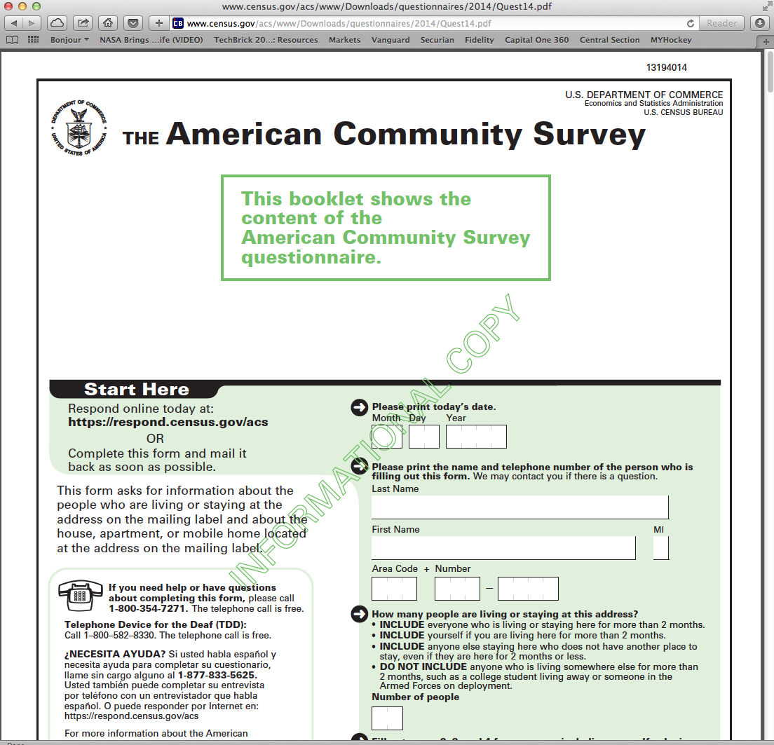
The American Community Survey (ACS)
Ongoing statistical survey conducted by the U.S. Census Bureau
Approximately 250,000 surveys/month (3 million per year)
Replacement for detailed long-form decennial census
14

Slide 15
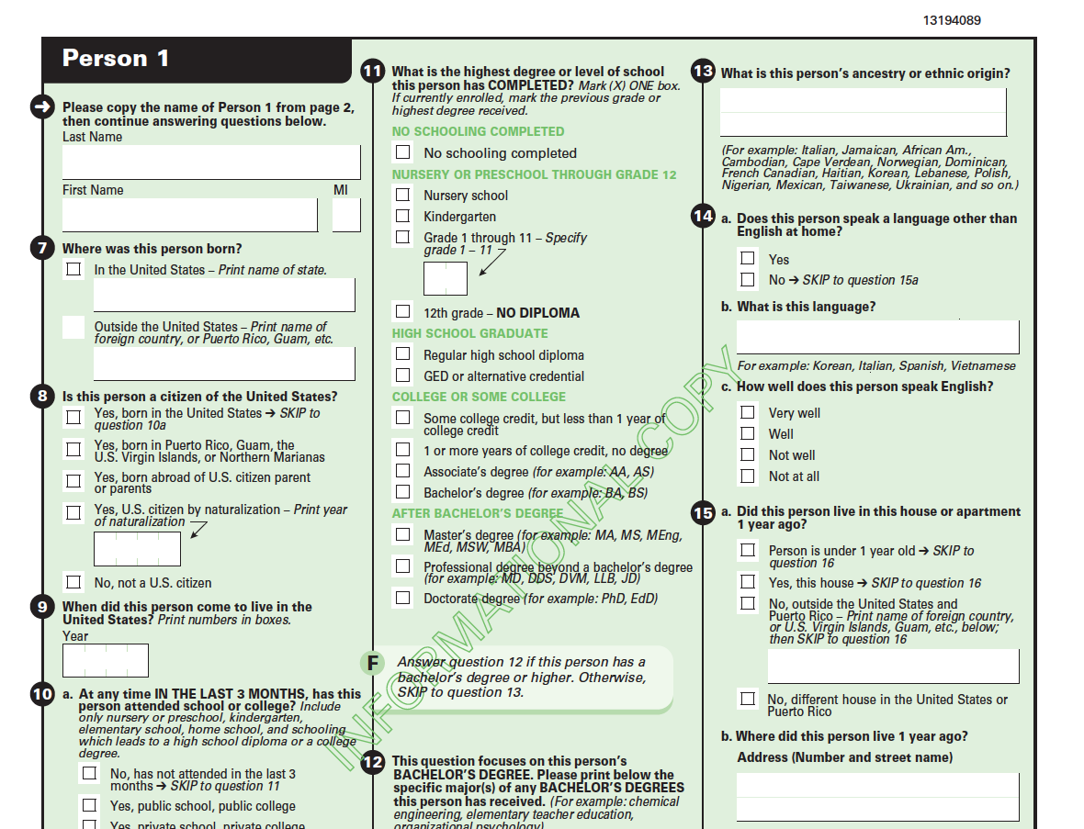
ACS Question on Ancestry or Ethnic Origin

Slide 16
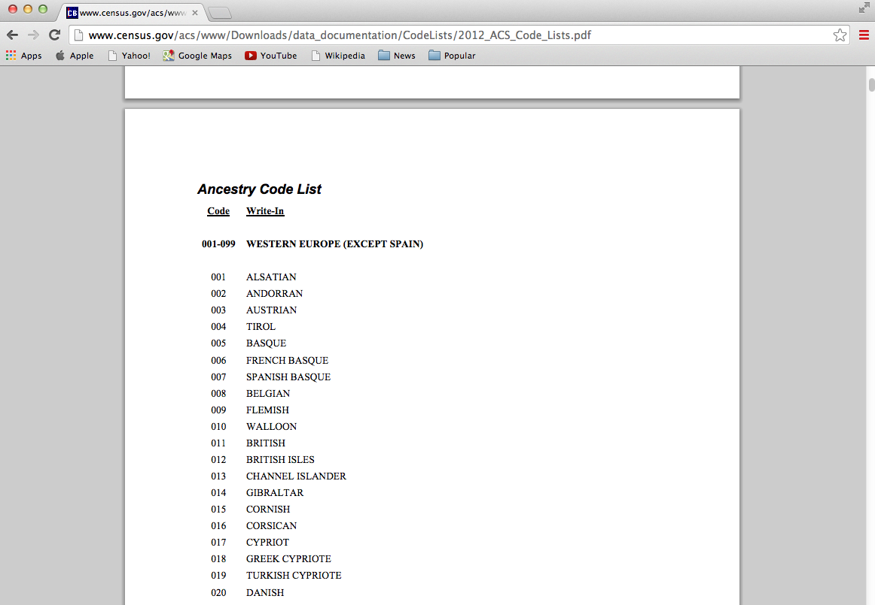
Three Use Cases: Researchers interested in people of Alsatian, Andorran, and Cypriot Ancestry
U.S. Census Bureau Documentation
Ancestry Code List
2012 ACS
16

Slide 17
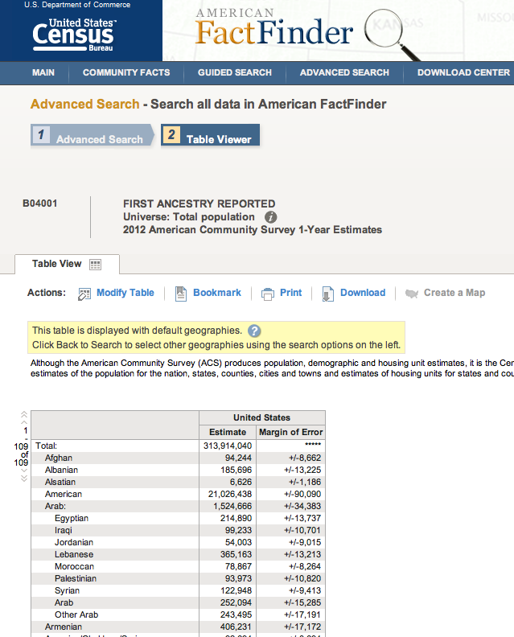
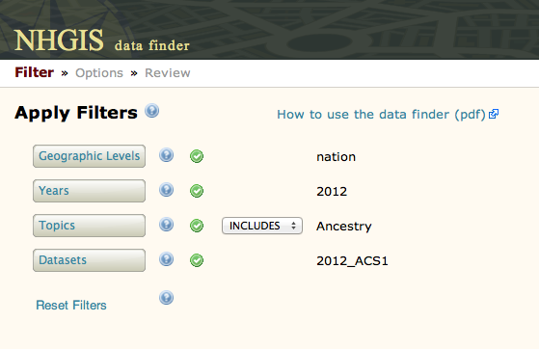
Multiple Sources of Data originating from the ACS: Examples of Aggregate Data
2012 ACS 1-year Estimate: 6,626 individuals of Alsatian Ancestry living in the United States
17

Slide 18
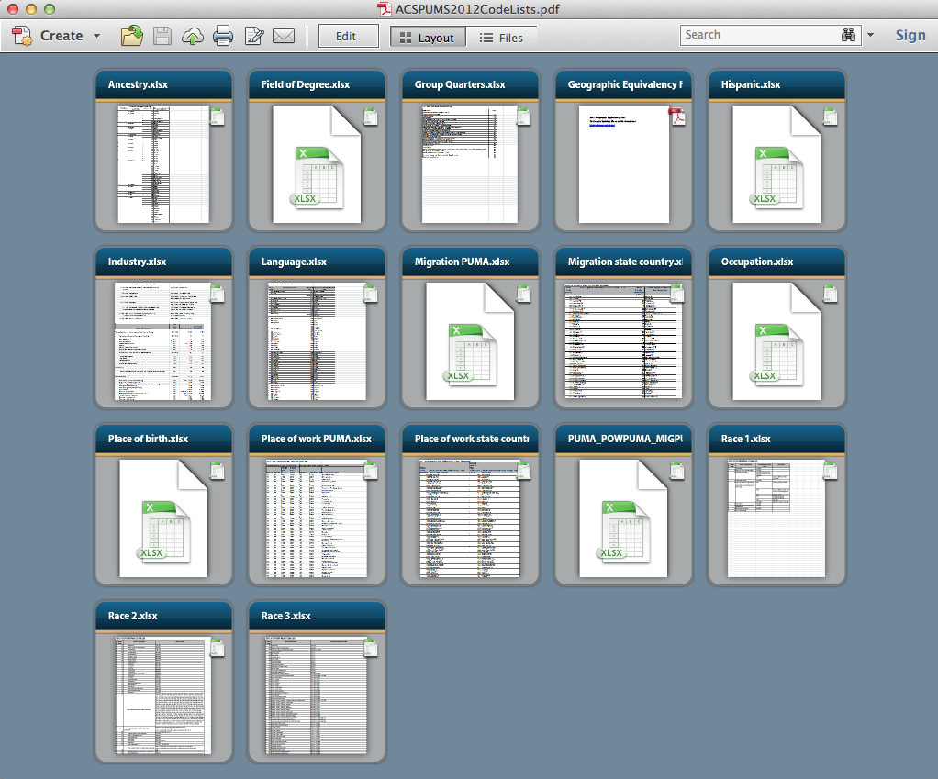
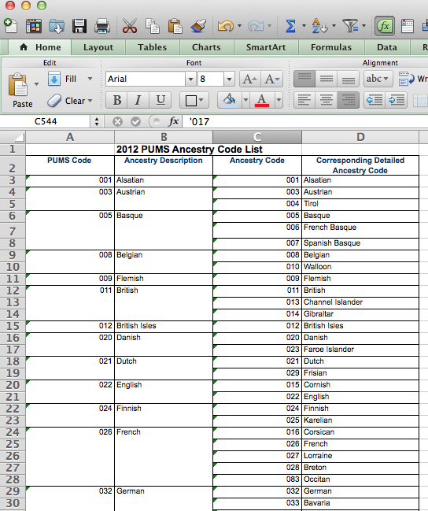
Multiple Sources of Data originating from the ACS: Example of PUMS Microdata
ACS 2012 PUMS:
ANCESTRY Code is 001 for Alsatian
18

Slide 19
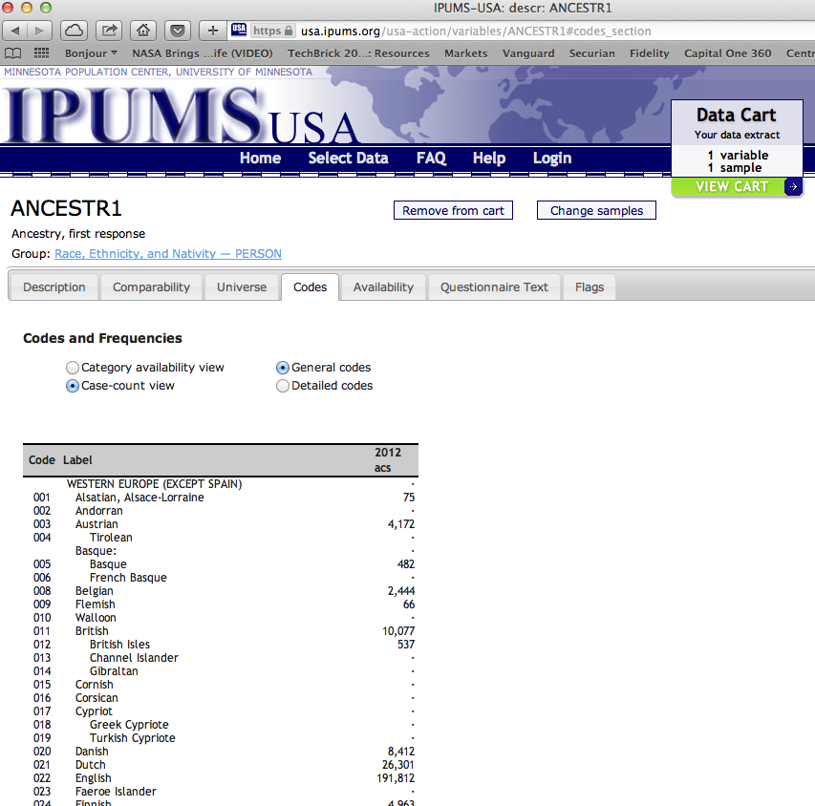
Multiple Sources of Data originating from the ACS: Example of IPUMS-USA
IPUMS-USA for ACS 2012:
001 Alsatian ANCESTRY Code
75 cases in the sample
19

Slide 20
Let’s review…
 | 2012 ACS Code List | ACS 2012 PUMS | IPUMS-USA | AFF | NHGIS
Alsatian | YES (001) | YES (001) | YES (75 cases) | 6,626 (est.) | 6,626 (est.)
Andorran
Cypriots
20

Slide 21
Three Use Cases: Researchers interested in people of Alsatian, Andorran, and Cypriot Ancestry
U.S. Census Bureau Documentation
Ancestry Code List
2012 ACS
21

Slide 22
 | 2012 ACS Code List | ACS 2012 PUMS | IPUMS-USA | AFF | NHGIS
Alsatian | YES (001) | YES (001) | YES (75 cases) | 6,626 (est.) | 6,626 (est.)
Andorran | YES (002)
Cypriots | YES (017)
22

Slide 23
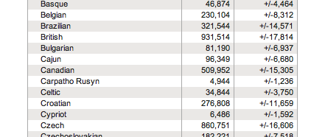
23

Slide 24
 | 2012 ACS Code List | ACS 2012 PUMS | IPUMS-USA | AFF | NHGIS
Alsatian | YES (001) | YES (001) | YES (75 cases) | 6,626 (est.) | 6,626 (est.)
Andorran | YES (002)
Cypriots | YES (017) |  |  | 6,486 (est.) | 6,486 (est.)
24

Slide 25
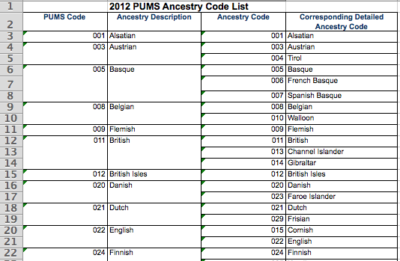
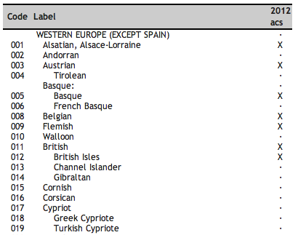

Slide 26
 | 2012 ACS Code List | ACS 2012 PUMS | IPUMS-USA | AFF | NHGIS
Alsatian | YES (001) | YES (001) | YES (75 cases) | 6,626 (est.) | 6,626 (est.)
Andorran | YES (002)
Cypriots | YES (017) | NO | NO | 6,486 (est.) | 6,486 (est.)
26

Slide 27
Three Use Cases: Researchers interested in people of Alsatian, Andorran, and Cypriot Ancestry
U.S. Census Bureau Documentation
Ancestry Code List
2012 ACS
27

Slide 28
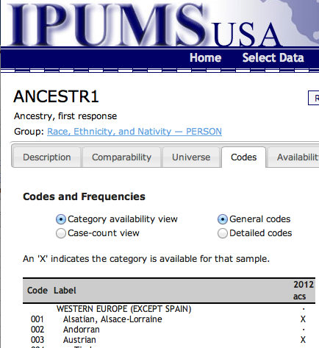
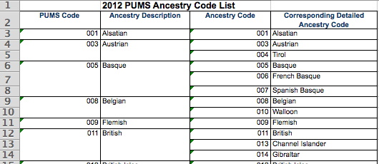
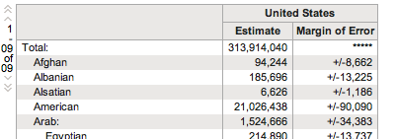

Slide 29
 | 2012 ACS Code List | ACS 2012 PUMS | IPUMS-USA | AFF | NHGIS
Alsatian | YES (001) | YES (001) | YES (75 cases) | 6,626 (est.) | 6,626 (est.)
Andorran | YES (002) | NO | NO | NO | NO
Cypriots | YES (017) | NO | NO | 6,486 (est.) | 6,486 (est.)
29

Slide 30
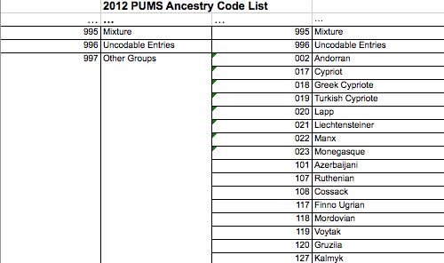
Three Use Cases: Researchers interested in people of Alsatian, Andorran, and Cypriot Ancestry
U.S. Census Bureau Documentation
Ancestry Code List
2012 ACS
30

Slide 31
Simple Provenance of ACS Data Files
ACS Questionaire
Internal Census File(s)
PUMS
Aggregate Tabulations
IPUMS
AFF
NHGIS
RDC

Slide 32
 | 2012 ACS Code List | ACS 2012 PUMS | IPUMS-USA | AFF | NHGIS | RDC
Alsatian | YES (001) | YES (001) | YES (75 cases) | 6,626 (est.) | 6,626 (est.) | Yes
Andorran | YES (002) | NO | NO | NO | NO | ?
Cypriots | YES (017) | NO | NO | 6,486 (est.) | 6,486 (est.) | ?
32

Slide 33
Provenance of ACS Data Files
ACS Questionaire
Internal Census File(s)
PUMS
Aggregate Tabulations
IPUMS
AFF
RDC
NHGIS

Slide 34
PROV at the Dataset/File Level
Mentioned earlier our exploration of encoding PROV in RDF/XML* (CDATA; less promising)
More recently: exploring W3C PROV Model as basis for encoding provenance metadata in DDI XML using <relStdy>
“…information on the relationship of the current data collection to others (e.g., predecessors, successors, other waves or rounds or to other editions of the same file). This would include the names of additional data collections generated from the same data collection vehicle plus other collections directed at the same general topic, which can take the form of bibliographic citations.”
Others working to develop an RDF encoding for DDI metadata that could easily accommodate RDF-encoding of provenance metadata
Both solutions might be viable; implementation could depend on local preferences

Slide 35
Embed PROV within <RelStdy>
Step 1 - Material Reference Complex Type with Prov
To include prov:Document within the <relStdy> element, a new complex type called ‘materialReferenceWithProvType’, which inherits from materialReferenceType can be introduced as follows:
This allows PROV document to be embedded or referenced by URI.

Slide 36
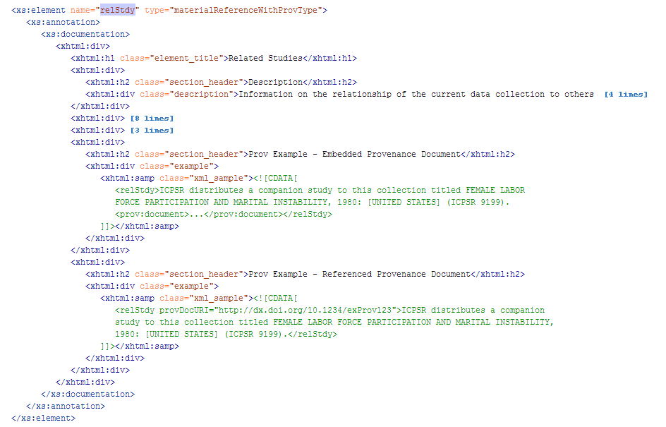
Embed PROV within <RelStdy> (Cont)
Step 2 - Modify the type of relStdy to the new complex type
The relStdy element is changed to inherit from this ‘materialReferenceWithProvType’, and examples are given

Slide 37
Provenance of ACS Data Files
ACS Questionaire
Internal Census File(s)
PUMS
Aggregate Tabulations
IPUMS
AFF
NHGIS
RDC

Slide 38
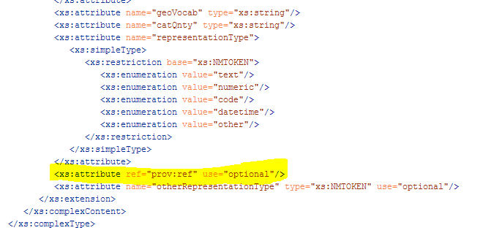
Variable Level Provenance
A single attribute is added to the variable type

Slide 39
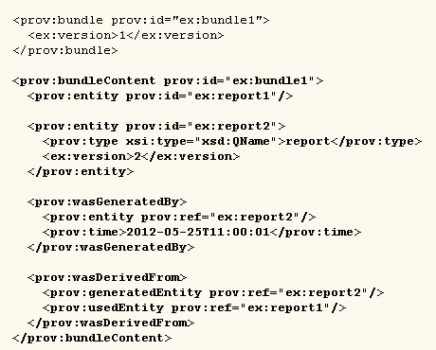
Variable Level Provenance (cont.)
In our implementation, a variable would reference a prov:Bundle that
would be found within embedded prov:Document. Here is an example of a
prov:Bundle:

Slide 40
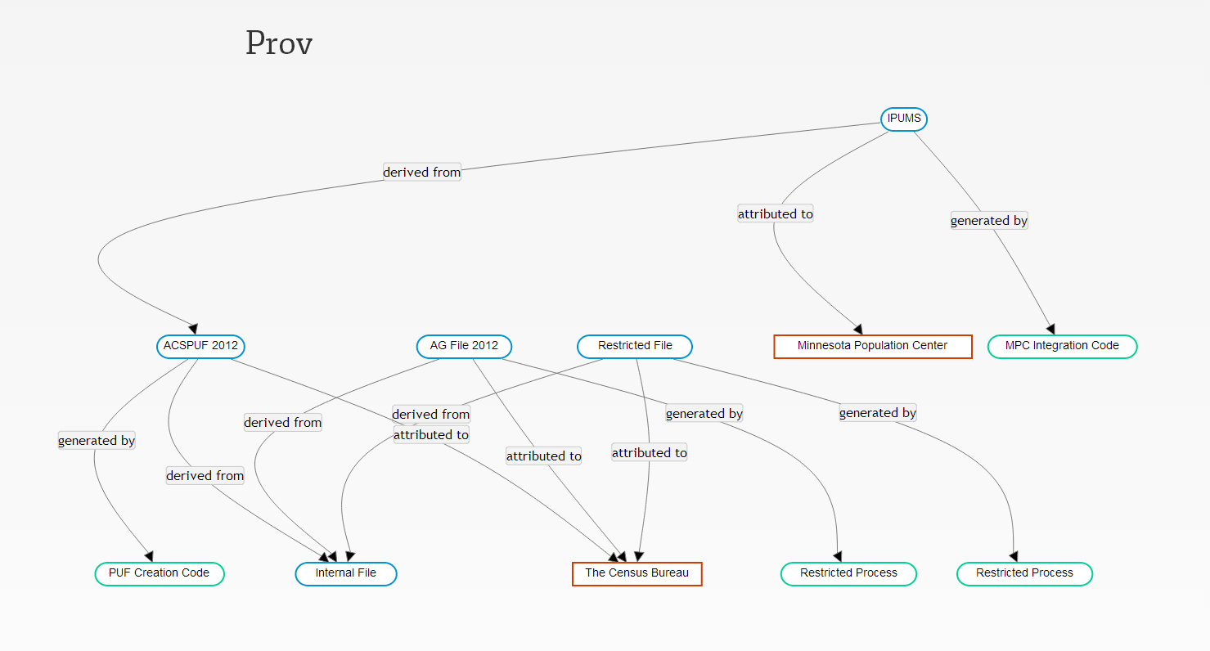

Slide 42
DDI Presentations at NCRN Spring Meeting
Data Documentation Initiative (DDI) Metadata within the Federal Statistical System: Implementation Challenges, Record Linkage, and Provenance Encoding
Jay Greenfield and Sophia Kuan (Booz Allen Hamilton): Describing Adaptive/Responsive Protocols and Data Processing in DDI
Tim Mulcahy (NORC): DDI and Record Linkage
Jeremy Williams (Cornell University): Encoding Provenance Metadata for
Social Science Datasets
DDI Tools Demonstration
Abdul K. Rahim and Pascal Heus (Metadata Technologies North America)

Slide 43
Thank you!
Questions?
block@cornell.edu
ncrn.cornell.edu

