Slide 1
Alternatives for Representing Coding of Qualitative Data in DDI
Larry Hoyle
Institute for Policy & Social Research
University of Kansas

Slide 2
Qualitative Data
Digital or real-world object (analog?)
- Purpose collected, gathered, or referenced
Text
XML
Web pages
Video
Audio
Images

Slide 3
Three Scenarios
Documentation at the object level
Segments of objects need documentation
E.g. CAQDAS – codes associated with defined segments
Segments have documentation and quantitative data have been generated from the qualitative segments
E.g. text mining
DDI Qualitative Data Model Working Group http://www.ddialliance.org/alliance/working-groups#qdewg

Slide 4
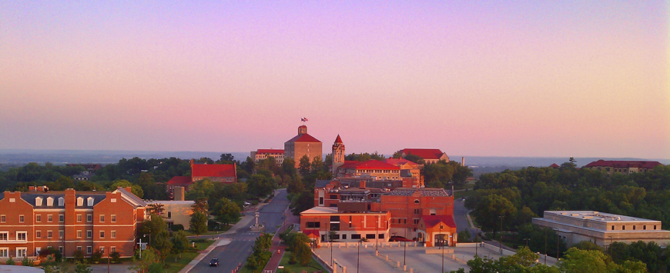
Segments Examples
Segment defined by a rectangle
Segment defined by a polygon
Segments can also be marked in text. Like in this text example.
Text segment
Overlapping text segment

Slide 5
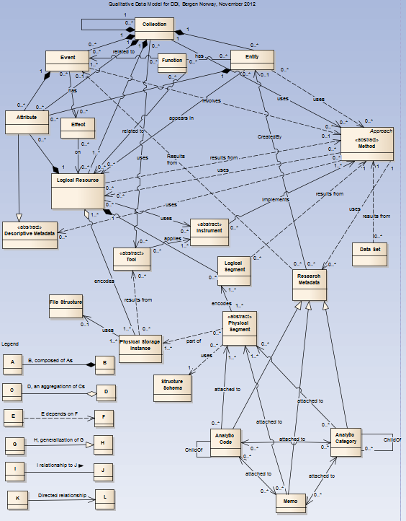
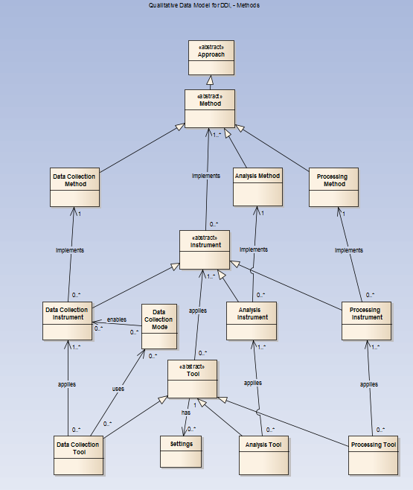
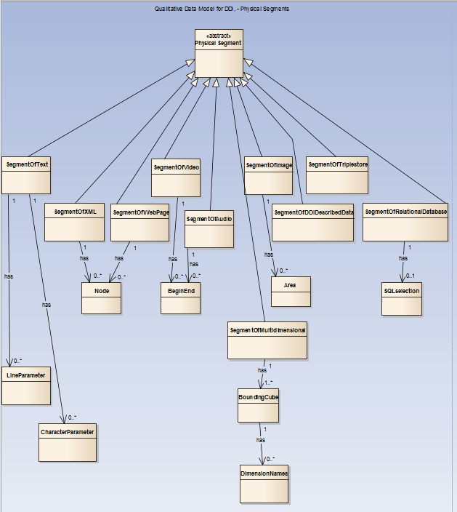
Current Model
Overall model
(many current DDI elements assumed to be applicable and not shown)
Methods and Instruments
Segment Definition

Slide 6
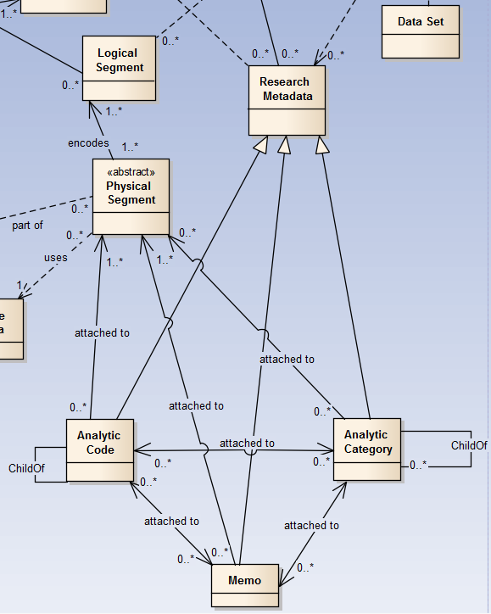
Codes, Categories and Memos
Segments can have “Codes”,
“Categories” and “Memos”
Modeled after terms from qualitative data analysis packages like Atlas/ti or NVIVO

Slide 7
Codes and Memos
“Dinner site”
“Presentations”
Memo: This is marked here for an example in a PowerPoint Presentation
Segments can also be marked in text. Like in this text example.
“Marking”
“Text reference”

Slide 8
Dataset
Off by itself is this Dataset
This might be produced by text mining, or might be quantitative data associated with an open-ended question

Slide 9
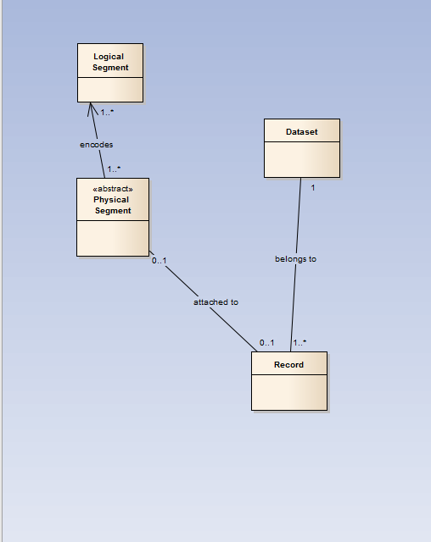
Alternative – Data/Metadata Record
This is a data record which can be described by existing DDI elements
It can contain codes, categories, memos, and any quantitative data associated with the segment

Slide 10
Alternative - Dataset
This dataset can be included in the DDI representation

Slide 11
Comparison

Slide 12
Example Records
Dataset
SegmentID | SegmentName | CampusBuilding | EveningVenue | YearBuilt | Address | Cluster1 | MiningVar
1 | AlumniCenter | 0 | 1 | 1983 | 1266 Oread Ave. | 0 | 1.27
2 | StudentUnion | 1 | 0 | 1926 | 1301 JayHawk Blvd. | 1 | 0.8

Slide 13
Example Record - Codes
Codes are handled like “Select all that apply” questions.
Codes
SegmentID | SegmentName | CampusBuilding | EveningVenue | YearBuilt | Address | Cluster1 | MiningVar
1 | AlumniCenter | 0 | 1 | 1983 | 1266 Oread Ave. | 0 | 1.27
2 | StudentUnion | 1 | 0 | 1926 | 1301 Jayhawk Blvd. | 1 | 0.8
1=has code
0=does not
Could have Categories and Memo here as well

Slide 14
Example Record – Other Variables
Quantitative Variables
Text Mining Variables
Codes
SegmentID | SegmentName | CampusBuilding | EveningVenue | YearBuilt | Address | Cluster1 | MiningVar
1 | AlumniCenter | 0 | 1 | 1983 | 1266 Oread Ave. | 0 | 1.27
2 | StudentUnion | 1 | 0 | 1926 | 1301 Jayhawk Blvd. | 1 | 0.8

Slide 15
Searching
Search for Evening Venue=1
SegmentID | SegmentName | CampusBuilding | EveningVenue | YearBuilt | Address | Cluster1 | MiningVar
1 | AlumniCenter | 0 | 1 | 1983 | 1266 Oread Ave. | 0 | 1.27
2 | StudentUnion | 1 | 0 | 1926 | 1301 Jayhawk Blvd. | 1 | 0.8

Slide 16
Searching
Search for YearBuilt<1950
SegmentID | SegmentName | CampusBuilding | EveningVenue | YearBuilt | Address | Cluster1 | MiningVar
1 | AlumniCenter | 0 | 1 | 1983 | 1266 Oread Ave. | 0 | 1.27
2 | StudentUnion | 1 | 0 | 1926 | 1301 Jayhawk Blvd. | 1 | 0.8

Slide 17
Text Mining Example
Each segment is a paragraph from a Beatrix Potter Story
(downloaded from Project Gutenberg - http://www.gutenberg.org/ )

Slide 18
A Text Topic Tool Can Build a Set of Topics

Slide 19
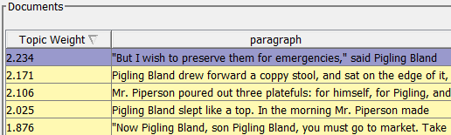
Topics are Based on Weighted Combinations of Words
The weights for calculation
Each segment can then be assigned a score for that topic

Slide 20
Future Segments Could be Scored on These
The weights for calculation
Described by a DDI Generation Instruction for a variable shared across studies?
SegmentID | paragraph | MiningVar
1001 | Did you read the paper? | 0.305
1002 | I wish spring would come | 0.173

Slide 21
Data or Metadata?
Depends on use, doesn’t it? (c.f. NSA use of phone “metadata”)
YearBuilt might be metadata when searching for image segments or text descriptions of old buildings
It might be data if we used the text mining variables to predict building age
Metadata?
Data?
SegmentID | SegmentName | CampusBuilding | EveningVenue | YearBuilt | Address | Cluster1 | MiningVar
1 | AlumniCenter | 0 | 1 | 1983 | 1266 Oread Ave. | 0 | 1.27
2 | StudentUnion | 1 | 0 | 1926 | 1301 Jayhawk Blvd. | 1 | 0.8

Slide 22
Similarity Between Models
A code (its associated category) can refer to a concept
A variable can refer to a concept
So both approaches ultimately relate a segment to some concept

Slide 23
Data Record Advantages
Can handle Mixed Method Research (Quantitative and Qualitative Approaches)
Works for surveys with open-ended questions
Allows for sharing of codes and quantitative variables across studies
Searching for codes is the same as searching for other attributes (e.g. building age from above)
Flexible

Slide 24
Disadvantages
More difficult to explain?
Searching involves more indirect lookup
Segment with a record with a value of 1 (“has attribute”) on Variable “AnalyticCode”
Vs
Segment with “AnalyticCode” of xxx
“Codes”, “categories”, and “memos” lose special meaning
Resistance from qualitative only researchers?

Slide 25
Discussion
Advantages and disadvantages to data record approach?
Other comments?

Slide 26
For More About the Qualitative Model
See:
Toward Qualitative Data in DDI. Larry Hoyle and Joachim Wackerow
Larry Hoyle is a Senior Scientist at the Institute for Policy & Social Research, University of Kansas
LarryHoyle@ku.edu .
Joachim Wackerow is a metadata expert at GESIS - Leibniz Institute for the Social Sciences and can be reached at joachim.wackerow@gesis.org. version: November 2013

