Slide 1
A DDI3.2 Style for Data and Metadata Extracted from SAS
Larry Hoyle
Institute for Policy & Social Research
University of Kansas

Slide 2
Metadata Embedded in Proprietary Data Files
SAS, Stata, SPSS, Excel, Relational Databases, R
All have some metadata which can be extracted
Variable names, labels, data types, formats
Missing value representation
Codelists
Integrity constraints (e.g. 0 <= age <=130)
Implied information format (Euro.)
indexes

Slide 3
Tools
Growing list of tools can harvest this information. Here are some:
Colectica
Dataset Documentation Manager
OpenDataForge Toolkit
DExT
Nesstar
RSpssConversion
SPSSOMS2DDI
StatTransfer

Slide 4
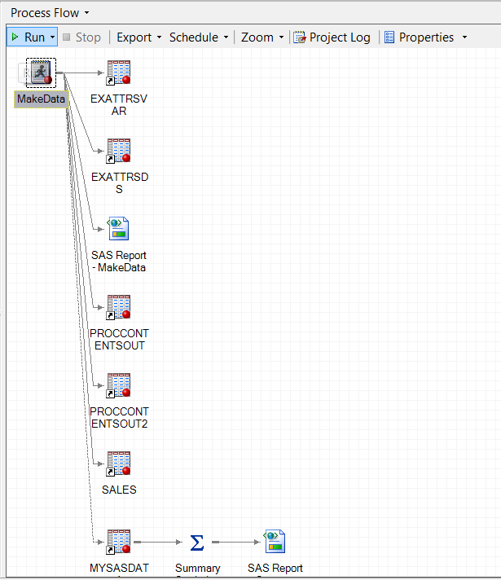
A Prototype Tool
Runs in SAS Enterprise Guide
Part of Documented Process Flow

Slide 5
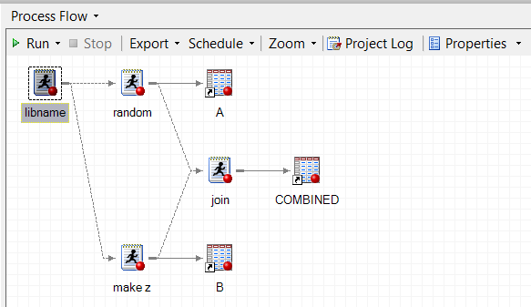
Why Enterprise Guide?
Document sequence of programs
Rerun whole sequence
REPLICATION !

Slide 6
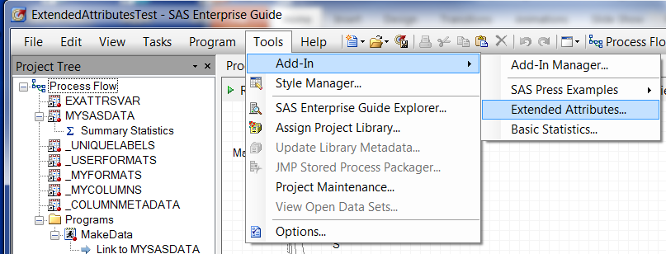
SAS – Addin ( C# .Net Program) Tools… Add-in…”Extended Attributes”
See: Hemedinger, Chris. 2012. Custom Tasks for SAS® Enterprise Guide ® Using Microsoft .NET. Cary, NC: SAS Institute Inc.
Just needs the appropriate .dll file copied to the system

Slide 7
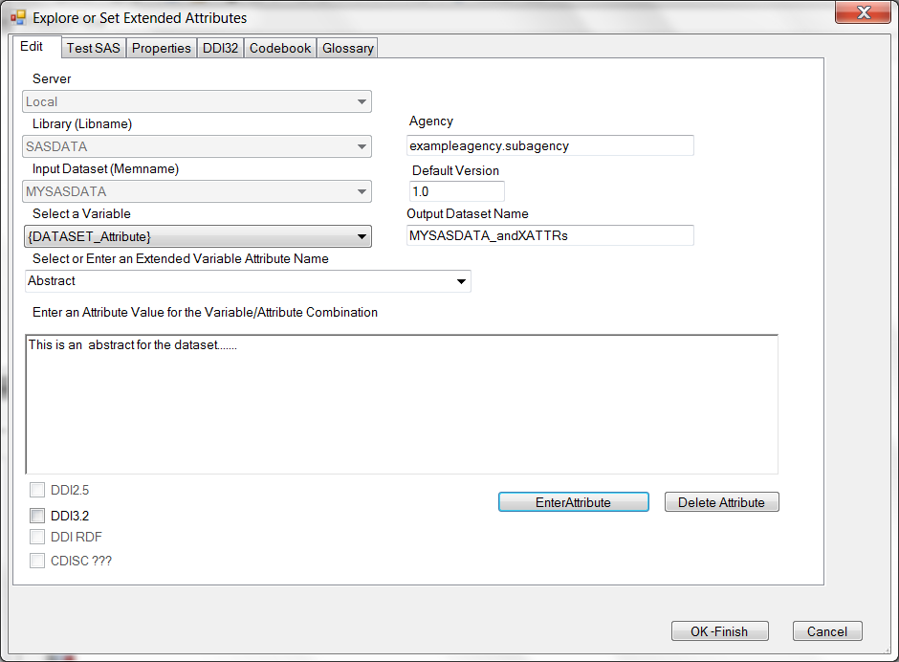
Editing Dataset Attributes
Output Dataset
Dataset
Attribute
Value

Slide 8
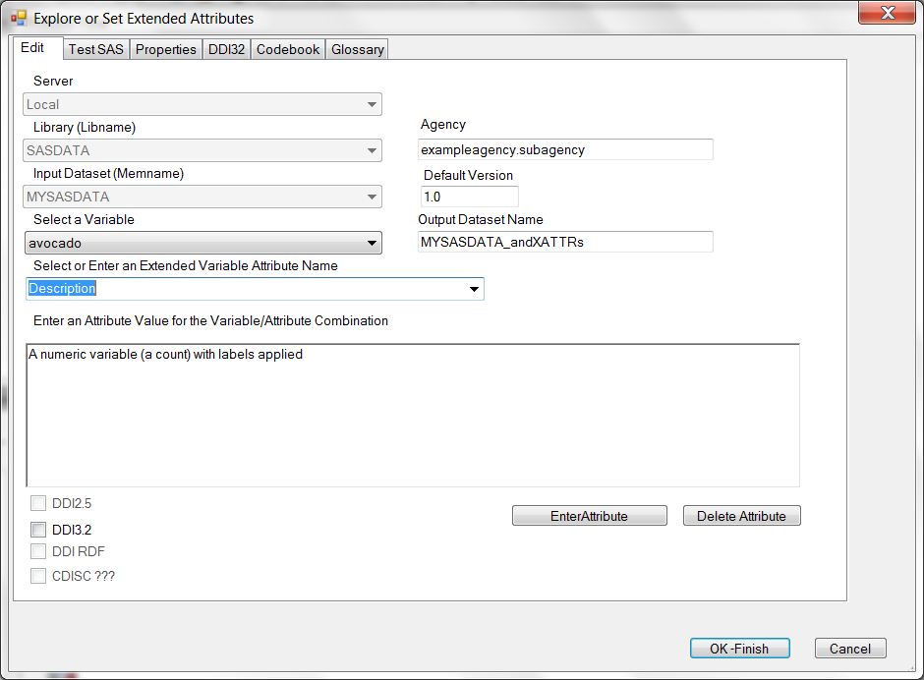
Editing Variable Attributes
Variable
Attribute
Value

Slide 9
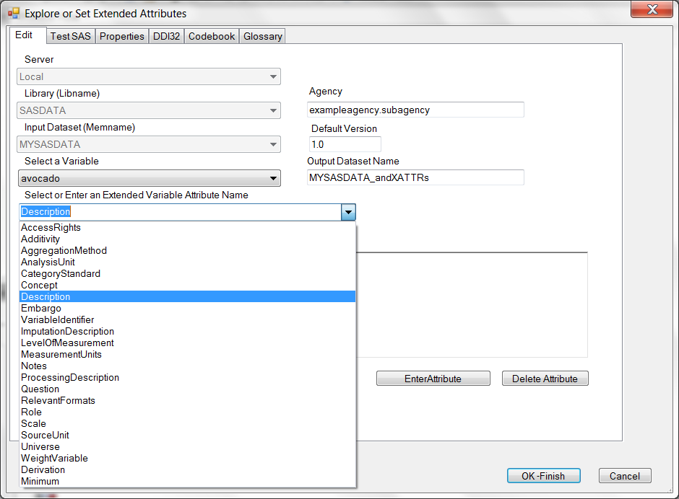
Pick from Drop-down List or Enter Value
Attribute

Slide 10
Pick from Drop-down List or Enter Value
Populated with DDI based terms plus any other extended attributes in the dataset

Slide 11
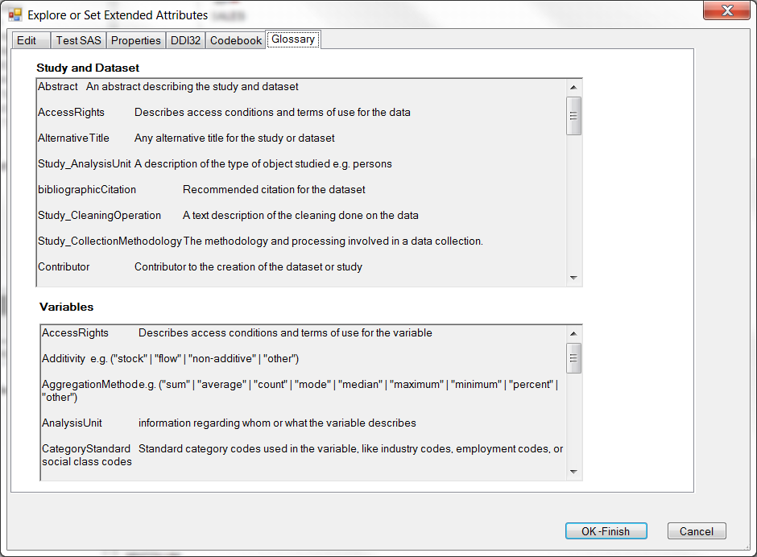
Glossary of Terms

Slide 12
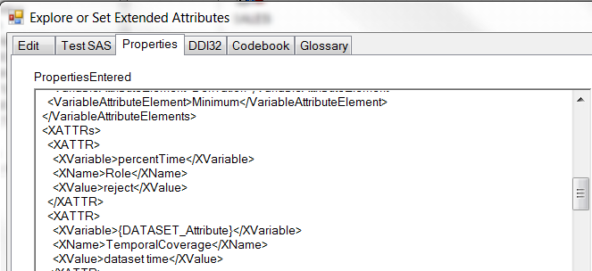
View of Internal Representation of Selections
subject
predicate
object
These should also map to a Semantic Web (RDF) style representation like DDI-Discovery

Slide 13
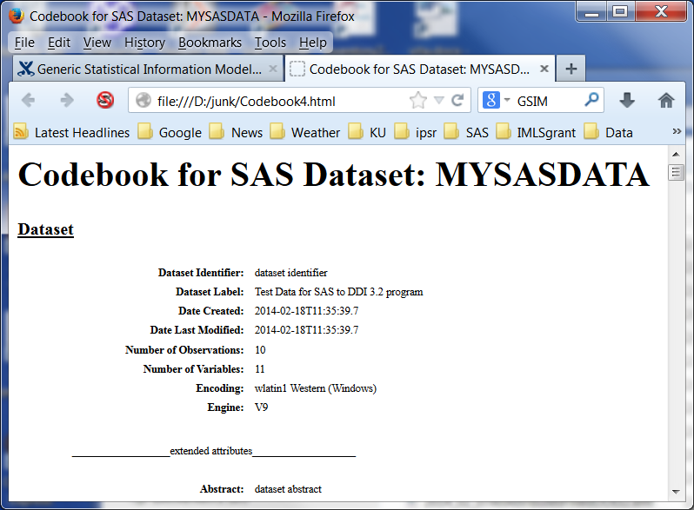
Codebook Generation (HTML)

Slide 14
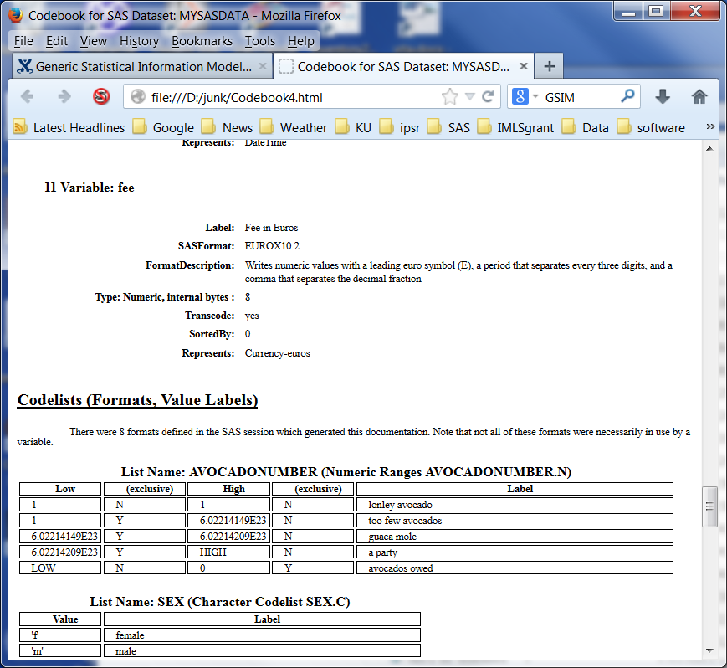
Dataset, Variables, Codelists
This is another reason to use a machine actionable representation for metadata – refactoring into representations like codebooks, or discovery web pages

Slide 15
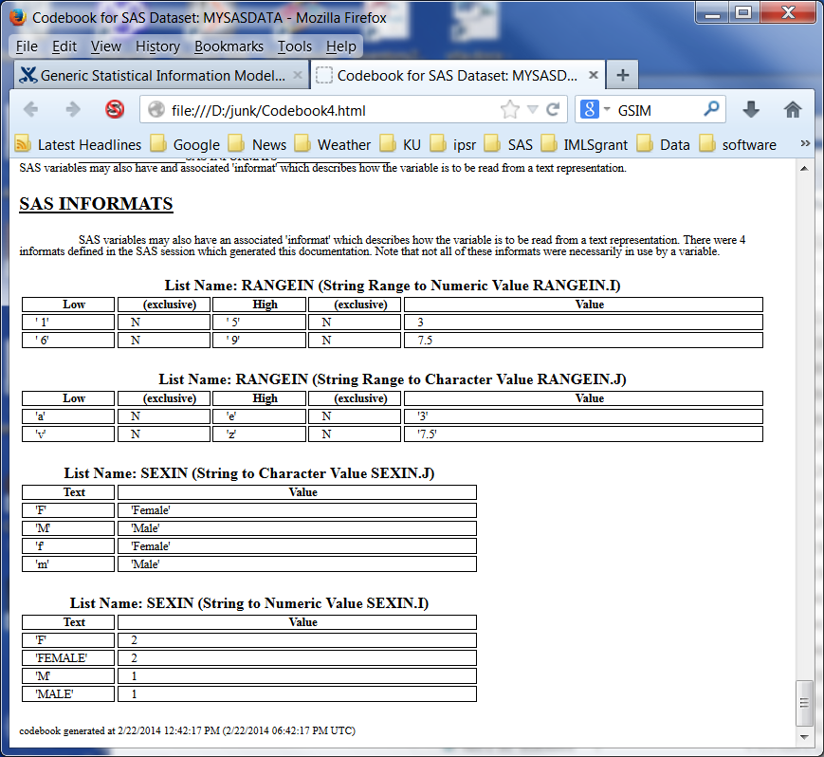
SAS Informats

Slide 16
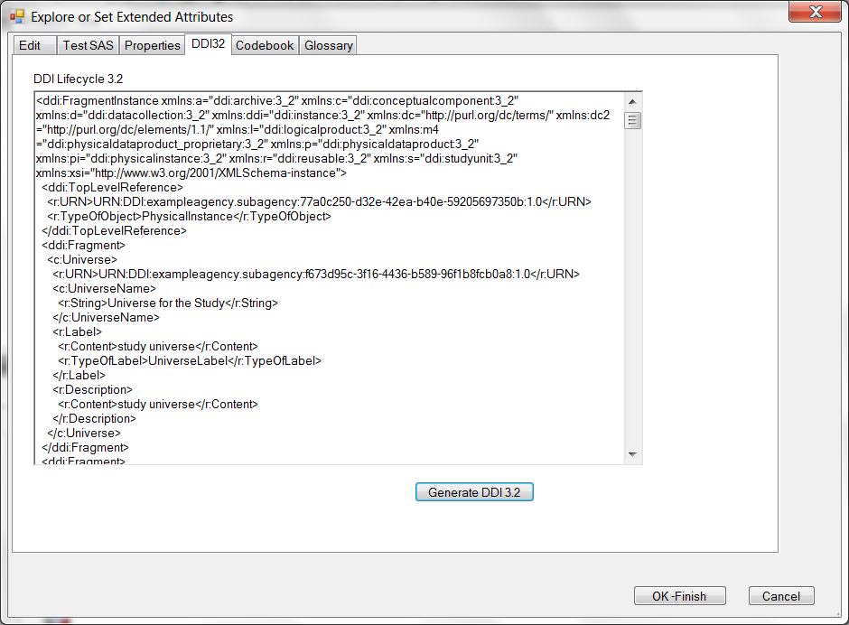
Metadata Structured as DDI 3.2 (XML)

Slide 17
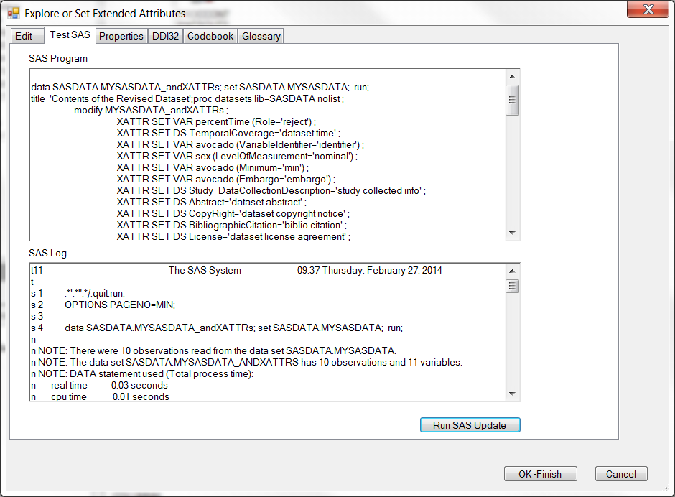
Review and Run the SAS Code

Slide 18
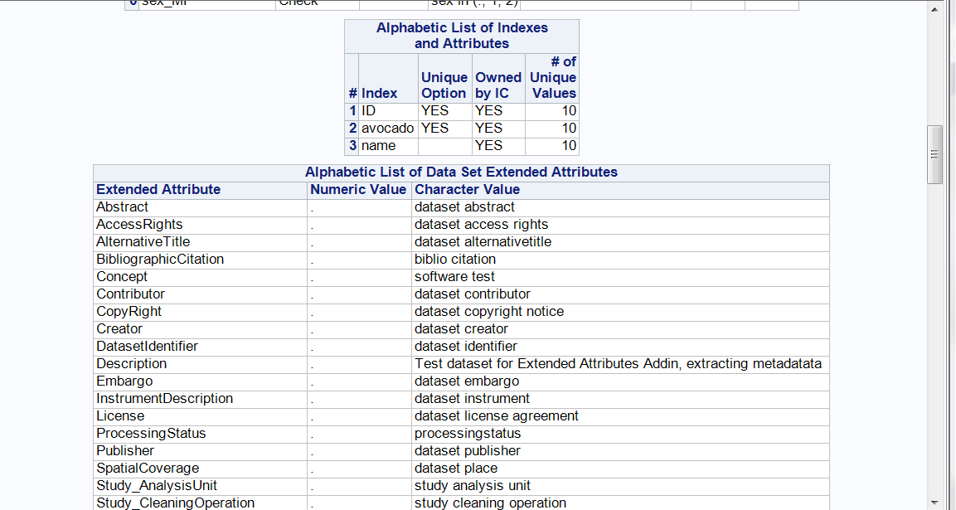
Upon Finishing Runs Proc Dataset to Create New Dataset
Name (attribute), value pairs

Slide 19
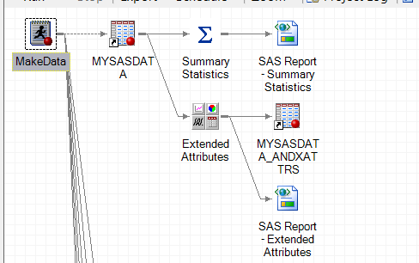
Becomes Part of Process Flow
Documented data

Slide 20
What Structure to use?

Slide 21
DDI-L Style
Valid DDI-L can be written in several ways for the same set of metadata

Slide 22
Software Incompatibilities
DDI-L Style:
Even though it shouldn’t matter, software importing DDI-L may handle only one style.

Slide 23
Alternative Styles
Embed in StudyUnit
ResourcePackage
Fragments

Slide 24
StudyUnit
“A primary packaging and publication module within DDI representing the purpose, background, development, data capture, and data products related to a study”
There may be no study level metadata in a data file.

Slide 25
ResourcePackage
“The Resource Package is a specialized structure which is intended to hold reusable metadata outside of the structures of a single StudyUnit or Group”
DDI 3.1 alternative when no study level information.

Slide 26
Fragment (DDI 3.2)
“A Fragment is a means of transporting a maintainable or versionable object plus any associated notes and other material.”

Slide 27
Custom Attributes
SAS, Stata, SPSS, Excel, R all can now have custom, or extended attributes as (name, value) pairs on variables or the dataset.
Opens up the possibility of embedded lifecycle information, including at the study level

Slide 28
Example Custom Attribute
(Embargo, one year)
name
value
Applies to
the dataset

Slide 29
Example Custom Attribute
(Embargo, one year)
name
value
Applies to
the dataset
You could also think of this as a sentence (a triple)
“The dataset has an embargo “one year”
subject, predicate, object

Slide 30
Representing Custom Attributes
(Embargo, one year)
As if attribute has no meaning within DDI
<r:UserAttributePair>
<r:AttributeKey>Embargo</r:AttributeKey>
<r:AttributeValue>one year</r:AttributeValue>
</r:UserAttributePair>
This also explicitly documents that this pair was in the dataset

Slide 31
Alternative – Assign Selected Terms Meaning
(Embargo, one year)
<l:Variable>
…
<l:EmbargoReference>
<r:URN>URN:DDI:exampleagency:e1:1.0
</r:URN>
<r:TypeOfObject>Embargo</r:TypeOfObject>
</l:EmbargoReference>
</l:Variable>
<r:Embargo>
<r:URN>URN:DDI:exampleagency :e1:1.0</r:URN>
<r:EmbargoName>
<r:String>Embargo for the variable avocado</r:String>
</r:EmbargoName>
<r:Description>
<r:Content> one year</r:Content>
</r:Description>
</r:Embargo>

Slide 32
Current Structured Dataset Attributes
BibliographicCitation
Abstract
Title
Subtitle
AlternativeTitle
Creator
Contributor
Publisher
DatasetIdentifier
Description
Note
AccessRights
CopyRight
License
Embargo
ProcessingStatus
SpatialCoverage
TemporalCoverage
TopicalCoverage
InstrumentDescription
Study_AnalysisUnit
Study_CleaningOperation
Study_CollectionMethodology
Study_DataCollectionDescription
Study_FundingInformation
Study_KindOfData
Study_LifecycleEvents
Study_ProcessingDescription
Study_Purpose
Study_SamplingProcedure
Study_Universe

Slide 33
Require a StudyUnit
All of these require a StudyUnit
Study_AnalysisUnit
Study_CleaningOperation
Study_CollectionMethodology
Study_DataCollectionDescription
Study_FundingInformation
Study_KindOfData
Study_LifecycleEvents
Study_ProcessingDescription
Study_Purpose
Study_SamplingProcedure
Study_Universe

Slide 34
Current Structured Dataset Attributes
BibliographicCitation
Abstract
Title
Subtitle
AlternativeTitle
Creator
Contributor
Publisher
DatasetIdentifier
Description
Note
AccessRights
CopyRight
License
Embargo
ProcessingStatus
SpatialCoverage
TemporalCoverage
TopicalCoverage
InstrumentDescription
Study_AnalysisUnit
Study_CleaningOperation
Study_CollectionMethodology
Study_DataCollectionDescription
Study_FundingInformation
Study_KindOfData
Study_LifecycleEvents
Study_ProcessingDescription
Study_Purpose
Study_SamplingProcedure
Study_Universe
Some of these may apply to the study as well, but they do not require a StudyUnit

Slide 35
DDI Profile Issue?
Could a recommended DDI profile be enough to specify a recommended style?
Exclude ResourcePackage?
Exclude sub-elements in StudyUnit that can be in Fragments?

Slide 36
Profile Possibility? In Separate Fragment
ddi:FragmentInstance/ddi:TopLevelReference
ddi:Fragment/c:Concept
ddi:Fragment/l:CategoryScheme
ddi:Fragment/l:CodeListScheme
ddi:Fragment/r:ManagedRepresentationScheme
ddi:Fragment/r:Note
ddi:Fragment/d:QuestionItem
ddi:Fragment/m4:RecordLayout
ddi:Fragment/c:Universe
ddi:Fragment/l:VariableScheme

Slide 37
Profile Possibility? In Archive Elements
ddi:Fragment/a:Archive/r:URN
ddi:Fragment/a:Archive/r:LifecycleInformation

Slide 38
Profile Possibility? In PhysicalInstance Elements
ddi:Fragment/pi:PhysicalInstance/r:Citation
ddi:Fragment/pi:PhysicalInstance/r:Software
ddi:Fragment/pi:PhysicalInstance/r:URN
ddi:Fragment/pi:PhysicalInstance/r:UserAttributePair
ddi:Fragment/pi:PhysicalInstance/r:UserID

Slide 39
Profile Possibility? In StudyUnit Elements
ddi:Fragment/s:StudyUnit/r:AnalysisUnit
ddi:Fragment/s:StudyUnit/r:ArchiveReference
ddi:Fragment/s:StudyUnit/r:Embargo
ddi:Fragment/s:StudyUnit/r:FundingInformation
ddi:Fragment/s:StudyUnit/r:KindOfData ddi:Fragment/s:StudyUnit/r:PhysicalInstanceReference
ddi:Fragment/s:StudyUnit/r:Purpose
ddi:Fragment/s:StudyUnit/r:UniverseReference
ddi:Fragment/s:StudyUnit/r:URN

Slide 40
Profile Possibility? In StudyUnit/DataCollection Elements
ddi:Fragment/s:StudyUnit/d:DataCollection/r:Description ddi:Fragment/s:StudyUnit/d:DataCollection/d:InstrumentScheme ddi:Fragment/s:StudyUnit/d:DataCollection/d:Methodology ddi:Fragment/s:StudyUnit/d:DataCollection/d:ProcessingEventScheme ddi:Fragment/s:StudyUnit/d:DataCollection/d:ProcessingInstructionScheme
ddi:Fragment/s:StudyUnit/d:DataCollection/r:URN

Slide 41
Profile Possibility? In StudyUnit/LogicalProduct Elements
Fragment/s:StudyUnit/l:LogicalProduct/r:CategorySchemeReference
Fragment/s:StudyUnit/l:LogicalProduct/r:CodeListSchemeReference
Fragment/s:StudyUnit/l:LogicalProduct/r:ManagedRepresentationSchemeReference
Fragment/s:StudyUnit/l:LogicalProduct/r:URN
Fragment/s:StudyUnit/l:LogicalProduct/r:VariableSchemeReference

Slide 42
Contact
Larry Hoyle
Senior Scientist
Institute for Policy & Social Research, University of Kansas
1541 Lilac Lane Suite 607 Blake
Lawrence, KS 66045-3129
LarryHoyle@ku.edu
ExtendedAttributes Addin
The project has been archived at:
http://kuscholarworks.ku.edu/dspace/handle/1808/12488

