Slide 1
Smart Waste Sorting System
Team 8 – Final Presentation “Everything is Simple with Sort-E”
Notes:
Justin Done

Slide 2
Team Members & Duties
ChinHo Wan
System design, Hardware Design, Market Analysis, Documentation
Dongyue Shi
Software design, System Design
Tianxiao Liu
Hardware Design, Market Analysis, Document Research
Chenxi Wang
Software design, Circuit Design, System Integration

Slide 3
Background - Canadians produce approximately 31 million tons of waste a year. - Only recycle about 30 percent of that material. Purpose - Reduce the negative impact of waste pollution on the global environment - Bring a more convenient life for Canadian residents - Provide information related to waste sorting Target Market Schools, Airports, Offices
Introduction & Background

Slide 4
System Overview
Notes:
J

Slide 5
System Overview
Camera
Mechanism
Sorting Waste
Rasp
Pi 4
Sensor
Screen
Displaying Result
Sorting waste automatically
Displaying sorting result on the screen

Slide 6
Hardware
Notes:
J

Slide 7
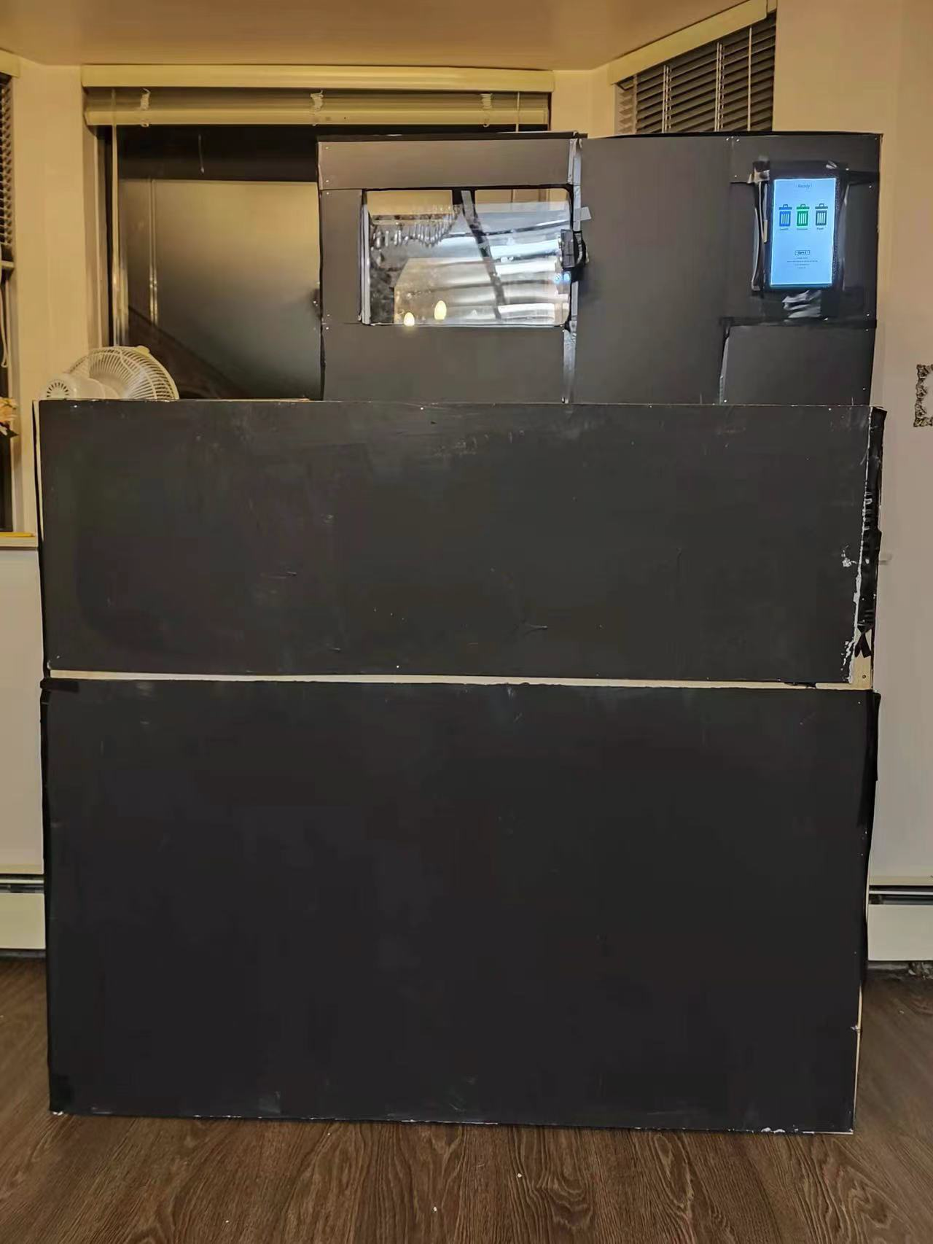
Hardware Overview
LCD Monitor (GUI)
Ultrasonic sensor
Scanning Area
Gate (Scanning Area)
Bottom Flaps
Waste Bins (3 types)

Slide 8
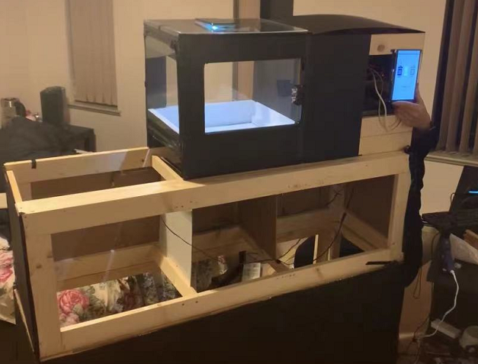
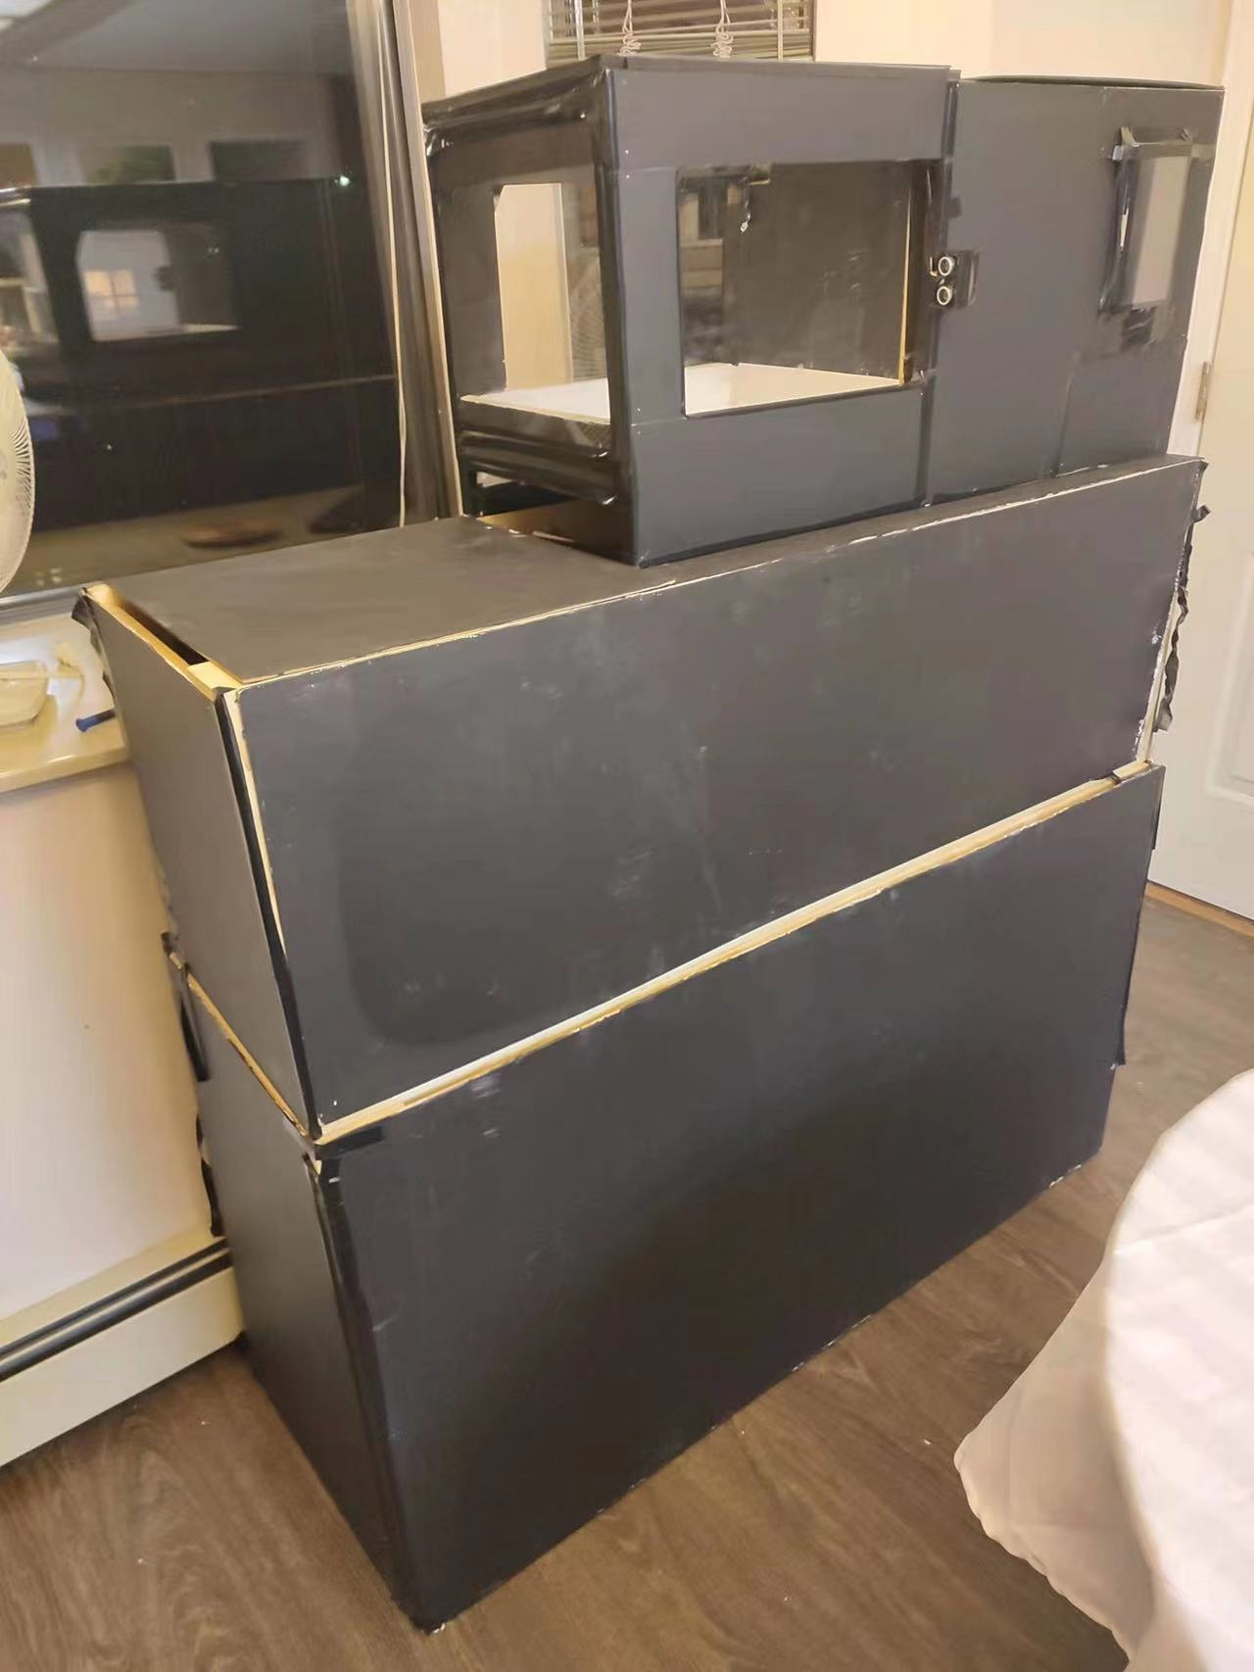
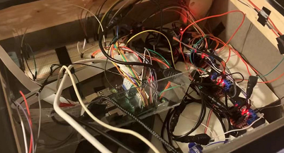
Progress Update – Enclosure
Installed enclosure to all parts
Organized wires
Install the LCD touchscreen for GUI
After
Before

Slide 9
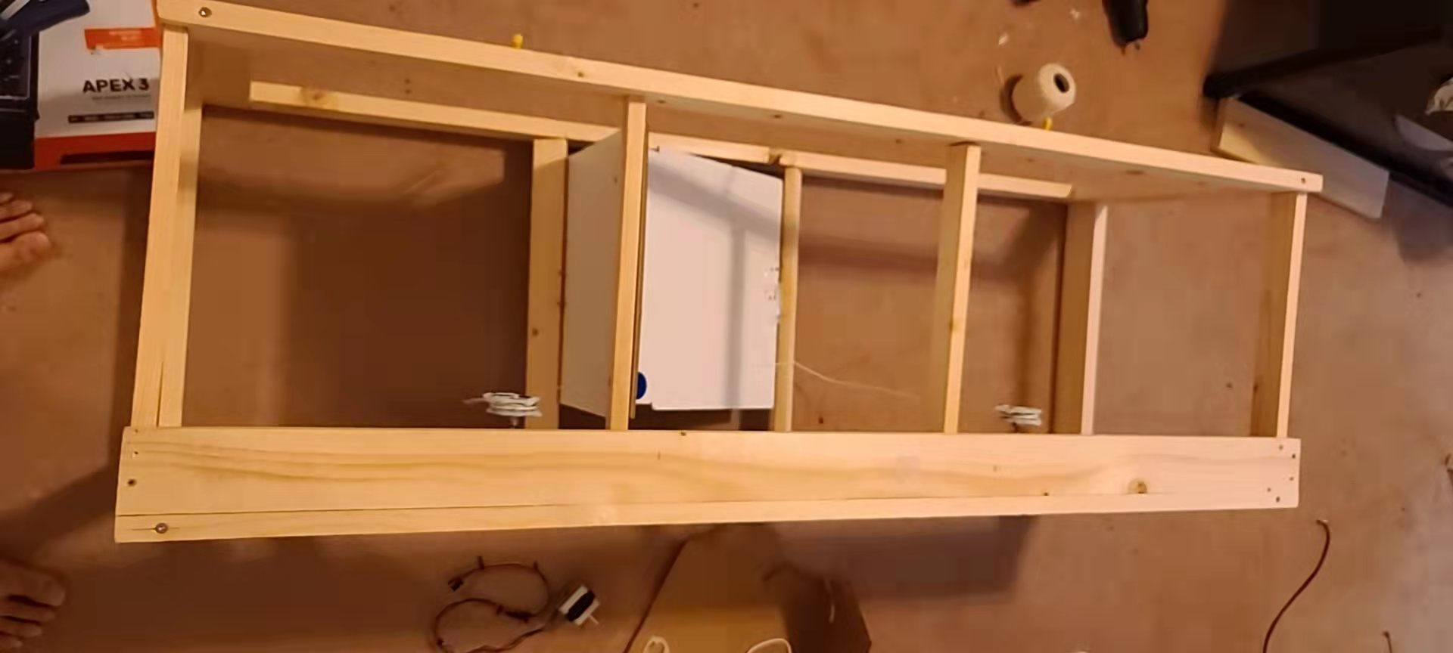
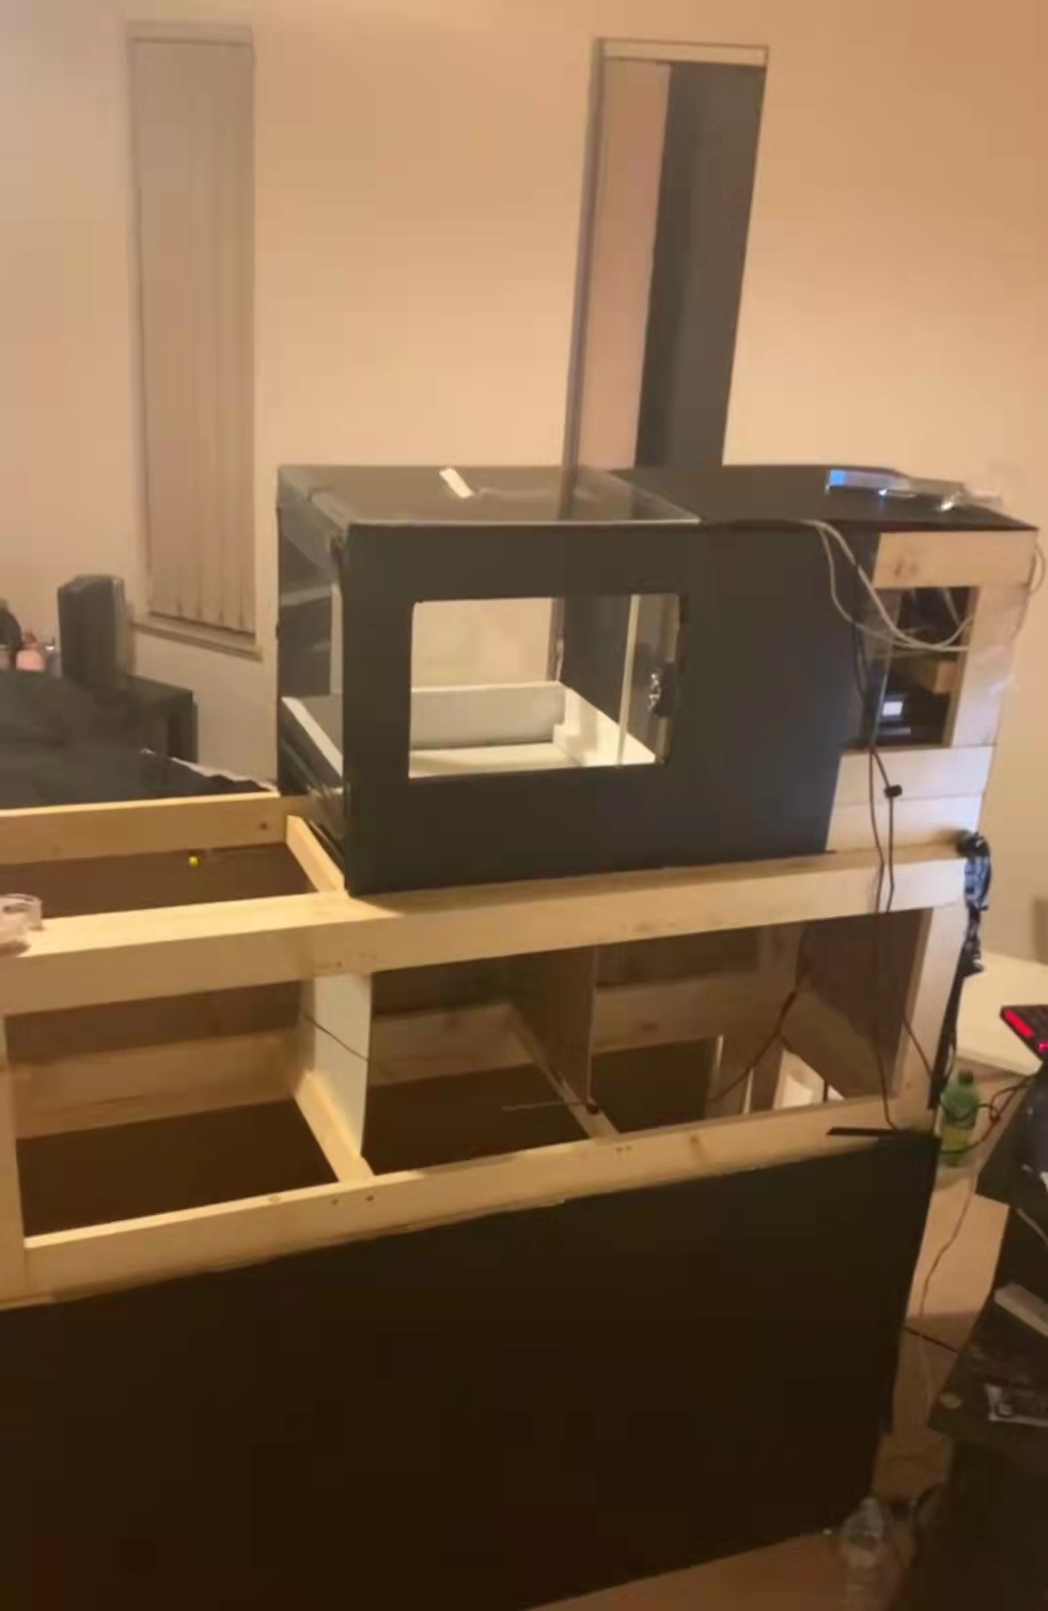
Progress Update - Bottom Flaps
Integrated the scanning area, bottom flaps and waste bins.
Modified and re-evaluated the angle of the stepper motors to ensure the proper operation
Shortened the waste sorting time.
Before
After

Slide 10
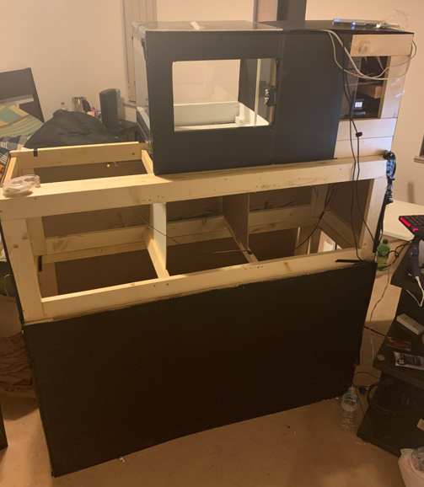
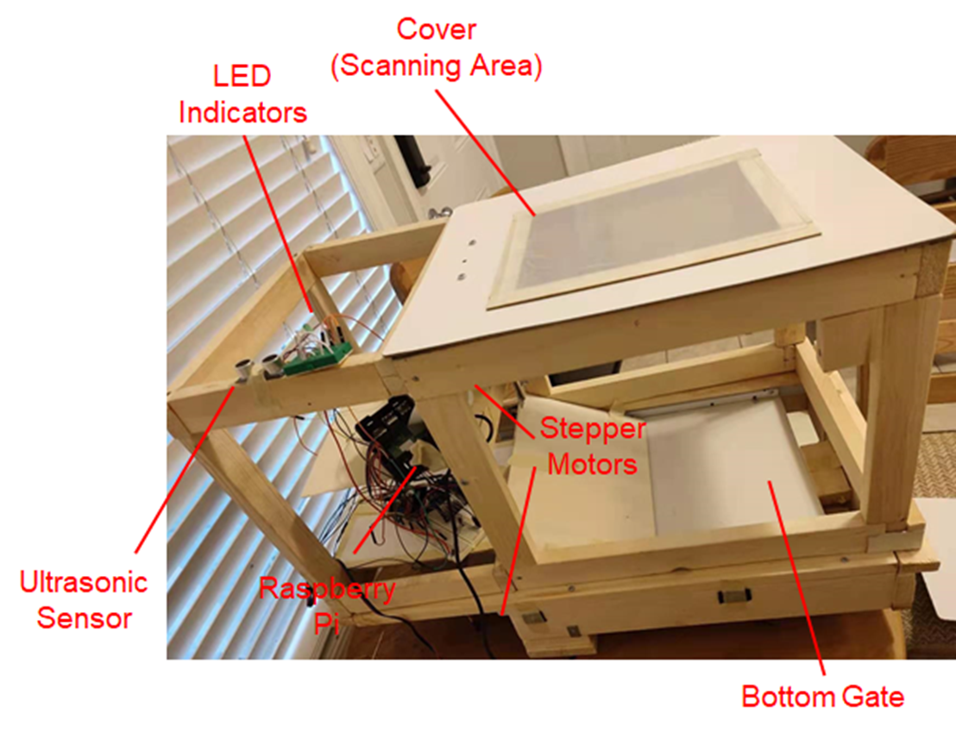
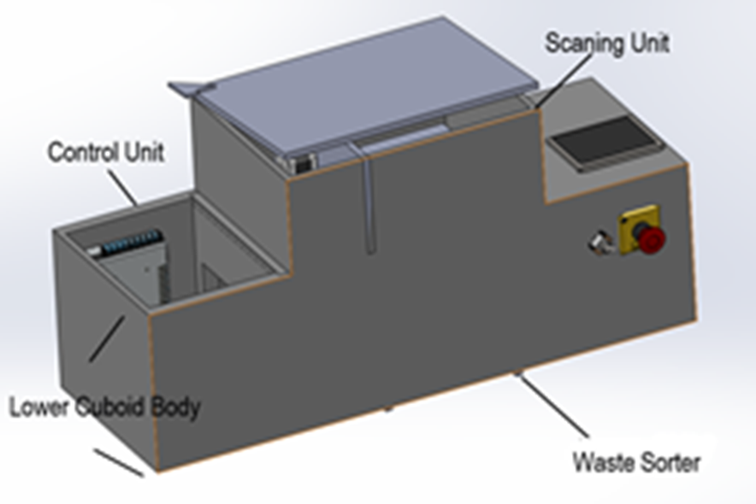
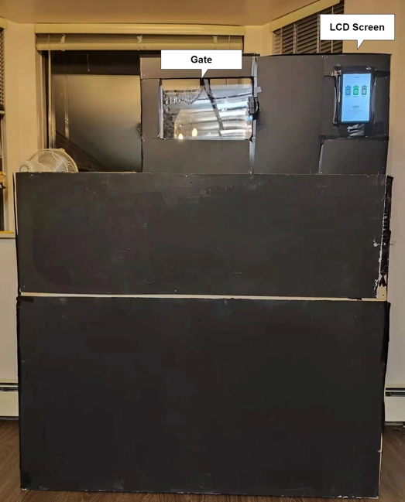
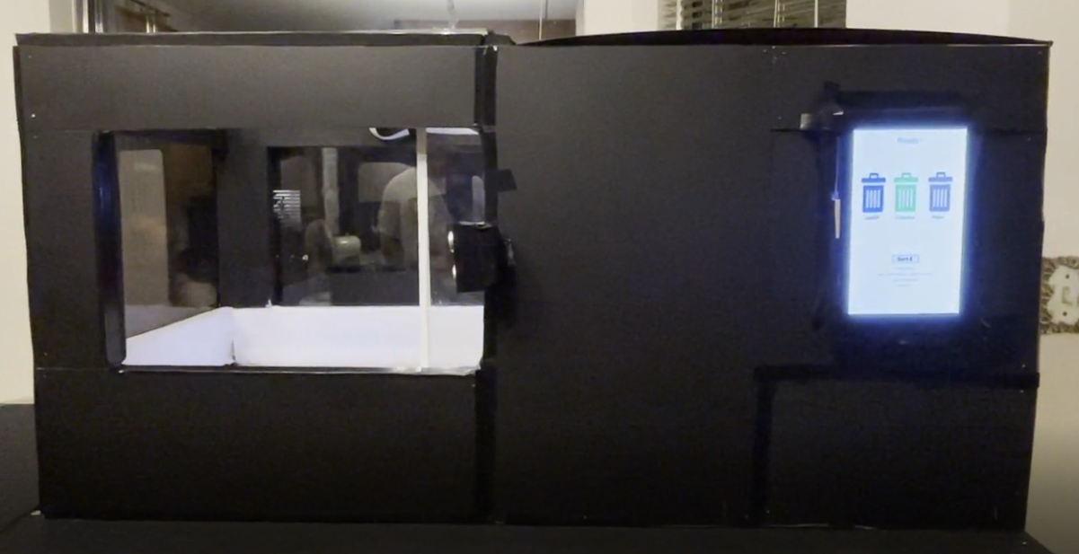
Frame and Enclosure

Slide 11
Materials
3mm clear acrylic sheet (enclosure)
Pine wood (frame)
Black electrical tape (circuit protection)
Screws & Nails (frame & enclosure)

Slide 12
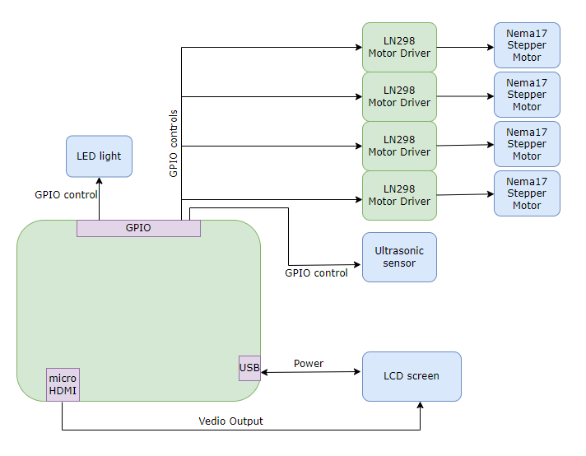
Circuit System Layout

Slide 13
Software
Notes:
J

Slide 14
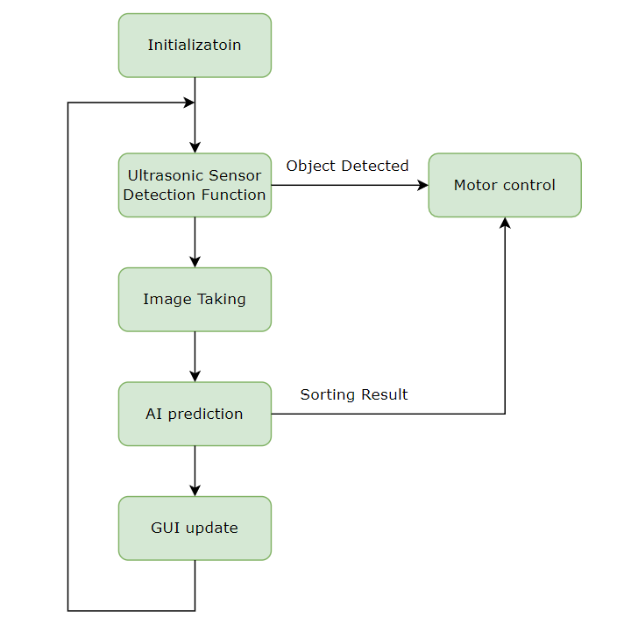
Software Overview Diagram

Slide 15
Software progress
Improvement
Modified the motor control function to ensure the stepper motors are able to drive the gates properly
Implemented the GUI and integrated with the system
Implemented an updated AI model to increase the accuracy

Slide 16
AI model
Improvement
Divided the container class into two classes: metal can and plastic bottle
Divided the paper class into two classes: non colored paper and colored paper
Adjust the waste sorting algorithm: If the percentage of the predict is lower than 60%; identify it as landfill type

Slide 17
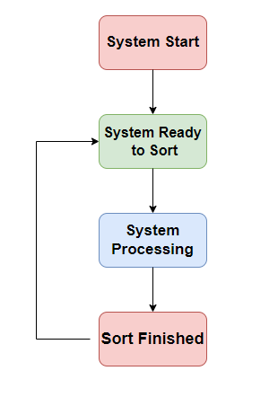
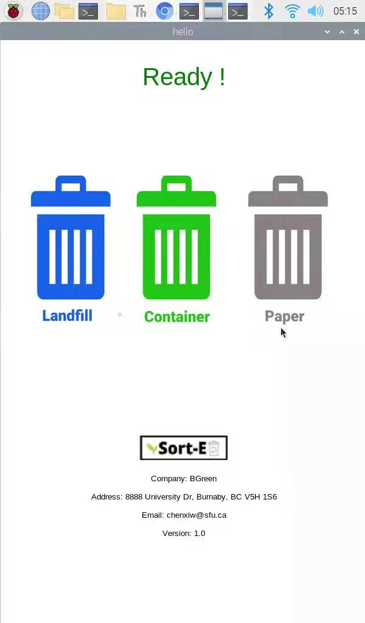
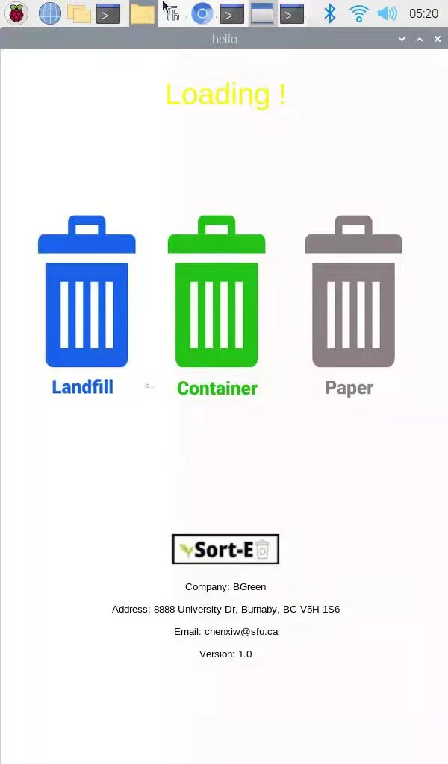
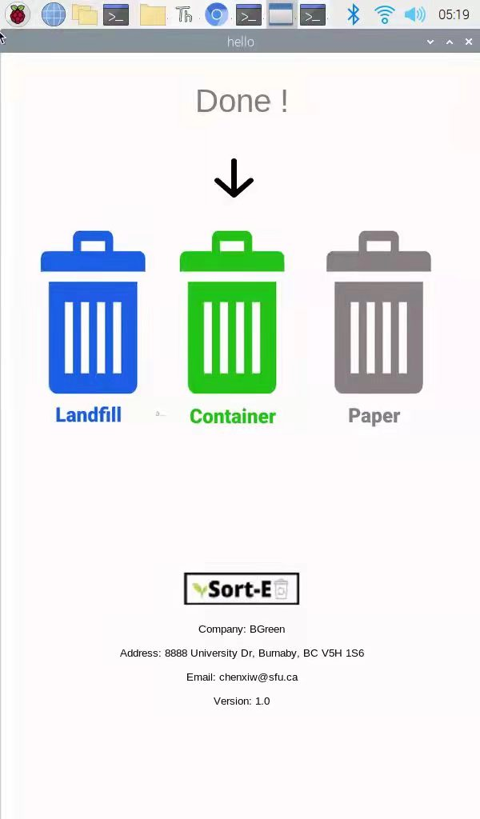
GUI Overview
GUI: 3 Status

Slide 18
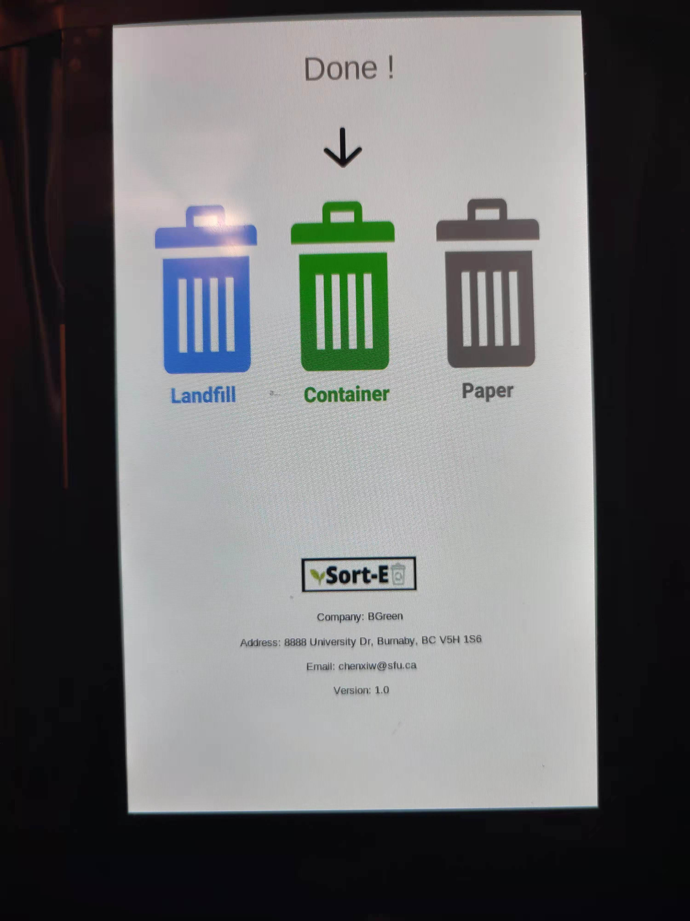
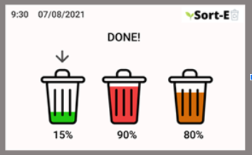
GUI Modification
Remove the display for the fullness of the bins
Company information are moved to the bottom of the screen
Landscape mode -> portrait mode
Arrow pointing to the sorting result
UI Design (Figma)
Final GUI Desgin

Slide 19
Cradle-to-Cradle
Recyclable
All wood frame and wood enclosure
Electronic Parts and Wires
Plastic waste bins and recyclable waste bags
Metal gear racks
Unrecyclable
Power system

Slide 20
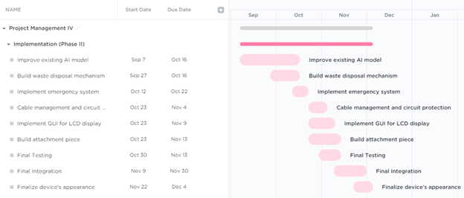
Scheduling (Estimated and Actual)

Slide 21
Live Demo
Notes:
J

Slide 22
Business Case
Notes:
J

Slide 23
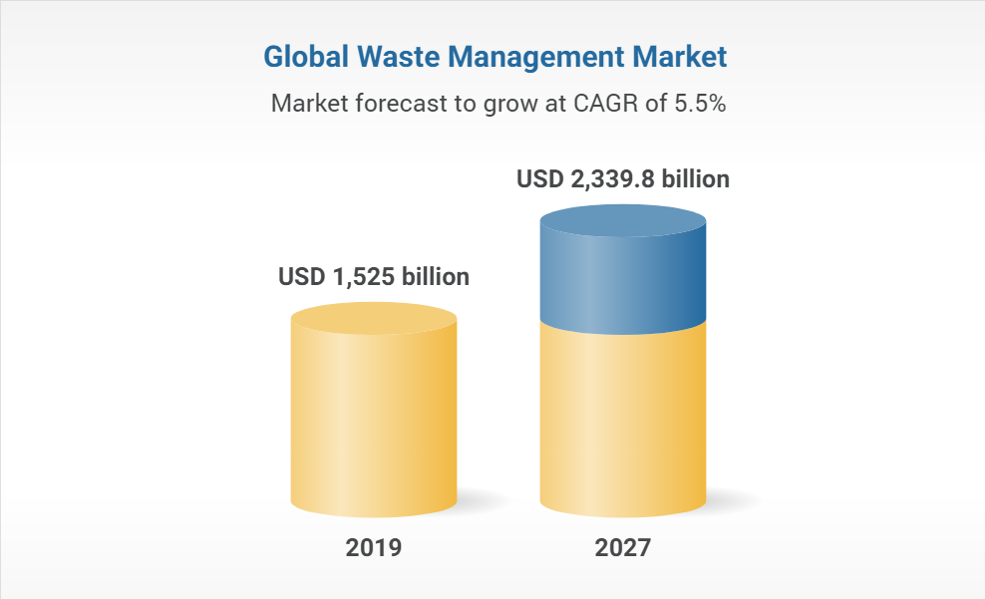
Potential Market Size
Compound annual growth rate (CAGR) = 5.5%
Notes:
JustinDone
Sort-e presents a solution to transition towards a zero-waste future. Canada has implemented multiple waste management programs across the country. To further support these programs, Sort-e emphasizes on creating waste literacy to advocate change for recycling intentions. In 2019, the global waste management market was valued at US$2,080.00 billion and by 2027, the market is expected to reach US$2,339.8 billion [3].

Slide 24
Entrance and Exit Strategy
Entrance Strategy
Understanding the current market
Optimize the investment plan
Set up a goal for the business expansion
Exit Strategy
Implementing and redesigning Sort-E for different fields
New proposal
Return System
(stores, libraries)
Notes:
Justin Done

Slide 25
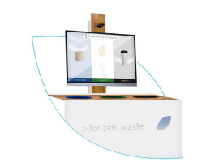
Competitors
Intuitive AI - Oscar Sort
Larger and more attractive LCD monitor
Better UI design
Why choose us?
More affordable
Suitable for both indoor & outdoor environments
Dispose waste materials automatically
Notes:
Justin Done

Slide 26
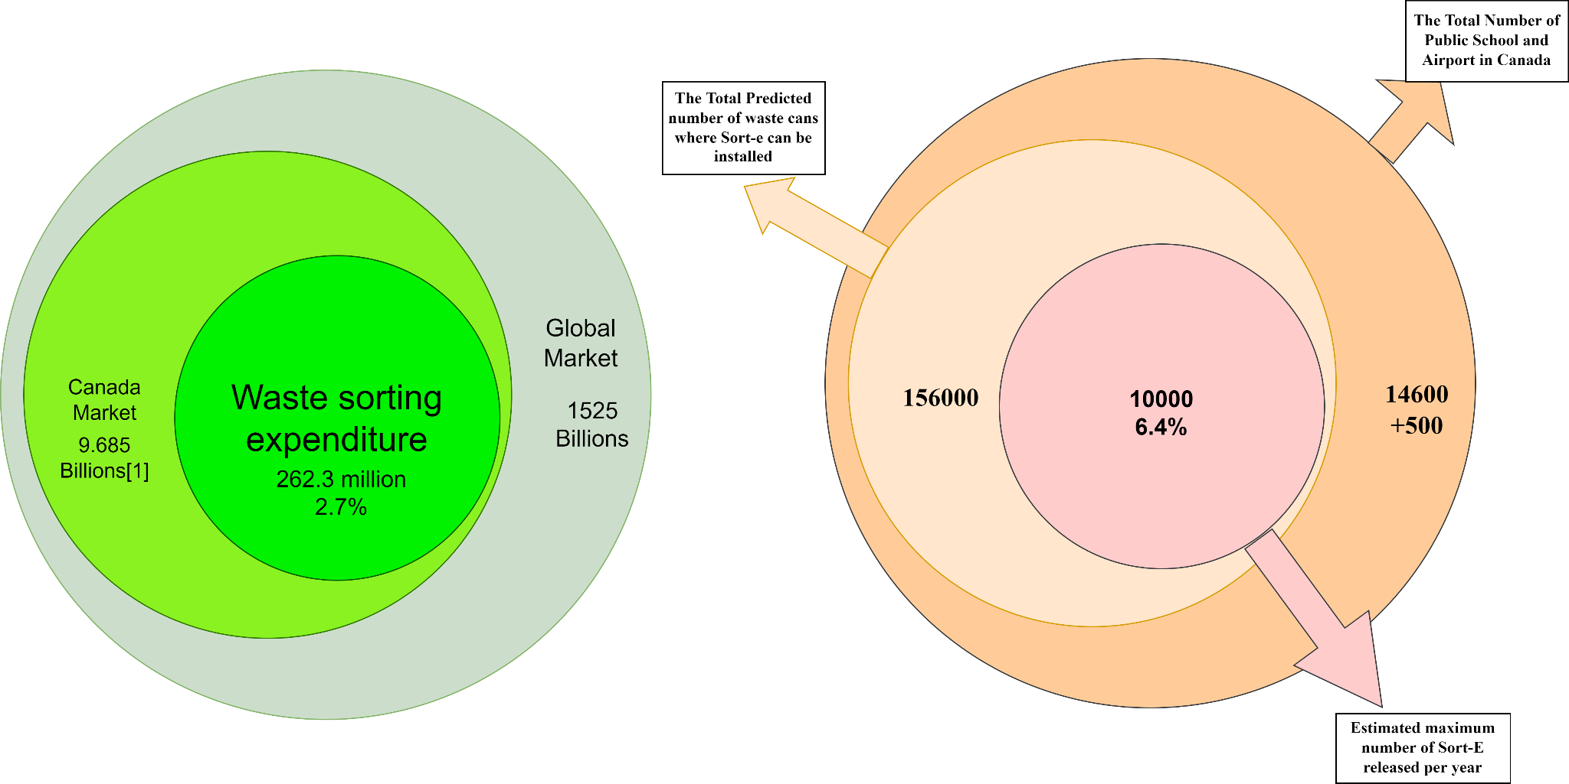
Believed Market Share
Notes:
Mich: Hi This is Michael, now I will introduce all market related information to everyone, for Belived Market Share, the graph in the left show the data from the statistic Canada, we can see that in 2018 the world spent around 1525 billions USD on Waste Sorting and Management,
Canada also spent around 9.7 billions, Although most of the money is spent on various sorted garbage disposal， but there is still 262.3 million of USD spent on waste sorting,
The right graph show the total number of public school in Canada is around 14600 and Canada also own more than 500 airport, These public institutions will be served as our main customer groups, let assume each school has 10 waste bin can be placed on our machine, and each airport has 20 waste bin, so there should be at least 156,000 bin can use our product, then we are planning to release 10000 units of Sort-E in the first year, and our Market share will reach 6.4% if those school will buy them.

Slide 27
Sales Strategy
Cooperate with existing Headquartered Electronics Retailer
Ex. Consulted with technology companies like Best Buy
Use imports to reduce costs
Ex. Cooperate with Chinese manufacturers and merchants
Establish Brand awareness
Ex. Promote through social networks like Facebook, Twitter, Google advertisement
Notes:
Michael， There are multiple sales strategy we gonna use in our Early stage，frist we gonna cooperate with existing power electronic retailer company, such as amazon, Best buy and Canadian Tire, we may sign some non-equal contract to improve the pobalitty to make this happen.
For the material we gonna use import to reduce cost of our product, which mean we gonna Cooperate with Chinese manufacturers and merchants,
For the commercial and advertisement our main goal is establish brand awareness to public and employee, so we gonna promote though social network like facebook twitter and google advertisement

Slide 28
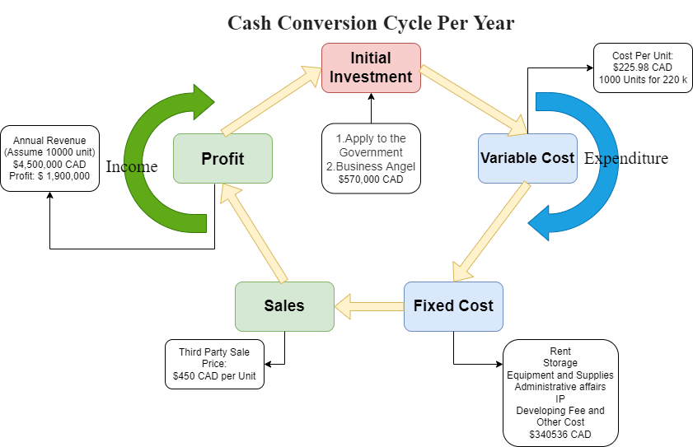
Business Model: Seeding
Notes:
For the Business Model, from the graph of cash conversion cycle per year, we can see that the initial investment we need is around 570k CAD, those money we will acquire from both government environment funding and Business angle. after we that we gonna spend around 220 k to produce 1000 units of sort-e, the the fixed cost for us include Rent, produc storage, equipment and supplies , adminstrative affaic, patent, developing fee and other cost should be in total of 340k. for the sale part we gonna sell sort-e with 450 cad per unit, assume

Slide 29
Financial Needs
57,000 CAD for 10 % Shares
For the Initial Investment
Notes:
Mich

Slide 30
Risk Analysis
Notes:
J

Slide 31
Risk Analysis
How we rate: 1 to 10, For harmful level to human-being,1 means Harmless, 5 extremely harmful
For Probability of appearance, 1 means Extremely rare, 5 means must happen
Risks | Harmful level | Probability of appearance | Solution
User electrocuted | 4 | 1 | All enclosure are made of insulating materials
User caught by front door | 2 | 1 | Smart detection by model system, and use harmless material for gate
User injured by screws | 2 | 3 | All screws are hidden by enclosures and tapes

Slide 32
Adherence to Standards
Notes:
J

Slide 33
Engineering Standards
Standard/Code | Regulation Content | How to apply
CSA Z463 | Maintenance of electrical systems | Hire professional's worker for regular maintenance
CAN/CSA-C22.2 No. 61508-1:17 | Functional safety of electrical/electronic/programmable electronic safety related systems - Part 1: General requirements | Let users follow the steps in the user manual for safe operations
CAN/CSA-Z434-14 (R2019) | Industrial robots and robot systems (Adopted ISO 10218-1:2011, second edition, 2011-07-01, with Canadian deviations and ISO 10218-2:2011, first edition, 2011-07-01, with Canadian deviations. | Continuously update the ai database to achieve more accurate classification
CAN/CSA-ISO/TR 14047-04 (R2008) | Environmental Management - Life Cycle Impact Assessment - Examples of Application of ISO 14042 (Adopted ISO/TR 14047:2003, first edition, 2003-10-01) | Use recyclable materials to produce Sort-E

Slide 34
Self-Reflection
Notes:
J

Slide 35
What we achieved
Built the Sort-E
Able to classify the waste using AI
Able to disposal the waste into different bins
Market analysis
Time management
Notes:
Justin Done

Slide 36
What would we do differently
Complete our design earlier (Planning)
Create our own AI model
Collect waste images for AI training
Better communication with teammates

Slide 37
What we learned
How to design the mechanical part
How to classify the waste using AI
How to disposal the waste into different bins
How to do Market analysis
Better Time management Skills
Communication skill

Slide 38
Conclusion
Notes:
J

Slide 39
Conclusion
Created a prototype for Sort-E, an automatic sorting system, to make sorting recycle materials easier and quicker.
Apply AI model for image classification.
Worked extensively in modeling and design software (SolidWork, Figma)

Slide 40
Future Plans
Notes:
J

Slide 41
In Future (If Continue)
Improve the waste disposal mechanism
Better GUI
Connect Sort-E with WiFi
Set up a database for the AI model
Use better materials for the frame and enclosure
Shortening the sorting time by improving the software and hardware system
Find findings

Slide 42
Question?

Slide 43
Thank you

Slide 44
Appendix: Video
https://drive.google.com/file/d/1rcXGysB8XtqbEj78r1R6dZgYPDLBm86q/view?usp=sharing
https://drive.google.com/file/d/10vqDDDPL7hCzdulvSUcw4pdrxiLCTd_f/view?usp=sharing

