Slide 1
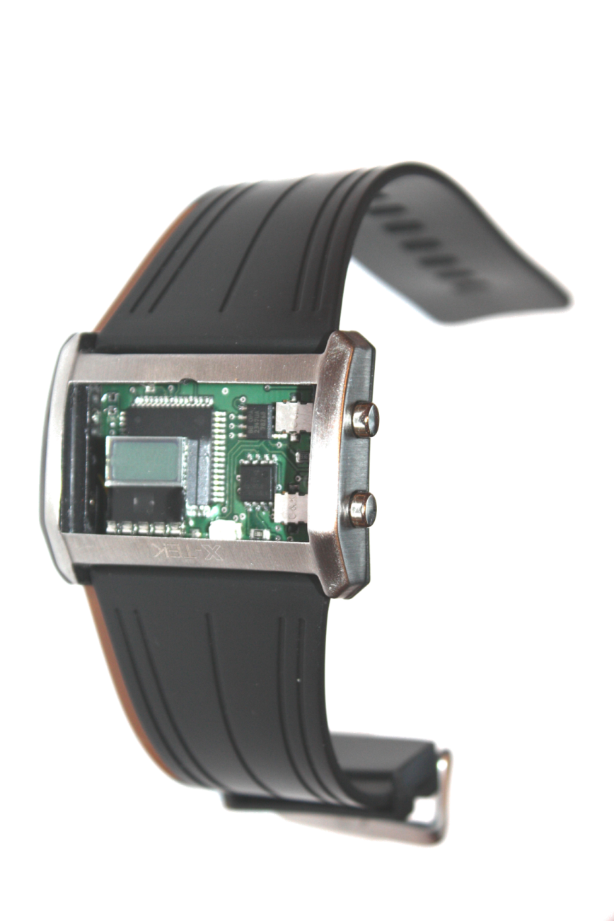
Portable UV Monitoring Device
Nima Edelkhani
Dariush Sahebjavaher
Kimia Nassehi

Slide 2
Agenda
Background
Motivation
Roles
System Overview
High level design
Implementation
Marketing
Potential Market
Cost and Financing
Competition
Timeline
What we learnt
Conclusion
Future work
Q/A

Slide 3
Background
“In 1992, Canada developed the UV Index and became the first country in the world to issue nation-wide daily UV forecasts.”
“The UV Index predicts the maximum amount of UV for the day, at the time it will occur (usually early afternoon).”

Slide 4
Background
“It is estimated that more than 76,000 new cases of skin cancers were diagnosed across Canada in 2004.”
“UVB damage is cumulative. However, diligent use of sunscreens during the first 18 years of life could reduce the lifetime incidence of non-melanoma skin cancers by 78%.”

Slide 5
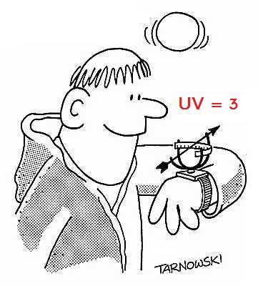
Motivation
Ever wonder if UV level is high?
Ever found yourself sunburnt when you did not expect it?
Sun Smart’s portable monitoring device provides you with real-time UV-index at location.

Slide 6
Motivation
Ever wonder what SPF sunscreen lotion would protect your skin?
Sun Smart’s portable monitoring device suggests suitable SPF to apply

Slide 7
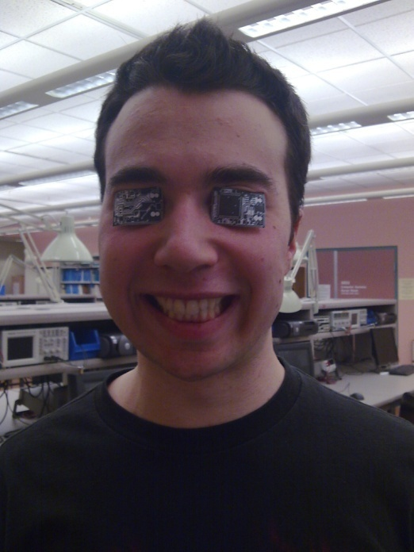
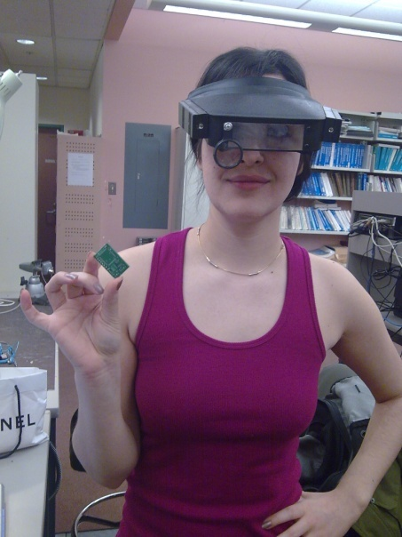
Roles
No Roles
Nima Edelkhani
Dariush Sahebjavaher
Kimia Nassehi
Meetings Every Day – All Day

Slide 8
System Overview
Input
Processing Unit
Output
UV radiation
Buttons
A/D
Calibration
Clock
UV index
SPF level

Slide 9
High Level Design
LCD
Micro Processor
UV Sensor
Analog Circuit
Buttons

Slide 10
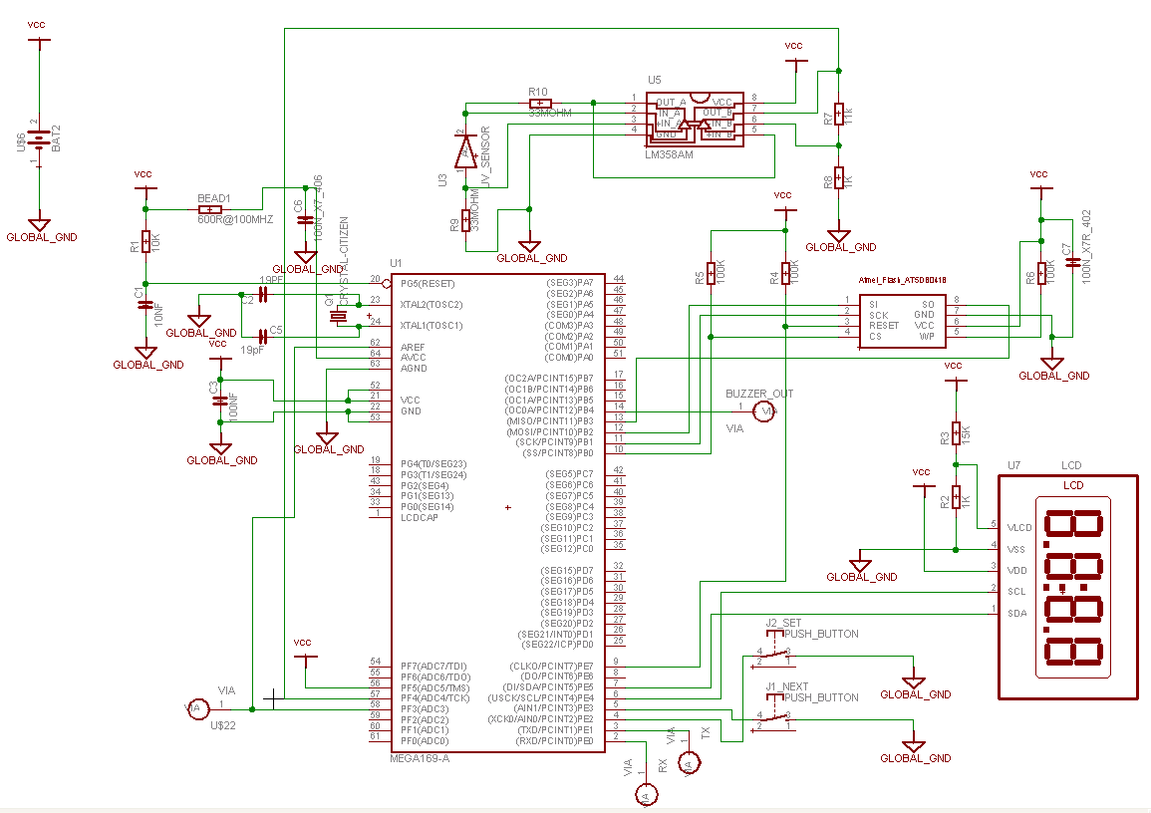
Implementation
Micro Processor
Analog circuit
Switches
LCD

Slide 11
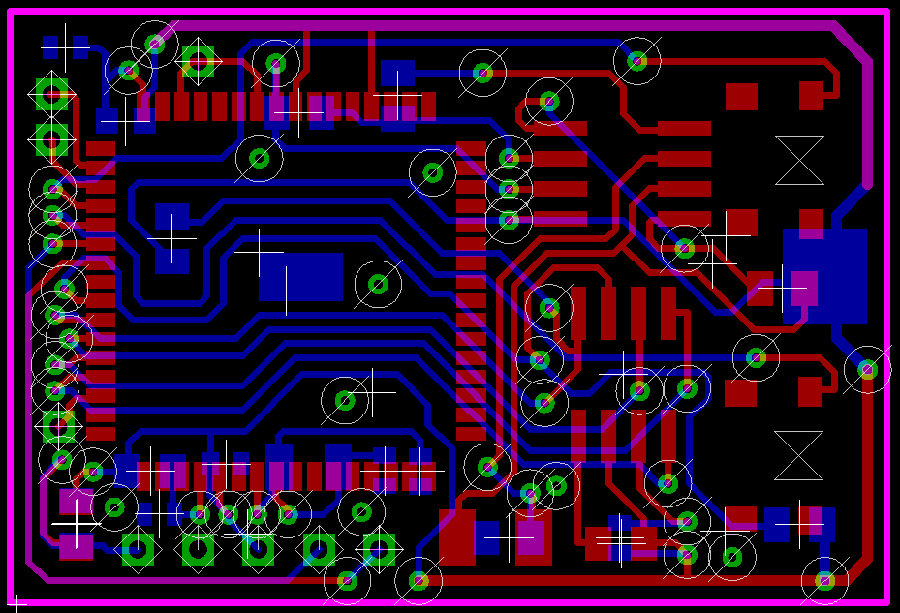
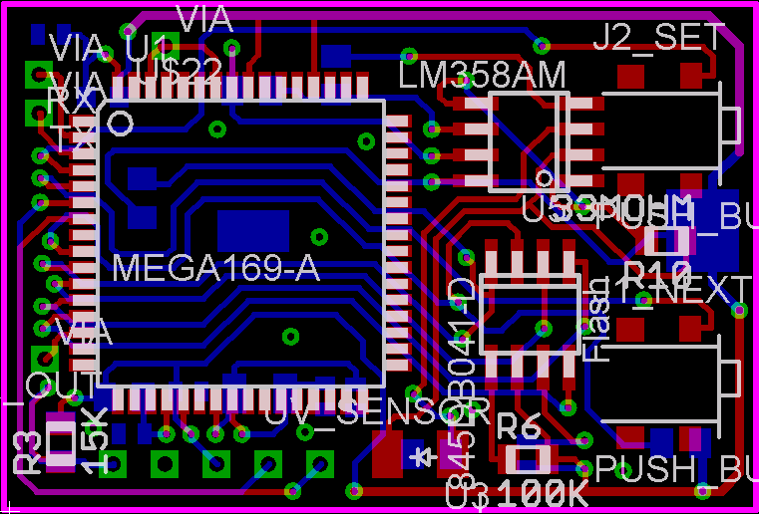
Implementation

Slide 12
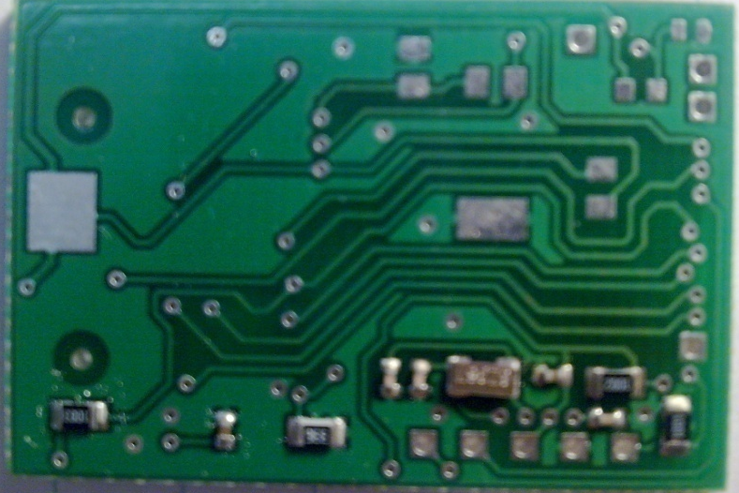
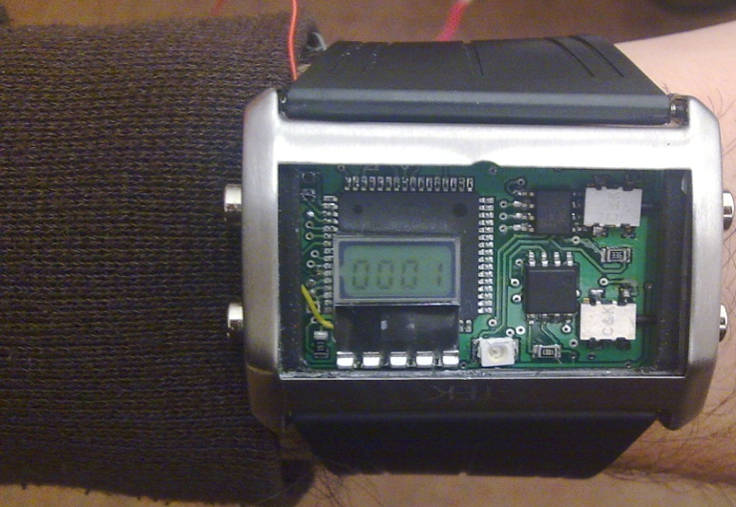
Functional Prototype

Slide 13
Marketing
Health care benefits
Portable and small
Easy to use in any age group
Inexpensive
Finished product as a watch $20
Module $5
Prospective functionalities
Implemented in different languages
Installed on many electronic devices
Text to speech feature
Buzzer/Vibrator
Skin type specifications

Slide 14
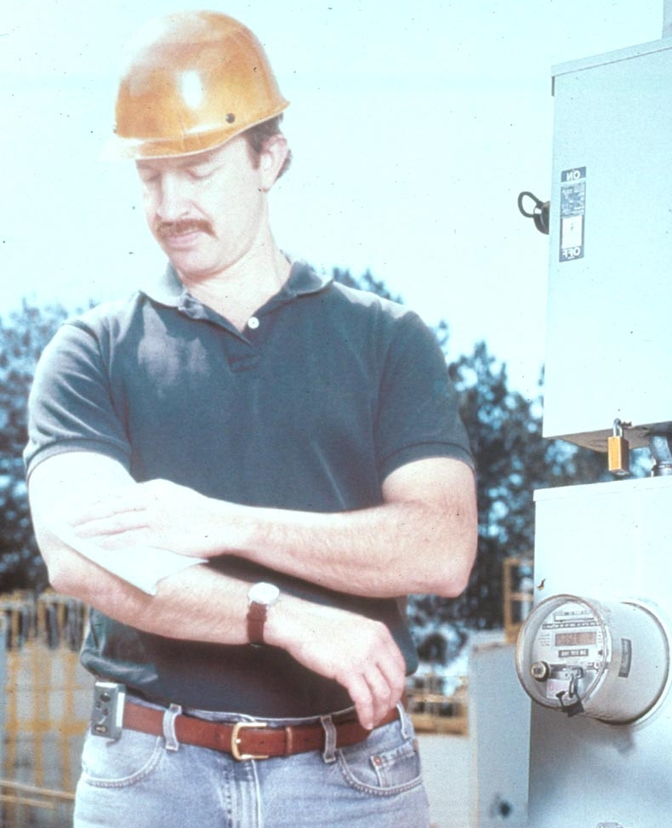
Potential Market
Outdoor workers

Slide 15
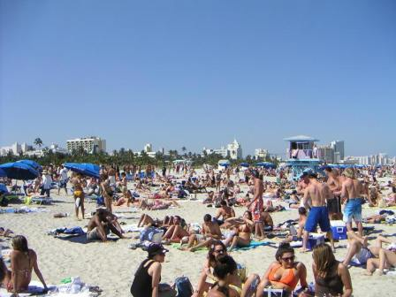
Potential Market

Slide 16
Cost and Financing
More costly than expected
Many parts are custom made
Small LCD with driver
PCB
Miniature electronic parts & battery
Financed through Weighton Student Fund

Slide 17
Cost and Financing
Quantity | Item | Cost
Various | Electronic Parts | $287.18
3 | PCB Board | $224.41
1 | AVR Butterfly | $88.68
1 | Milling Bid | $33.60
1 | LCD | $51.33
1 | Solder tip | $10.87
1 | Watch Case | $27.91
1 | Black Lamp | $22.39
1 | Serial to USB cable | $51.51
Total |  | $797.88

Slide 18
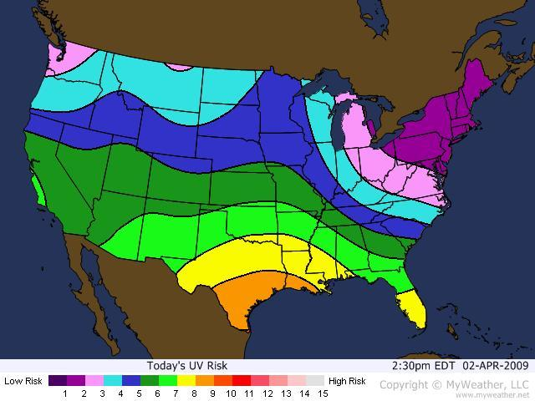
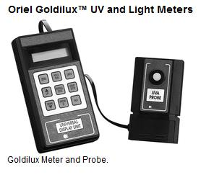
Competition
Weather forecast on TV
Radio
Internet
Bulky UV meter
and probe

Slide 19
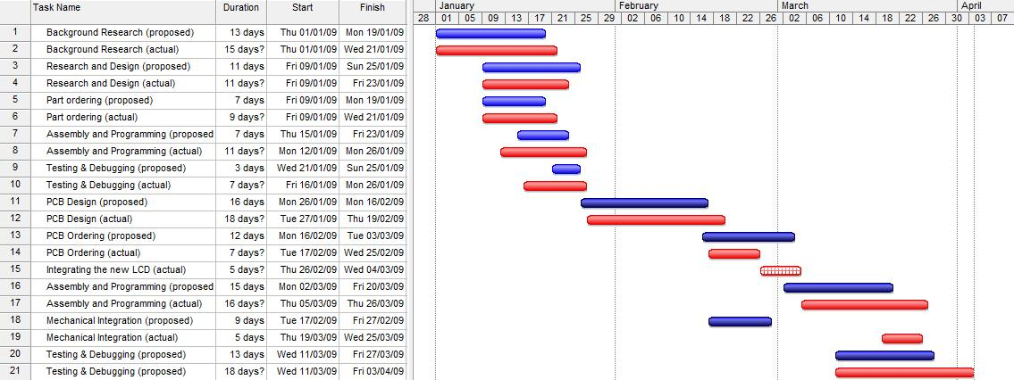
Time Line
The proposed vs. actual timeline

Slide 20
What Did we Learn?
Time line: 60 Hr/Wk
Cost due to optimizing
Shipping
Miniaturization

Slide 21
Conclusion
Useful, portable and inexpensive
Marketable/ Applicable
Health benefits
Cost, timeline and effort
Group of 3, disastrous?

Slide 22
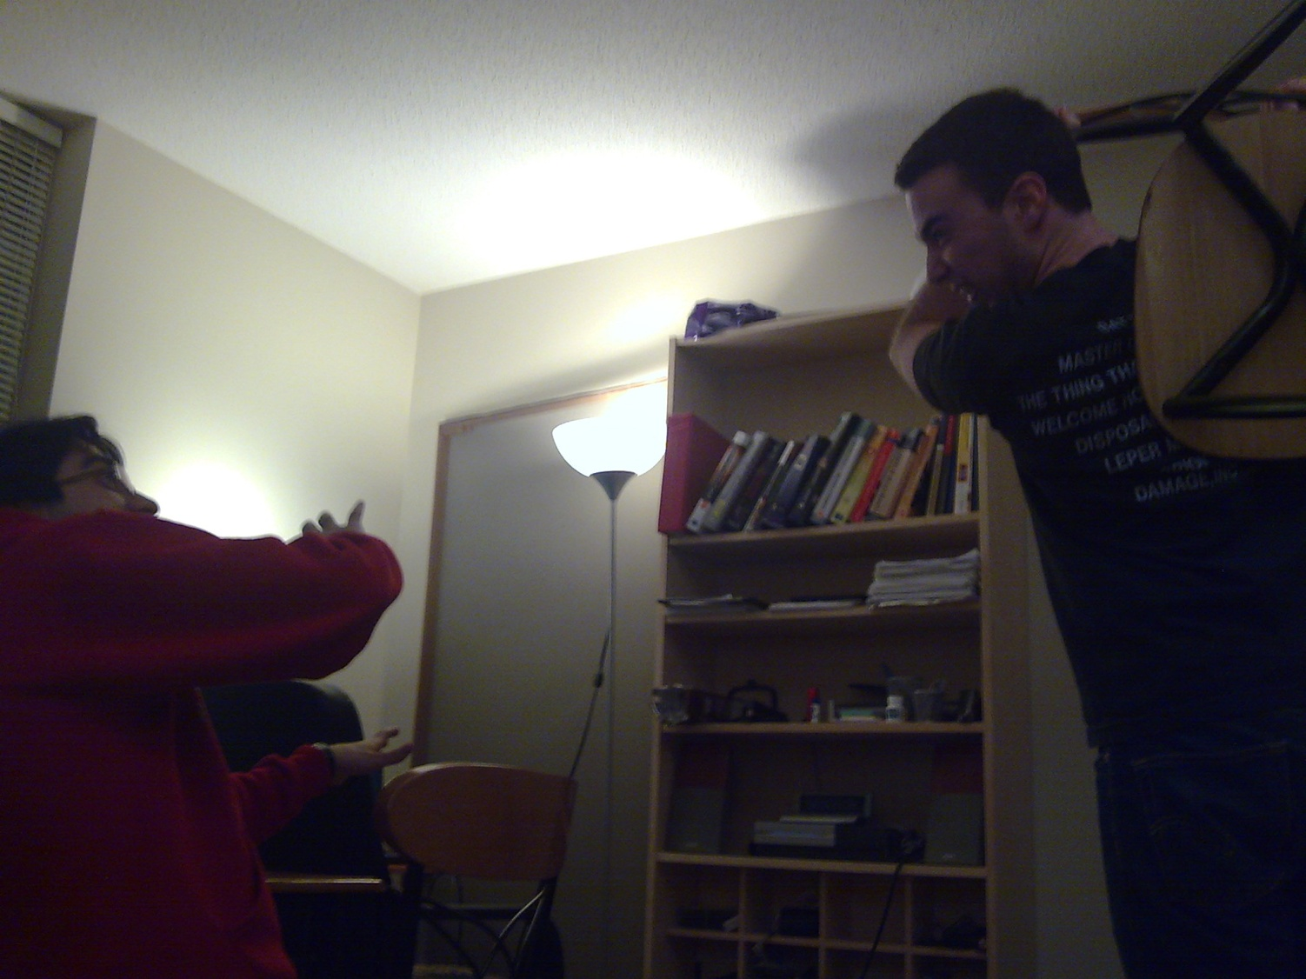
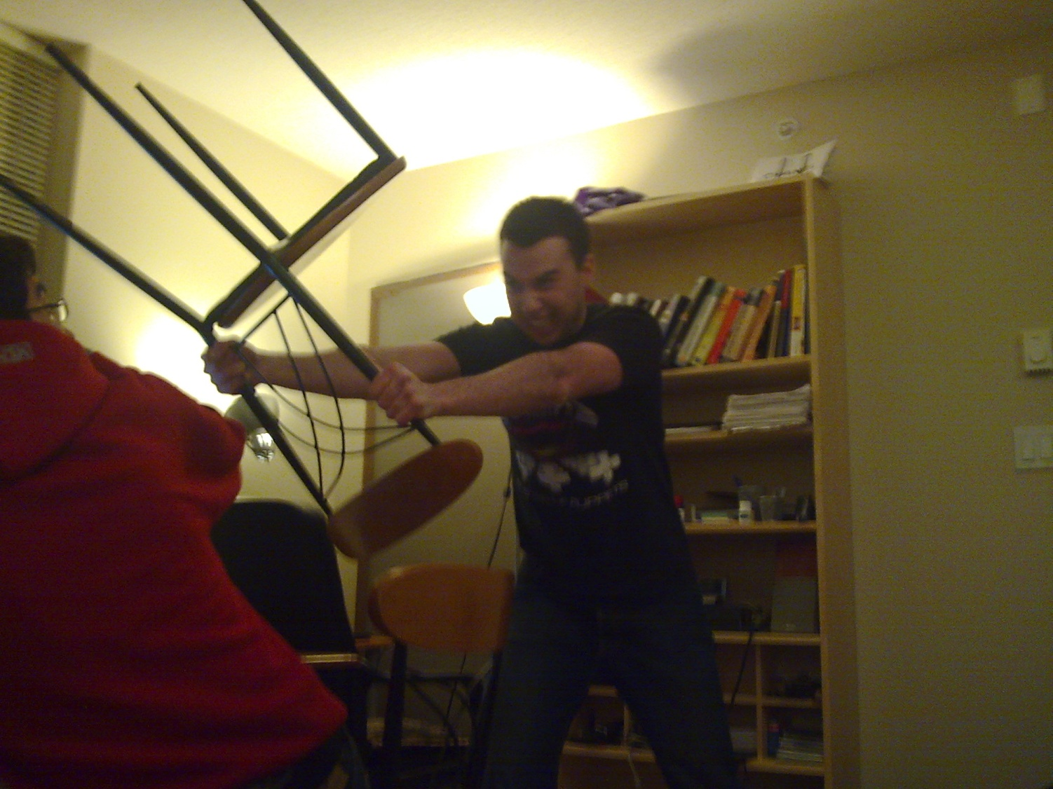
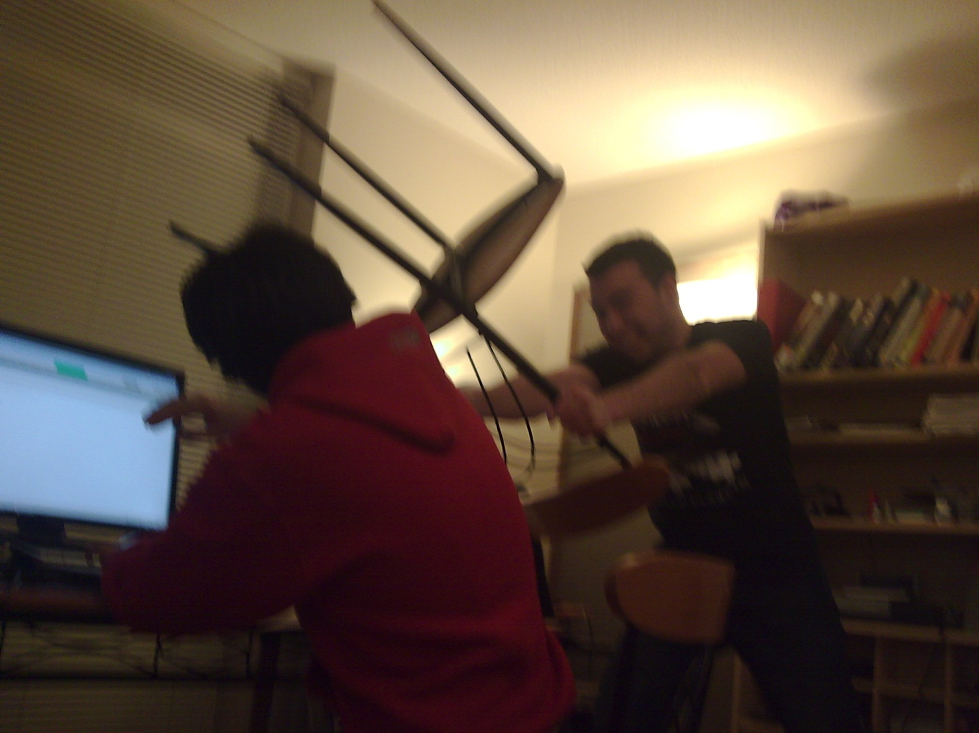
Conclusion

Slide 23
Future Work
Optimize size
Improve power consumption
Improve durability
Improve user interface
Improve accuracy
Implement buzzer/vibrator
Implement power monitoring
Quartz surface shield
Improve software

Slide 24
Sources of Information
Environment Canada,
http://www.msc.ec.gc.ca/
KTVU,
http://www.ktvu.com/wxmap/3978600/detail.html Oriel Goldilux, http://www.newport.com/store/genproduct.aspx?id=378893&lang=1033&Section=Pricing Medical News Today, http://www.medicalnewstoday.com/articles/142133.php ThomasNet, http://news.thomasnet.com/fullstory/9776

Slide 25
Acknowledgement
Patrick Leung
Steve Whitmore
Andrew Rawicz
Jamie Westell
Glenn Chapman
Fred Heep
Gary Houghton

Slide 26
Question and Answer

Slide 27
Technical Breakdown
Hardware
Software
Programming Methods

Slide 28
Technical Breakdown
Hardware
Microprocessor
Flash
LCD
UV Sensor
Op-amp
Push button
Crystal
PCB Design
Butterfly
Software
Programming Methods
Main Menu

Slide 29
Technical Breakdown
Hardware
Microprocessor
Flash
LCD
UV Sensor
Op-amp
Push button
Crystal
PCB Design Pins
Butterfly Evaluation doc
Software
Programming Methods
Main Menu

Slide 30
Technical Breakdown
Hardware
Microprocessor
Flash
LCD
UV Sensor
Op-amp
Push button
Crystal
PCB Design EAGLE
Butterfly
Software
Programming Methods
Main Menu

Slide 31
Technical Breakdown
Hardware
Microprocessor
Flash
LCD
UV Sensor
Op-amp
Push button
Crystal CITIZEN CM315
PCB Design
Butterfly
Software
Programming Methods
Main Menu

Slide 32
Technical Breakdown
Hardware
Microprocessor
Flash
LCD
UV Sensor
Op-amp
Push button SDS004
Crystal
PCB Design
Butterfly
Software
Programming Methods
Main Menu

Slide 33
Technical Breakdown
Hardware
Microprocessor
Flash
LCD
UV Sensor
Op-amp OPA2347
Push button
Crystal
PCB Design
Butterfly
Software
Programming Methods
Main Menu

Slide 34
Technical Breakdown
Hardware
Microprocessor
Flash
LCD
UV Sensor PDU-G106B-SM
Op-amp
Push button
Crystal
PCB Design
Butterfly
Software
Programming Methods
Main Menu

Slide 35
Technical Breakdown
Hardware
Microprocessor
Flash
LCD CDM-04101
UV Sensor Philips Controller
Op-amp
Push button
Crystal
PCB Design
Butterfly
Software
Programming Methods
Main Menu

Slide 36
Technical Breakdown
Hardware
Microprocessor
Flash AT45DB041D
LCD
UV Sensor
Op-amp
Push button
Crystal
PCB Design
Butterfly
Software
Programming Methods
Main Menu

Slide 37
Technical Breakdown
Hardware
Microprocessor Atmel Atmega169
Flash
LCD
UV Sensor
Op-amp
Push button
Crystal
PCB Design
Butterfly
Software
Programming Methods
Main Menu

Slide 38
Technical Breakdown
Hardware
Software
Code
Programming Methods
Main Menu

Slide 39
Technical Breakdown
Hardware
Software
Programming Methods
ISP
Parallel Programming
Main Menu

Slide 40
Technical Breakdown
Hardware
Software
Programming Methods
ISP AVRISP mkII
Parallel Programming
Main Menu

