Slide 1
Freedom Innovation Research
April 30th, 2010

Slide 2
Topics Covered
Introduction
System Overview
Project Budget
Timeline
Future Development
Question and Answers

Slide 3
Team Members
Hardware and Drivers
Steven Choi
Kenta Yuan
Richard Zhang
Client Side Software/Testing
John Ogawa
Jason Tsai

Slide 4
Motivation
14% of Canadian population has some form of disability
Half of reported disabilities are mobility restrictions
Difficulty taking a book or cup from a distant table
Automated system can improve quality of life

Slide 5
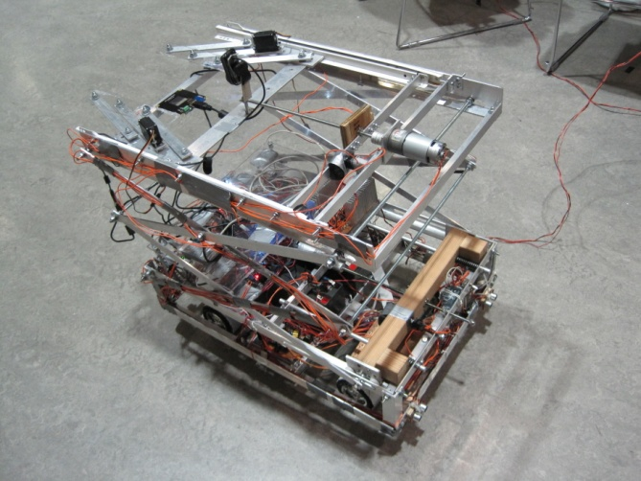
Product: Retriever 247

Slide 6
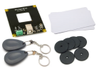
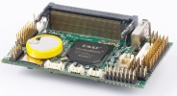
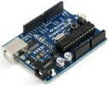
System Overview
What it’s made of?
Top
Robot Arm
Item Identify
Center
Control
Units
Base
Drive System

Slide 7
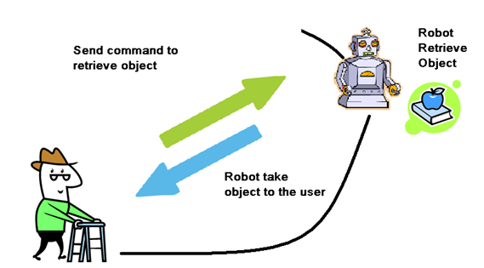
System Overview
Project Conceptual Model

Slide 8
System Overview
Client and Server Communication

Slide 9
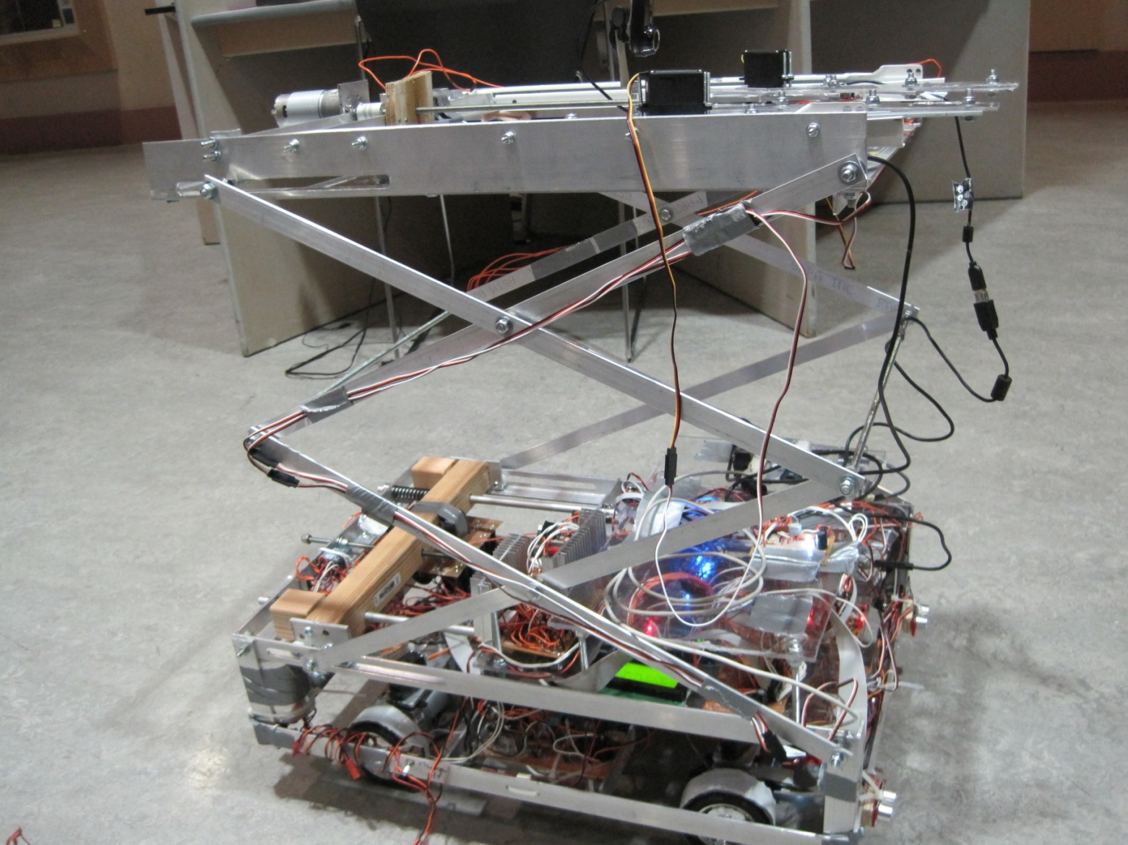
Hardware Overview
Lifting Platform

Slide 10
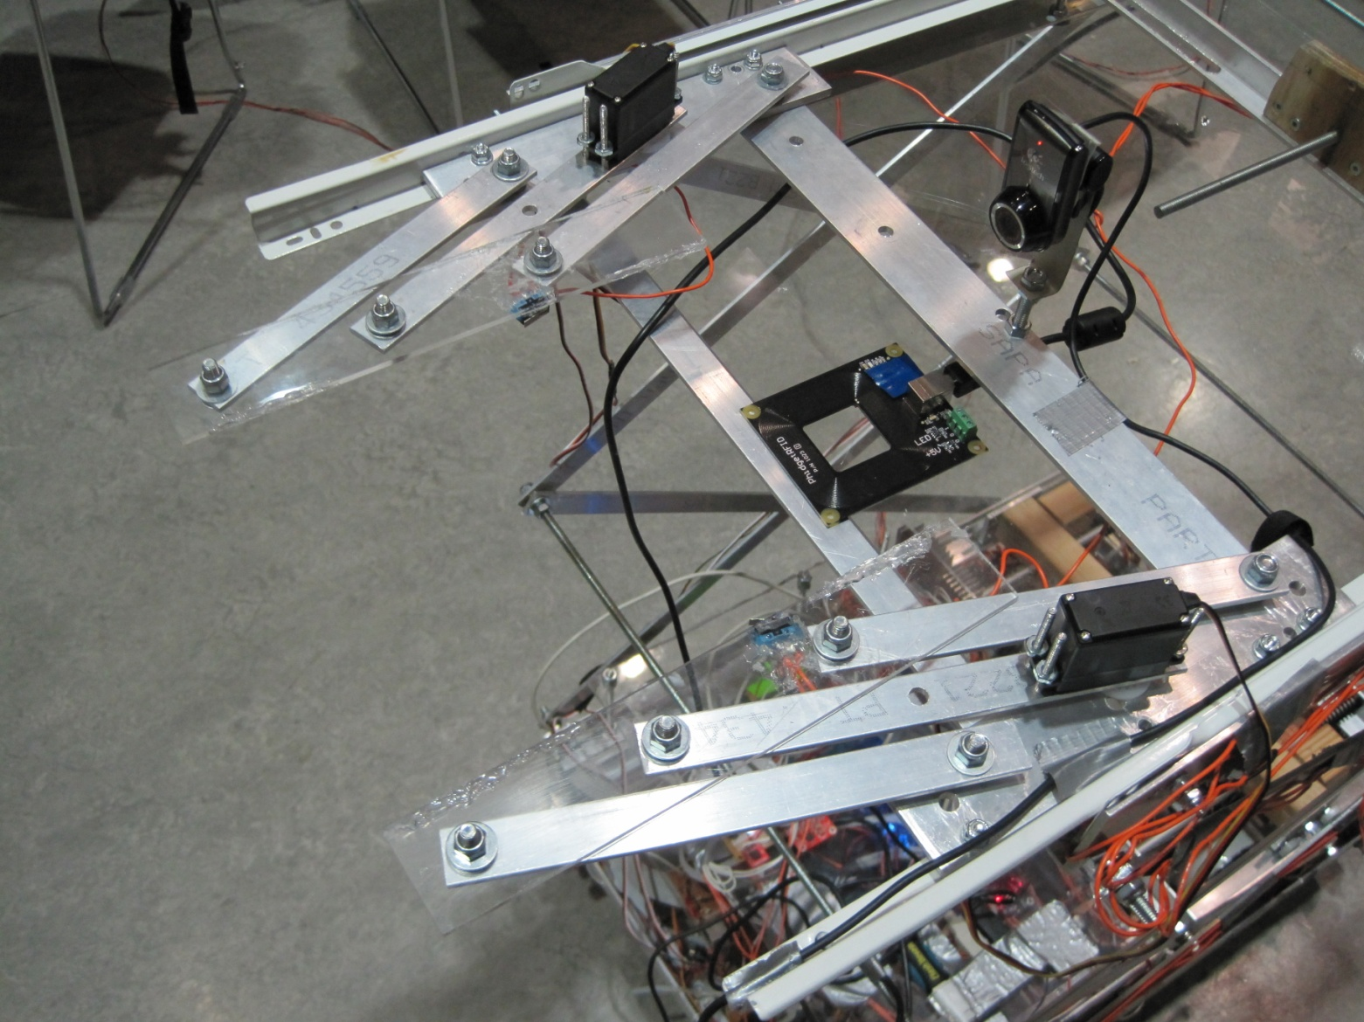
Hardware Overview
Robotic Arm

Slide 11
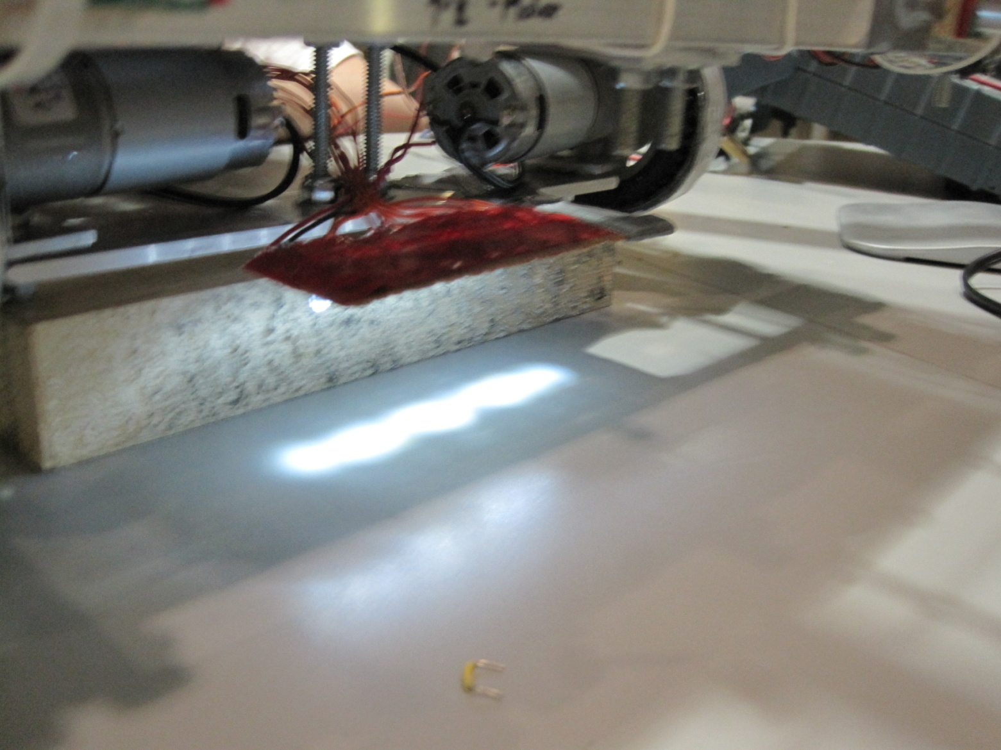
Hardware Overview
Line Sensor

Slide 12
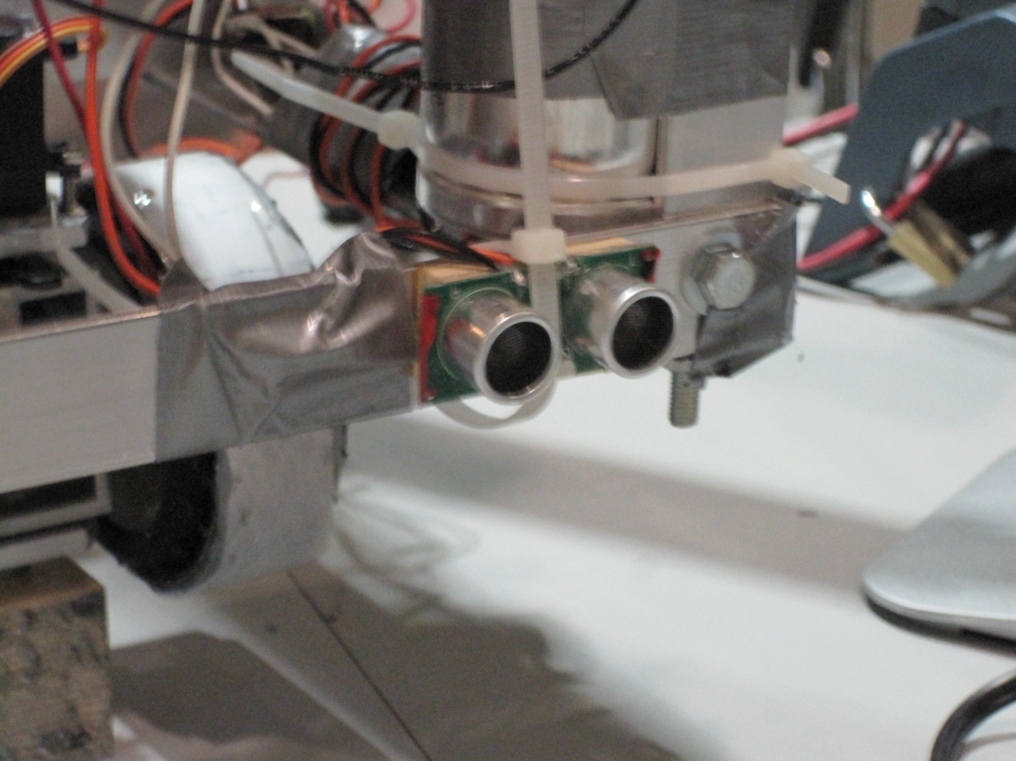
Hardware Overview
Ultrasonic Distance Sensor

Slide 13
Software Overview
Driver and real-time programming
Multithread
Server and client create wireless channel for communication
Video streaming server
GUI
Visual C++ and .NET Framework

Slide 14
Project Budget
Component | Cost
Controller and Driving System
DC, Servo, motor coupler and connector | 321.11
Wheels | 49.47
Central Controller | 400.38
Sensors
Reflectance Sensor Array | 76.44
Utrasonic Range Sensor | 40.45
Compass Module | 70.13
RFID module | 89.99
Accelerometer | 20.67
Current Sensor | 15
Mechanical
Base and Arm material | 214.68
Power
H Bridge | 10
Power components (battery, regulator, relay) | 97.5
Protection Fuses | 8.54
Miscellaneous
Electronic Components | 116.3
Wireless Router | 50
Shipping Total | 62.11
Tax | 49.85
Total Cost | 1692.6
Funding:
ESSEF: $ 800
Wighton(applied)
Total Spending:
$1692.6

Slide 15
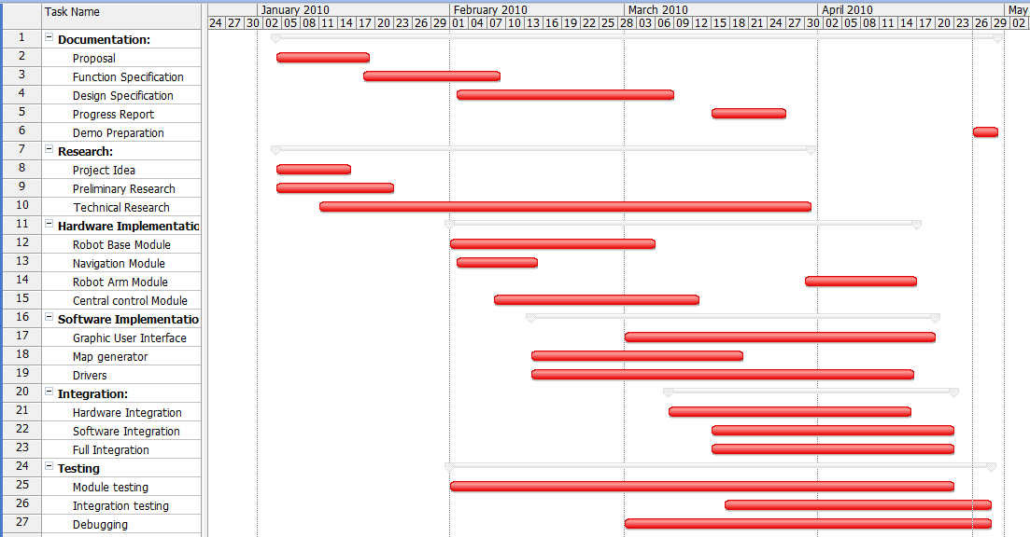
Timeline

Slide 16
Future Development
More sophisticated Robotic Arm
Map generation
Webcam position Control
Reduce robot weight
Image processing
Self located without lines on floor

Slide 17
Courses that helped us
ENSC 489 – Computer aid design and manufacturing
ENSC 483 – Modern control system
ENSC 425, ENSC 325, ENSC225 – Analog circuits, buck convertor, non-ideal op-amp
ENSC 387 – Sensors and Actuators
ENSC383 – Feedback control system
ENSC 351 – Real-time embedded System
ENSC 330 – Engineering materials
ENSC 320 – Filters
ENSC 304 – Usability engineering
ENSC 250 – Logic gates
ENSC 230 – introduction to mechanical design
ENSC 220 – Electric circuits
CMPT 225 – Data structure
CMPT 128 – C++ object orientated programming
And most importantly, engineering co-op experiences

Slide 18
Final Remarks
Overall System:
Managed to meet the major functional specification
Fully automated algorithm requires more optimization
Automatic Map Generation is still under integration
What we learned:
Communication and Team work
Meeting deadlines
Work with limited facility and budget

Slide 19
Demo
and
Questions

Slide 20
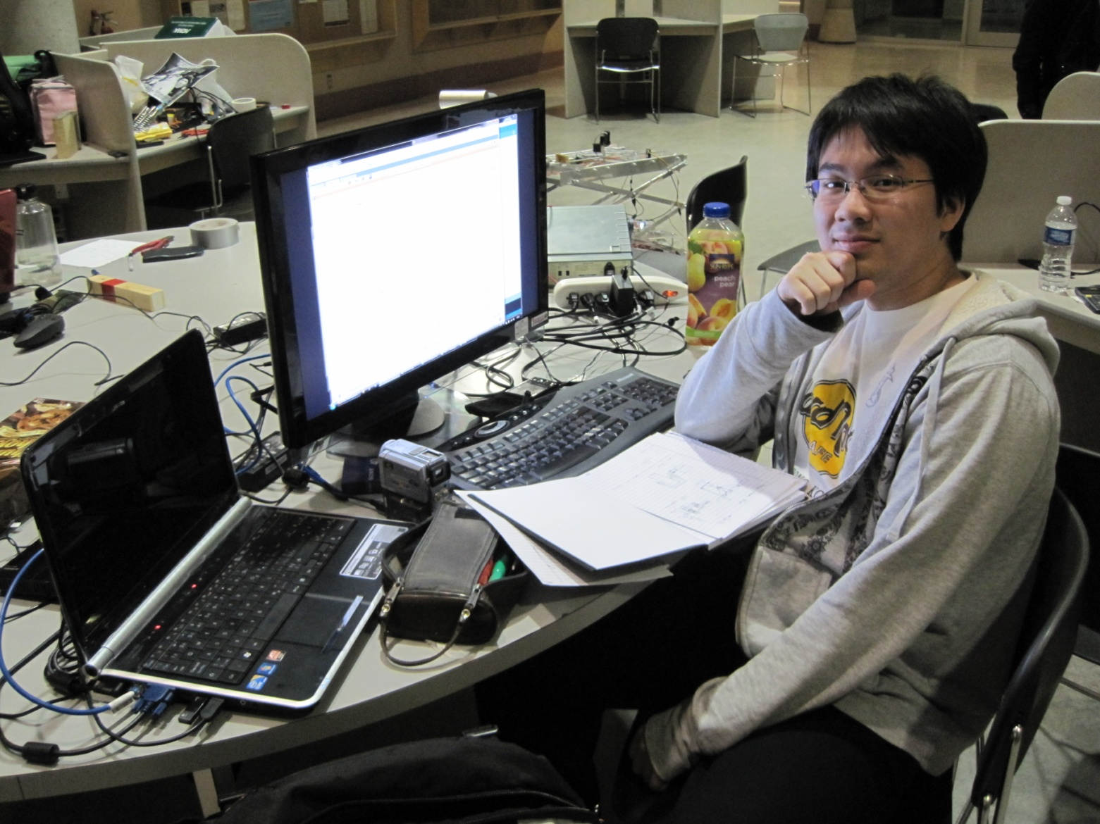
ASB is my home.

