Slide 1
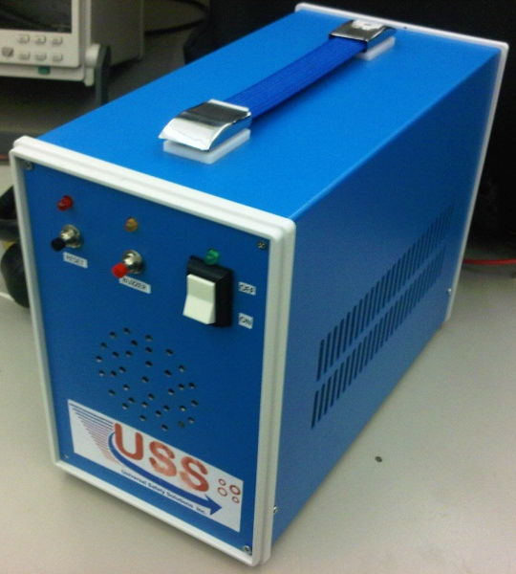
Welcome to the demo presentation for ShutSmart by USS
Presented by:
Sibghat Ullah
Abhishek Dubey
Vikas Yadav
13 April,2011

Slide 2
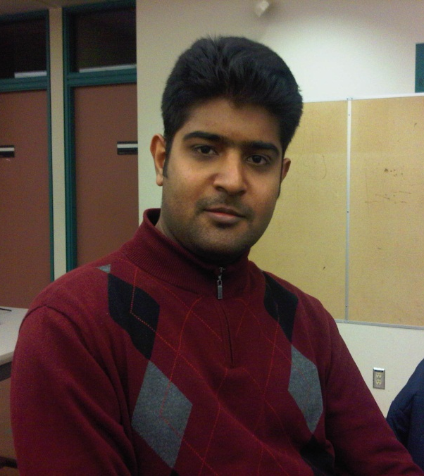
Sibghat Ullah Integration Engineer
Sibghat is a 4th year Electronics Engineering student at
Simon Fraser University. He has expertise mainly in hardware and somewhat in software
development. Sibghat was mainly responsible for designing the wireless unit and integrating the two units together towards the end.

Slide 3
Abhishek Dubey Hardware Engineer
Abhishek is a 5th year Electronics Engineering student at Simon Fraser University. Owing to his specialisation in the hardware field, he led the Hardware side of the project. He spent most of his time in the machine shop on 8th floor cutting the casing for the wireless unit, drilling holes in the main unit etc.

Slide 4
Vikas Yadav Software Engineer & PM
Vikas is a final year computer engineering student at SFU.
His areas of interest include software development, hardware designing and graphic designing. His main role in this project involved programming the microcontroller for the main unit and interfacing various components to the IC within main unit.

Slide 5
Agenda
Introduction
System Overview
Main unit
Control Unit
Business Case
Future Aspirations
Timeline
Budget
What we learned
Acknowledgement

Slide 6
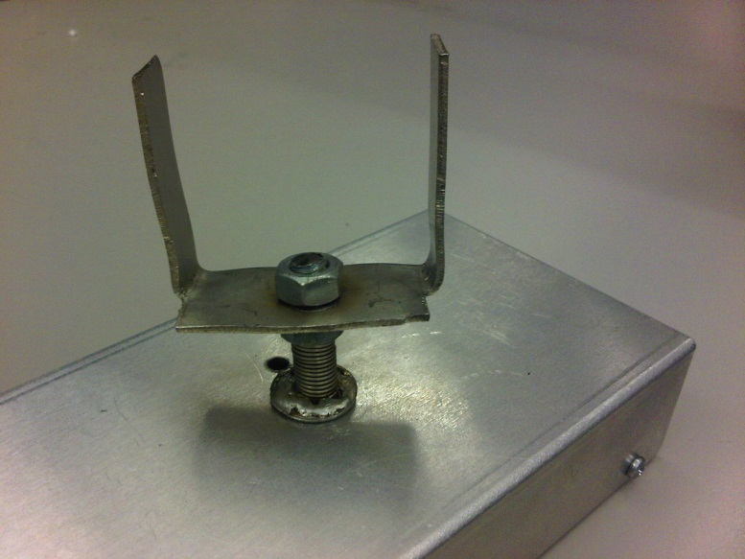
ShutSmart
Wireless Control Unit
Main Unit

Slide 7
Motivation
Reduce number of fires caused due to stoves being left unattended
Save LIVES!
Standalone product

Slide 8
System Overview
Comprises of two units: Main Unit & Wireless Unit
Wireless Unit is placed underneath the stove
Main unit acts as a medium between the stove and wall outlet

Slide 9
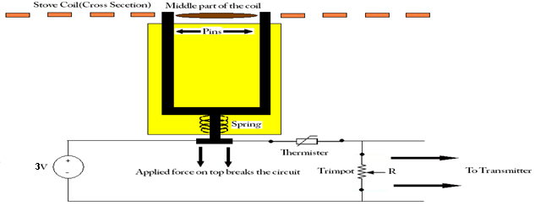
Wireless Control Unit
Mechanical Design
Thermistor Placement

Slide 10
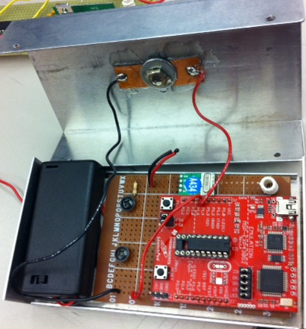
Wireless Control Unit
MSP430 Development board
Microcontroller - MSP430-G2211
QAM-TX1-433-ND Transmitter
Honeywell NTC Thermistor

Slide 11
Main Unit
On/Off switch
Reset buzzer
Reset relay
Speakers in the front
Fan at the back
Ventilation holes on either side

Slide 12
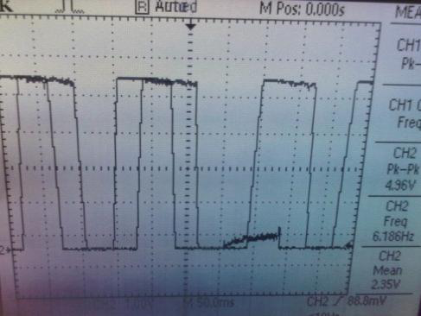
Main Unit
Receiving the signal – sampling required
Role of a capacitor

Slide 13
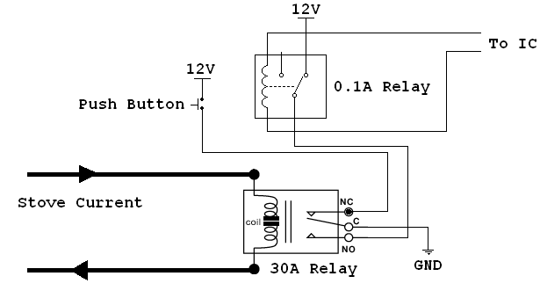
Main Unit
Relay Mechanism
Insufficient voltage from the IC to operate a 30 amp relay
Smaller relay used to trigger the circuit for a bigger relay

Slide 14
Business Case
Affordability
Outsource the production to China or India, manufacturing cost comes down to 75 to 100 CAD!
Reliability
Product has been tested on the actual stove (demo video at the end) at maximum heat.
Quick installation
Safety
Canadian safety standards were kept in mind and followed as explained in the design specs

Slide 15
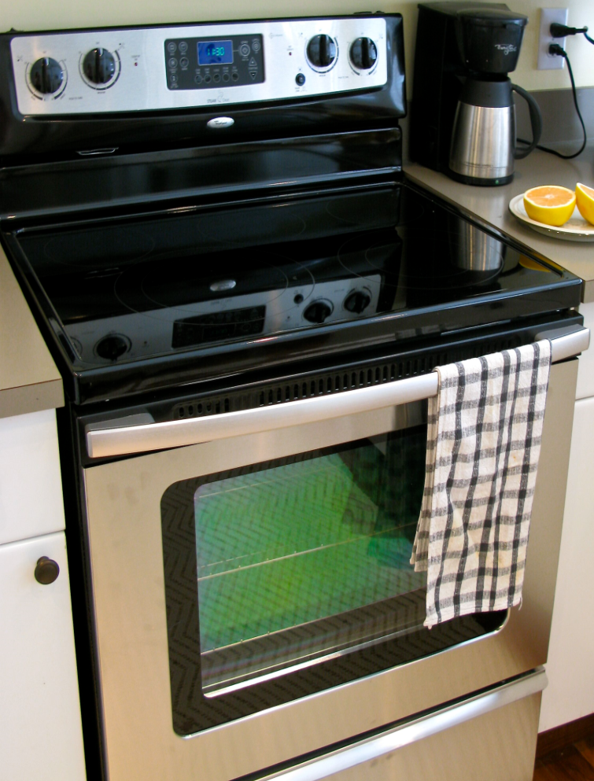
Business Case
Evolving market – new style stoves are in production
Wireless unit may be incorporated in the new design – useful tactic to increase sales

Slide 16
Future Aspirations
Incorporate the sensor unit – motion sensor and smoke sensor
Localised smoke detector for quick action and reaction
Set up SMS Alert for users to notify them of the unattended stove

Slide 17
Timeline

Slide 18
Budget
ESSEF provided us with CAD 800
Total price came to around CAD 925
Circuit components used up majority of the funds
Miscellaneous involved acquiring a stove for testing and its transport

Slide 19
What we learned
Programming microcontrollers
Enhanced programming skills
Developed entrepreneurial skills
Enhanced soldering skills
Teamwork
Time management
RP is overpriced – Lee electronics and Main electronics on Main St. are alternatives!

Slide 20
Acknowledgement
Thanks to Mike, Andrew, and all the TAs for constant feedback
Special thanks to Fred and Nerdkits

Slide 22
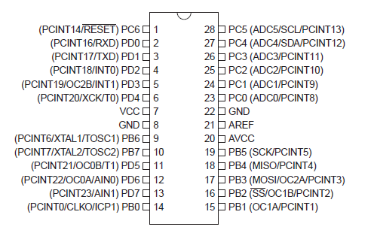
Extras
Pins specifications for ATMEGA168 microcontroller

Slide 23
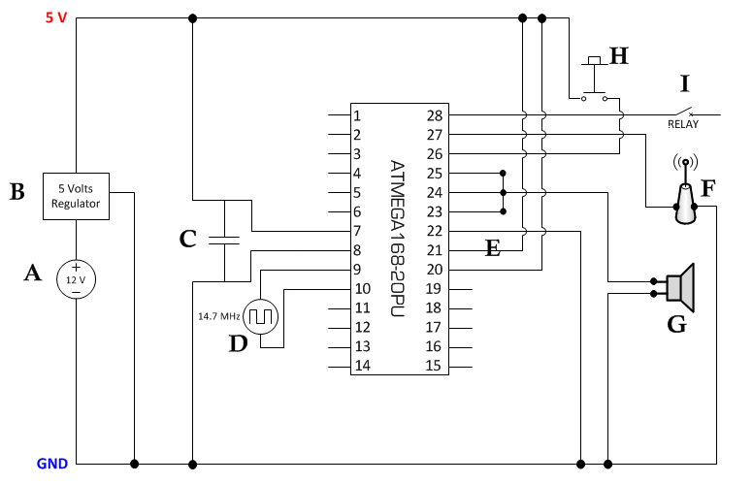
Extras
Circuit diagram for Main Unit with various components interfaced

Slide 24
Extras
Constructive interference phenomenon used to produce a loud sound from the speaker

Slide 25
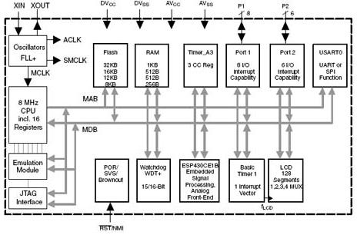
Extras
MSP430-G2211 MCU Schematic

Slide 26
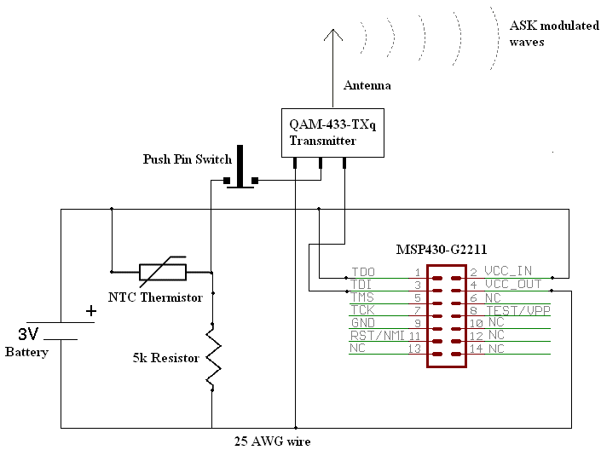
Extras
Wireless unit microcontroller interfaced with various components

Slide 27
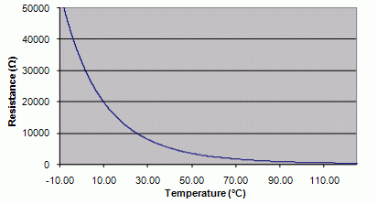
Extras
Restistance vs Temperature graph of the Honeywell thermistor used in the wireless control unit

