Slide 1
uControl
“Your Home At Your Fingertips”
Stoyan Petrov
Ivan Petrov
Sajib Saha
John Kenyon

Slide 2
Goals
Create an effective, reliable, innovative, and expandable home automation system for every day use
Increase the user's comfort by providing environmental controls at their fingertips
Biomedical application for physically impaired individuals
Create a scalable platform that could be used and controlled from various devices (Tablets, Cellphones, PC's, etc.)

Slide 3
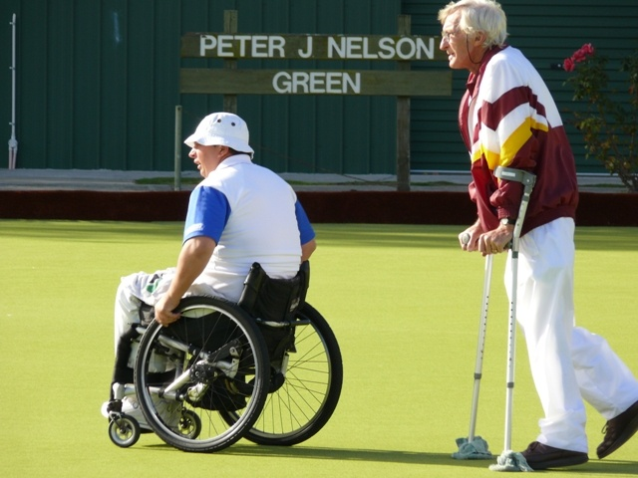
Motivation

Slide 4
Introduction
Team Members:
CEO Ivan Petrov
CTO Stoyan Petrov
COO John Kenyon
CFO Sajib Saha

Slide 5
System Overview
Portable Devices
End Control Modules
Central Unit

Slide 6
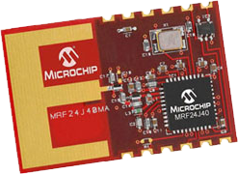
Central Unit
Acts like a hub
Receives commands from Portable Device v.a Bluetooth
Transmits to End Control Modules
Vital Roles
Entertainment systems Control
infrared LEDs
uControl Wireless Stack
Based on IEEE805.14.2 protocol

Slide 7
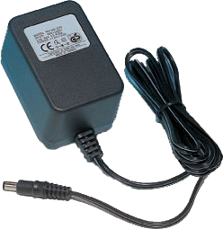
Central Unit
Features:
Dual Power Supply
Internal battery
External Power Supply adapter
Automatically switch to power
Universal Remote for any entertainment system
Internal remote database
Recording of new codes
Any number of user programmable Remote controls
No Pointing Required
TVs, DVDs, Cable boxes
Current support for 255 light switches
Slick and Sexy design

Slide 8
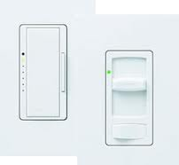
Light Switch
Wireless Turn on and off any paired uControl Light
Low Power Consumption
up to 255 lights
Simple Installation
No professional experience required
Simple Pairing Process
North America only
Easily modified for Europe , Asia and South America
Unlimited possibilities
Automatic timed commands
Power consumption monitoring
Light fault monitoring

Slide 9
The Pairing Process
Press the pair button on the Central Unit
Turn unpaired light on/off
Done!
Future design for even simpler pairing process
Automatic.
“Plug and Play”

Slide 10
System Summary
Infrared Communication Protocols
User Interface
End Control Modules
Central Unit
2.4 GHz IEEE 802.15.4 Transceiver Module

Slide 11
Reliability
Definition
Analysis
System Overview

Slide 12
Reliability
The probability that an item will continue to perform its intended function without failure for a specified period of time under stated conditions
Identify potential reliability problems as early as possible in the product lifecycle
Ongoing process and continuous throughout all phases of a product lifecycle
Hardware & Software reliability
Important Factors to Consider:
ROCF – Rate of Occurrence of Failure
CDF – Cumulitive Distribution Function F(t)
PDF – Probability Density Function f(t)
R(t) – Reliability (or Survivability) function
h(t) – Failure (or Hazard) rate
H(t) – Cumulitive Hazard Function
Effects of highly reliable products:
Better reputation
Higher customer satisfaction
Competitive advantage

Slide 13
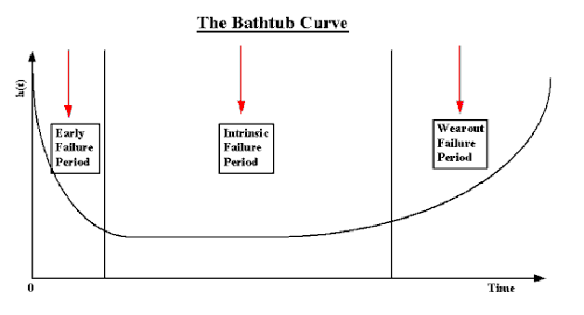
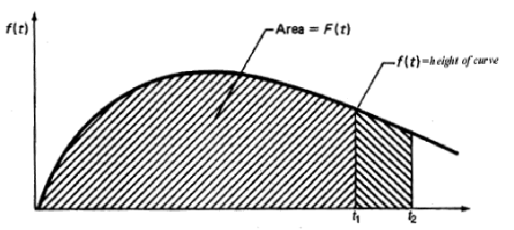
Analysis
Reliability analysis is obtained through sustained experimentation over time. Empirical population failure rates have been calculated as units age over time and the following was observed:

Slide 14
Quality vs. Reliability
The quality of a product is a snapshot at the start of life of a product and is motion picture of day by day operation.
When a “reliable” product is manufactured and used in the field, its reliability may be unsatisfactory due to the the manufacturing products.
Chosing high quality componenents can produce a high quality products
Overall reliability depends on the quality of the products and the manufacturing process

Slide 15
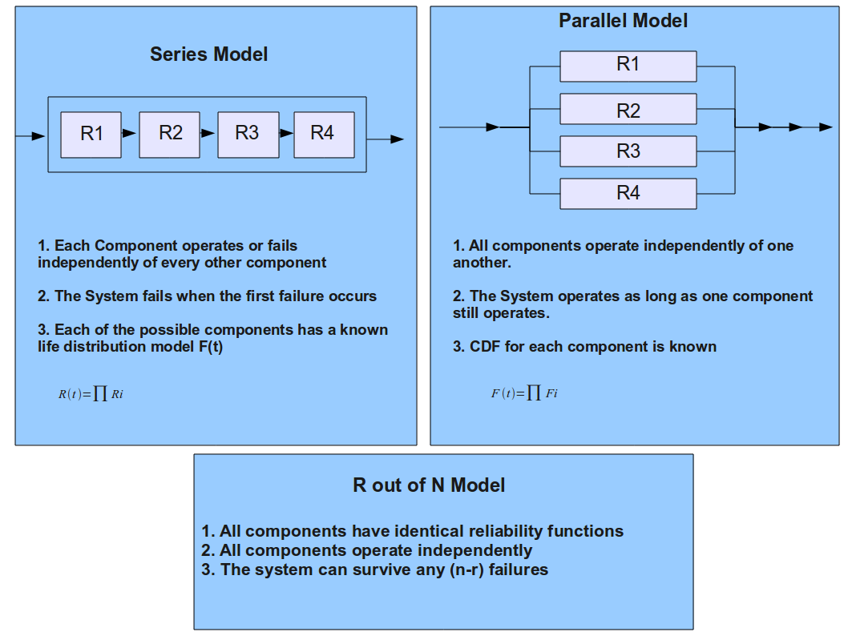

Slide 16
System Overview
Designed with reliability in mind
Series System model to reduce costs
Highly reliable components (Proper power ratings chosen)
Damage to resistors, capacitors, and transistors most often occurs due to overheating when the average power delivered to it greatly exceeds its ability to dissipate heat.
To increase reliability we picked components with twice as much power rating than required!

Slide 17
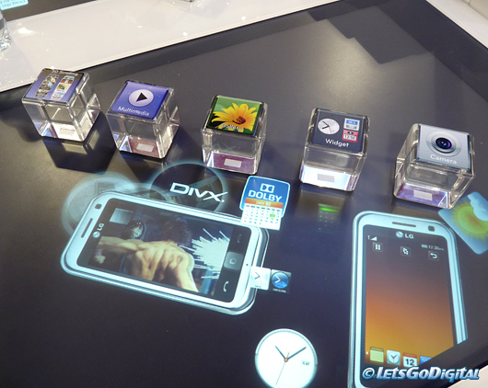
User Interface
Our goal is to create a simple, sexy, elegant, effective and intuitive user interface which allows the user to communicate seamlessly with out system.
Basic Requirements:
Responsive
Direct Selection Method
Self Explanatory
Interactive
Expandable

Slide 18
System Design
The user interface allows us to interact with different components of the system
The exchange of information between the user and the device is done through the user interface and hence a well designed user interface is of paramount importance
A well designed UI with an inferior technology will outperform a cutting edge product with a poorly designed user interface

Slide 19
Elements of a Well Designed User Interface
Control Interface
Selection sets – items available from which choices are made
Selection methods – direct or indirect selection
Direct Selection
Indirect Selection
Most Intuitive
More physical action required
Intermediate steps involved in making a selection
Ex: staggered menus

Slide 20
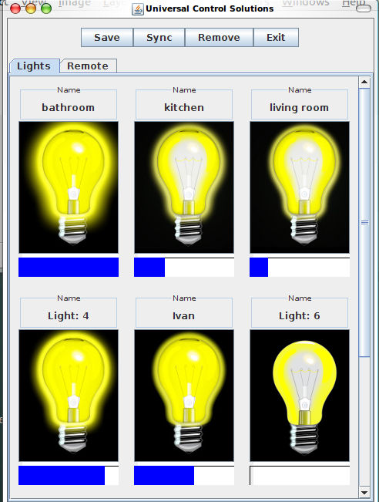
Elegant
Intuitive
Effective
Portable

Slide 21
Business
Competitors
Target Market
Industry
Price Model
Future Work

Slide 22
Competitors

Slide 23
Target Market
Price
Quality

Slide 24
Industry
Reduce costs though mass production
Save money
Surface Mounting
Designing Own Components
Buying wholesale
Reducing labour costs
Light Switch: $25
Central Unit: $100

Slide 25
Price Model
Cost:
Light Switch - $25
Central Unit - $100
Sale Price:
Light Switch - $45
Unit Pack - $350
Margin:
Light Switch - %80
Central Unit - %75

Slide 26
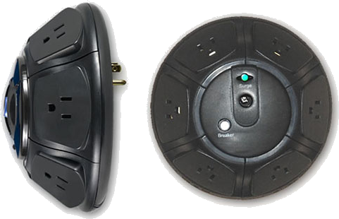
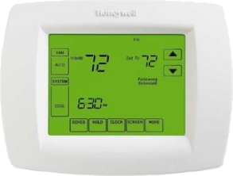
Future Products
uControl Thermostat
Wirelessly adjust room temperature
Similar technology to Light Switch
uControl Adapter
Power Cord plug in
Wireless

Slide 27
Project Specifics
Timeline
Budget
Team Dynamics

Slide 28
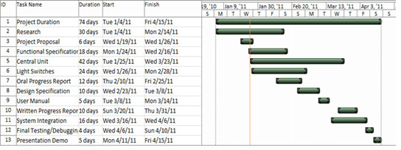
Project Specifics
Schedule

Slide 29
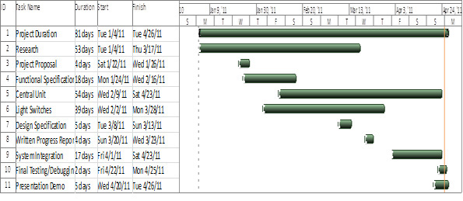
Actual Schedule
Project Specifics

Slide 30
Budget
Equipment | Estimated cost (rounded to nearest whole number)
Central Unit | $ 162
Light Switch (x4) | $ 73
Central Unit and Switch Interfacing | $15
Project Enclosure | $25
20% Contingency Plan | $55
Total | $330

Slide 31
Cost
Equipment | Estimated cost (rounded to nearest whole number)
Central Unit | $ 160
Light Switch (x4) and interfacing | $ 143
ZENA Network Analyzer | $140
AVR Programmer | $39
Other Cost ( Breadboard, PCB Etching Chemical, Socket, Light Bulb, etc.) | $50
Total | $532

Slide 32
Team Dynamics
Technical
We all refined our skills in several design programs including
Solidworks
Photoshop
Eagle
Avr Studio
Arduino
We all learned how to program microcontrollers
learned how to use several different wireless technologies
PCB Designing
JAVA for UI designing

Slide 33
Team Dynamics
Soft
learned the dynamics of working in a team, while both developing, as well as writing specifications for, a specific product
proved to feel like a much more realistic scenario for a small starting company
realized the intricacies of working with a tight fixed budget, saving money when needed, etc.

Slide 34
Team Dynamics
We used gmail for communication
Helped each other even though specific task was assigned to each other
Team Dynamics proved useful
working on other courses besides 440 with the same group
Reduced the amount of effort to be put into those courses

Slide 35
Conclusion

Slide 36
Thank You
Andrew Rawicz
Lucky One
Michael Sjoerdsma
TA’s

Slide 37
The End
Questions?

