Slide 1
Motivation
Video: Silent Drowning

Slide 2
Facts
≈ 1.2 million people die of drowning each year around the world, 50% below the age of 6
29% of drowning deaths involving children occur in public pools with certified lifeguards present.
Drowning Prevention Foundation
In 2004, there were 3,308 unintentional drownings in the United States, an average of nine people per day.(CDC 2006) U.S. Centers for Disease Control and Prevention
Of all preschoolers who drown, 70 percent are in
the care of one or both parents at the time of the
drowning and 75 percent are missing from sight
for five minutes or less. Orange County, CA,
Fire Authority

Slide 3
Present Solutions:
Poseidon:
Helping lifeguards “see what they can’t see”
Camera surveillance
Alert communicated via pager and co-ordinates of the victim known
Reasons for failure:
Expensive- Operators of a six-lane expect to pay upwards of $150,000 in hardware, software and installation costs
Rushed to market before it was ready
Blockage of underwater cameras

Slide 4
GESS Team
Shivam Kishore – Chief Executive Officer
Elis Micka – Chief Design Engineer
Suleiman Mohamed – Chief Software Engineer
Gurman Thind – Chief Hardware Engineer
Mehdi Elahi – Chief Research Engineer

Slide 5
iLifeGuard and its Goals:
Effective assistive device to alert lifeguards when a person is drowning
Uses underwater acoustic and in air Radio Frequency (RF) communication
Triggers strobe and siren warnings in receivers positioned along the perimeter of ponds and pools (as well as lifeguard pagers) after a predetermined amount of time underwater
Reduce the stress and burden of the
lifeguards
Target children and elderly
Keep the installation cost under $2000

Slide 6
Market Research
Spoke to a lot of lifeguards
Made sure that the need for the product exists
Discussed the idea with many parents having young children
Lifeguard Interview Video

Slide 7
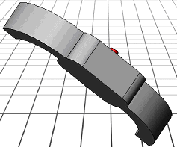
System Overview
Radio Frequency Transmitter
RF Signal
Transceiver
Micro-
controller
Lifeguard with Receiver
Acoustic Receiver
Acoustic Signal
Acoustic Transmitter
Bracelet worn by
the swimmer

Slide 8
Hardware Design
Three Components:
Bracelet (Acoustic Transmitter)
Transceiver (Acoustic Receiver + RF Transmitter)
Receiver (RF Receiver)

Slide 9
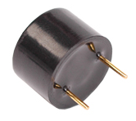
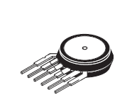
Bracelet
Printed Circuit Board + Pressure Sensor + Acoustic Buzzer
Designed to be worn by the swimmer
Output
Micro-controller Processing
Inputs
Acoustic Signal
12V, 5khz signal
Analog Pressure Sensor value
Analog to Digital Conversion
Currently for a depth of 4 meters
Timer
Currently a wait for 5 seconds

Slide 10
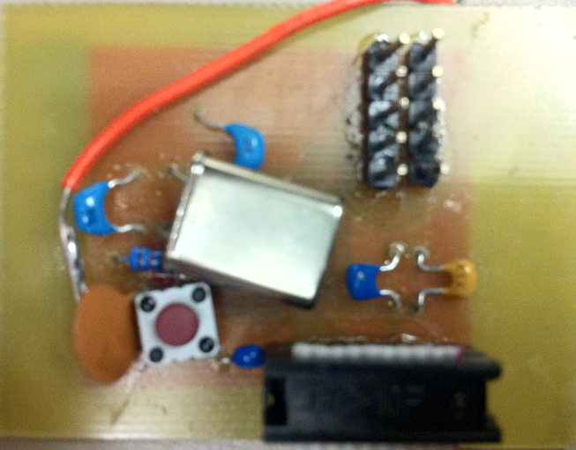
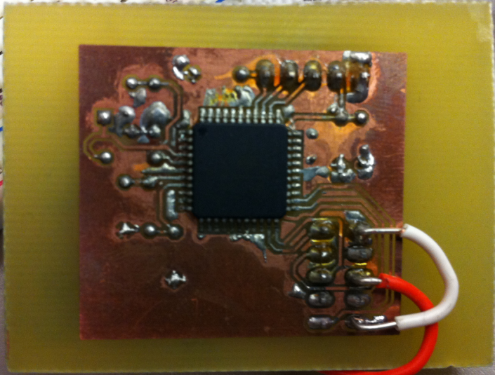
Bracelet Cont…
Printed Circuit Board (PCB) Design:
Micro-controller ATMEGA644V
is the “brain” and the powerhouse of
the PCB
Clock Crystal, 10Mhz
Output/
Inputs
Micro-controller
Ground
Reset Button

Slide 11
Bracelet Cont…
Packaging:
Proposed:
Epoxy coating
Enclosing the epoxy coated PCB in a watch case
Actual:
The PCB is held outside water
Cables are run to the pressure sensor and to the buzzer underwater
So, it is still underwater communication since the buzzer and the sensor are underwater
Reason:
Epoxy expands very slowly and gradually on cooling
The micro-controller became obsolete
Two tries two different methods = FAIL!

Slide 12
Transceiver
Acoustic receiver (Microphone) + RF board capable of transmission and reception. Use the Transmission feature
To be placed at the corner brim of the swimming pool
Inputs
Micro-controller Processing
Output
RF signal, 2.4Ghz at 3dBm
LEDs, Alarm
Acoustic signal received by the microphone
Reads the acoustic signal received by the microphone
Enables the RF transmitter to transmit a RF signal

Slide 13
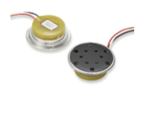
Transceiver Cont…
Microphone:
Waterproof magnetic microphone
No performance loss after 15-20 meters of water submersion
Receives frequency of up to 5Khz
Extremely low impendence
Power Supply:
≈ 0.001V dc

Slide 14
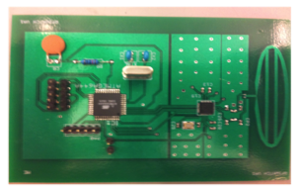
Transceiver Cont…
RF Transmitter:
PCB board with antenna
Folder Dipolar Antenna:
2.4 GHz Centre Frequency
-17dBm to 3dBm
Micro-controller Circuit
RF Circuit
Clock crystal
Output/
Input
Micro-controller
ATMEGA644PV
AT86RF230, 2.4 GHz Radio transceiver
Ground Separator

Slide 15
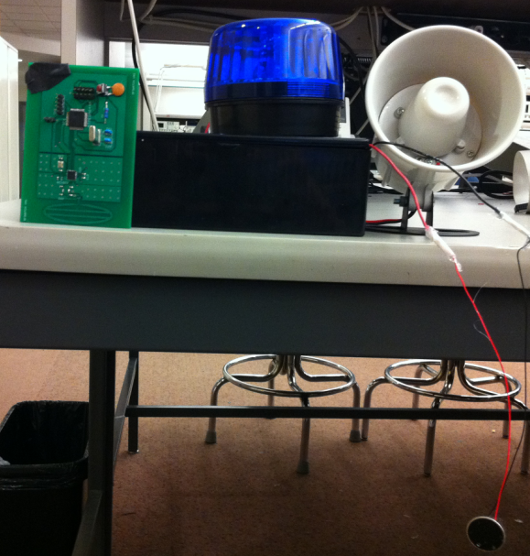
Transceiver Cont…
Packaging and Alarm System:
A black waterproof box is used to encapsulate the RF board
RF Transceiver board
Case
Alarm System
Microphone

Slide 16
Receiver
Folder Dipolar Antenna:
2.4 GHz Centre Frequency
-17dBm to 3dBm
RF Receiver board + Alarming System
Micro-controller Circuit
RF Circuit
Clock crystal
Output/
Input
AT86RF230, 2.4 GHz Radio transceiver
Micro-controller
ATMEGA644PV

Slide 17
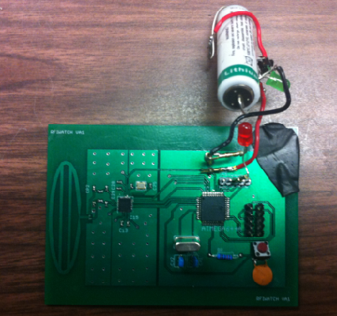
Receiver Cont…
RF Receiver board + Alarming System
Folder Dipolar Antenna:
2.4 GHz Centre Frequency
-17dBm to 3dBm
Lithium Battery
Indicator LED

Slide 18
Efficiency and total Power Consumption
Bracelet
Micro-controller ≈ 0.0014W
Buzzer ≈ 0.36W
Pressure Sensor ≈ 0.036W
Total ≈ 0.3974
Transceiver
Receiver
Micro-controller ≈ 0.0014W
Flash Light ≈ 1.8W
Total ≈ 1.8014
Micro-controller ≈ 0.0014W
Siren ≈ 20W
Total ≈20.0014
3.6V and 12V lithium batteries along with voltage dividers are used

Slide 19
Software Design:
JTAGMKII ICE used to program the micro-controllers in all the three components
Power the system
Y
Read Sensor values
Receiver Receives
Y
If sensor value >
N
If
4.5 KHz<signal frequency <5.5KHz
Y
Y
Y
Increment counter starting at zero
Y
Y
N
Send signal to receiver
If count =10
Y
Send signal to microphone

Slide 20
Finances:
Component
 | Projected Prototype Cost | Actual Cost | Projected Unit cost
Bracelet | $195.9 | $ 245.9 | $ 50
Transceiver | $ 361.6 | $ 395.7 | $ 70
Receiver | $ 332.5 | $ 354 | $ 74
Total | $ 890 | $ 995 | $ 206

Slide 21
Finances:
Projected Cost Break-down: Bracelet
Part | Cost
Microcontroller | $ 6.0
Switch | $ 0.10
Battery | $ 10.0
PCB | $ 1.0
Resistors | $ 0.1
Capacitors | $ 0.1
Clock crystal | $ 0.3
Labor | $ 5.0
Advertising | $ 8.0
Total | $30.6

Slide 22
Finances:
Projected Cost Break-down: Transceiver
Part | Cost
Microcontroller | $ 6.0
Switch | $ 0.10
Battery | $ 5.0
PCB | $ 2.0
Resistors | $ 0.1
Siren | $20.0
Capacitors | $ 0.1
Clock crystal | $ 0.3
Labor | $ 5.0
Advertising | $ 8.0
Total | $46.6

Slide 23
Finances:
Cost Break-down: Receiver
Part | Cost
Microcontroller | $ 6.0
Switch | $ 0.10
Battery | $ 5.0
PCB | $ 2.0
Resistors | $ 0.1
Siren | $20.0
Capacitors | $ 0.1
Clock crystal | $ 0.3
Labor | $ 5.0
Advertising | $ 8.0
Total | $46.6

Slide 24
Future Work:
Design
Integrate the receiver in the home phones
Miniaturize components for appeal and efficiency
Better ways to water-proof
Better alarming systems
Customize the product for specific uses
Audience
Extend to uncontrolled environments like ponds and lakes
Extend to controlled environments having
minimal supervision like theme parks
Extend to private pools

Slide 25
What We Learned:
Software skills:
Communication – Digital, wireless, underwater
Design using Solidworks
Micro-controller programming
Hardware skills:
PCB – Build circuit – Schematic – PCB – Print/ Edge PCB
Facts about drowning
Machine shop equipment
Other:
Waterproofing of electronic components
Sourcing parts cheaply

Slide 26
Acknowledgments
Dr. Lakshman One (Advice on Electronics)
Dr. John Bird (Underwater communication)
Melanie Klapstock (Aquatics Assistant)
Dr Ash M. Parameswaran (Advice on Electronics)
Dr. Sami Muhaidat (Advice on Digital communication)
Dr. Shawn Stapleton(Advice on Digital communication)
Mike Sjoerdsma (Advice on details of project)
Dr. Andrew Rawicz (Advice on details
of project)
ESSS (Funding)

Slide 27
Conclusion
Address issues of long term waterproofing solutions
Working prototype done, tested and re-tested to provide Proof of Concept
iLifeGuard has a high market potential
iLifeGuard has the potential to be integrated in existing products like wrist watches and home phones

