Slide 1
HelperTech
Snow Removal Robot – RoboBlow
April 18, 2011

Slide 2
HelperTech Members
Leo Cheng (CEO)
Software Design & Development
YuYuan Liu (VP Operations)
Software Design & Development
Peter Hsiao (CFO)
Hardware Development (Mechanical & Electrical)
Joseph Shen (VP Marketing)
Hardware Development (Mechanical & Electrical)

Slide 3
Outline
Team Members
Introduction
System Overview
Software
Hardware
Financial & Marketing
Future Development
Question
Demo

Slide 4
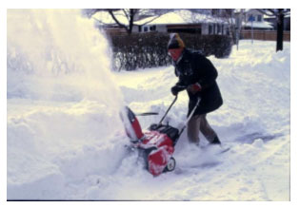
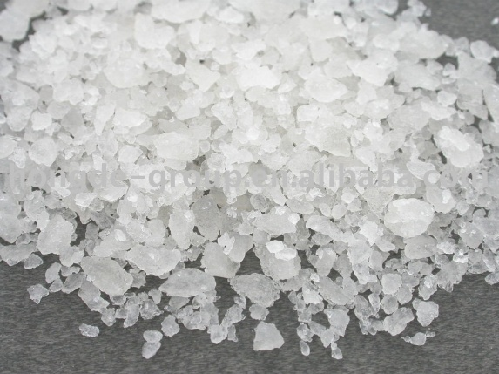
Household Snow Removal
Snow Shovel
Snow Blower
Anti-Icing Chemical

Slide 5
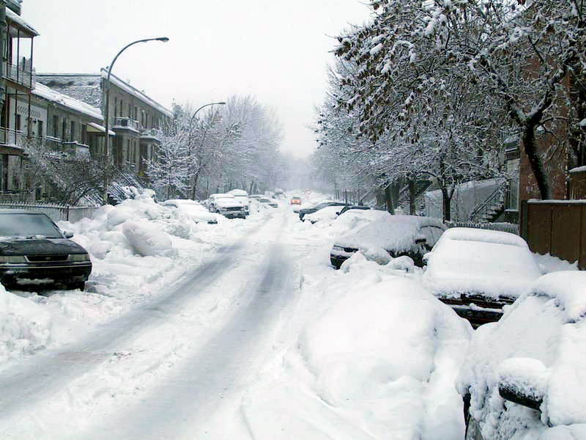
Limitation: Outdoor
Hazardous Weather
Slippery Ground

Slide 6
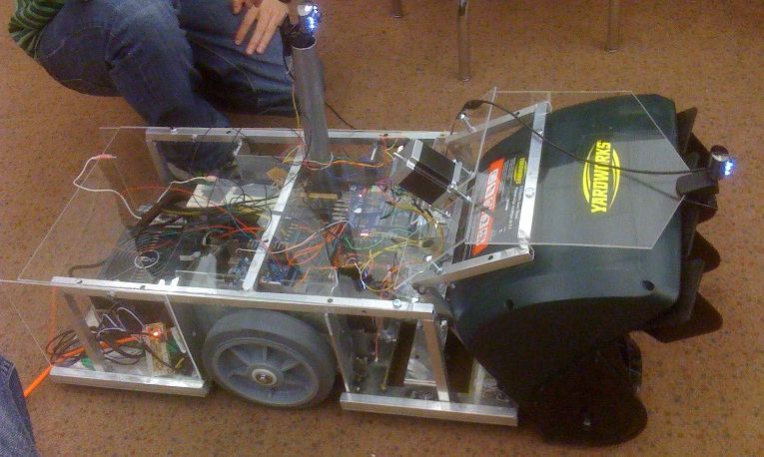
Product Goal
Snow Removal Robot
Snow Blower (Completed)
Salt Spraying (Incomplete)
Wireless Remote Control
Real-time Video
Safety Consideration
Emergency Stop

Slide 7
System Overview
Controller
Snow Removal Robot
Button & Joystick Input
Cameras
Input Signal
Video
Control Signal
Wi-Fi
Snow Blower Switch
MCU
MCU
Control Signal
Video
Robot State
Arduino
LCD Screen
LED
Wheel Control
Snow-out Direction Control
Camera Direction Control

Slide 8
Software
Goals and objectives
Software system overview
Details of components

Slide 9
Goals and Objectives
The robot can be controlled wirelessly by our remote controller
Real-time image can be displayed on the remote controller. Views from different cameras can be switched.
Snow out direction can be controlled by our remote controller.
Safety design

Slide 10
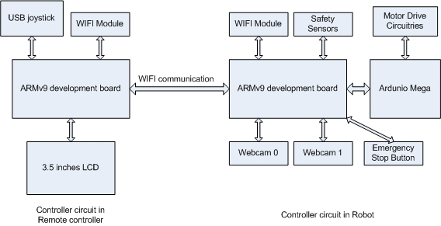
Software System

Slide 11
Details of components
Armv9 processor
video processing
complete communication protocol
multi-tasking , Linux program.
better driver support
lack of PWM output pins

Slide 12
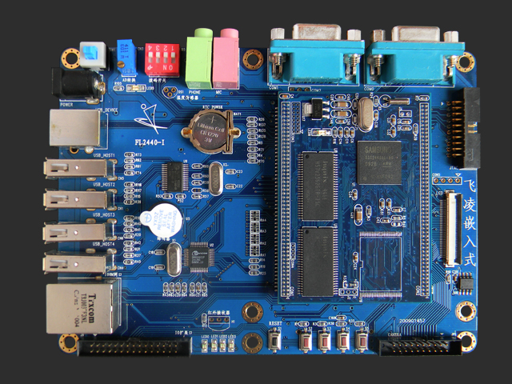
Armv9 processor and development board
Image source: http://www.arm9board.net/sel/prddetail.aspx?id=352&pid=200

Slide 13
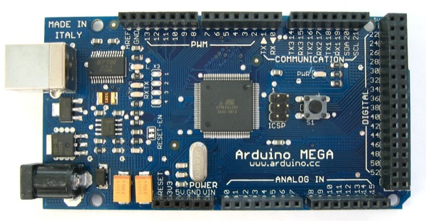
Details of components
Arduino (Mega)
lots of PMW output pins
easy programming
suitable to be a slave
Image source: http://arduino.cc/en/Main/ArduinoBoardMega

Slide 14
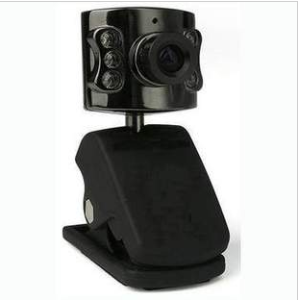
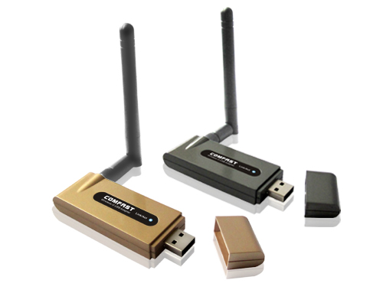
Details of components
Webcam
Mircovim webcam. Linux Driver is built in the kernel.
WIFI Module
Ralink rt73 chip. Driver and relevant tools are cross-complied by ourselves.

Slide 15
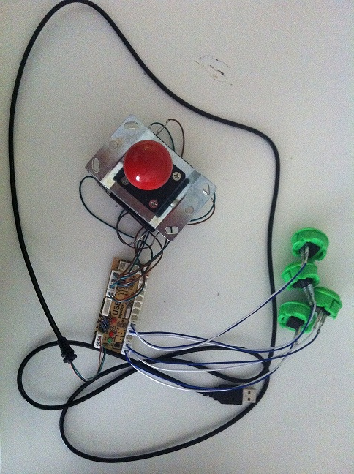
Details of components
USB joystick
We bought USB controller breadboard, buttons and direction controller and assembly them together according to our design.

Slide 16
Hardware – Goals and Objectives
-The snow thrower can be switched on/off wirelessly
-The snow can be blown into desired direction
-The robot can be driven to desired location wirelessly
-The monitoring cameras can be rotated wirelessly
-The robot can move on icy surface (traction)
-Safety features

Slide 17
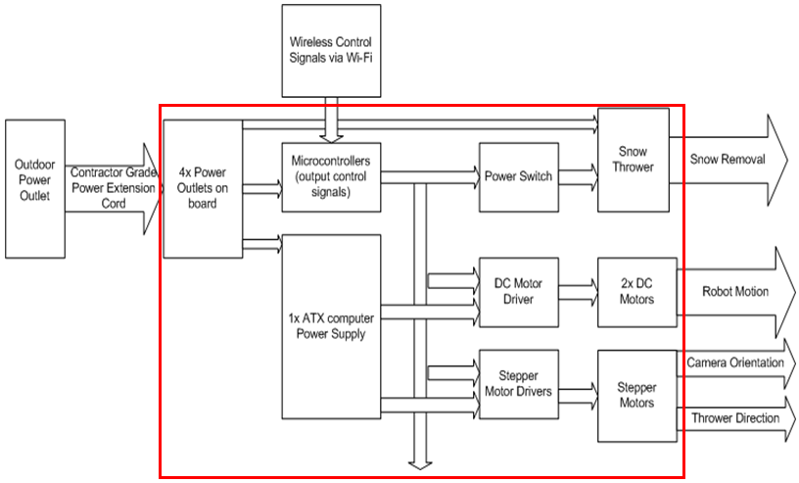
Hardware – System Overview

Slide 18
System Overview
Snow intake (clearing): up to 15.2 cm
Power requirement: 1680 Watt maximum
Total weight: ~ 40 Kg
Frame material: Aluminum & Acrylic boards
System Inputs:
- Power supply from home outlet
- Remote control signals via Wi-Fi
System Outputs:
- Robot motion
- Snow thrower -> snow removal
- Snow thrower -> snow blowing direction control
- Camera orientation control

Slide 19
System Overview – Structure -Robot base & frame -Robot case & frame

Slide 20
System Overview – 1st Layer
Includes:
- Power extension cord
- Power outlets
- ATX power supply
- 2x geared DC motors
- Power switch circuit
- Snow thrower
- 2x rubber wheel of 8’’ in diameter
-2x supporting wheels

Slide 21
System Overview – 2nd Layer
Includes:
- ARM development board
- Arduino microcontroller (slave)
- DC motor driver circuit
- Stepper motor control circuits
- 0.33Amp stepper motor
- 4 Amp stepper motor

Slide 22
COST ANALYSIS
ARM Development Board x2 | $215
Webcam Camera x2 | $30
NPC DC Gear Moto set (K24466)x2 | $575
Yardworks 9A Sow Thrower | $172
Arduino Microcontroller x2 | $70
Aluminum Welding | $700
White Acrylic Board x3 | $70

Slide 23
COST ANALYSIS
ATX 600W Power Supply | $50
Extension Chord+ Multi Power Plugs | $90
0.33A Bipolar Mercury Stepper Motor | $27
4A Bipolar Mercury Stepper Motor | $37
Glue Gun, PCB Boards, Screws and Other Tools | $30
H-Bridge DC Motor Driver | $160
WIFI Adaptor | $30
Joystick s+ Control Button | $5
Electronics (Wire+ Heat Sinks + Transistors) etc | $246
TOTAL | $2507

Slide 24
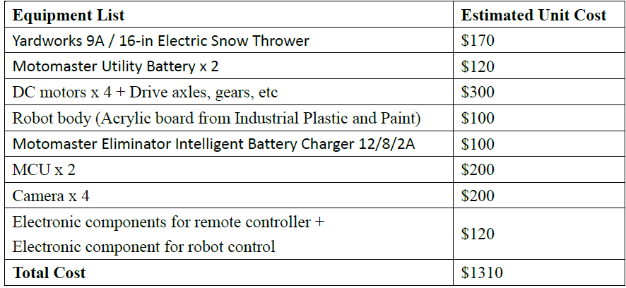
COST ANALYSIS
Comparing to the proposed cost budget, we are over-budgeted by $1200.
Originally proposed budget:

Slide 25
TEAM WORK
Divided Into Group Of Two
Software Team: Leo and Yuyuan
Hardware Team: Peter and Joseph
Peter and Yuyuan are in charge of the communication between two teams
The team have regular meeting on a weekly basis

Slide 26
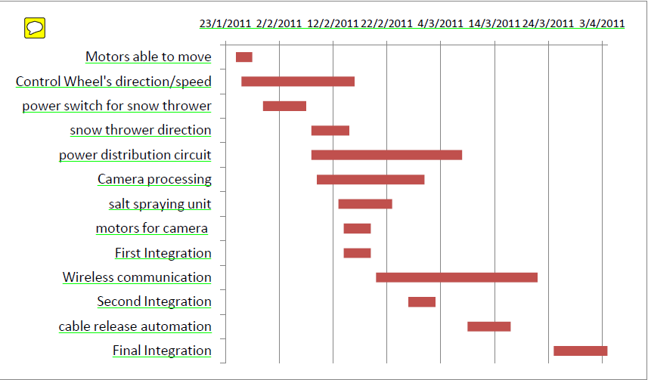
Timeline Accomplished
Proposed Timeline:

Slide 27
Timeline Accomplished
Troubles Met:
Underestimated the Difficulty of Dealing With High Power Motor
2. Struggled Finding Right Component that Would Do the Job
3. Had to Omit the Salt Spraying Unit and Cable Automation
Therefore, The First Integration Was Greatly Delayed

Slide 28
Timeline Accomplished
Real Timeline:

Slide 29
Future Development
Traction
The current wheels are definitely not suitable for slippery surfaces (budget and time constraints)
Potential improvements:
Snow chains
Glue treads onto the wheel surfaces
Add two more driving motors and replace the wheels with caterpillar tracks
Snow thrower leveling
The current design is not adequate for bumpy road conditions.
Potential improvements:
Add two stepper motors to adjust the level of the snow thrower so it can be slid up/down along the supportive bars

Slide 30
Future Development
Cable Automation
The cable would get in the way of the robot while it’s moving from time to time, causing difficulty for the robot to function properly.
Potential Improvement:
Design an automation unit with motor and sensor, to pull/release the extension cable to make sure that the cable is not in the way.
buy retractable power extension cord, there are alot of options on the market, but we don't really have any budget left

Slide 31
Future Development
Improve video processing speed
The current video processing speed is not fast enough to be real-time displayed on the LCD. The possible problem is due to the Wi-Fi speed and the size of the video frame
Extra Functionality
Salt Spraying
Motion Sensor
Positioning System
AI
Cost Reduction

Slide 32
Question?

Slide 33
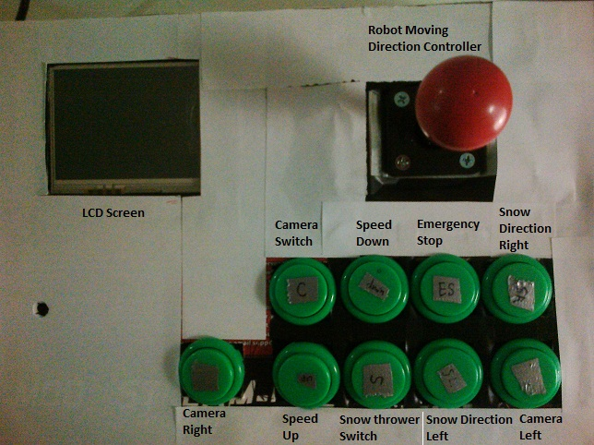
Controller Layout

