Slide 1
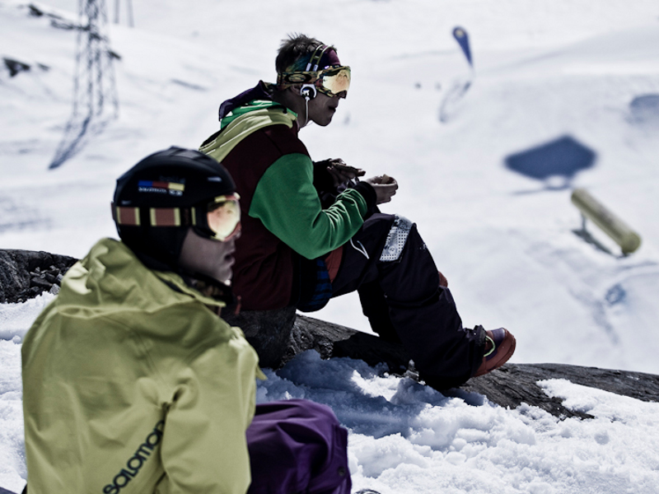

Slide 4
Presents

Slide 5
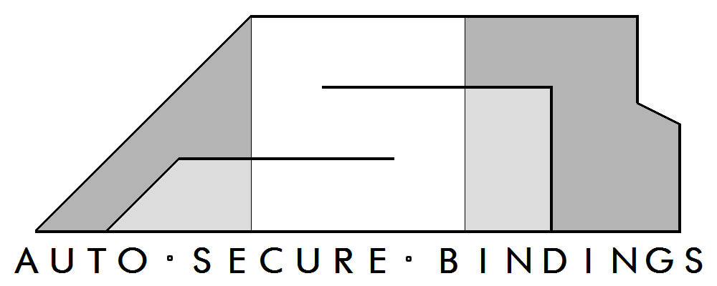

Slide 6
OUR TEAM
CEO Jacky Wong
COO Clara Luo
CFO Jeffrey Sun
CTO Andrew Ng
CMO Jackie Ng

Slide 7
Outline
Product Overview
System Overview
Hardware - Controller Unit
Hardware - Binding Unit
Software
Business Aspect
Complications
Timeline
Future Development
Conclusion
Questions
Acknowledgements

Slide 8
Outline
Product Overview
System Overview
Hardware - Controller Unit
Hardware - Binding Unit
Software
Business Aspect
Complications
Timeline
Future Development
Conclusion
Questions
Acknowledgements

Slide 9
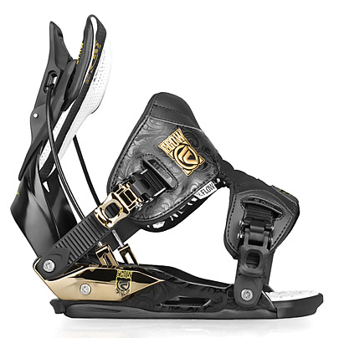
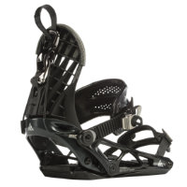
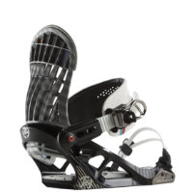
Existing Solutions
Strap Bindings
Step-in Bindings
Flow Bindings
All Require Some Physical Action
Flow Bindings
K2 Cinch
K2 Auto

Slide 10
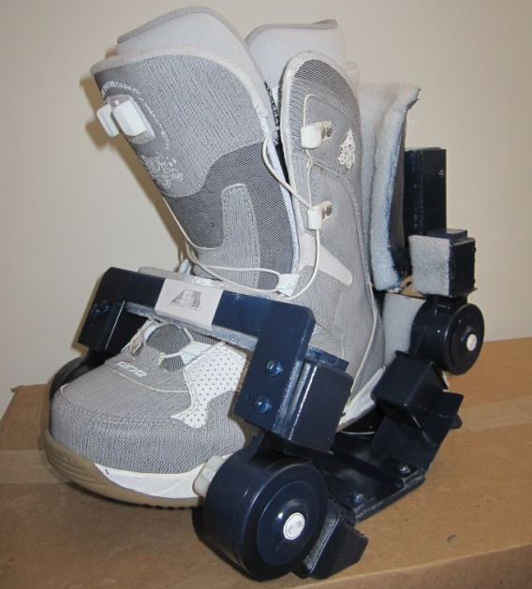
Our Product
Automatic Snowboard Bindings
Binding Unit
Controller Unit
Hands-Free Adjustments
Tighten/Release Bindings Automatically

Slide 11
Benefits
Decreases
Set up time
Physical Energy Spent
Increased Accessibility
Shorten learning curve
Decrease level of difficulty
Least amount of physical motion required

Slide 12
Safety Features
Manual Override
LED Light

Slide 13
Outline
Product Overview
System Overview
Hardware - Controller Unit
Hardware - Binding Unit
Software
Business Aspect
Complications
Timeline
Future Development
Conclusion
Questions
Acknowledgements

Slide 14
System Overview

Slide 15
Outline
Product Overview
System Overview
Hardware - Controller Unit
Hardware - Binding Unit
Software
Business Aspect
Complications
Timeline
Future Development
Conclusion
Questions
Acknowledgements

Slide 16
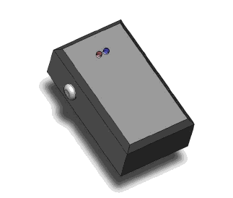
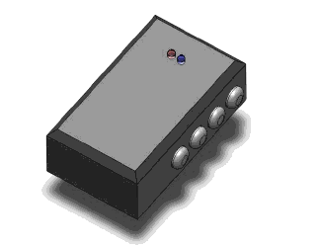
Controller Design Wireless Controller Casing

Slide 17
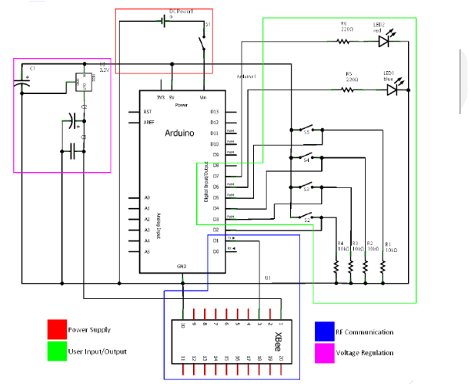
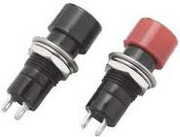
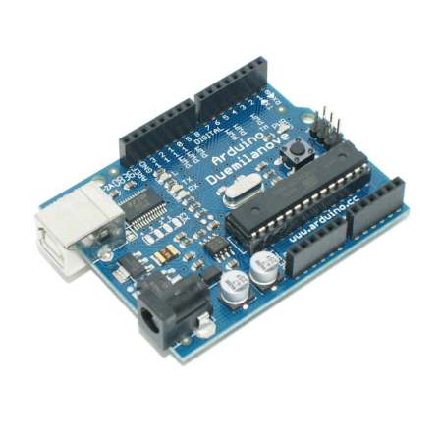
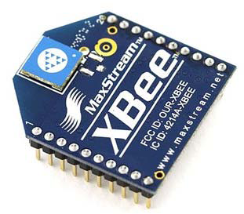
Controller Design Electrical Schematics
Momentary Switches
Xbee Module
Arduino Microcontroller

Slide 18
Outline
Product Overview
System Overview
Hardware - Controller Unit
Hardware - Binding Unit
Software
Business Aspect
Complications
Timeline
Future Development
Conclusion
Questions
Acknowledgements
Notes:
Thanks Jeff, now I am going to explain about the design of our binding unit

Slide 19
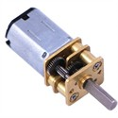
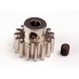
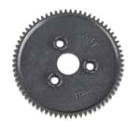
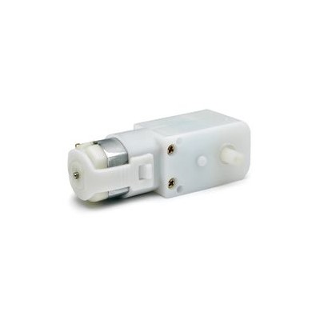
Binding Design Binding Unit Top View
Pinion Gear
Pololu Motor
Spur Gear
Variloc Hinges
Geared Motor 90 Degree Shaft
Notes:
This is a top view of our binding unit.
We used industrial graded plastic hinges as the anchor of the front and back plate of the binding. I will talk about more about the hinges in later slide. The binding plate are mounted onto the hinges as you can see from the actual product.
We used a 90 degree shaft geared motor to drive the front plate. This is because we don’t have too much room to work with in the front area.
We have two micro gear motors mounted on the back side of the binding. Motor 1 is for the hinge release and motor 2 is for the rotation of back hinges.
There is a pinion gear mounted on the motor 2 and it drives the big spur gear which is screwed onto the back hinge. The gear ratio is roughly 5:1 so it has enough torque to move the back plate.

Slide 20
Binding Design Variloc Plastic Hinges
Locking Hinge
450 lb-inch torque
Resolution of 10 degrees
Range of movement 220 degrees
Notes:
It is made out of industrial grade plastic.
It is an adjustable locking hinge which can withstand huge amount of force.
It will lock itself every 10 degree of turning and the range of movement is 220 degree.
To release the hinge, simply press the cap into the hinge

Slide 21
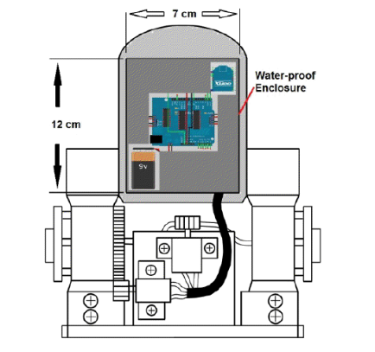
Binding Design Bindings Back View
Xbee Module
Notes:
On the back of backplate is the brain of the binding unit.
The MCU, motor shield, battery and RF transceiver all goes inside this enclosure.

Slide 22
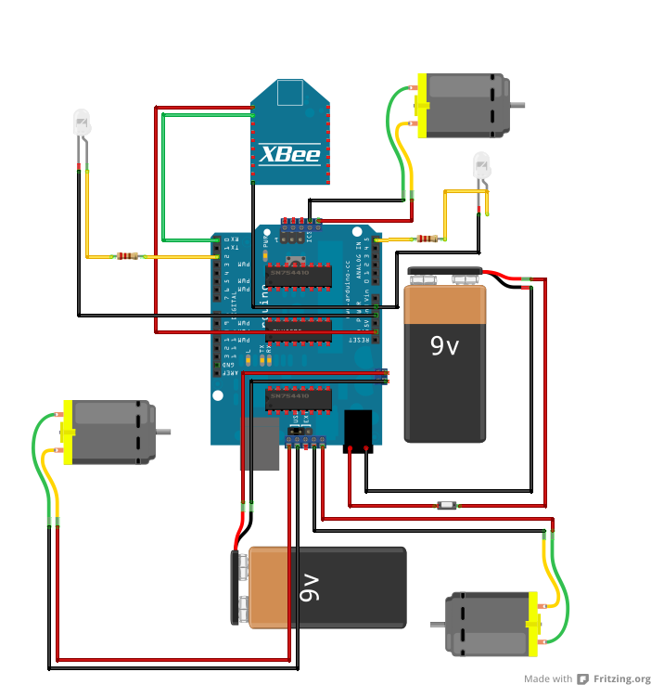
Binding Design Electrical Schematics
Notes:
This is a diagram of our circuitry of the binding unit.
There is a little switch on the graph which is a momentary switch on the binding.
As long as the user steps into the binding, it connects and turns on the circuit.
Here we have a RF receiver receive signals and command from the remote unit.
2 x 9V battery there, one is to power the MCU board and one is for the motor shield which eventually powers the motors

Slide 23
Outline
Product Overview
System Overview
Hardware - Controller Unit
Hardware - Binding Unit
Software
Business Aspect
Complications
Timeline
Future Development
Conclusion
Questions
Acknowledgements

Slide 24
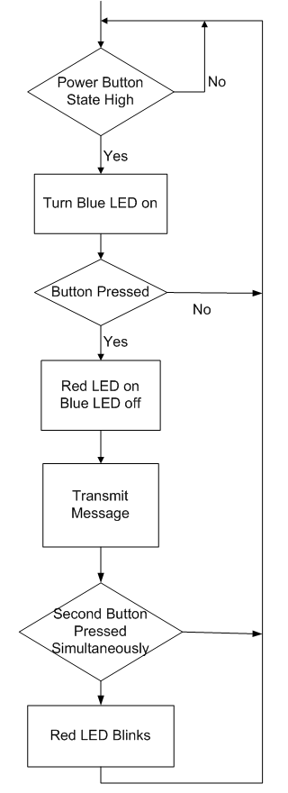
Software Wireless Controller
Activates when power button is Pressed
Four Messages
- Release Left
- Release Right
- Release All
- Tighten All
Encryption Technique
- Code - Binding ID - Command
Can’t enter two commands at once
Notes:
Activates when the power button is pressed
A Blue LED turns on giving the user some response
Depending on what button is pressed a message is sent and a red LED turns on giving the user some feedback
There are four different messages release left release right release all and tighten all
We use an encryption when sending in order to prevent one user commanding another user’s bindings and makes it easier to hack
We place a code for our products and a binding ID in the header It is then followed by the command desired
If you attempt to send two commands at once it won’t work
The red LED will blink telling you that you are performing an illegal action
And now I Clara will talk about the business aspect of our product

Slide 25
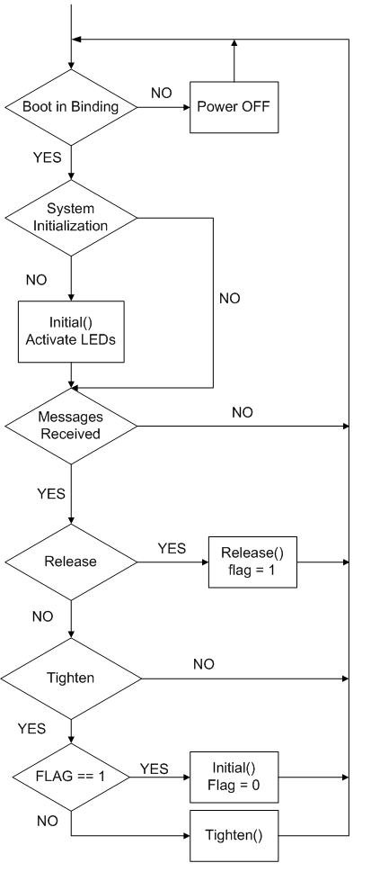
Software Bindings
Activates when boots are in binding
Initial()
- Initial tightening sequence
Release()
- Releases bindings
Tighten()
- Incremental tightening of front brace
Flag
- Determines if the release command was used
Notes:
Activates when boots are in binding
If boots aren’t in binding the power is turned off
During the start up operation the initial functino is ran and the LEDs are activated
After it is run the software checks for messages while the boot is still in the binding
Depending on what message is received a different function is ran
If the release command is sent the release function is ran whereby it releases the boot and sets a flag to 1
If the tighten command is sent it depends on whether or not the flag is set to 1
If the flag is set to 1 the initial function is run meaning the it will close all the way from the open position
Otherwise it will run the tighten function where it tightens the front brace

Slide 26
Outline
Product Overview
System Overview
Hardware - Controller Unit
Hardware - Binding Unit
Software
Business Aspect
Complications
Timeline
Future Development
Conclusion
Questions
Acknowledgements

Slide 27
Prototype Expenditures
 | Unit Cost | # of Units | Subtotal
Steel | $30 | 2 | $60
Rotary Ratchet Hinges | $27 | 4 | $108
Arduino Dueliminova | $25.50 | 3 | $76.50
Adafruit Motor Shield | $20.50 | 2 | $41
Maxstream Xbee Transceiver | $25.87 | 3 | $77.61
Motors | $16.28 | 10 | $162.80
Padding | $10 | 1 | $10
Miscellaneous (Screws, Bolts, etc.) | $5 | 1 | $3
Aesthetics (Paint and Design) | $10 | 1 | $10
Plexiglass | $30 | 1 | $30
Electronics Box | $4 | 1 | $4
Momentary Switches | $2 | 7 | $14
 |  | Total | $596.91

Slide 28
Production Cost Breakdown
 | Unit Cost | # of Units | Subtotal
Aluminum | $7 | 2 | $14
Rotary Ratchet Hinges | $13 | 4 | $42
Arduino Dueliminova | $25.50 | 3 | $76.50
Adafruit Motor Shield | $19.50 | 2 | $39
Maxstream 1mW Xbee Transceiver Module (chip antennae) | $25.87 | 3 | $77.61
Motors | $16.28 | 6 | $97.68
Padding | $10 | 1 | $10
Miscellaneous (Screws, Bolts, etc.) | $3 | 1 | $3
Aesthetics (Paint and Design) | $4 | 1 | $4
Electronics Box | $4 | 1 | $4
Momentary Switches | $0.50 | 7 | $3.50
 |  | Total | $371.29

Slide 29
Sales Strategy
Pricing
MSRP $450
Retailers: $420
Average price per unit: $440

Slide 30
Financial Forecast
Net Income will be zero after 1.5 years
Expected revenue after 5 years: $25,000,000

Slide 31
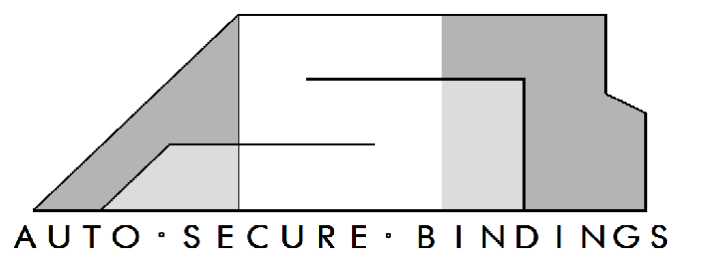
Competitive Advantage
 | ASB | Burton | K2 | Flow | Union | Rome SDS | Gnu
Binding Type | Step | Strap | Strap, Cinch, Auto | Flow | Strap | Strap | Strap
Brand Name Appeal | No | Yes | Yes | Yes/No | Yes/No | Yes/No | No
Target Market | All Recreational Riders | Experienced Riders | New Riders | Young Riders | Free Riders | Free Riders | Free Riders
Strap on Convenience | Yes | No | Yes/No | Yes/No | No | No | No
Sit or Bend-Down Required | No | Yes | Yes | Yes | Yes | Yes | Yes
Specialty Features | Fully Automated, Customizable Designs | Reliability, Quality | Value | Simplicity | Lightweight | Designs | American Made
Price Range | $400-$500 | $150-$500 | $120-$300 | $150-$350 | $180-$350 | $200-$300 | $190-300
Drawbacks | - Price - No brand name appeal | - No added appeal - Price | Lower quality | Design provides less control | - Price - Little value | - Price - Little value | - Price - Little value

Slide 32
Outline
Product Overview
System Overview
Hardware - Controller Unit
Hardware - Binding Unit
Software
Business Aspect
Complications
Timeline
Future Development
Conclusion
Questions
Acknowledgements

Slide 33
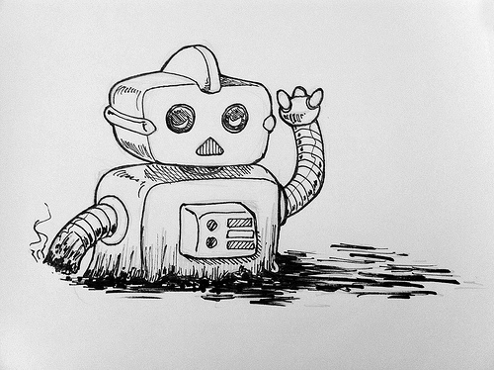
Complications
Hinge Alignment
Gear Alignment
Hinge Issues
Friction too strong
Springs too strong
Motor Issues
Lack of power
Gears stripping
Material Issues
Steel is hard to work with

Slide 34
Outline
Product Overview
System Overview
Hardware - Controller Unit
Hardware - Binding Unit
Software
Business Aspect
Complications
Timeline
Future Development
Conclusion
Questions
Acknowledgements

Slide 35
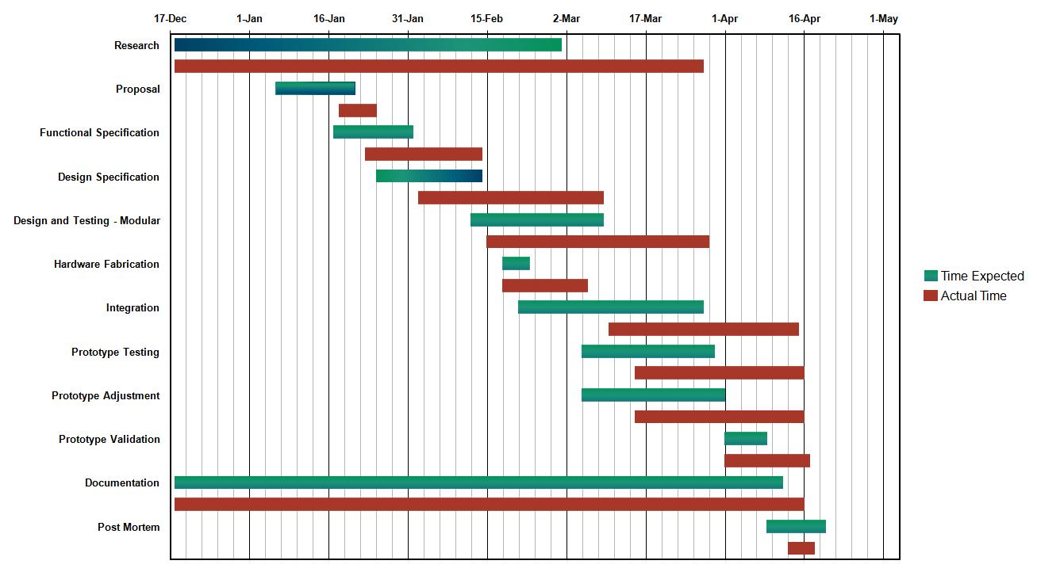
Timeline
Delays in everything after Hardware Fabrication
Lack of resources
Lack of parts

Slide 36
Outline
Product Overview
System Overview
Hardware - Controller Unit
Hardware - Binding Unit
Software
Business Aspect
Timeline
Complications
Future Development
Conclusion
Questions
Acknowledgements

Slide 37
Future Developments
ASB
Create a product series
Improve efficiency
Added functionality
JAC Innovations
Continue making cutting-edge products
Provide support for existing products
Notes:
Our future goals for our product the ASB is to create a series for the product improve its efficiency and add some more functionality
Our company plans on making more cutting edge products which aid the human lifestyle and provide support for our current products
I will now pass the baton to Jackie to conclude the presentation

Slide 38
Outline
Product Overview
System Overview
Hardware - Controller Unit
Hardware - Binding Unit
Software
Business Aspect
Timeline
Complications
Future Development
Conclusion
Questions
Acknowledgements

Slide 39
What We Learned
Technical Skills
Mechanical skills
Design
Fabrication
Programming skills
Applying algorithms in different languages
Electronic skills
Troubleshooting circuitry
Schematic analysis
Non-Technical Skills
Communication
Troubleshooting
Project management

Slide 40
Conclusion
ASB is a fun and easy device to use
Low maintenance
Targeted to snowboard enthusiasts
With more capital and resources the device will be further improved
Completed device will be a desired product

Slide 41
QUESTIONS?

Slide 42
Acknowledgements
Gary Chiang (Undergraduate Student)
Dr. Andrew Rawicz
Mr. Michael Sjoerdsma

