Slide 1
Integrated Climate Evaluator (ICE) Tracker
ENSC 440 Project Demonstration and Presentation
April 23, 2011
© 2011, ArcTech Inc.

Slide 2
Overview
Background
Design
High Level Details
Demonstration
Conclusions
© 2011, ArcTech Inc.

Slide 3
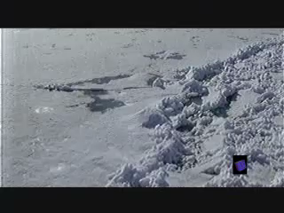
The Problem
Background | Design |  | High Level Details | Demonstration |  | Conclusion
 |  | © 2011, ArcTech Inc.

Slide 4
The Problem
Climate change is a controversial issue; the best way to resolve is usually more information
The Arctic is a sensitive environment: tracking ice floes to monitor ice formation and environmental conditions can tell us more about climate change
Background | Design |  | High Level Details | Demonstration |  | Conclusion
 |  | © 2011, ArcTech Inc.

Slide 5
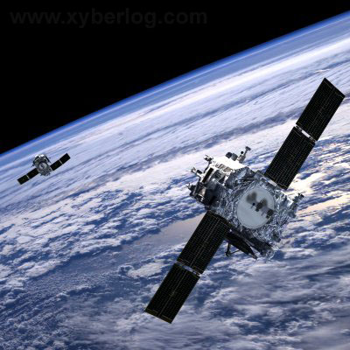
Possible Solutions
Satellite Photographic Analysis
Unreliable: low level lights in winter
Loss of monitoring during storms
Poor update frequency
Background | Design |  | High Level Details | Demonstration |  | Conclusion
 |  | © 2011, ArcTech Inc.

Slide 6
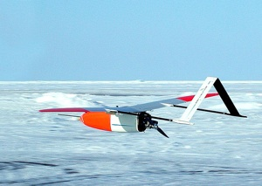
Possible Solutions
Unmanned Aerial Vehicle (UAV) Monitoring
Identifying distinct ice features can be difficult
Cannot measure large areas simultaneously
Requires base station throughout season
(expensive)
Background | Design |  | High Level Details | Demonstration |  | Conclusion
 |  | © 2011, ArcTech Inc.

Slide 7
Possible Solutions
Fixed Monitoring Stations
Can measure secondary data along with position
Groups of pods can measure data simultaneously
Pods need power supplies which can last all winter
Hard to recover pods and new ones must be purchased every year
Background | Design |  | High Level Details | Demonstration |  | Conclusion
 |  | © 2011, ArcTech Inc.

Slide 8
Our Solution
Autonomous unit that determines its GPS location and takes environmental data
Communicates via Iridium satellite modem hourly, every 30 mins etc.
Self powered (approx. 8 months)
Design challenges: reliability in marine environment, temperature range, power consumption

Slide 9
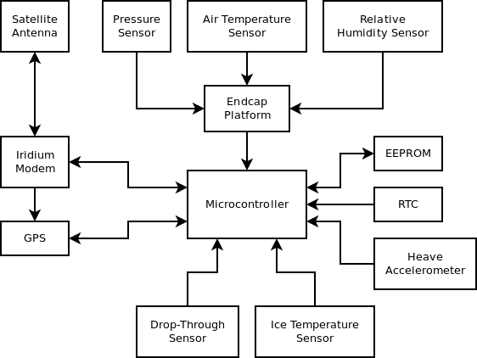
System Overview

Slide 10
General Design Considerations
Sustainability – all components RoHS compliant
Reliability
Functional to -20°C
Avoids damage to -40°C
Internal and external PCB
IP-67 standards
Low power components where possible
Usability – system is assembled and calibrated

Slide 11
Design Areas
Mechanical: Enclosure
Conrad Lichota and Gianmarco Spiga
Electronics: Sensors, Communication, Power Control
Brendan Moran and Lydia Zajiczek
Software: Microcontroller
Andrei Simion

Slide 12
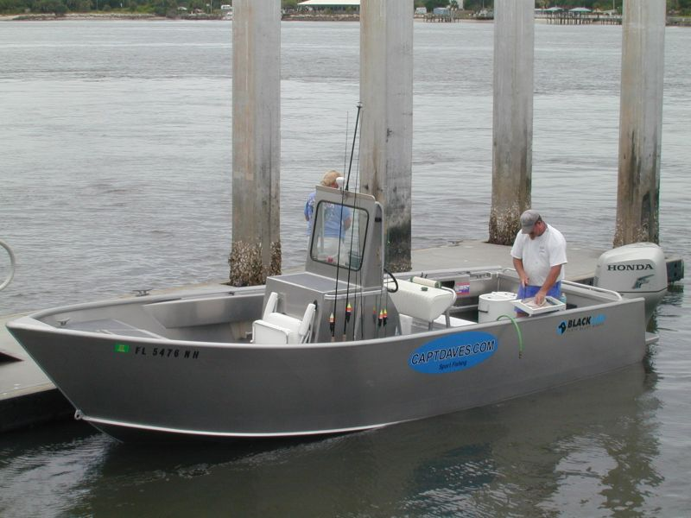
Enclosure
Material: 6061 Aluminum
Lightweight
Corrosion-resistant
Easy to machine
Low cost
Alternative is stainless steel or Delrin
12
Notes:
12

Slide 13
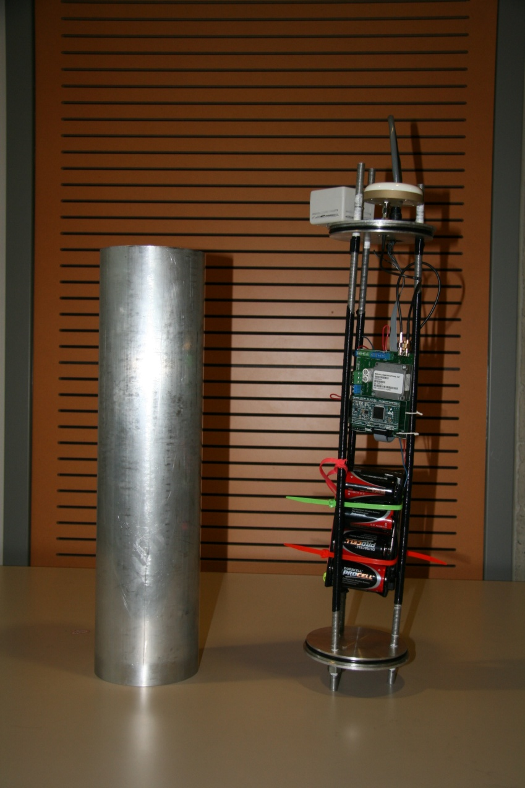
Enclosure
Main Enclosure Design:
Tube and Caps
Advantages
Threaded rods act as support beams
Easy to machine
Radial O-rings protect interior electronics
Disadvantage
Threaded rods: 6 more holes for leaks
13
Notes:
13

Slide 14
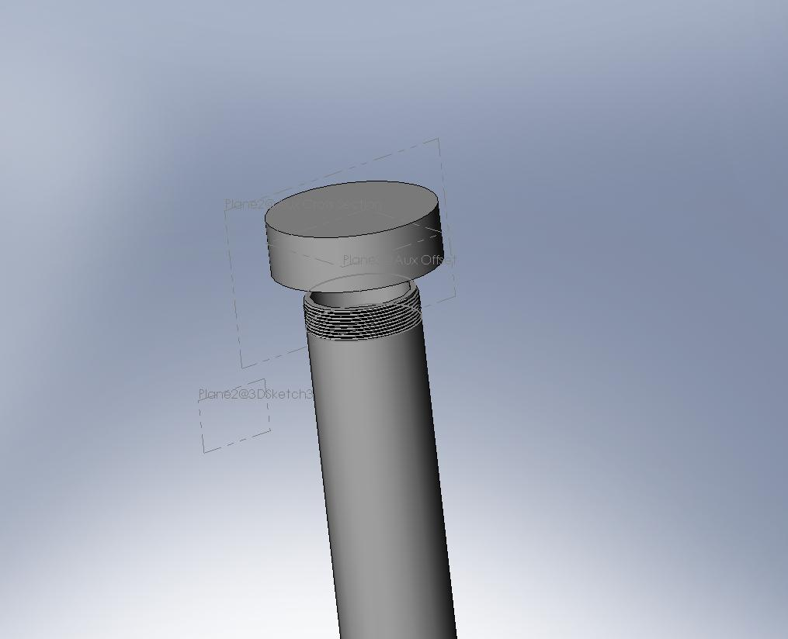
Alternative Solution
14
Notes:
14

Slide 15
Environmental Data
Air temperature/relative humidity
Barometric pressure
Ice temperature/fall through detection
Not implemented for demo:
Heave
Large number of sensors → increased complexity
Solution: microcontroller to interface between them
Background | Design |  | High Level Details | Demonstration |  | Conclusion
 |  | © 2011, ArcTech Inc.

Slide 16
Satellite Communication
Other key requirement: determining its location and communicating it (with other data) to end user
Location: low-cost, low-power GPS receiver
Communication: Iridium modem for satellite communication with end user, set up account and can send message to any email address
Antenna: dual-band antenna with waterproof connector
Background | Design |  | High Level Details | Demonstration |  | Conclusion
 |  | © 2011, ArcTech Inc.

Slide 17
Power Control
Key goal is to maximize battery life
Power to sensors, GPS, Modem is gated
Separate voltage regulators for standby and active modes
Backup capacitor to supply large currents for data bursts

Slide 18
Microcontroller
LPC1769 chosen for development software
Free, open source and royalty free operating system
Each sensor acquires information in parallel tasks
Results are sent to a central task
Sensor information is compiled into a message and sent to an email via the Iridium modem
18
Notes:
18

Slide 19
High Level Project Details
Teamwork – Andrei Simion
Schedule – Brendan Moran
Budget – Conrad Lichota
Lessons learned – Gianmarco Spiga
Current status – Lydia Zajiczek
Background | Design |  | High Level Details | Demonstration |  | Conclusion
 |  | © 2011, ArcTech Inc.

Slide 20
Team Dynamics
Tasks allocated/roles assigned according to strengths:
CEO Brendan Moran
COO Gianmarco Spiga
VP Software Andrei Simion
VP Hardware Conrad Lichota
Corporate Secretary Lydia Zajiczek

Slide 21
Team Collaboration
Weekly progress meetings throughout the semester
Constant communication: lots of emails! (~300)
21
Notes:
21

Slide 22
Schedule
Deviation from proposed schedule: extension!
Sources of delay:
External fabrication
Changes requested by client
Background | Design |  | High Level Details | Demonstration |  | Conclusion
 |  | © 2011, ArcTech Inc.

Slide 23
Budget
Component | Estimated Cost | Production Cost
Enclosure | $500 | $100
Iridium modem | $340 | same
Antenna(s) | $200 | same
Battery pack | $70 | same
Accelerometer | $50 | same
GPS receiver | $45 | same
Temperature/humidity sensor | $40 | same
Pressure sensor | $40 | same
Microcontroller | $20 | $10
Power control circuitry | $20 | same
Total | $1,325 | $915
Background | Design |  | High Level Details | Demonstration |  | Conclusion
 |  | © 2011, ArcTech Inc.
Notes:
Not production values! Includes development board costs

Slide 24
Lessons Learned
Client sponsored project: have to be comfortable with changing specifications
External fabrication: have to plan for
scheduling mishaps
Top-down management: easy to let one
person do more work
Everyone learning the same things vs. finishing a complex project
Background | Design |  | High Level Details | Demonstration |  | Conclusion
 |  | © 2011, ArcTech Inc.

Slide 25
Current Status
Have working prototype, have not satisfied all requirements but will produce second prototype that includes
Heave calculation
Fall through detection
Flotation collar
Background | Design |  | High Level Details | Demonstration |  | Conclusion
 |  | © 2011, ArcTech Inc.

Slide 26
Demonstration
Tests:
Real-time communication
Sensor tests have been performed
Submersion test has been performed
Background | Design |  | High Level Details | Demonstration |  | Conclusion
 |  | © 2011, ArcTech Inc.

Slide 27
Sources of Information/Acknowledgements
Client Pavel Haintz for design requirements, suggestions on materials, electronics
Dr. Andrew Rawicz for information regarding reliability in a marine environment
Delyane Pleskore for guidance on power control
Matthew Asplin for information on end-user requirements
Background | Design |  | High Level Details | Demonstration |  | Conclusion
 |  | © 2011, ArcTech Inc.

Slide 28
Conclusion
Met critical design criteria: autonomous, determines location, takes data, communicates it
Project sounded simple but actually had a high degree of complexity and subtlety
Completing a complex project successfully vs. everyone learning
Next step: improve and expand current design for possible sale to end user
Background | Design |  | High Level Details | Demonstration |  | Conclusion
 |  | © 2011, ArcTech Inc.

Slide 29
Questions?
Background | Design |  | High Level Details | Demonstration |  | Conclusion
 |  | © 2011, ArcTech Inc.

Slide 30
References
Video reference
http://www.youtube.com/watch?v=W0F-RmOswOs
Image references
http://www.cleveland.com/nation/index.ssf/2010/01/spy_satellites_are_now_being_u.html
http://www.xyberlog.com/2008/07/01/we-will-buy-satellites-for-spying-our-enemies-pentagon/
http://earthsky.org/biodiversity/betsy-weatherhead-monitors-arctic-wildlife-with-unmanned-aircraft
http://www.keytometals.com/Article99.htm
Hands photo credit: Steven Bridge
Background | Design |  | High Level Details | Demonstration |  | Conclusion
 |  | © 2011, ArcTech Inc.

Slide 31
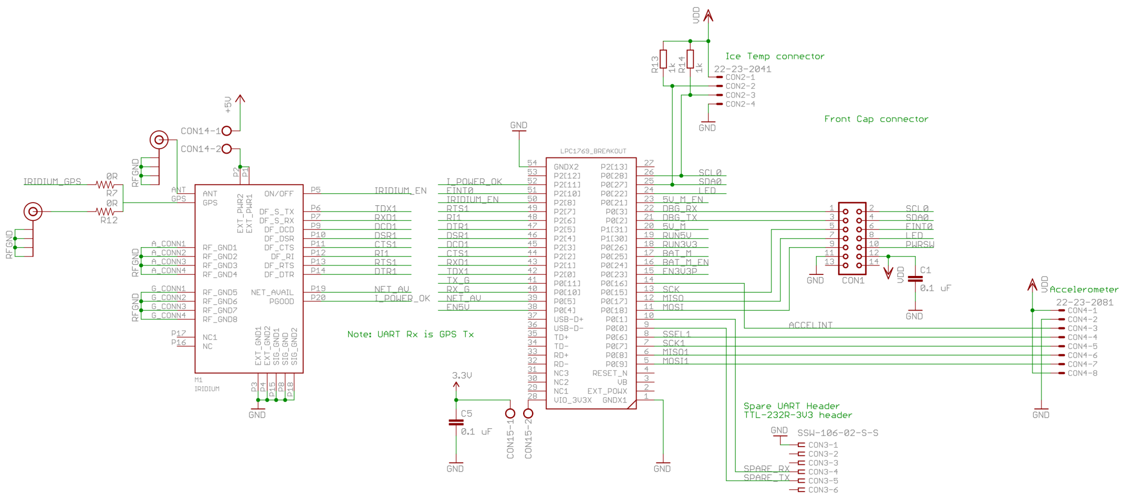
Internal Schematic – 1
Background | Design |  | High Level Details | Demonstration |  | Conclusion
 |  | © 2011, ArcTech Inc.

Slide 32
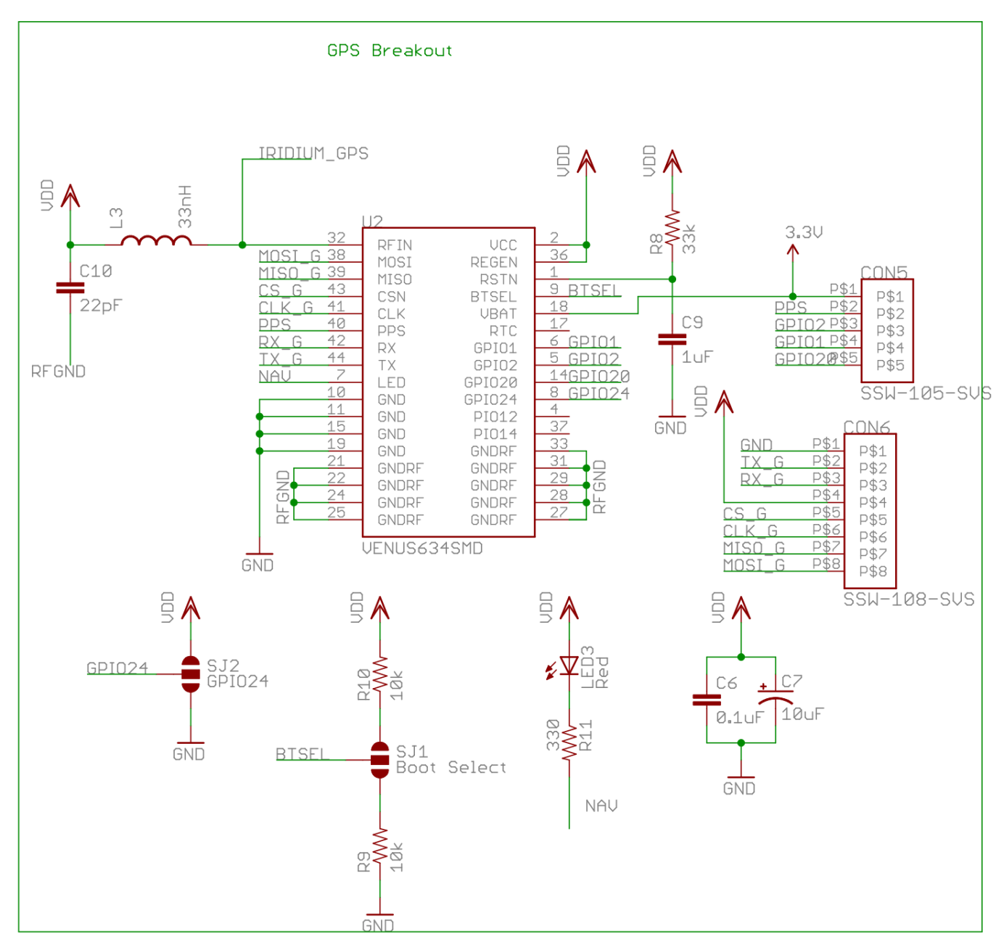
Internal Schematic – 2
Background | Design |  | High Level Details | Demonstration |  | Conclusion
 |  | © 2011, ArcTech Inc.

Slide 33
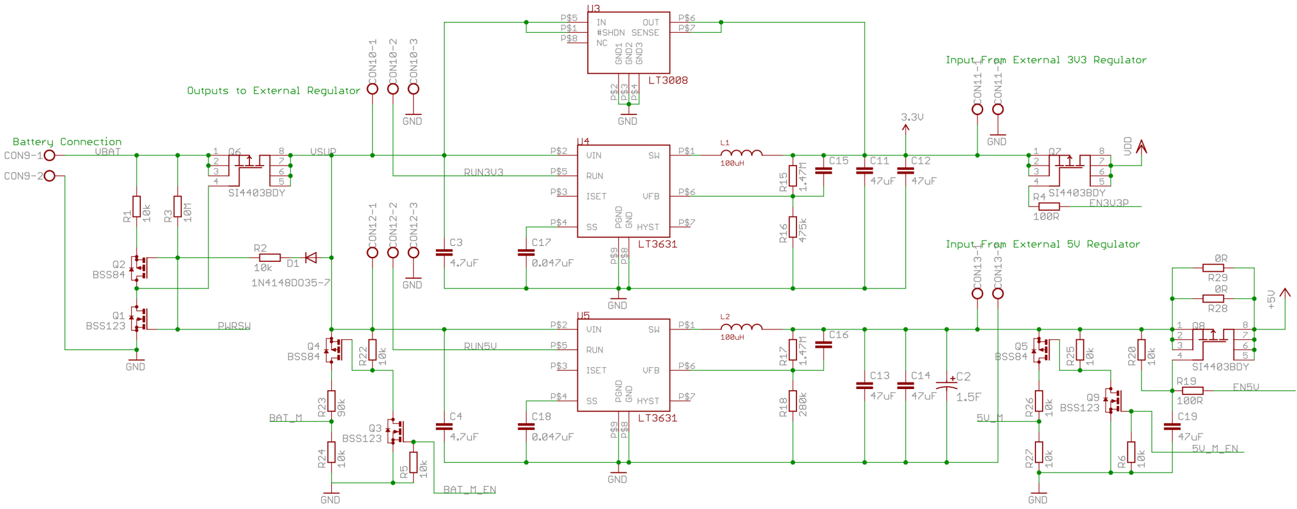
Internal Schematic – 3
Background | Design |  | High Level Details | Demonstration |  | Conclusion
 |  | © 2011, ArcTech Inc.

Slide 34
External Schematic
Background | Design |  | High Level Details | Demonstration |  | Conclusion
 |  | © 2011, ArcTech Inc.

Slide 35
Possible Reliability Problems
Single point of failure: real-time clock (RTC) of microcontroller
End cap may be susceptible to water ingress (add isolation)
We cannot test lifetime in our timeframe
Background | Design |  | High Level Details | Demonstration |  | Conclusion
 |  | © 2011, ArcTech Inc.

