Slide 1

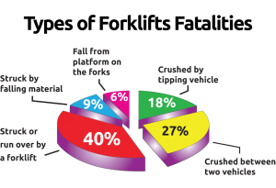
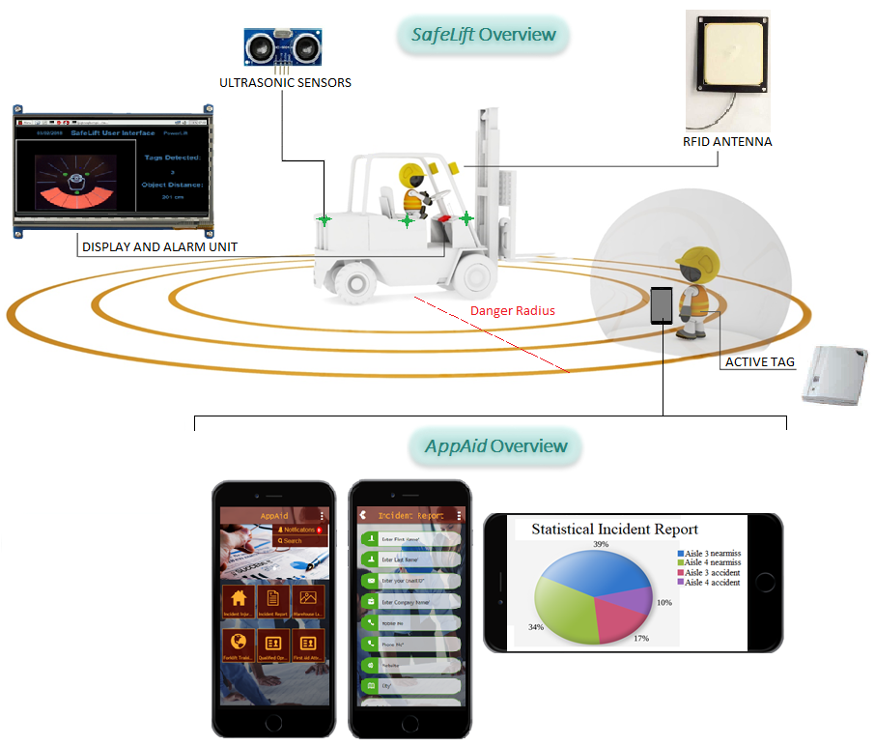


SafeLift and AppAid
Introduction
There are about 0.9 M forklifts in US of which 11% are involved in accidents
70% of these can be avoided by proper training and policy
By: Daniya Zafar | Fred Mose | Layomi Dele – Dare | Wenhao Zhang
What is SafeLift?
Future Work
System designed to reduce the risk of collision between pedestrians and moving vehicles in your workplace
Active RFID tags
Auto generate hit report
Conclusion
PowerLift ensures employee safety by providing affordable solution
SafeLift and AppAid come in an easy-to-install kit
With PowerLift, you don’t have to be a statistic!
What is AppAid?
An app designed to compliment SafeLift by providing training and managing incident locations
Reference
"Home | Occupational Safety and Health Administration", Osha.gov, 2018. [Online]. Available: https://www.osha.gov/. [Accessed: 09 – Apr – 2018].
Monday, April 9, 2018
Fred Mose – fmose@sfu.ca

