Slide 1
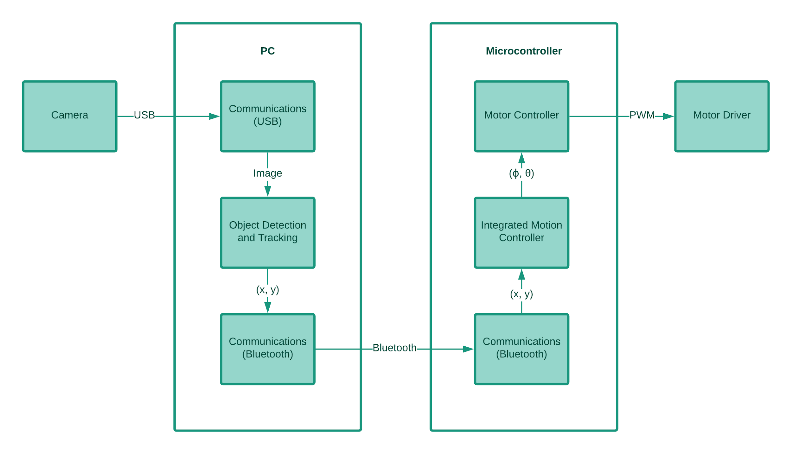
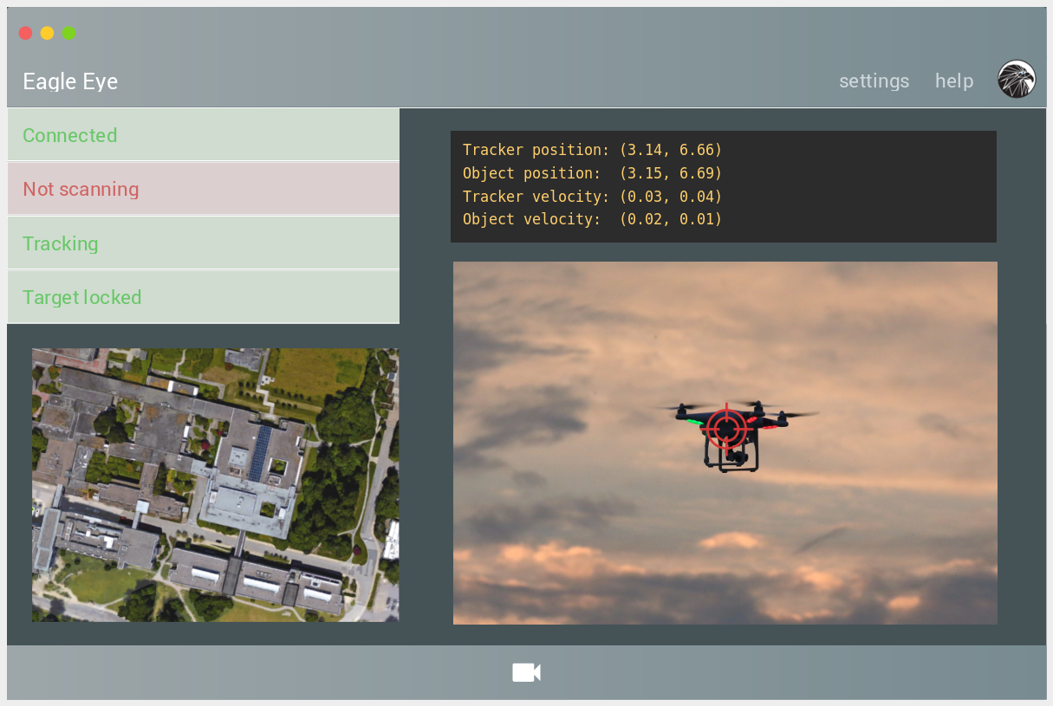
Eagle Eye Tracker
Autonomous object-tracking system
Arman Athwal - CCO
Bud Yarrow - CEO
Martin Leung - COO
Mateen Ulhaq - CTO
Naim Tejani - CFO
Victor Yun - CIO
Introduction
System Overview
Future Work
Conclusion
Behold, the Eagle Eye TrackerTM. We have developed a versatile device that is capable of performing a plethora of tasks, from aerial defense to pest control. This is achieved through a simple, yet ever-evolving technology – object tracking.
Its design involves two key factors: modularity and deep learning. Modularity means the Tracker can be upgraded and modified through modular attachments without buying a new system. Meanwhile, our deep learning algorithm (to be implemented in the full prototype) identifies objects and makes decisions completely autonomously.
Uses feature identification to pick an object
Object is tracked through time and space
Tracking algorithm based on optical flow, which estimates the motion of the object
Prototype will feature deep learning object identification
DNN database of recognizable objects can be updated without any hardware update
To be installed in region with clear field of view
Additional components can be added on easily thanks to modular design
Preparation already underway to create prototype
Construct advanced rotating stage to hold camera
Implement motor control system, including related electronics and software
Integration of deep-learning for object recognition.
Improve tracking algorithm to enable feedback control and prediction
Implement graphical user interface for monitoring the Tracker’s status
Our proof of concept device can follow a moving point over its field of view, using an optical flow algorithm. The PoC is built from a LEGO Mindstorms kit, and represents the initial realization of the project. Feel free to walk across its operating range and observe its tracking capabilities. We hope you enjoy our demo!
References
YOLO: Real-Time Object Detection [Online] https://pjreddie.com/darknet/yolo/ [Accessed 7 Apr 2018]
CONTACT
Arman Athwal
Chief Communications Officer
aathwal@sfu.ca

