Slide 1
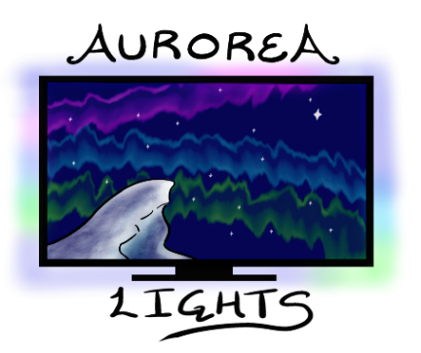
Aurorea Lights
A Bias Lighting Kit for everyone
“Aurorea Lights!
Dazzling Sights!”
Team:
Ian Carlsen
Justine Kwan
Daiki Miyanabe
Ryan Kiew
Notes:
Grey world, black, dimming lights may be a bad idea, look at medium will create gaps in big screens compared to small screen one led per connector, using a lot of connectors – why not just a strip of leds? Variable sizes of LED connector? More beneficial to learn human vision – one thing is for sure – we are very good in seeing contrast – we should have things to compare with. Perception of colors can be additive or subtractive – illummincation is affecting color perception – Why are the LED modules so big? Plan to reduce the size Competitive advantage – able to adjust size? If you research more about color, u will find some niche points that we can use as a competitive advantage. Adjustable size is not a competitive advantage. Philips is a big company and they can do adjustable size if they want to. How many people need the desktop monitor bias lighting product? This is not a good competitive advantage. Can find something in the technology that can be a good competitive advantage – research color, how others are implementing, come up with a better algorithm, adjust color better? Consider it. Try to tell to people that u’re offering something new. About 14 mins of presentation – always good to be concise – use all your time, plan all your time. It’s not always good to wrap up very quickly. It’s not that complex, so these guys don’t have much to present. Highlight important points. Don’t let others jump in. Take care of 20 mins and be ready for the answers. Where is Ian? Be prepared on your presentation day. Can you install the system to the back of the monitor right now? Nope. How many attachment points? How to attach to the back of the monitor? Imagine two points of attachment. Will see clamp in front of TV – does not look good. Consider something else – double-sided tape? Shouldn’t ruin the appearance of the TV. Should be able to come up with a mechanic to hide behind the monitor. Modular design – this is important competitive advantage – maneuvre around this and using this as a competitive advantage. 4 connection points might work better than 2. maybe fine for the first day or two, but long term could be bad. 3 to 4 contact points. There is torque. SPI or I2C? Each module has a counter? Look at the library? Wouldve been nice to see PoC on a display – why so thick? What thickness can u support? Isn’t too thick that it becomes too close to the wall. Gripping mechanism? Maximum force? How heavy are the modules? What kind of weight it can support? Mechanical interference on the back of the monitor. Still don’t know what we’re going to show at the end of 440

Slide 2
Outline
Introduction & Background
Product Overview
Technical Overview
Live Demo
Test Plans
Business Case
Plan for ENSC 440
Team Reflection

Slide 3
Introduction
Background
Product Overview
3

Slide 4
Background
Bias lighting is lighting placed behind a screen to provide ambient light around the display
Why do we use bias lighting?​
Reduce eye strain​ ^{[1]}
Increases the visual spectacle when watching movies​
Typical bias lighting options today are made to fit a specific monitor size, and many don’t have the capability of matching what’s displayed
Notes:
So before we get into the details, we’d like to first introduce some background and motivation as to why we decided to pursue this product.
Bias lighting is any lighting placed behind a screen that provides ambient light around the display. Here we have a video showcasing the Philips Ambilight bias lighting product, just to give a better picture of what it is. We primarily use it to reduce eye strain caused by sudden changes in luminosity emitted from the screen. We also use it to increase the visual spectacle when say, we’re watching a movie or playing a game, improving the visual experience for the user.
However, a recent study has shown that only 23% of people prefers watching movies on their TV. Around 46% actually prefers laptops and desktops as their primary entertainment device.
Typical bias lighting options today are made to fit a very specific monitor size, and many don’t have the capability of matching what’s being displayed on screen. Thus, many people disregard the possibility of ever experiencing bias lighting for their devices.

Slide 5
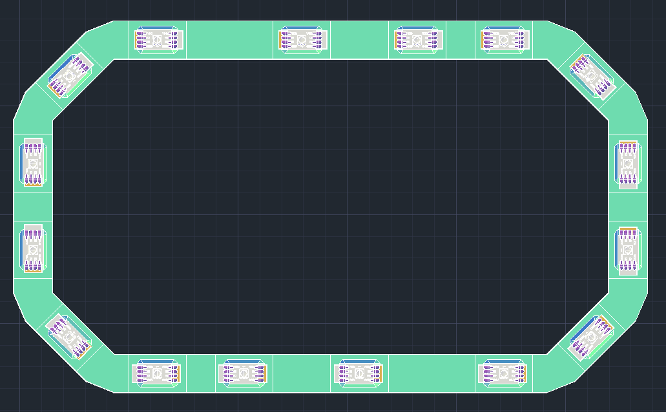
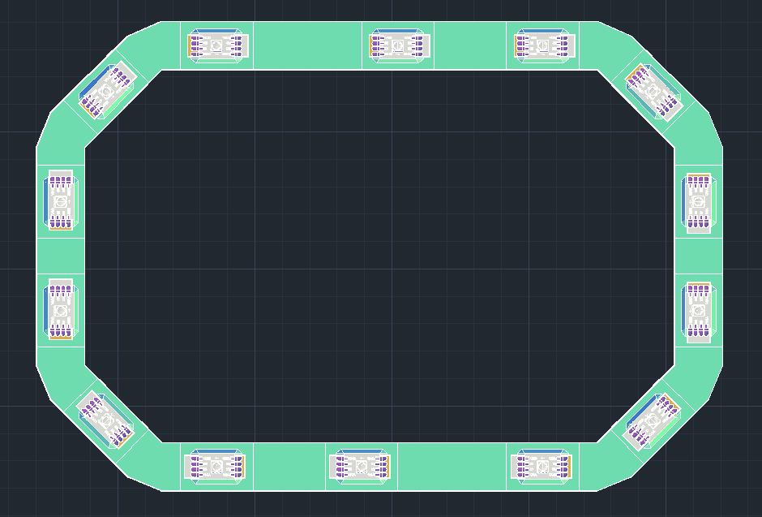
Product Overview
Aurorea Lights – a bias lighting kit fit for any screen
Consists of:
Main black box processing unit
Various modules that can be mixed and matched to fit most screens
A web server UI that allows users to control settings
Designed to be easy to set up and versatile
Example Structures
Notes:
Introducing Aurorea Lights, a bias lighting kit fit for any screen. It is a module based bias lighting kit, consisting of the main black box processing unit, the various modules that can be mixed and matched to fit most screens, and a web server that allows the user to control the settings of the device. We are designing Aurorea lights to be easy to set up and as versatile as possible. We can see on the right our plan on how the modules can fit together, by mixing and matching the modules we can account for a16:9 screen, or a 3:4 screen.

Slide 6
Product Details
Modules
Web Server
Video Processing
6

Slide 7
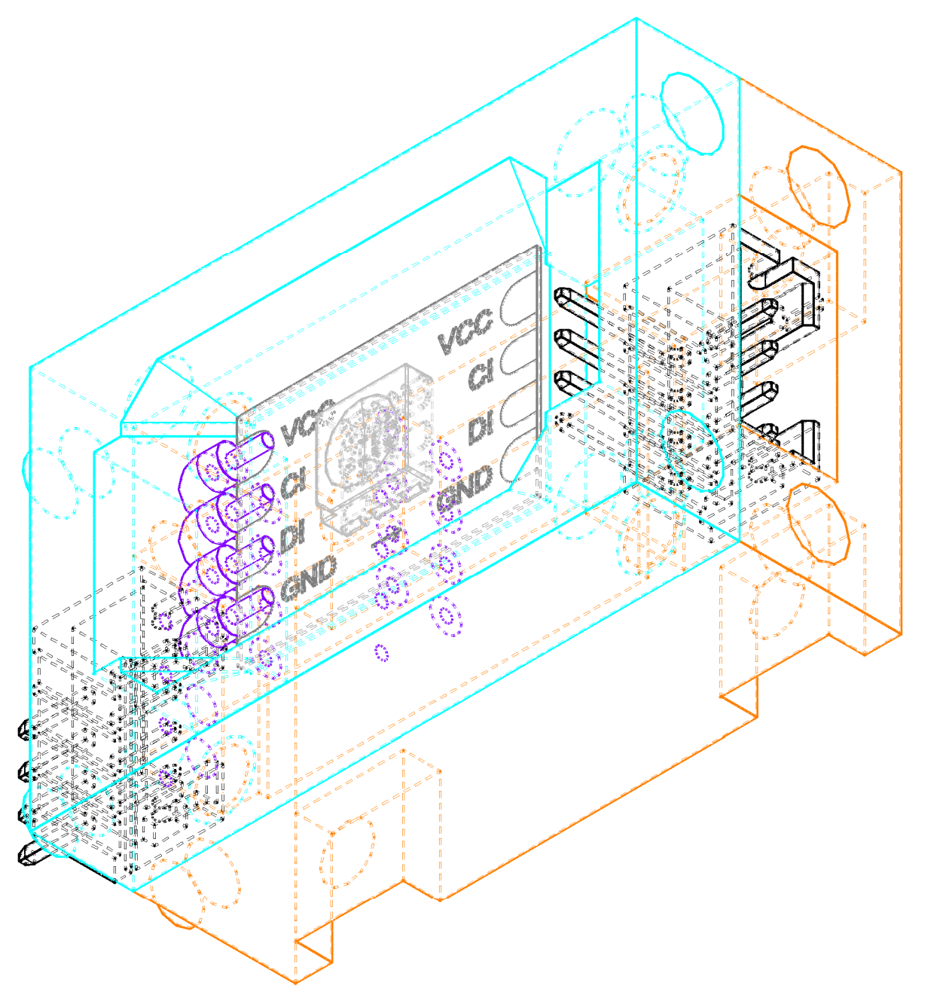
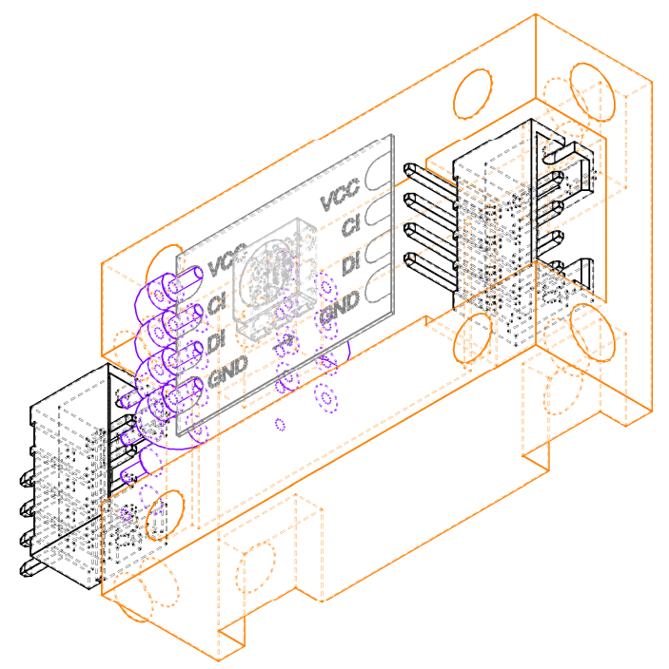
LED Module
Components:
Top Module
Bottom Module
Screws (x4)
Heat-set Threads (x4)
Connectors (M/F)
LED (on PCB)

Slide 8
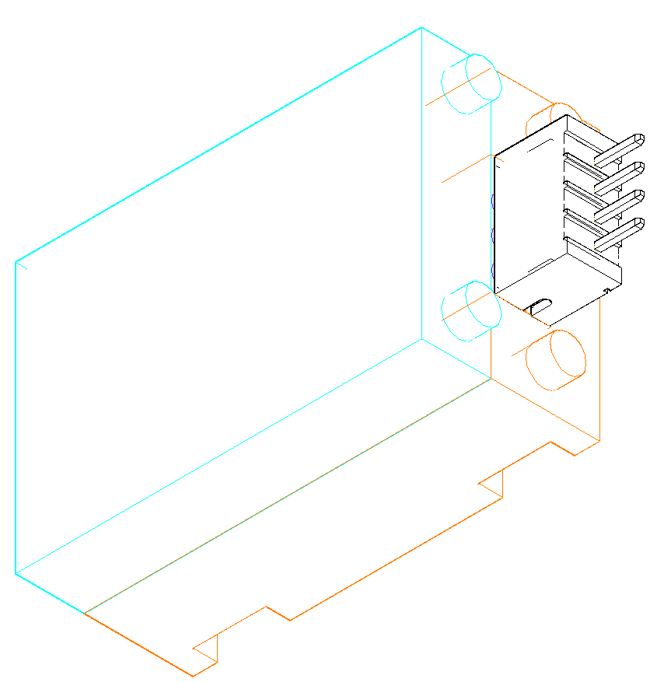
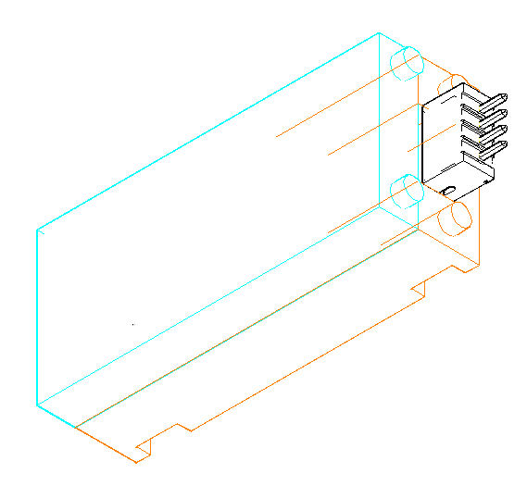
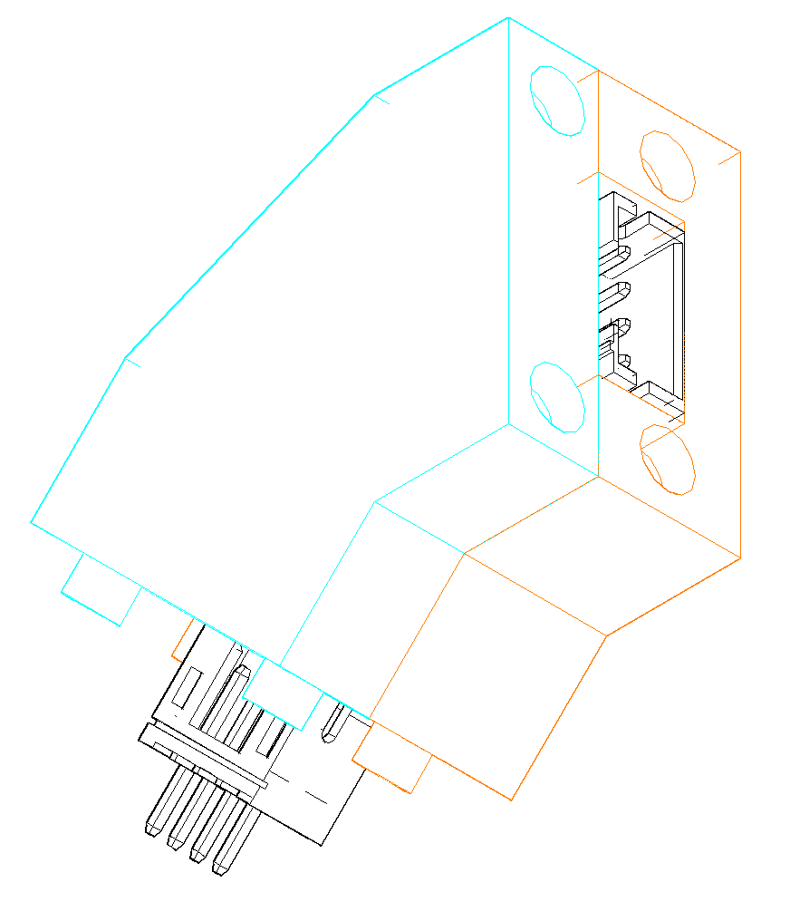
Connector Modules

Slide 9
Attachment Mechanism
Installation
Notes:
I might show attachment live

Slide 10
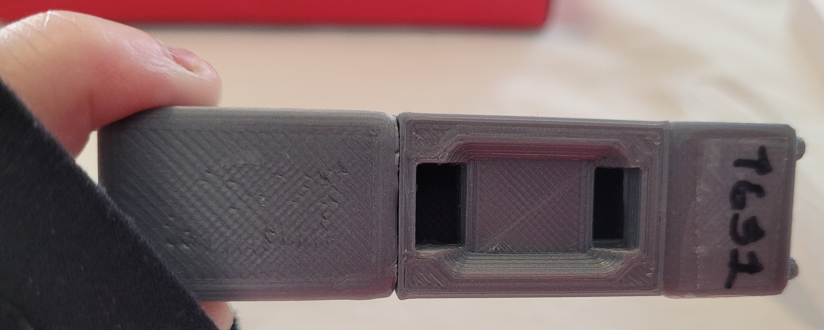
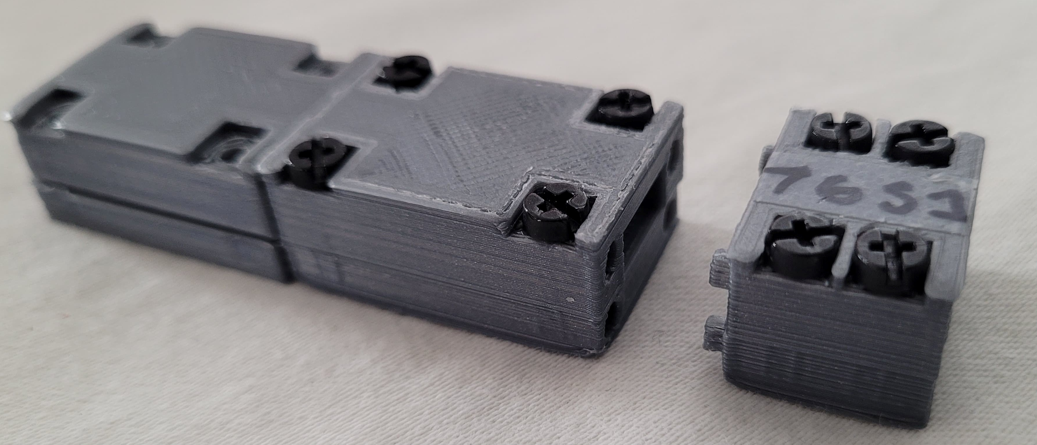
Connecting Between Modules
Side-by-Side Connection
Lego-Inspired Snap Fit
(Temporary Implementation)

Slide 11
Web User Interface
Wifi / Ethernet
Intermediate File
Frontend
Webserver
Backend
HTTP Request
Request
Response Json
Response
Error Message
React
Node.js
Video Processing
Program
Notes:
Web interface component of the product has to parts: Frontend and webserver
Frontend component runs on user’s computer or smartphone and it is designed React and it sends requests such as requests to change the brightness of the lights to the webserver,
Webserver software runs on the Raspberry Pi and it uses Node.js to process the requests received from the frontend and passes it to the backend video processing program

Slide 12
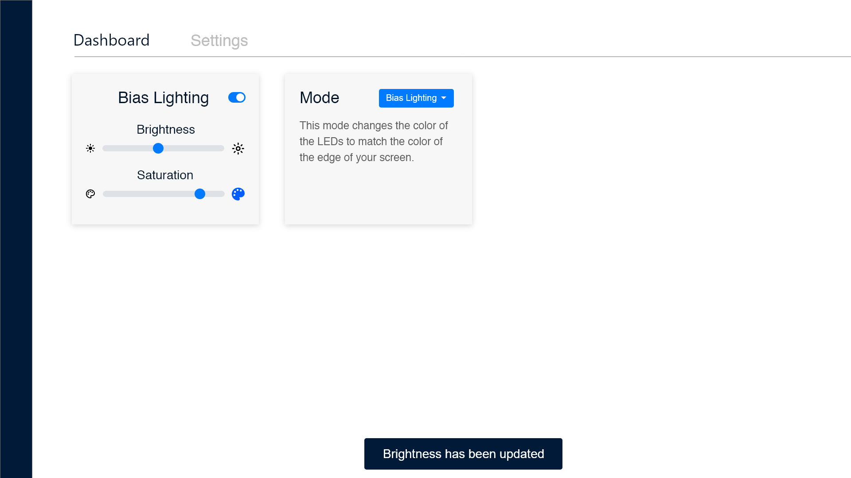
Web User Interface Designs
Proof of Concept Design
Mock-up Design
Notes:
Here’s a mockup UI design on the left and our design for the proof of concept on the right
We have basic functionalities in the current Proof of concept version and planning of improving the design in the future
Currently, the User interface has ability to switch the lights on/off and adjust the brightness, also entering setup configuration.
Also the UI notifies when user changes setting by popping a toast on the top right corner.

Slide 13
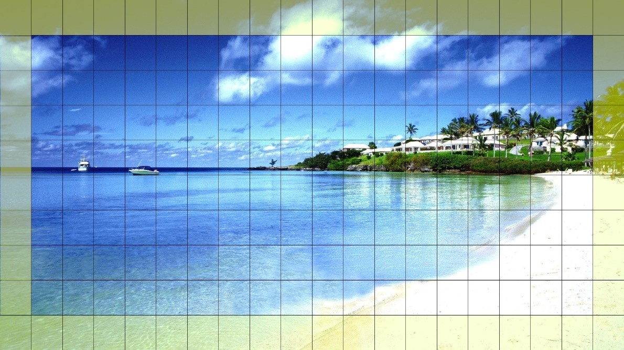
Video Processing
Video is processed in a frame-by-frame basis
Video frame is divided according to the user’s module setup
LED color is determined from average color of its corresponding area
Notes:
So the video processing portion of the device is relatively simple. The HDMI video signal is fed into the Raspberry Pi and processed in a frame-by-frame basis. The video frame is divided according to the user’s module setup, and the LED color is determined from the average color of its corresponding area. And as you can see from the figure on the right,

Slide 14
Live Demonstration
14

Slide 15
Test Plans
15

Slide 16
Test Passed
Section | Test Name: | Pass/Fail
Module | Module Fitting
 | Module Alignment
 | Check securing methods
 | Safety of Modules (Wiring)
 | Clip-On Attachment | Pending
Power | Power On
 | Check connectivity between LED Modules
Back-End Software | Video Input Detection
 | LED colors are changing
 | LED colors match video input
 | Number of LEDs match
User Interface | Accessing the user interface from web browser
 | Turning On/Off LEDs
 | Adjust brightness of LEDs

Slide 17
Business Case
Market
Costs
Competition
17
Notes:
We will talk about business case, Market, costs and conpetition

Slide 18
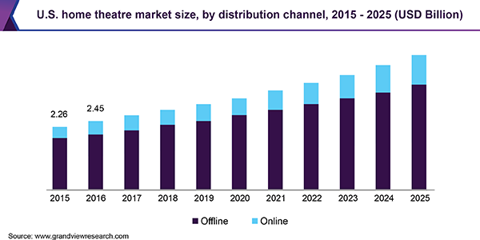
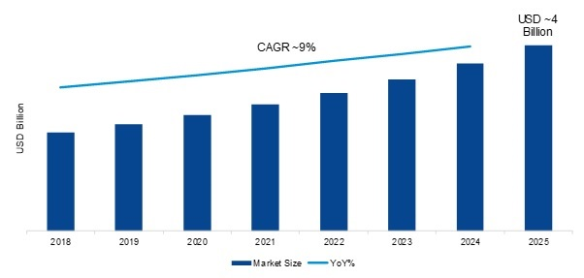
Target Customers
Desktop computer users
Gaming users
TV users
Home theater
AnalysisGlobal Gaming Accessories Market, USD Billion
Source: grandviewresearch.com [4]
Source: MRFR Analysis[3]
Notes:
Aurorea Lights is primarily aimed towards two types of customers: desktop computer users – especially gaming users who buys gaming accessories – and users looking to enhance their home theater.
There is a recent gaming trends of illuminating gaming accessories such as mice, keyboards with colourful lights.
Because of this trends and the ability to fit to desktop monitors of any size, Aurorea Lights is expected to fit nicely in the market for gaming accessories.
The global gaming accessories market size was valued 2.14 billion USD dollars in 2018 and expected to reach 4.04 billion by 2025
The global home theatre market size was valued at 7.7 billion US dollars in 2018.

Slide 19
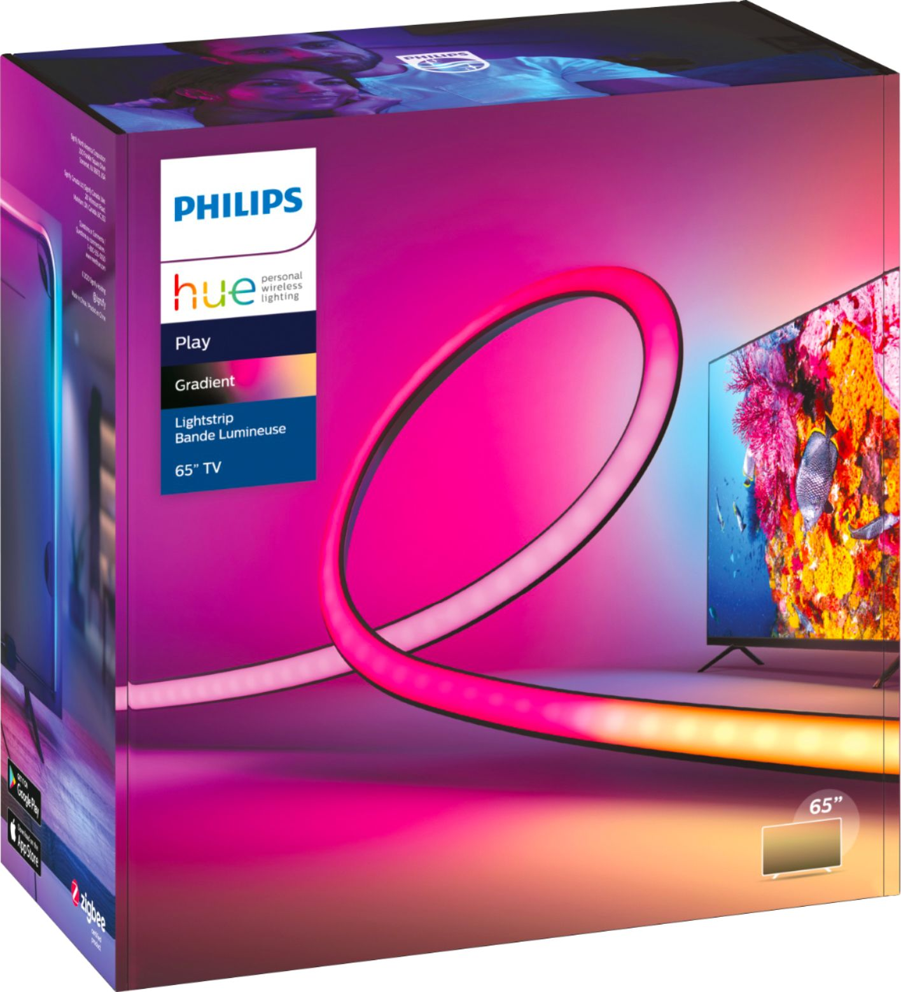
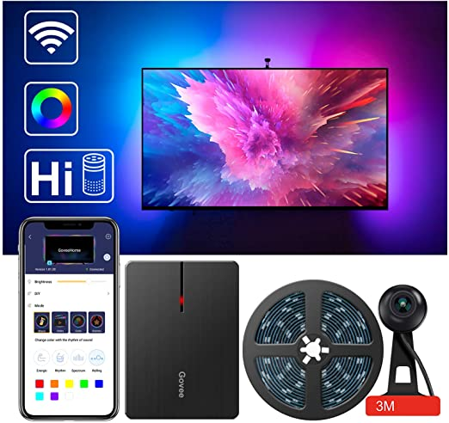
Competitors
Philips Play Gradient Lightstrip + Philips Hue Sync (CAD$599.97)
High-end bias lighting set
Non-adjustable LED strip
Only supports TV with 55” or larger (55”, 65”, 75”)
LED TV Backlights, Govee WiFi TV Backlights Kit with Camera (CAD$159.99)
Low-end bias lighting kit
Non-adjustable LED strip
Video feed from camera
Notes:
We have two main competitors currently in the market: one is Philips play Gradient with Philips Hue sync
Philips Play gradient is a highend bias lighting set which cost around $599 Canadian with non-adjustable LED strip and only supports 3 set sizes 55”, 65”, and 75” TVs and does not support desktop monitors
Another competitor is TV backlight kit from Govee, which is lowend bias lighting kit with also non-adjustable LED strip and video feed is fed from a camera that is attached on top of the TV
The main advantage of our product over these competitors are, adjustable LED strips which can support screen of any size, from desktop to TV

Slide 20
Cost Analysis (16:9 Implementation)
Product Description | Ext. Price $CDN +12% tax | Qty.
Adafruit DotStar Digital LED Strip - White 60 LED - Per Meter 1m - WHITE | $ 169.06 | 32
Raspberry Pi 4 Model B - 2 GB RAM | $ 49.39 | 1
Official Raspberry Pi Power Supply 5.1V 3A with USB C - 1.5 meter long | $ 11.22 | 1
HDMI Input to USB 2.0 Video Capture Adapter | $ 28.15 | 1
Brass Heat-Set Inserts for Plastic - 50 pack: (M3 x 3mm) + 50 pack: (M3 x 4mm) | $ 5.95 | 128
Black Nylon Screw and Stand-off Set – M3 Thread | $ 23.92 | 128
Connectors | $ 2.00 | 32
LED Printed Module | $ 0.28 | 16
Spacer Module Sml | $ 0.17 | 4
Spacer Module Med | $ 0.31 | 2
Spacer Module Lrg | $ 0.47 | 2
Corner Module | $ 0.23 | 8
Attachment Module | $ 0.26 | 2
Total | $291.41
Notes:
This is the bulk cost of all the products we bought and the quantity is for implementing 16*9 size.

Slide 21
Plans for ENSC 440
Hardware & Module Design
Web Server
Video Processing
21

Slide 22
Module Design
Hardware
Reduce/Optimize plastic usage
Snap-fit implementation
Compression Connectors
Light Diffusion
Wiring a power supply
Casing for all the components

Slide 23
User Interface
Support color saturation adjustment from the UI
Implement user friendly UI to enter light configuration
Improve the UI design
Support changing lighting mode
Notes:
For user interface, we are planning of improving to support color saturation adjustment from the UI,
Implementing user friendly UI to enter light configuration,
Also support changing lighting mode between the bias lighting mode that we currently have and the uniform mode.

Slide 24
Video Processing
Take into account spacer modules when determining processing area
Implement different starting positions of LEDs
Implement uniform lighting mode
Implement ability to change color saturation
Detect and adapt to black borders
Automatically determine LED config

Slide 25
Team & Self Reflection
25

Slide 26
Team
Team | Task
Ian | Hardware/Electrical Designer
Justine | Module Designer
Ryan | Back-End Software
Daiki | Front-End Software

Slide 27
Self Reflection – The learning process
Iterative process in product
Meeting Organization
Team Management
Product Organization
Clear concise documentation
Planning

Slide 28
Acknowledgements
Dr. Craig Scratchley
Dr. Shervin Jannesar
Dr. Andrew Rawicz
Michael Hegedus
Chris Hynes
Notes:
So before we go into the Questions, we would like to extend our gratitude to the professors and Tas for helping us work through this product design process. Thank you very much for your time and effort.

Slide 29
Questions

Slide 30
References
[1] "What Bias Lighting Is and Why You Should Be Using It," 13 11 2017. [Online]. Available: https://www.howtogeek.com/213464/how-to-decrease-eye-fatigue-while-watching-tv-and-gaming-with-bias-lighting/. [Accessed 18 03 2021].
[2] "Just 23% of people now prefer watching TV shows on televisions," [Online]. Available: https://www.techspot.com/news/69060-23-people-now-prefer-watching-tv-shows-televisions.html. [Accessed 5 04 2021].
[3] "Home Theatre Market Size, Share & Trends Analysis Report By Product," [Online]. Available: https://www.grandviewresearch.com/industry-analysis/home-theatre-market#:~:text=Industry%20Insights,the%20market%20for%20home%20theatre..
[4] "Global Gaming Accessories Market Research," [Online]. Available: https://www.marketresearchfuture.com/reports/gaming-accessories-market-8609?fbclid=IwAR3OTZxFqWyLwaqfePNUZROqTMrQLQjUXbTzXXItgSLp8-YS0ftmKsp3zqw.

