Slide 1
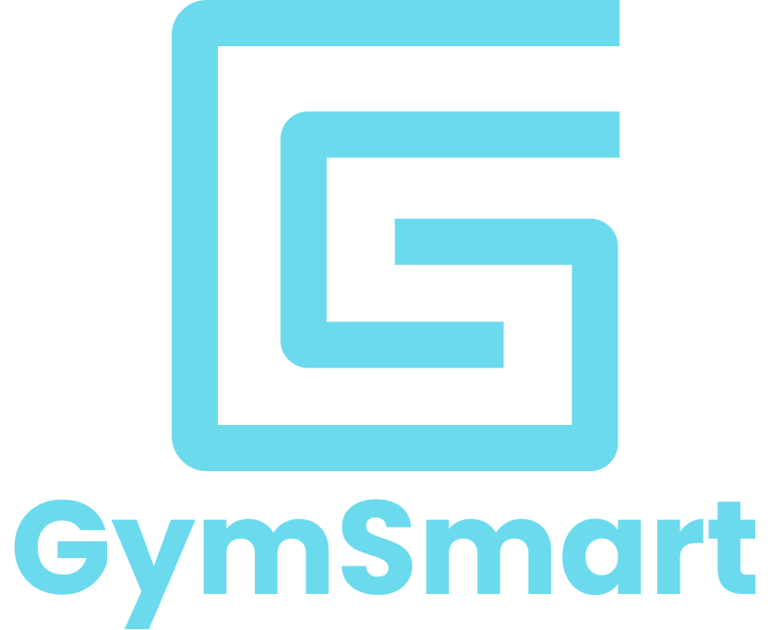
Making proper form the new norm
Team 16: Proof-of-concept Presentation and Demo
Presented by: Harpreet, Lee, Patrick, Mitch, Fisher, Jason
1

Slide 2
Overview
Introduction
Business Case
Technical Case
Self-Reflection
Schedule & Plan for 405W and 440
Conclusion
Live Demo
2

Slide 3
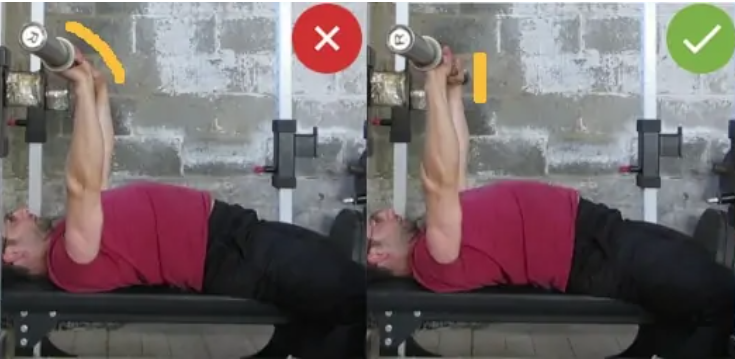
Introduction - Background
Don’t you want a workout without any hustle of availability of personal trainer?
Exercises you could do anytime, anywhere without worrying about your form
Want an immediate feedback when your form is incorrect?
[1]
3

Slide 4
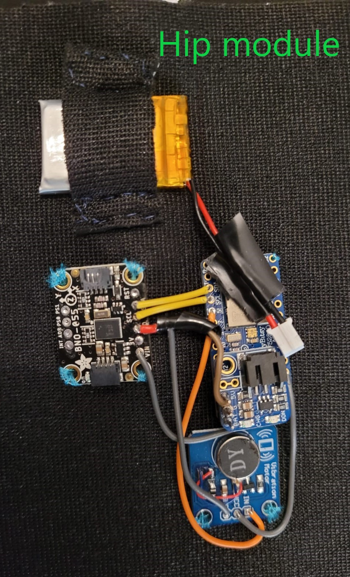
Introduction – Problem/ Motivation
Pro-Tek --- Form Trainer
Helps to prevent injuries by providing notification to user when form is wrong
System Components: 3 main modules (2 forearms+1hip) and an App
Main Modules: detect incorrect forms and provides direct feedback
App: Provides an easy-to-use interface for users to select the exercise and access recorded data
Provides ease of use with its simple and comfortable design
4

Slide 5
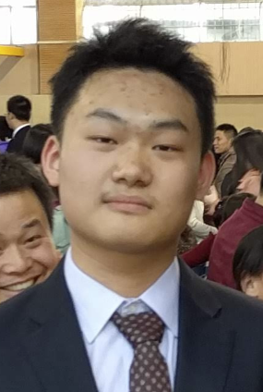
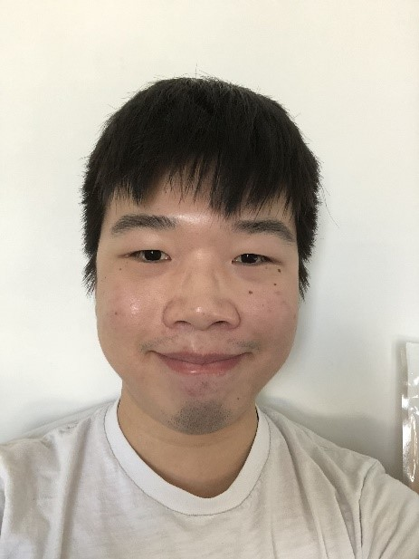
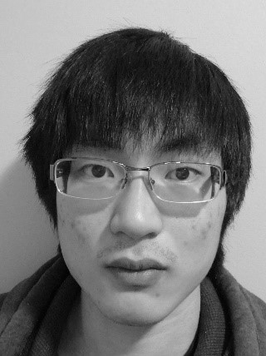
Team Members
Fisher - CEO | Mitch - CTO | Jason - CFO
Patrick - CIO | Harpreet - CCO | Lee - CPO
5

Slide 6
Business Case – Ideal Customers & Consideration
Ideal customers:
Beginners in anaerobic exercise
Prefer exercise alone without others interruption
Work out at home
Considerations for ideal customers:
Fix all units at proper positions
User's phone supports Bluetooth protocol
Download the App and pair the Bluetooth
Calibration before exercises
6
Notes:
Format is vague. Can make a table and then have both things there. Font is small. Two much emplty space. Spelling mistakes

Slide 7
Business Case – Market
In 2019, 468,315 cases of exercise injuries involved with or without equipment occured in the US - National Safety Council (NSC)[2]
Based on our research analysis, electronic detectors in the market only detect the heart beating or Calorie consumption (cardio-training)
"A device detecting incorrect forms during workout will be a great help." - Nicolas, Personal trainer
7
Notes:
Font is too big for 2 points

Slide 8
Business Case – Competitors
Product | Price ($) | Record Repetition | Heart Rate | Velocity | Wrist angle | Track exercise forms | Direct notification
Pro-Tek | 200 | ✓ | ☓ | ✓ | ✓ | ✓ | ✓
Atlas Wearables | 49.99 | ✓ | ✓ | ✓ | ☓ | ☓ | ☓
Beast Sensor | 289 | ✓ | ✓ | ✓ | ☓ | ☓ | ☓
Onyx: Home Workout | 79.99/yr | ✓ | ✓ | ✓ | ☓ | ✓ | ☓
Gymatic Workout Tracker | Free app with tiered pricing | ✓ | ☓ | ✓ | ☓ | ☓ | ☓

Slide 9
Business Case – Price & Cost
Price of components before tax and shipping fees: $284.16
Cost so far: $585.67​ (Include abandoned designs)
Estimate cost for Beta Prototype: $500
Design PCB
Enclosure
Alternative Components
Expected retail price: $200
Reduce costs by using cheaper components, build production line
Component | Number of Units | Price/unit
IMU | 3 | 27.10
Distance Sensor | 2 | 39.90
Microcontroller | 3 | 24.38
Vibrator | 3 | 1.74
Battery | 3 | 14.90
Notes:
Font is off and smaller.

Slide 10
Live Demo
10

Slide 11
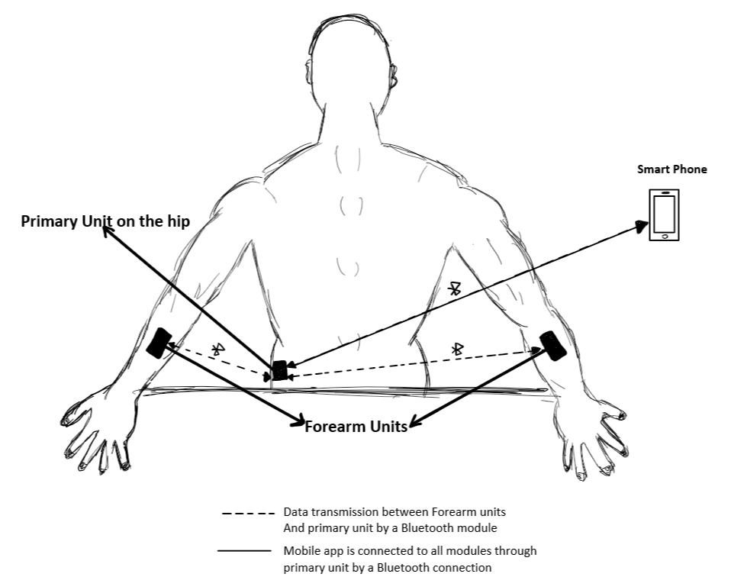
Technical case – high - Level description
3 main modules and an App connect through Bluetooth
1 primary/hip module:
Module has 4 components: microcontroller, IMU, vibration motor and battery adapter
2 forearm modules:
Each module has 5 components: microcontroller, orientation sensor (IMU), distance sensor, vibration motor and battery adapter

Slide 12
Technical case – Main Functions
Microcontroller:
Receive commands from user's device
Calibrate with sensors
Detect user form using implemented Detection Algorithms
Battery powered
LEDs and Vibration Motor:
Turn on to notify user's improper form
App:
Send/receive commands to/from units for calibration, data, notifications
Exercise Selection (bench press, squats)
Colour code: Hardware, Software, User Interface)

Slide 13
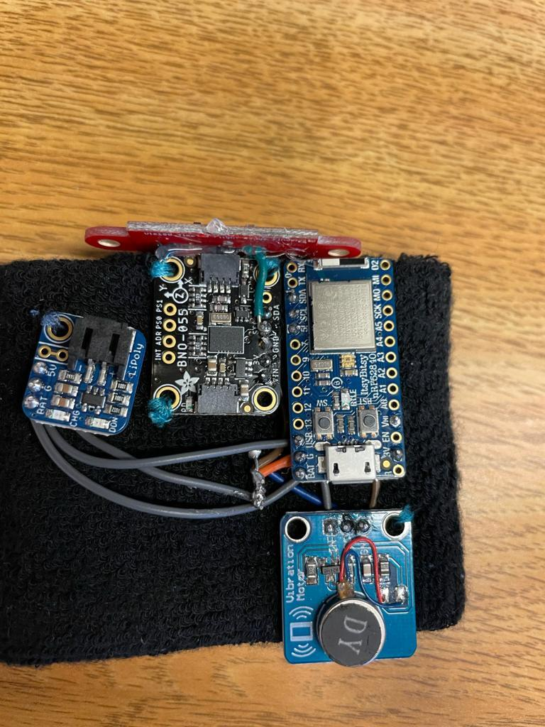
Technical case – MATERIALS
Materials: | Cradle to Cradle Design:
Microcontroller - Adafruit ItsyBitsy nRF52840 Vibration Motor - DFR0440 Distance sensor - VL6180 IMU - BNO055 Lithium Battery - 250 mAh Wiring Breadboard and wrist band | Recyclable and Durable Find suppliers with the most environment friendly components Battery
Distance sensor
IMU
Battery adapter
Microcontroller
Vibration motor
Notes:
Cradle to cradle needs work

Slide 14
TECHNICAL CASE – Changes in scope
Position of primary unit:
Back hip
Data display on mobile app:
Graphs of data only displaying values
Connection:
Primary unit sends command mobile app sends command
Connecting to Bluetooth module microcontroller with Bluetooth module

Slide 15
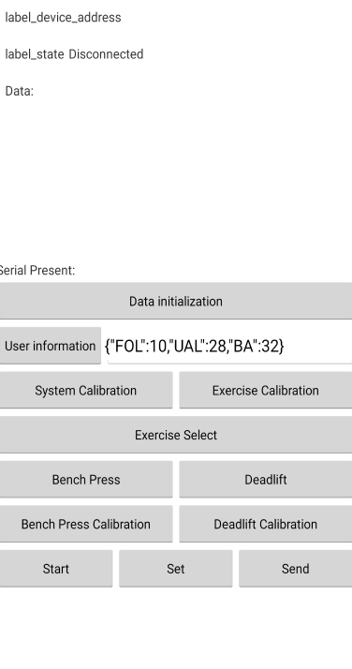
Technical case – design
Primary/Hip Unit
Detects the back angle for squatting and other exercise
Minimizing the obstruction for exercise while getting the most accurate back angle
Easy to reach and place at the correct location
Wrist Unit:
Detects the wrist and lower arm angle for bench press
Uses distance between wrist and hand to calculate the angle
Phone App
Assumes users have access to a phone with Bluetooth capability
An instinctive interface for the user to interact instead of working directly on the modules
Visualizes received data
Notes:
Need to explain the implications. If you leave it like this I will ask questions why hip why not somewhere else?

Slide 16
ADHERENCE TO Standards
Standard | Description
CAN/CSA-C22.2 No. 61508-1:17 | Functional safety of electrical/electronic/programmable electronic safety related systems — Part 1: General requirements [3]
IEC 61010-1 Ed. 3.1 b:2017 | Safety requirements for electrical equipment for measurement, control, and laboratory use - Part 1: General requirements CONSOLIDATED EDITION.
IEEE 802.151-2002 | Specific requirements — Part 15.1a: Wireless Medium Access Control (MAC) and Physical Layer (PHY) specifications for Wireless Personal Area Networks (WPAN) [4]
Some standards that Pro-Tek adheres to (extended list is in the requirement documentation)

Slide 17
Self-reflection
Things we have learned as a whole: Integrating the work done by different person How to track the work of each team members How to organize the development in a remote environment | Things we have learned as individuals: Understanding of the Bluetooth protocol, such as services and characteristics Android development with Fragments and MYSQL Arduino development involving with different hardware | Changes to development process: Update our progress more frequently Time management
Notes:
Shields (elements that can be plugged onto a board to give it extra features)
This need to be more specific

Slide 18
Schedule & Brief plan for 405w
Notes:
Today is April 20th and we are at the end of this semester,
the alpha phase is concluded and we finished the construction of out Proof of Concept prototype
we will continue developing in the upcoming 440.

Slide 19
Schedule & Brief plan for 440
Notes:
In 440 we would work towards our beta product with going through all the testings defined.

Slide 20
Plan for 440
Hardware | Software | Integration
Adjust the connections between modules to ensure a smooth operation Implement a reliable and comfortable mounting solution. | Improve detection algorithms to increase the result accuracy. Integrate a database to help with calibration and form detection. Improvement of the mobile app, such as UI, error handling and data storage. | Propose a more compact design for integration, allowing it to fit inside a wearable enclosure.
Notes:
Here is the summary for our plan in the next 4 months,

Slide 21
Conclusion
Pro-Tek can reduce the chances of getting work-out injuries, by reliably detecting extreme wrist or back angle and immediately informing the user.
The current algorithm is sensitive to incorrect form provided with a proper calibration.
The current developed App can connect to one module and exchange data one at a time.
Notes:
In conclusion, our product, Pro-Tek has shown its ability to reduce …......., at the current stage, the algorithm................., lastly, the app we have now.... But we are working to make it possible to connect all the modules at the same time.

Slide 22
acknowledgements
Professor Craig Scratchley
Michael Hegedus
Chris Hynes
Professor Shervin Jannesar
Professor Andrew Rawicz
For Providing Guidance and Invaluable Suggestions

Slide 23
Thank you
Any Questions?

Slide 24
References
[1] StrongLifts. 2021. How to Bench Press with Proper Form: Definitive Guide. [online] Available at: <https://stronglifts.com/bench-press/> [Accessed 17 April 2021].
[2] “Facts + Statistics: Sports injuries,” III. [Online]. Available: https://www.iii.org/fact-statistic/facts-statistics-sports-injuries. [Accessed: 05-Apr-2021]
[3] CSA Group, Functional safety of electrical/electronic/programmable electronic safety related systems, 2017, [Online] Available at: https://www.scc.ca/en/standardsdb/standards
[4] "IEEE Standard for Information technology--Local and metropolitan area networks--Specific requirements--Part 15.1a: Wireless Medium Access Control (MAC) and Physical Layer (PHY) specifications for Wireless Personal Area Networks (WPAN)," in IEEE Std 802.15.1-2005 (Revision of IEEE Std 802.15.1-2002),vol., no., pp.1-700, 14 June 2005, doi: 10.1109/IEEESTD.2005.96290
Notes:
[1] format is not ieee so its wrong

