Slide 1
Monitoring the Heart Health of the World
Notes:
Jamyl

Slide 2
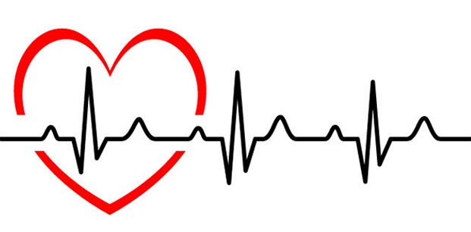
Outline
Introduction Video
Standards, Design and Changes in Scope
Business and Marketing Plan
SWOT Analysis
Scheduling
Team Reflection
Live Demo
Questions
Notes:
Jamyl

Slide 3
Proof of Concept Video

Slide 4
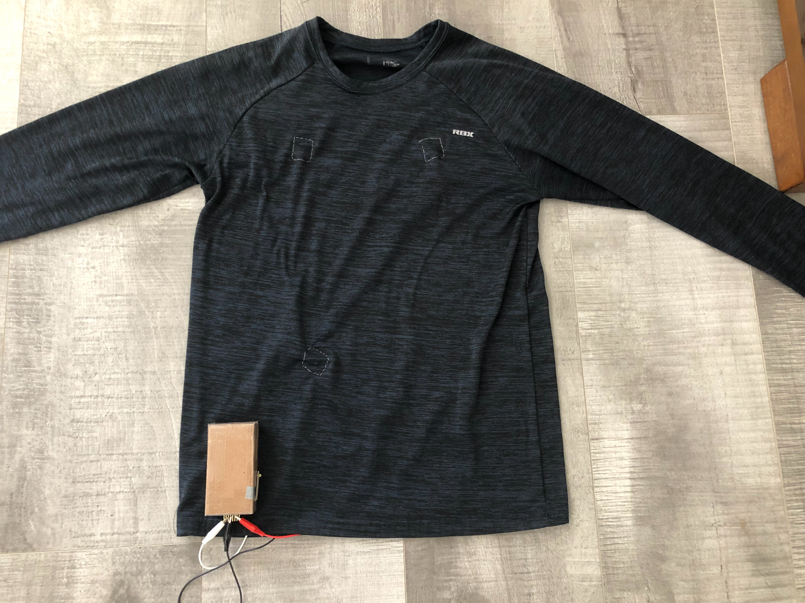
Standards, Design and Changes in Scope
Product attempts to conform to IEEE standards
IEEE 11073-10406-2011
Class 2 Device
Cradle-to-Cradle Design
Product reusability
Recycled device
Changes in Design
Removed one precordial lead
Pulse oximeter addition

Slide 5
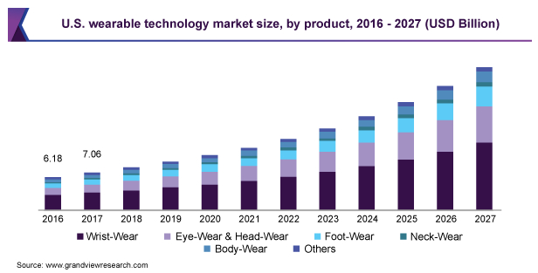
Business and Marketing Plan
Business case
Mobile EKG market
Pricing range
POC cost estimate: ~ $300 CAD
Financing options
Ideal customer
Notes:
Stef/Diego

Slide 6
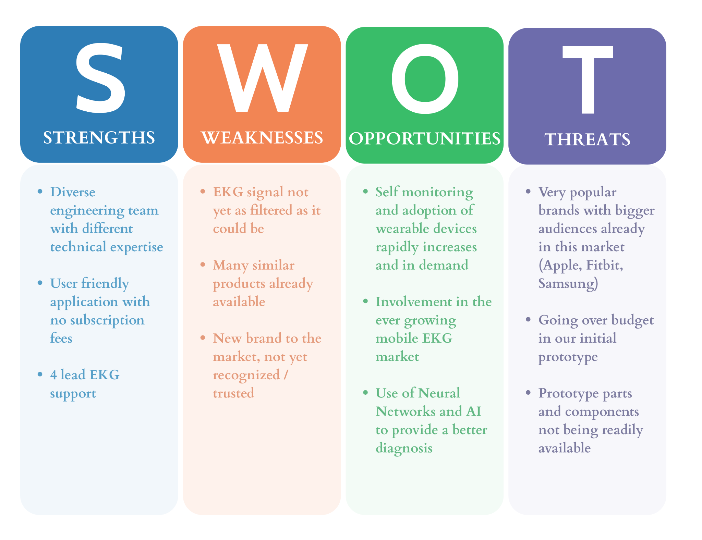
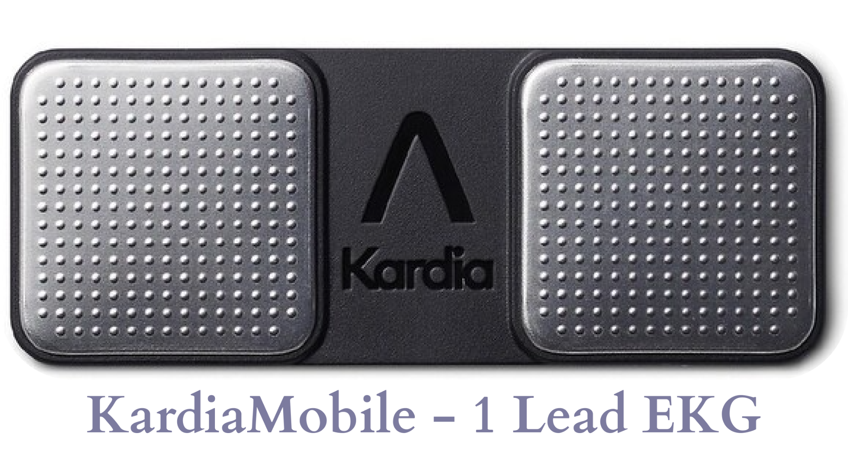
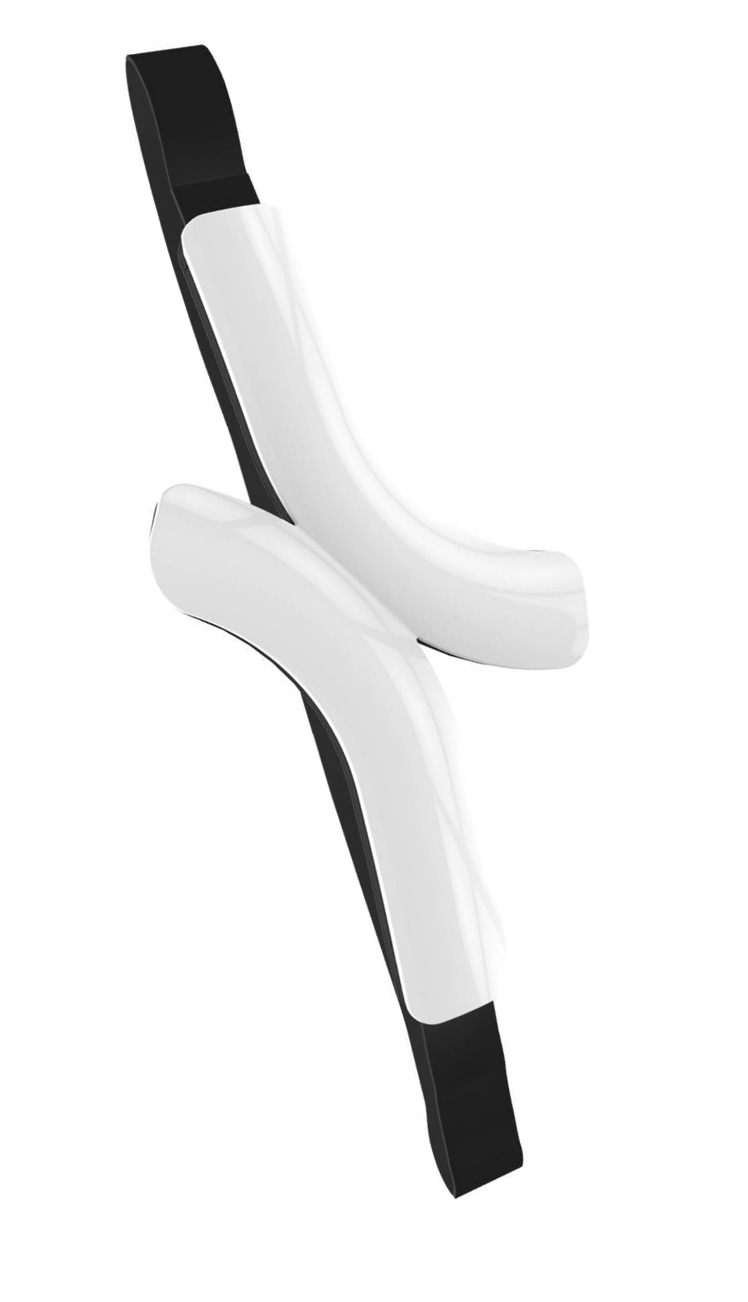
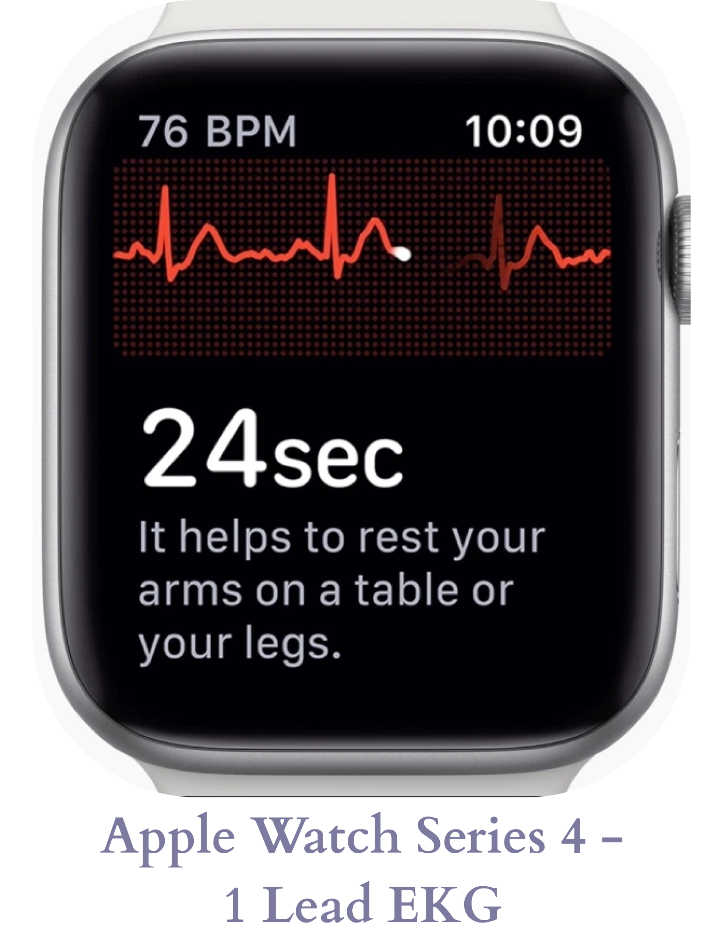
S.W.O.T Analysis & Competitors

Slide 7
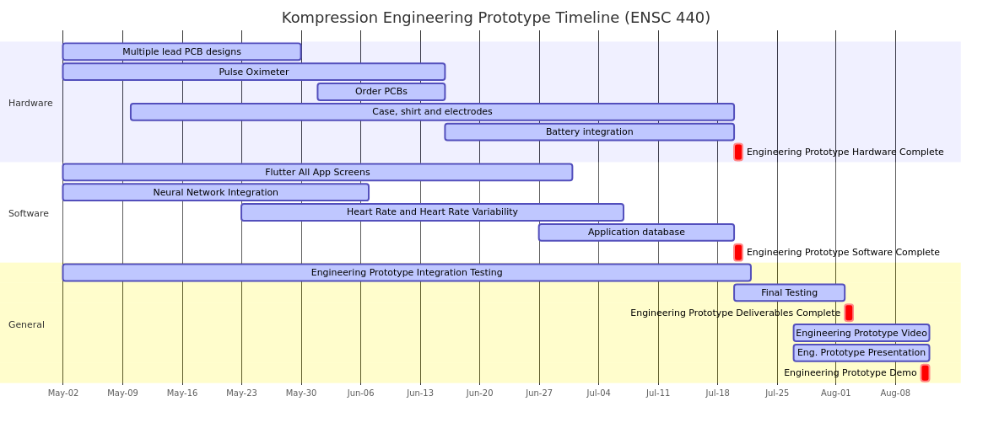
Scheduling
Scheduling so far
Approach for 440

Slide 8
Team Reflection
Key roles
Hardware Team
Software Team
What have we learned?
EKG Analysis
Product designing
Contingency planning
Development process changes for ENSC 440

Slide 9
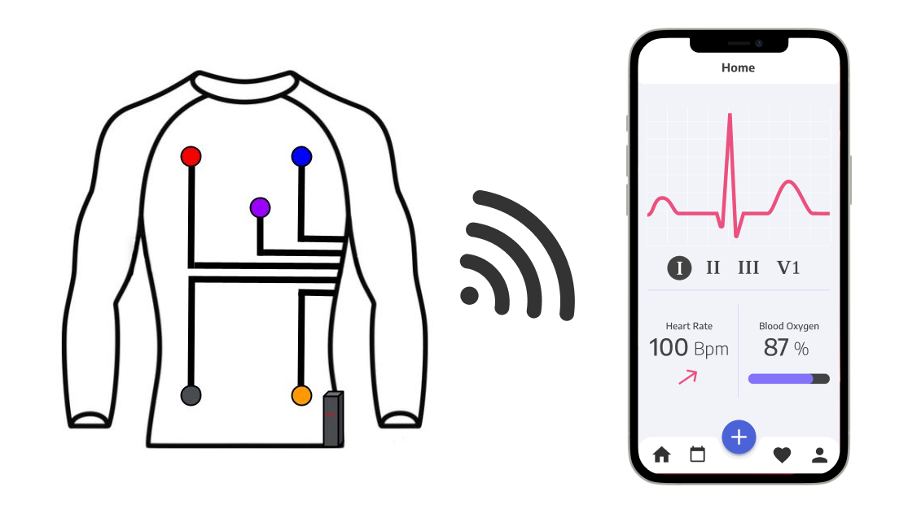
Live Demo

Slide 10
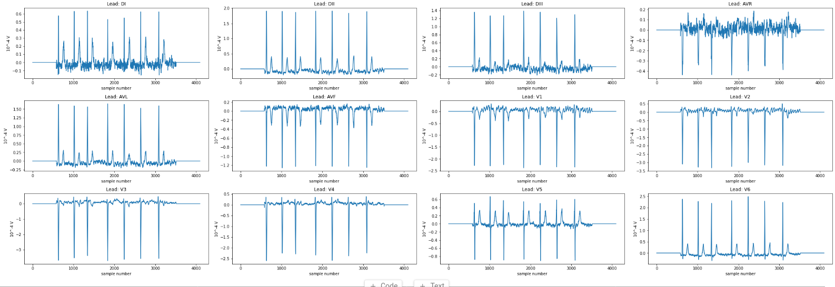
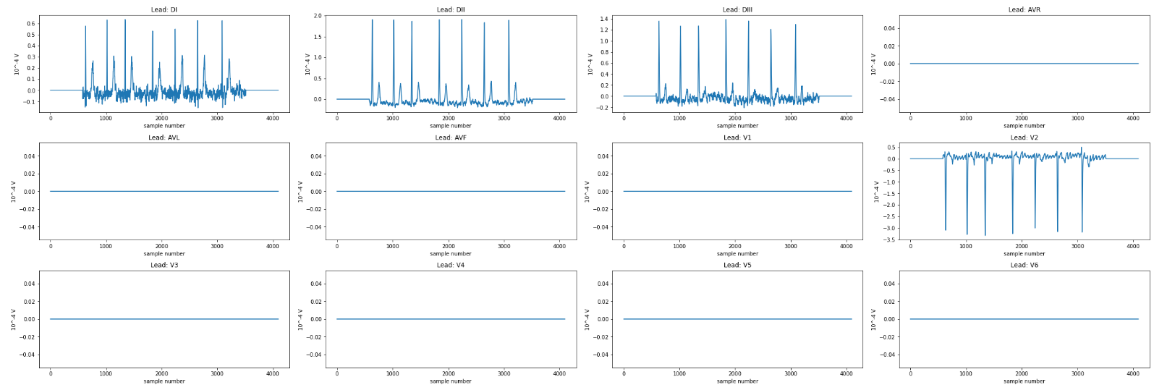
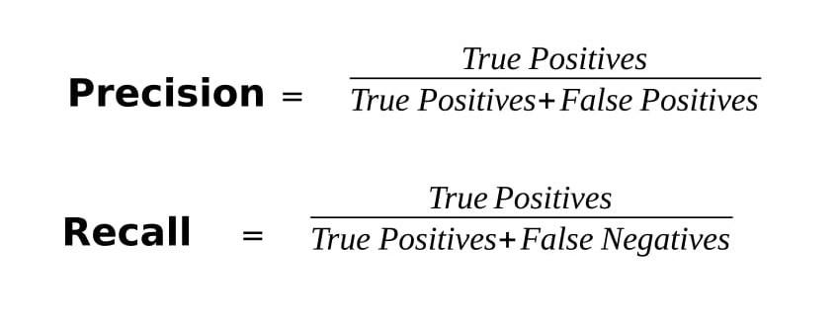
Arrhythmia Detection Testing Demo
Example correctly classified patient with atrial fibrillation
Testing Dataset with missing leads:
Precision Decrease: 5.3%
Recall Decrease: 24%

Slide 11
Testable and Tested
Potential Risks
Technical Design and Exploration Research
Feedback
Demo Discussion
Requirement | Test Procedure | Desired Result
[REQ 2.1 H-A] [REQ 2.1.1 H-A] | Check shirt has 6 electrodes available and they are all connected and sending data | Shirt indeed has 6 electrodes
[REQ 2.2 H-A] [REQ 2.4 H-A] | Record the same lead EKG with a known working EKG module | Resulting graphs from both Kompression and the control device should be the same
[REQ 2.3 H-A] | Verify that signal on oscilloscope matches the theoretical lead measurement | Oscilloscope displays a proper EKG reading from every lead
[REQ 2.5 H-A] [REQ 3.1 H-A] | Connect device to another bluetooth device, | Connection must be established between two bluetooth devices
[REQ 2.5.1 H-A] [REQ 3.1 H-A] | Transmit EKG measurements between devices | Transmitted signal matches received signal
[REQ 3.2 M-A] | Input labelled open source sample EKG measurements with abnormal rhythms | Correctly detects positive and negative cases of the abnormal rhythms
[REQ 3.3 H-A] | Check on a device if signal received is displayed | Displayed signal must match signal on oscilloscope if measured directly from device electronics

Slide 12
Questions?

Slide 13
References
[1] Grand View Research, Wearable Technology Market Size, Share & Trends Analysis Report By Product (Wrist-wear, Eye-wear & Head-wear, Foot-wear, Neck-wear, Body-wear), By Application, By Region, And Segment Forecasts, 2020 - 2027, 2020. [Online] Available: https://www.grandviewresearch.com/industry-analysis/wearable-technology-market. Accessed: April 20th, 2021.
[2] Kardia Mobile. 2020. [Online] Available: https://ak1.ostkcdn.com/images/products/is/images/direct/ceafbacedb1b1b84eb61cea168ea58b5f6d816df/AliveCor---KardiaMobile-Personal-EKG-Monitor---Black.jpg. Accessed: April 20th, 2021.
[3]VentureBeat. 2020. [Online] Available: https://venturebeat.com/wp-content/uploads/2018/11/Screen-Shot-2018-11-28-at-9.14.36-AM.jpg?resize=1024%2C739&strip=all. Accessed: April 20th, 2021.
[4] Get Quardio, 2020 [Online] Available: https://www.getqardio.com/wp-content/themes/qardio-3.0/images/qcore_new/QCfrontfacing_desktop.jpg?v=1.0 Accessed: April 20th, 2021.
Circuit Design Courtesy of Dr Gray

