Slide 1
Rise (Company 4) Proof-of-Concept Presentation and Demo
Jonathan Choy, Joon Kwon, Wilson Liu, Tyler Rasmussen, Himson Chick

Slide 2
Overview
Introduction/Background
Technical Case
Business Case
Schedule & Brief Plan for ENSC 440
Team and Self-Reflection
Testable and Tested
Concept Proven
Appearance modelled
Technical Design, Exploration Research
Feedback considered
Conclusions
Questions
Notes:
Himson – These will be the topics that will be covered during this presentation

Slide 3
Introduction/Background
Bed bound patients in hospitals have nursing staff to help reposition which will prevent bed sores complications throughout the day and night.
In a residential setting, however, bed bound patients may have difficulties trying to find help for repositioning if their caretaker is not around.
Notes:
Joon

Slide 4
Introduction/Background
The engineers at Rise seek to solve this problem by developing an affordable solution which will automatically reposition a patient.
Roll24 will use camera sensors to determine the patient's location on the bed and use motors to rotate and move the patient
Notes:
Joon

Slide 5
Introduction/Background
Interviewed a nurse to get her feedback on current problems
Nursing staff is usually too busy to reposition patients
Would allow for patients to be repositioned consistently during short-staffed shifts
Notes:
Joon

Slide 6
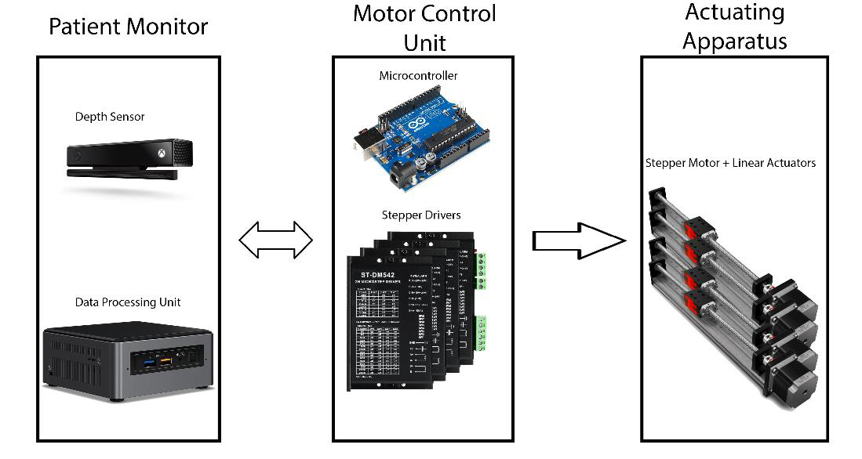
Technical Case - Overview
The main components of Roll24 are:
Patient Monitor
Depth Sensor (Kinect)
Data Processing Unit
Motor Control Unit
Microcontroller (Arduino)
Motor Stepper Drivers
Actuating Apparatus
Bipolar Stepper Motors
Linear Actuators
Figure 1: Overview of Roll24's Components
Notes:
Joon

Slide 7
Technical Case - Functions
The main functions for the final prototype of Roll24 is to:
Be able to roll a patient of up to 250 lbs to their side
Be able to reposition a patient at a set interval
Be able to process the transmitted raw image data in real-time
Be able to send a halt signal in cases defined to be dangerous that will stop the repositioning process
Notes:
Joon

Slide 8
Technical Case – Materials
Materials:
Stepper Motors
Stepper Motor Drivers
Linear Actuators
Arduino Mega2560
PVC Insulated Hook-up wires
350W Single Output Switching Power Supply
Microsoft Kinect
Sling

Slide 9
Technical Case – Scope and Design
Changes in Scope and Design for the PoC prototype:
Rotate the patient in one direction
No image sensor integration
No 80/20 to support the bedframe and motors
Unable to reposition at set interval due to control of motors still needing manual intervention

Slide 10
Technical Case - Standards
Standard | Brief Description
CSA C22.2 NO. 0:20 | General Requirements for Canadian Electrical Code, Part II [1]
IEC 60601-1-2:2014 –Ed.4.0 | General Requirements for basic safety and essential performance [2]
IEEE/ISO/IEC 12207-2017 | Systems and Software Engineering – Software Life Cycle Processes [3]
IEC 60204-1:2016 | Safety of machinery – Electrical equipment of machines – Part 1: General Requirements [4]
CSA C22.2 NO. 127-15 | Equipment and lead wires [5]
CSA C22.2 NO. 107.1-16 | Power Conversion Equipment [6]
Figure 2: Table of Standards
View the Specifications document for more standards and requirements
Notes:
Tyler

Slide 11
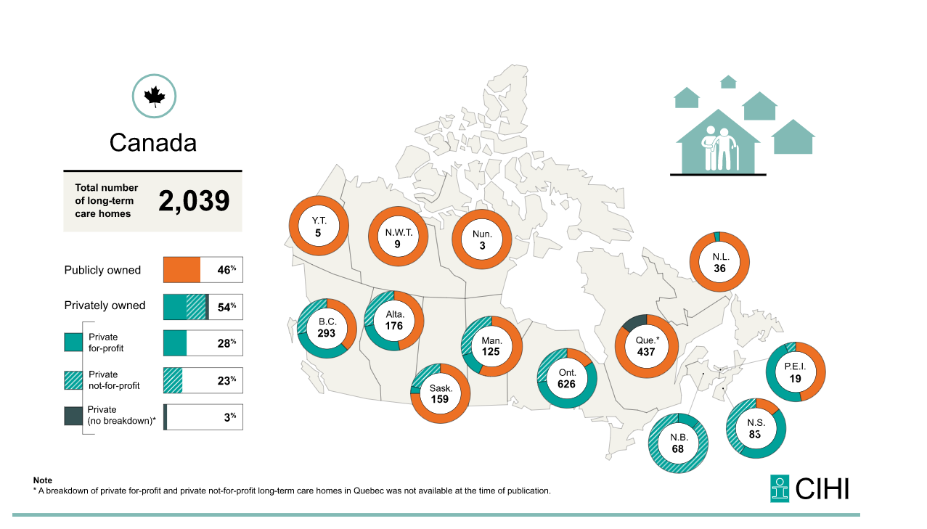
Business Case - Market
In Canada, there are 2039 residential care homes
We plan to market our product to residential care homes and to the elderly
Figure 3: Number of Long-Term Care Homes in Canada [7]

Slide 12
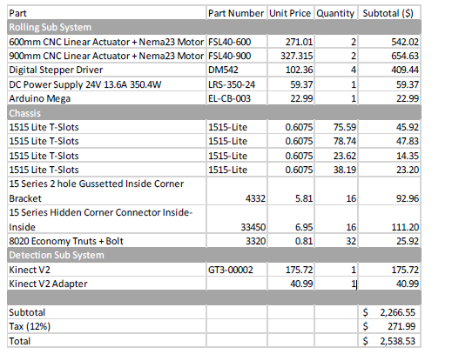
Business Case – Price, Financing
Approximate cost for the prototype of the Roll24:
Figure on the right shows the Hardware purchases for the PoC prototype
Insulated Hookup Wires: $62
Fasteners: $20
Sling: $20
PoC prototype final approximated cost: $2700
Figure 4: Bill of Materials

Slide 13
Business Case – Competitors
ProBed Medical Technology Inc., Freedom Bed
Allows the patient to choose between manual and automatic operation for a configurable operation duration [8]
Lifts certain areas of the mattress to move the patient from left to right and can also raise the patient’s back to a sitting position [8]
For safety, uses voice control and safety rails installed the sides of the bed [8]
Hillrom, RepoSheet® Lift Aid
Uses a sheet attached to an apparatus over the patient’s bed to manually lift the patient off the mattress, turn the patient, and reposition the patient [9]
Can be attached and detached for cleaning, and can be changed to support various patient weights [9]
Manual operation [9]

Slide 14
Business Case – Ideal Customer
Patient who suffers from bed-bound injuries that lives alone or in a residential care-home
Wants a quiet and affordable solution

Slide 15
Schedule & Brief Plan for 440
Replace the Arduino microcontroller with a PCB
Improve the Hardware/System
Integration of Software Component
Integration of more Safety Features
Figure 5: Gantt Chart

Slide 16
Team and Self-Reflection
Himson Chick, CEO
Integration of the hardware components
Jonathan Choy, CTO
Hardware design and programming
Joon Kwon, COO
Kinect and Image Detection
Wilson Liu, CCO
Integration of mechanical components
Tyler Rasmussen, CFO
Kinect and Image Detection

Slide 17
Team and Self Reflection
What we learned:
How to integrate different project components together
Properly research a problem before designing a unique solution
Creating a Gantt chart
Changes for ENSC 440:
Have more than one scheduled weekly meeting
Share daily progress and keep every member of the group updated

Slide 18
Testable and Tested
Proof of Concept Testable:
Stepper Motor
Stepper Motor Driver
Microcontroller
Power Supply
Patient Monitor

Slide 19
Testable and Tested cont.
Completed Design Specification Requirements (Hardware):
[Req 4.1.1-AP] Motor must be National Electrical Manufacturers Association (NEMA) compliant
[Req 4.1.2-AP] Motor must move more than 13.5kg vertically and horizontally
[Des 4.3.1-AP] The microcontroller must transmit/receive signals from stepper driver in real-time
[Des 4.3.2-AP] The microcontroller must receive data from data processing unit
[Des 4.4.1-AP] Stepper Motor Driver must be capable of transmitting/receiving signals from the stepper motor
[Des 4.4.2-AP] Stepper Motor Driver must be compatible with National Electrical Manufacturers Association (NEMA) stepper motors
[Des 4.4.3-AP] Stepper Motor Driver must be suitable for a quiet, residential environment
[Des 4.4.4-AP] Stepper Motor Driver output current matches current rating of stepper motor for proper functionality
[Des 4.5.1-AP] Power supply must supply a minimum voltage of 24V DC to each of the four stepper motor drivers
[Des 4.5.2-AP] Power supply should be able to supply 345.6 W
[Des 4.5.3-AP] Power supply must use power derived from a North American wall outlet.

Slide 20
Testable and Tested cont.
Completed Design Specification Requirements (Software):
[Req 3.1.1-AP] The product must monitor the patient's positioning on the bed
[Req 3.1.2-AP] The monitor must determine the boundary in which the patient can be repositioned
[Req 3.1.3-AP] The monitor should not record information that would invade the patient's privacy
[Req 3.2.1-AP] The repositioning process must halt if the patient monitor sends a signal that it detects danger and/or the patient has moved out of the boundary determined by the monitor

Slide 21
Concept Proven
Hardware:
Power supply can support the 4 stepper drivers, 4 stepper motors and micro controller.
Roll24 PoC prototype can rotate a patient to their side and will be shown in the live demo/video later in the presentation
Software:
Patient location is captured.
A signal is sent when the patient moves out of the safe zone with the intention of stopping the motor through serial connection.

Slide 22
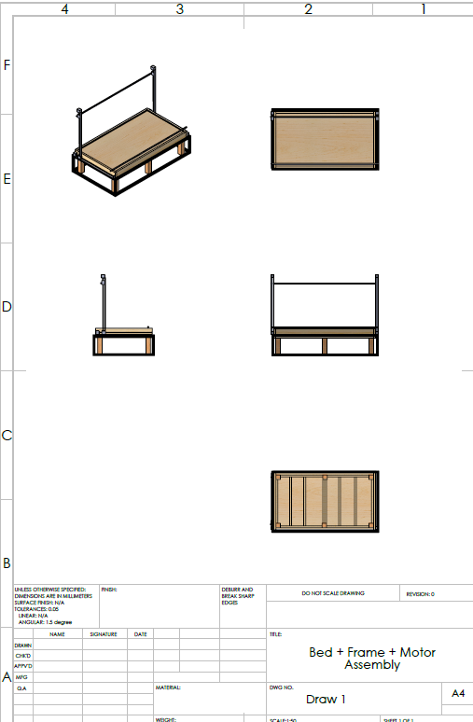
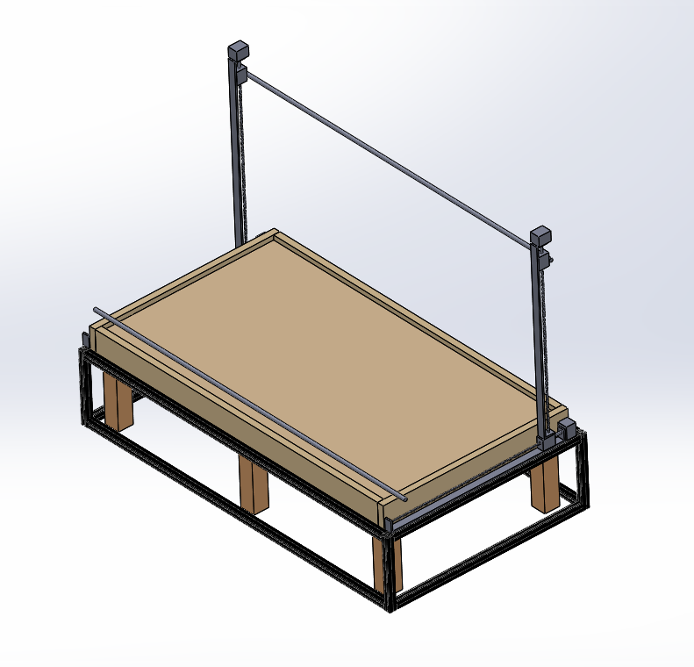
Appearance Modelled
Figure 6: Roll24 Model
Figure 7: Different Topologies

Slide 23
Technical Design Exploration Research
Physical Appearance
Image Sensor System
Movement Methods
Data Transfer Protocol
Power Management
Notes:
Wilson

Slide 24
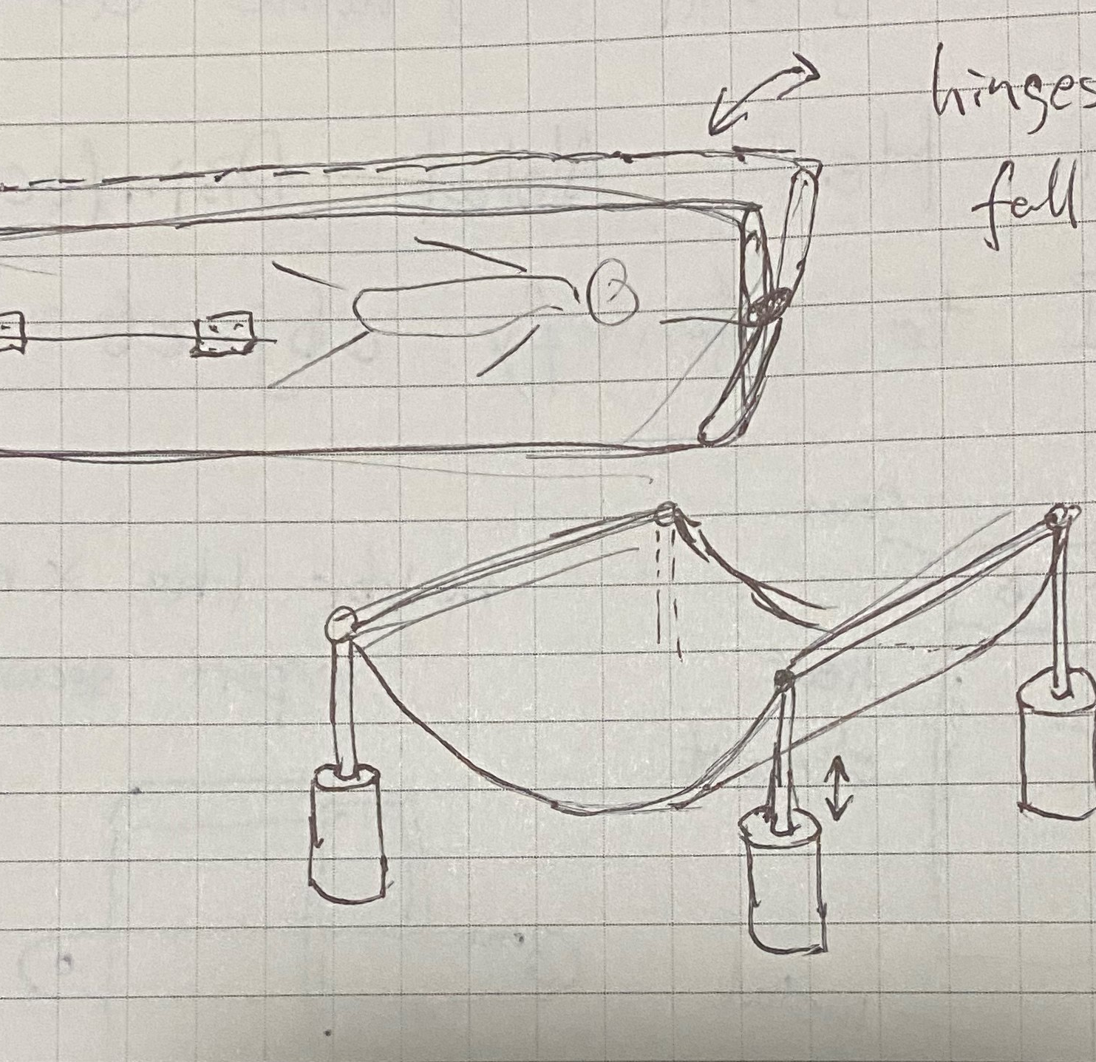
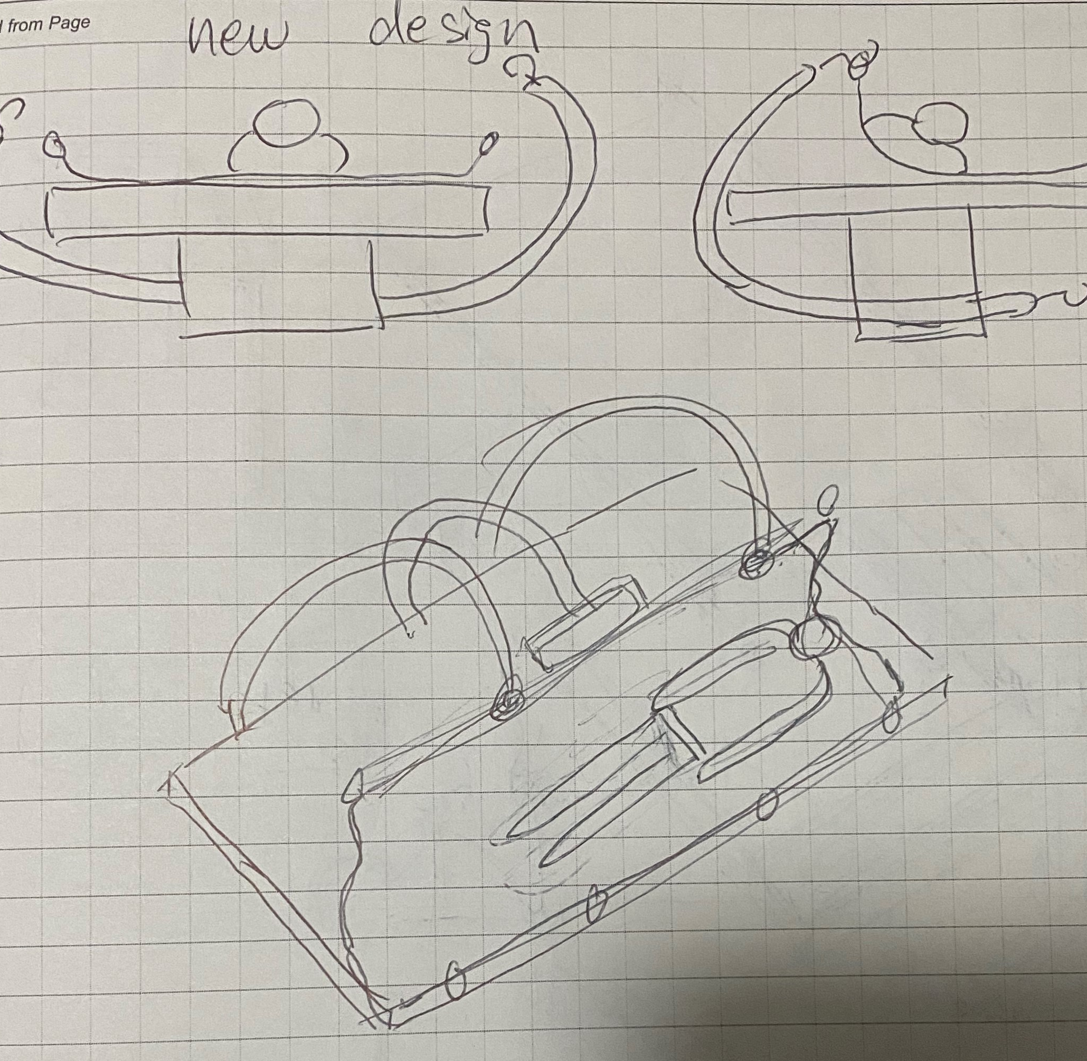
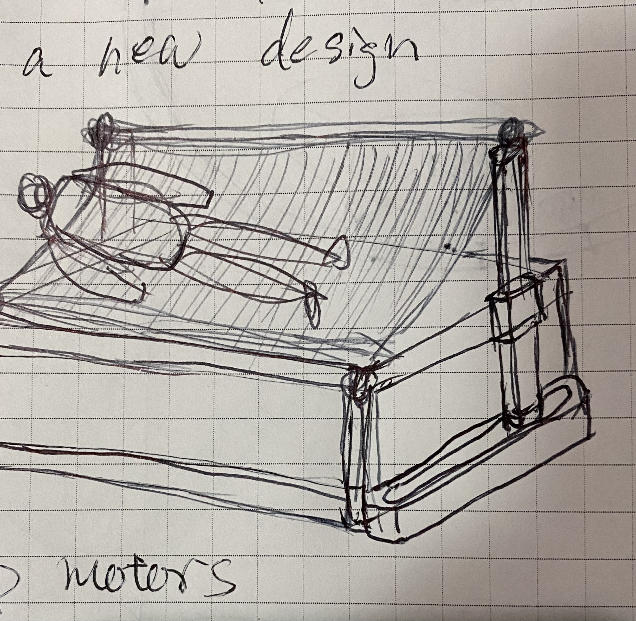
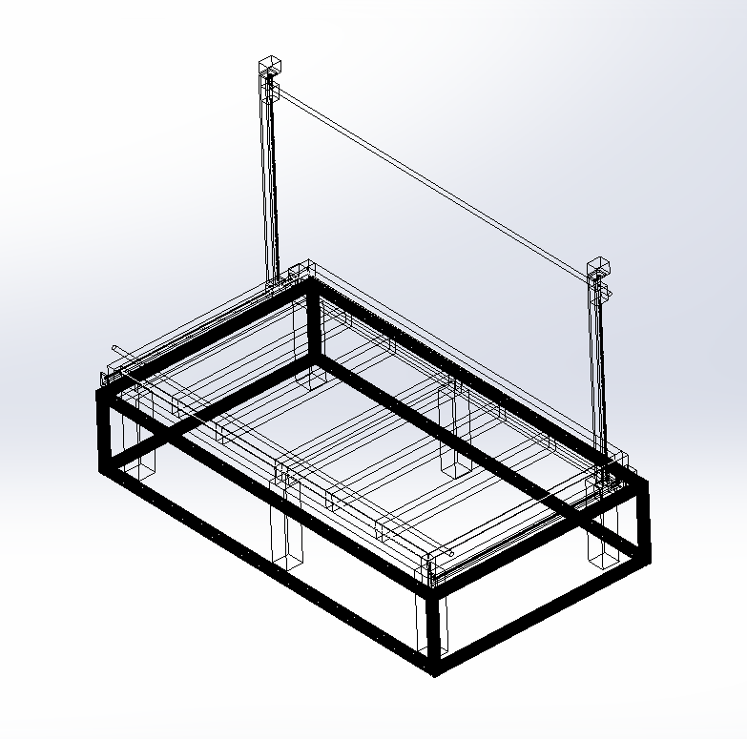
Technical Design Exploration Research
Physical Appearance
Initial proposal: Hinges and Hydraulics
2nd Revision: Curved Bar and Pusher
3rd Revision: Linear Actuators attach to bed
PoC Revision: XY Linear Actuators and Frame
Figure 8: Initial Proposal Figure 9: 2nd Revision Figure 10: 3rd Revision Figure 11: PoC Revision
Notes:
Wilson put your bed designs here

Slide 25
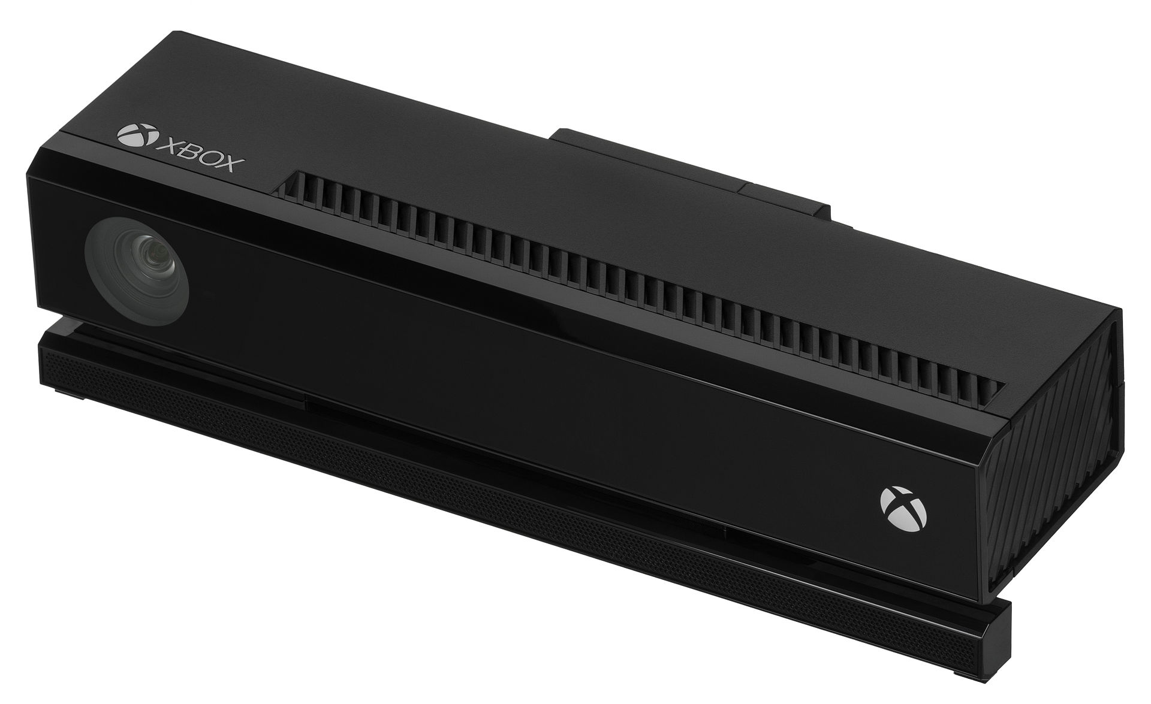
Technical Design Exploration Research
Patient Monitor System
Using Kinect V2 sensor
Exploring implementation of Point Cloud Library
Statistical Outlier Removal
Segmentation
Figure 12: Kinect V2 Sensor [10]

Slide 26
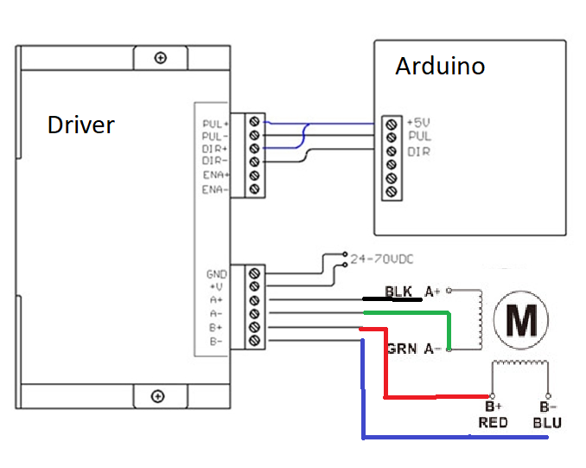
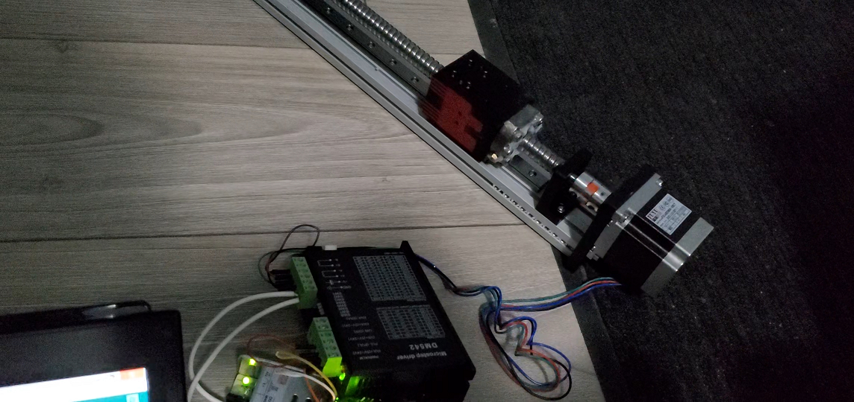
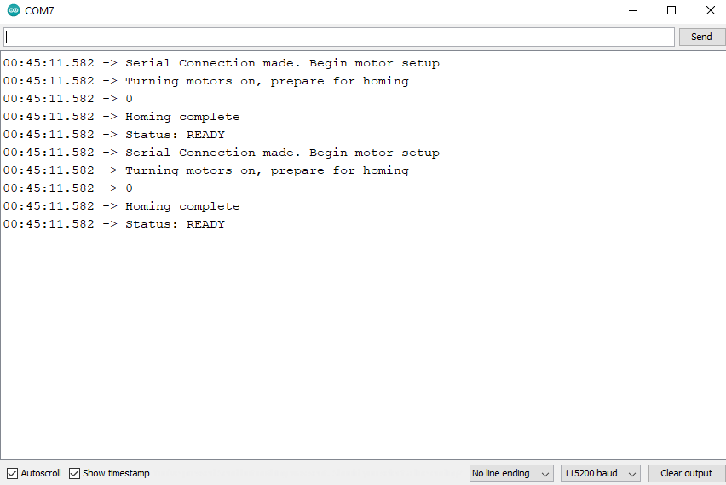
Technical Design Exploration Research
Movement Methods
Initial proposal: Arduino connects to a stepper driver and unipolar stepper motor and operated using rotary encoder
2nd Revision: Selected 1Nm bipolar motor based on calculations required to lift 13.5kg; tested movement with open source Arduino library and linear actuators
PoC Revision: Connected 4 bipolar stepper motors and drivers operated by Serial inputs from Arduino software and serial monitor
Figure 13: Motor System Wiring Diagram
Figure 14: 2nd Revision setup
Figure 15: Arduino Serial Monitor
Notes:
Jonathan

Slide 27
Technical Design Exploration Research
Data Transfer Protocol
Initial Proposal: Test if Arduino can read a single character or number sent through USB from a computer
2nd Revision: Write an Arduino sketch to move unipolar motor after sending a character through its Serial Monitor
PoC Revision: Simulate sending a character based on Image sensor results, write to terminal then simulate this operation using Arduino Serial Monitor
Notes:
Jonathan

Slide 28
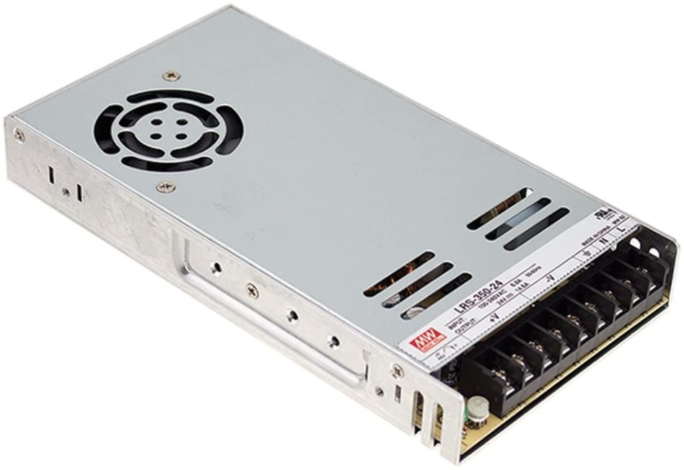
Technical Design Exploration Research
Power Management
Initial Proposal: Power the system using AC wall power and stepping down with converters and transformers
2nd Revision: Make use of power units supplied with Kinect and the Data Processing Unit simplifying product system
3rd Revision: Calculated and selected over provisioned switching power supply to convert AC wall power to DC suitable for the motor system
PoC Revision: Selected power supply with overhead to power stronger motors if needed. Connected to surge protector
Power supply selected has certification by several North America safety standards
Compact, easy to install and connect various devices
Comfortably powers 4x 1Nm 2A Stepper motors and 24V Stepper Drivers with enough overhead for 4x 2Nm 3A Stepper Motors
Figure 16: Compact Switching PSU [11]
Notes:
Jonathan

Slide 29
Feedback Considered
Pivot to target a residential market rather than a hospital
Pursue full automation without nurse intervention
Look into other functions for safety and accessibility features
Notes:
Jonathan
Competitors Product:

Slide 30
Conclusion
For ENSC 405W, we built a PoC prototype for Roll24, a solution to help prevent bedsores for bed-bound patients.
We have 3 main components:
Patient Monitor, Motor Control Unit, Actuating Apparatus
We learned how to use a variety of different hardware components and integrate them.
Notes:
Jonathan

Slide 31
Demo

Slide 32
Questions?

Slide 33
References
[1] “CSA C22.2 No. 0:20,” Standards Council of Canada - Conseil canadien des normes. https://www.scc.ca/en/standardsdb/standards/30464 [Accessed Feb. 21, 2021].
[2] "List of Recognized Standards for Medical Devices - Canada.ca", Canada.ca, 2019. [Online]. Available: https://www.canada.ca/en/health-canada/services/drugs-healthproducts/medical-devices/standards/list-recognized-standards-medical-devicesguidance.html#s1-1. [Accessed Feb. 21, 2021].
[3] “IEEE/ISO/IEC 12207-2017 - ISO/IEC/IEEE International Standard - Systems and software engineering -- Software life cycle processes.” https://standards.ieee.org/standard/12207- 2017.html [Accessed Feb. 21, 2021].
[4] “IEC 60204-1:2016 | IEC Webstore.” https://webstore.iec.ch/publication/26037 [Accessed Feb. 21, 2021].
[5] “CSA C22.2 No. 127-15,” Standards Council of Canada - Conseil canadien des normes. https://www.scc.ca/en/standardsdb/standards/28242 [Accessed Feb. 21, 2021].
[6] “CSA C22.2 No. 107.1-16,” Standards Council of Canada - Conseil canadien des normes. https://www.scc.ca/en/standardsdb/standards/28508 [Accessed Feb. 21, 2021].
[7] "Long-term care homes in Canada: How many and who owns them?", Cihi.ca, 2020. [Online]. Available: https://www.cihi.ca/en/long-term-care-homes-in-canada-how-many-and-who-owns-them. [Accessed: 06- Apr- 2021].
[8] "A Turn for the Better! Freedom Bed™", Pro-bed.com, 2019. [Online]. Available: https://www.pro-bed.com/spinal-cord-injury#:~:text=The%20Freedom%20Bed%E2%84%A2%20is,family%20members%2C%20or%20healthcare%20professionals. [Accessed: 06- Apr- 2021].
[9] "Repo Sheet®", Hillrom.com, 2021. [Online]. Available: https://www.hillrom.com/en/products/reposheet-lift-aid/. [Accessed: 06- Apr- 2021].
[10] “Kinect,” Wikipedia, 10-Mar-2021. [Online]. Available: https://en.wikipedia.org/wiki/Kinect#/media/File:Xbox-One-Kinect.jpg. [Accessed: 23-Apr-2021].
[11] "MEAN WELL LRS-350-24 350.4W 24V 14.6 Amp Single Output Switchable Power", Amazon.ca. [Online]. Available: https://www.amazon.ca/gp/product/B013ETVO12/ref=ppx_yo_dt_b_asin_title_o00_s00?ie=UTF8&psc=1. [Accessed: 23- Apr- 2021].

